Slide 1
Anodiam Teacher App: Wireframes
Link: https://github.com/anodiamadm/Docs > ProjectExecution > BA > SpecsWireframes
Version | Editor | Reviewer | Date | Note
1.0 | AC | AM | 13/11/2020 | Teacher App wireframes

Slide 2
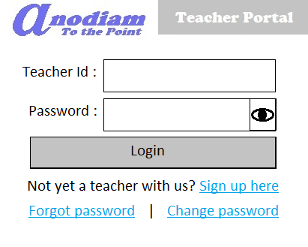
Teacher App: Signup / Login page
Link: https://anodiam.com/teacher

Slide 3
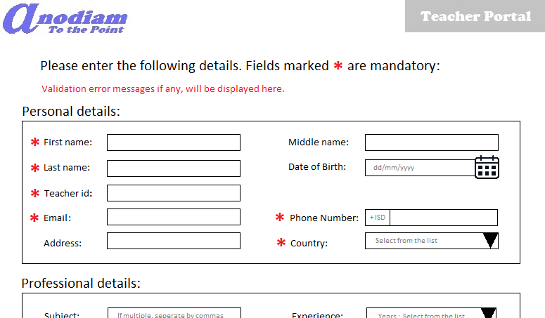
Teacher App: Signup – Teacher Details page
Link: https://anodiam.com/teacher

Slide 4
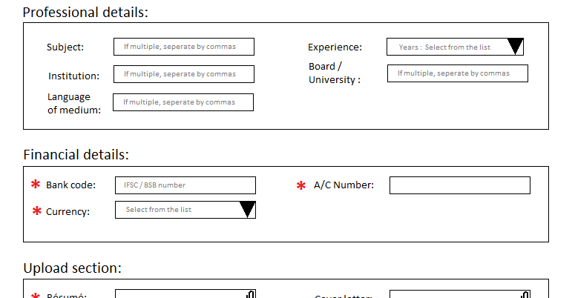
Teacher App: Signup – Teacher Details page contd.
Link: https://anodiam.com/teacher

Slide 5
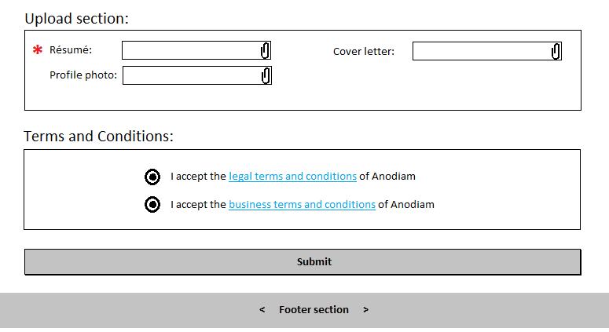
Teacher App: Signup – Teacher Details page contd.
Link: https://anodiam.com/teacher

Slide 6
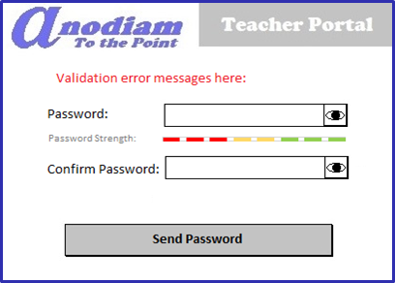
Teacher App: Signup - Confirm Password page
Link: https://anodiam.com/teacher

Slide 7
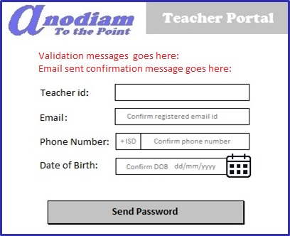
Teacher App: Signup – Forget Password page
Link: https://anodiam.com/teacher

Slide 8
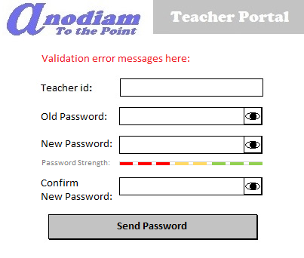
Teacher App: Signup – Change Password page
Link: https://anodiam.com/teacher

Slide 9
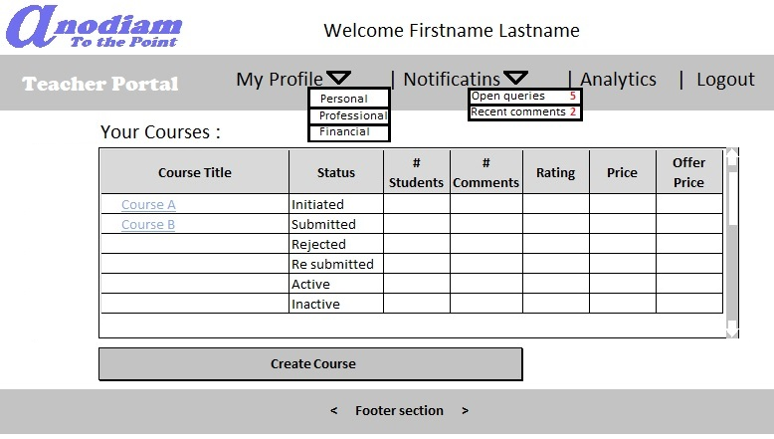
Teacher App: My Teacher Home page
Link: https://anodiam.com/teacher

Slide 10
Teacher App: My Teacher Profile page
Link: https://anodiam.com/teacher

