Slide 1


Slide 2

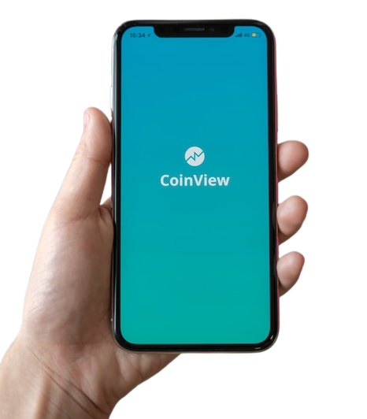


Data is Future
© PROTECTED ANODIAM 2023 || PRIVATE & CONFIDENTIAL

Slide 3
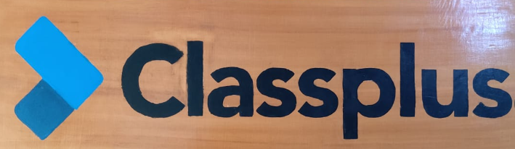
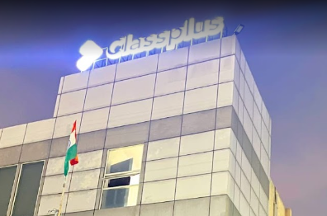
Our Business Partner ClassPlus
Classplus started in 2018
Classplus is a SaaS-based platform for offline coaching institutes, teachers and content creators to launch their online teaching business.
Legal Name: Bunch Microtechnologies Pvt Ltd.
Location: 1st Floor, Building No, D8, Block D, Sector 3, Noida, Uttar Pradesh 201301
© PROTECTED ANODIAM 2023 || PRIVATE & CONFIDENTIAL

Slide 4
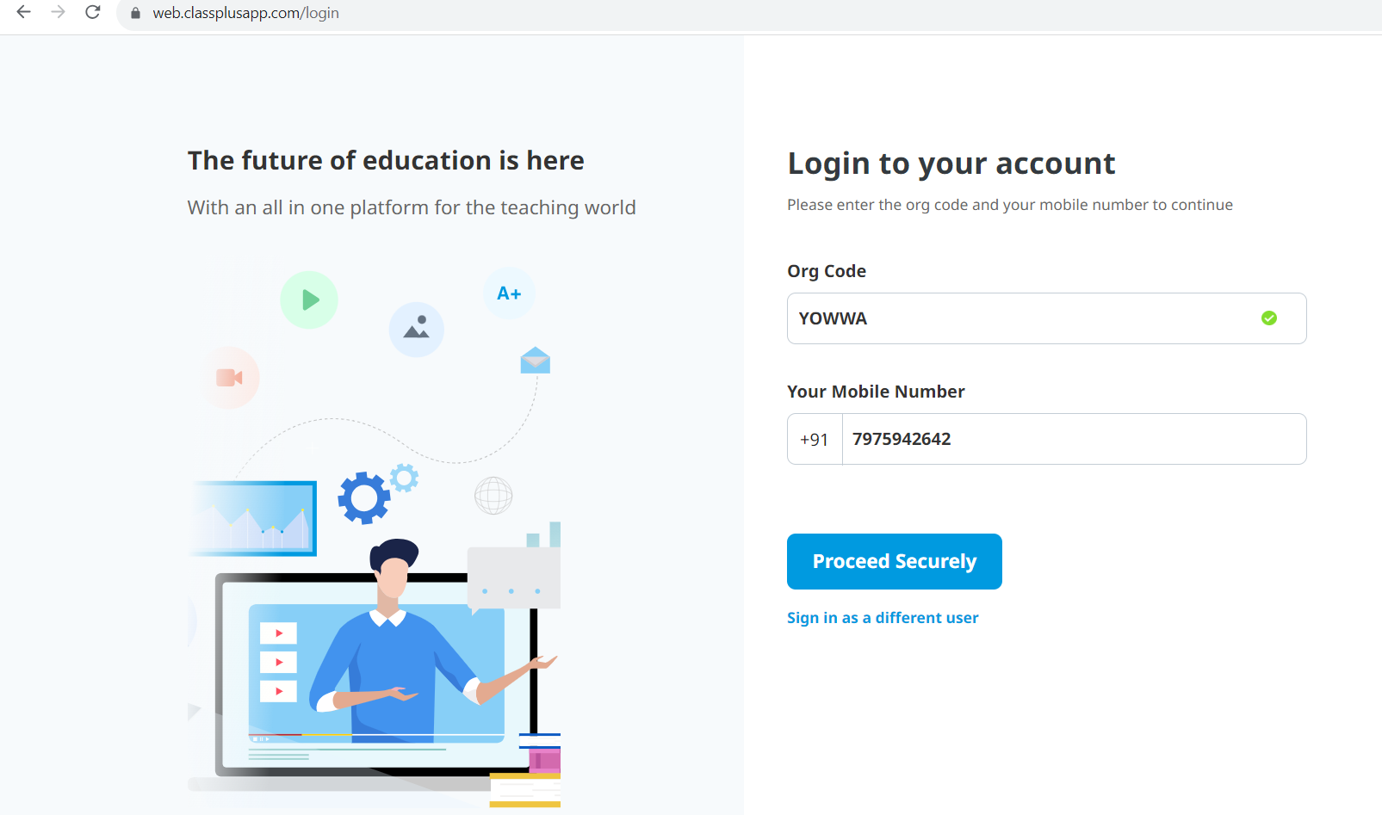
ClassPlus Login in Desktop
Link : https://web.classplusapp.com
Organisation Code : YOWWA
© PROTECTED ANODIAM 2023 || PRIVATE & CONFIDENTIAL

Slide 5
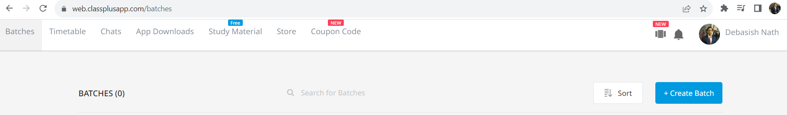
Services of ClassPlus
Batches
Timetable
Chats
App Downloads
Study Material
Store
Coupon Code
© PROTECTED ANODIAM 2023 || PRIVATE & CONFIDENTIAL

Slide 6
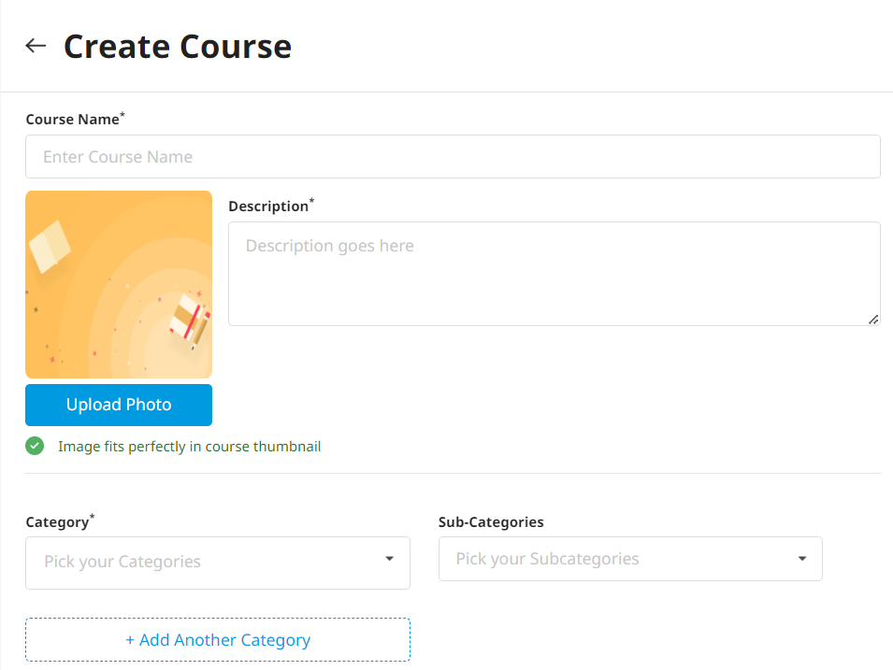
How to build a Course
© PROTECTED ANODIAM 2023 || PRIVATE & CONFIDENTIAL

Slide 7
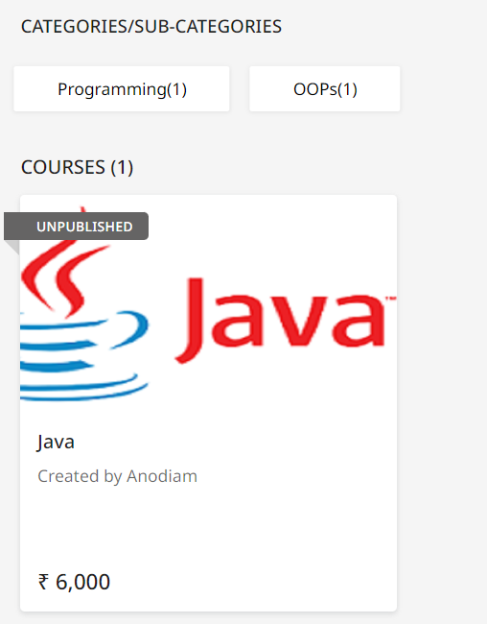
Course
© PROTECTED ANODIAM 2023 || PRIVATE & CONFIDENTIAL

Slide 8
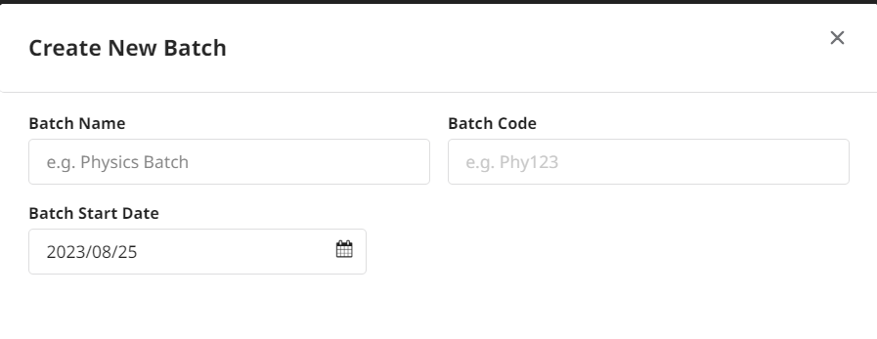
How to build a Batch
© PROTECTED ANODIAM 2023 || PRIVATE & CONFIDENTIAL

Slide 9
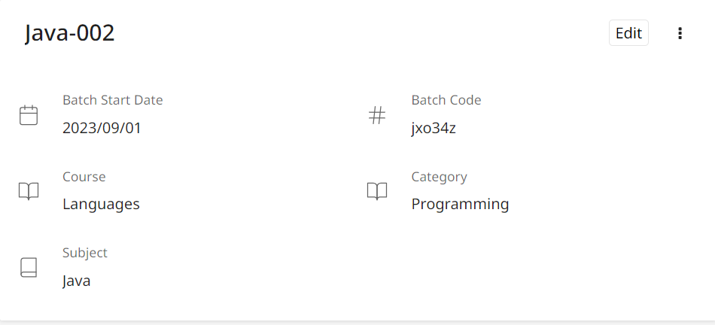
Batch
© PROTECTED ANODIAM 2023 || PRIVATE & CONFIDENTIAL

