Slide 1


Slide 2

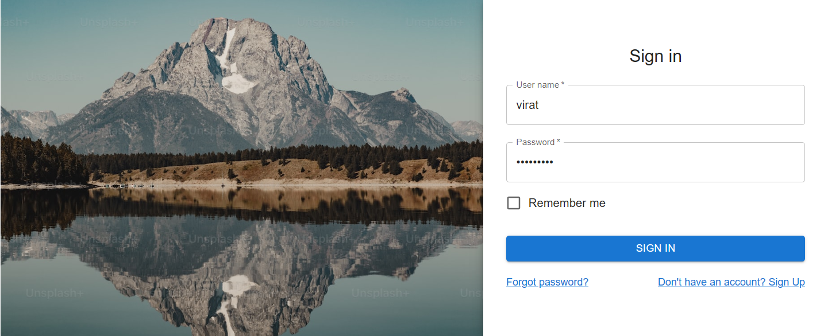
© PROTECTED ANODIAM 2023 || PRIVATE & CONFIDENTIAL

Slide 3
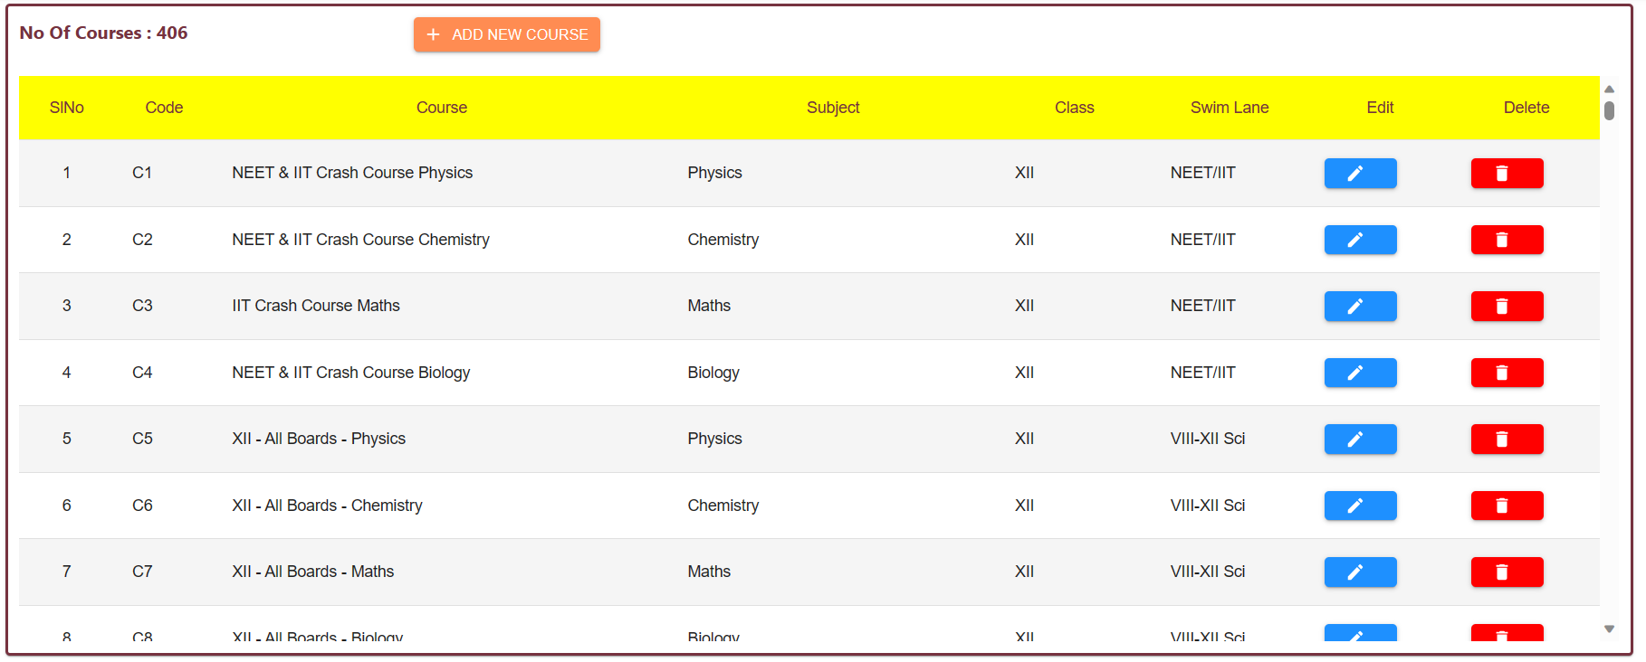
© PROTECTED ANODIAM 2023 || PRIVATE & CONFIDENTIAL

Slide 4
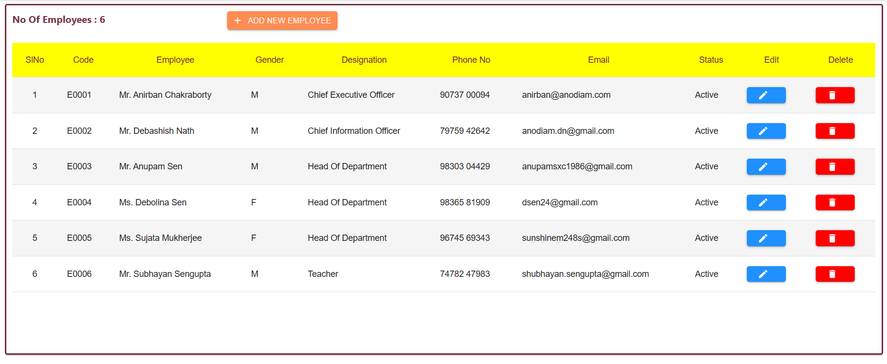
© PROTECTED ANODIAM 2023 || PRIVATE & CONFIDENTIAL

