Slide 1






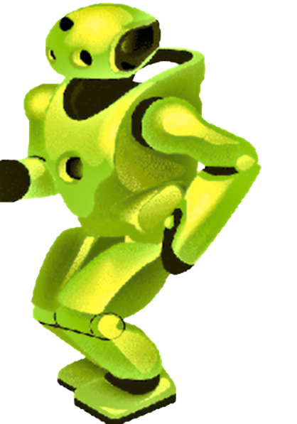
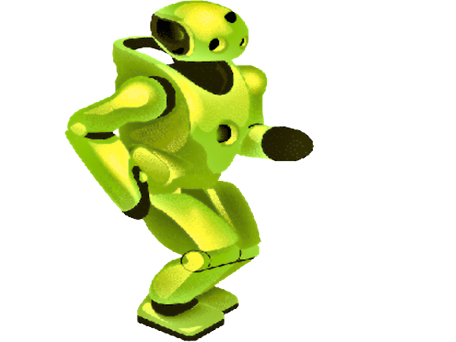



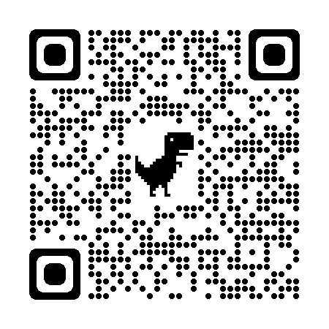
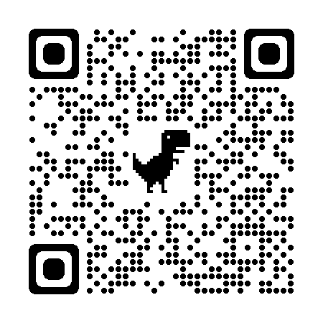


Artificial Intelligence & IT Training
N-1/25 Patuli, Kol 94, Near Fire Brigade & Krisi Vikas
9073 700094
Upto 50% Off
T&C Apply
Follow
for Discount
App Download
AI, IoT-Robotics, Coding – Class III-XII
IT & AI Professional Training & Projects
Data Science, Computer Vision, NLP, DSP, Python
Data Analytics, C, C++, IoT, Robotics
Java, .NET, JavaScript, ReactJS, Native, PHP
DevOps, Docker, Kubernetes, Cloud
Database, Firebase, Cyber Security, Automation Testing
Pmp, Agile, Office, Adv Excel, Tally, Html, Css
Globally experienced faculty from prestigious organizations, fun & easy learning
Project-based, Job-Focused, Certification Help, Smart Classrooms, AC, CCTV
www.anodiam.com || anirban@anodiam.com

