Slide 1


#0f0f7f, 40px
nodiam
60px
Type Here
60px
60px
60px
Sign Up
Login
cooper black, 36, #fff
200 px horizontal, 40 px vertical, #fff
Arial, 16, #afafff, Middle alignment
Arial, 18, B, 0f0f7f
Arial, 18, B, 0f0f7f
Logo Reverse colour right aligned. 15 Px gape from the left wall
#6f6fef-67%
#fff-100%, 100 Px,
Header
#6f6fef, 98%, 47%, #fff 1%
Arial, #fff, 14
35 %, #0f0f7f
© 2020 Anodiam All rights reserved

Slide 2
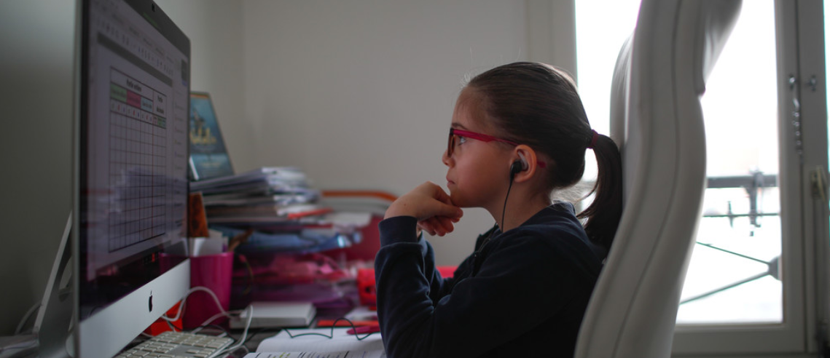
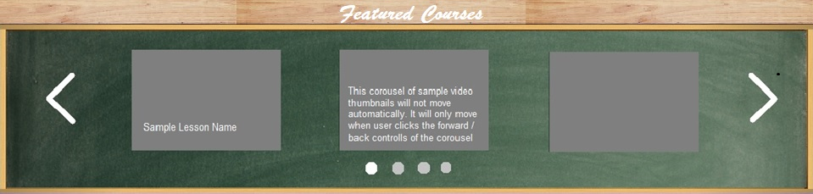
nodiam
Type Here
Sign Up Login
Carousel with notes will display one by one within 4 sec
Carousel will display 3 featured courses at a time
© 2020 Anodiam All rights reserved

Slide 3
nodiam
#6f6fef 98%, #9f9fff 60%, #fff 1%, Linier gradient
Sign Up
Login

