Slide 1

Artificial Intelligence
& Data Science
Make India
an AI
Super Power
Artificial Intelligence
nodiam, Education that enlightens!
Dependable Competency Partners
Expert Industry Veterans
Lucid & Practical
IT
Competency
Scientific
Knowledge

Slide 2


AI is Not Rocket Science
Our mentors will help you:
Comprehensive teaching
Python computing skills & all relevant libraries
Data Science, AI, Analytics & Data Visualization
Computer Vision, LLM, GAN, NLP etc.
IoT & Robotics
Hands-on labs & project-based mentoring
Free internship & job experience
AI won’t replace humans. But those with AI will replace those without AI.

Slide 3

Job Opportunities in AI
AI Professionals
Data Scientists
NLP, CV, LLM, GAN Specialists
IoT Specialists & Robotics Engineers
Salary Band
Highest paid professionals in India & abroad
Fastest growing careers, globally
Highest vacancy rates in job sites

Slide 4

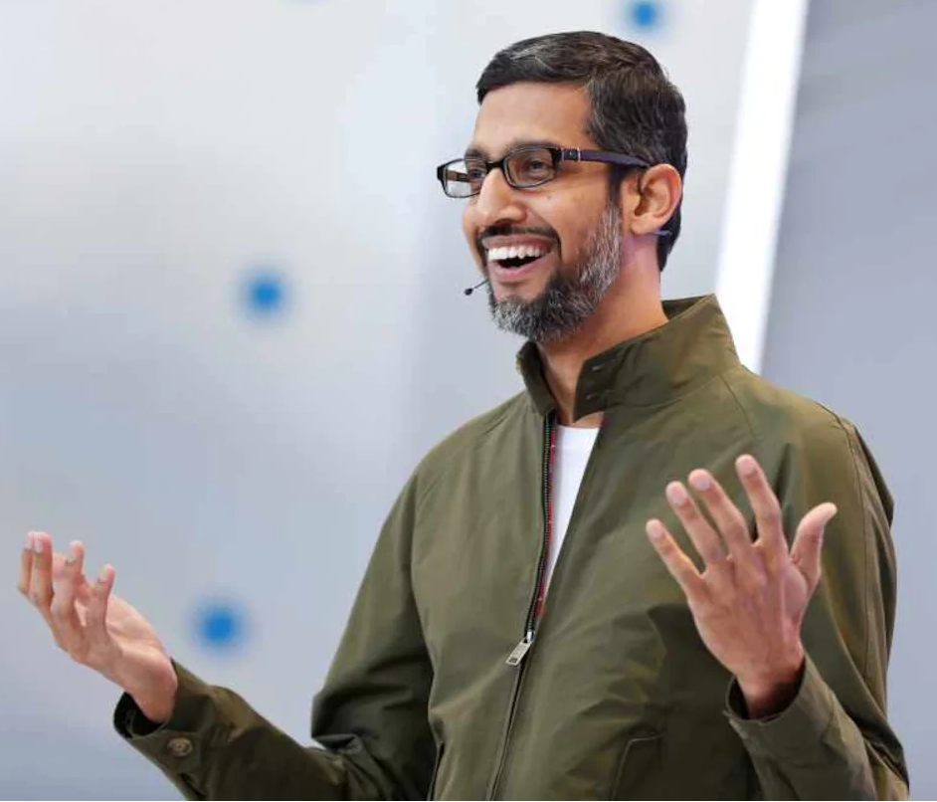
AI Supports All Aspects of Life
Civil, Mechanical, Chemical & all Engineers
Doctors, Teachers
Scientists & Researchers
Corporate Strategists, Bankers & Lawyers etc.
A.I. – more profound than fire or electricity! - Sundar Pichai, Alphabet C.E.O.

Slide 5
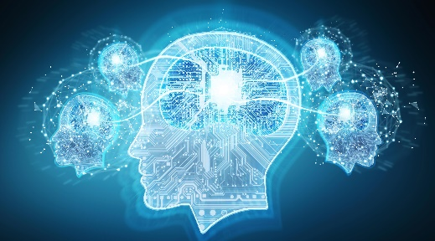
Courses Offered
Duration per course: 3 months (2 classes of 2 hours per week)
Fees per course: 12,000 + G.S.T.
AI for Beginners
Chat GPT & Other AI Tools
LLM & GAN Applications
Ethical Considerations
AI Project Mgmt. & Structuring
Advanced Excel
Project Work
Data Science
Python for AI
Data Analytics & Visualization
Maths for AI
Data Science Fundamentals
Project Work
Machine Learning
Neural Network
Deep Learning
Optimizing & Tuning Network
Structuring ML Projects
Project Work
NLP Engineer
NLP
GAN & LLM
Tensor Flow & Keras
Project Work

Slide 6
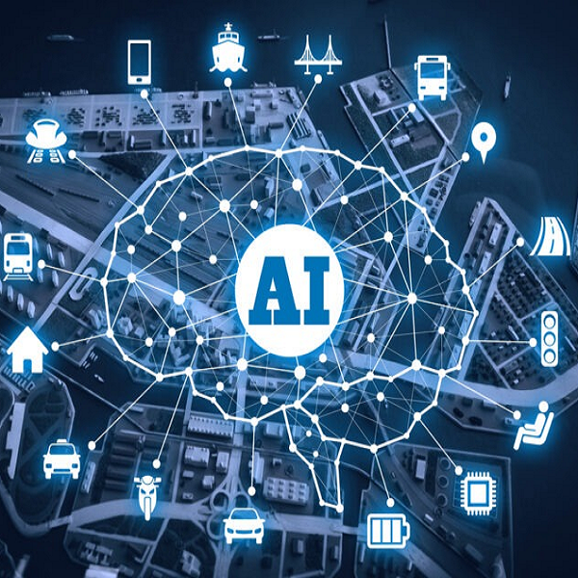
Courses Offered
Computer Vision
CNN
Sequence Models
Open CV
Tensor Flow & Keras
Project Work
Medical Engineering
AI for Medical Diagnosis
AI for Medical Prognosis
AI for Medical Treatment
Project Work
Data Science: Audio DSP
DSP
Tensor Flow
Keras
Project Work
Senior Developer
Git Hub & Jira
Business Intelligence & DevOps
Optimizing Neural Networks
Structuring ML Projects
ML Ops & AWS AI/ML Services
Interview Prep & Project Work
IoT
Arduino, Raspberry Pi etc.
Sensor & network design
Data & knowledge management
Understanding IoT architecture
IoT security & Industry 4.0
Project Work

Slide 7

Free Internship & Job Experience
Live Project Training
Business Analysis
Design Thinking
Agile Project Management
AI Development
Interview Prep
Communications & Grooming
Duration: 12 months (20 Hours per week)
Fees: 100% Scholarship on successful completion of prerequisite courses.
Thank You!

