Slide 1


The Edtech that creates possibilities beyond
barriers through innovation & empathy.
Business Introduction
Ananya Moitra
Marketing Head
ananyaloveslife@gmail.com
+61 405706206

Slide 2






Education System Needs Our Help
?
Most kids - tired, stressed & bored in school
Rigid, top-down approach
Small attention span
No time for sports & recreation
Education system needs Edtech evolution
300 – 3000 year old system
Capped by numbers
Can be scaled up effectively using technology
Flaws of tuition classes (online & in person)
Difficult to access the best quality teaching
Not affordable for most parents
Competitors lack quality
Unsuitable for a wide range of merit levels
Inflated price, pressure sales & toxic culture
PC: news.yale.edu Jan 2020

Slide 3




Anodiam Model: Connect Most Students to the Best Education
Content Team
Students
High Quality Contents:
Video,
& non video
Anodiam mobile app & web site
Student centric design
Learn in own time, pace & comfort
Queries resolved within 3 days
Highest quality content
Engaging, comprehensive, pre-recorded
80% video & 20% others
Self tests, repeat until perfection
Value driven business model for max returns
Ensure students find us dependable
Affordable, AI based pricing
Teachers
Constant
Assistance
Queries
Resolutions
Ratings & feedback
Film Crew &
Head Teachers
Platform Dev & Support
Platform Dev & Support
Platform Team
$
IT, Marketing
Operations etc.

Slide 4
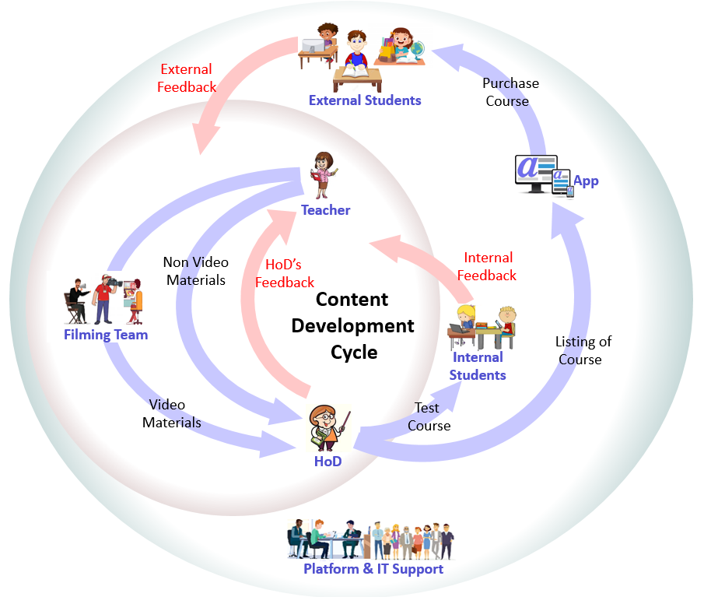


Content Quality is Our Game Changer
Professional QC lifecycle
Feedback based quality at all levels
Tested by real students of all merit levels
Benchmark against the best
Official training video from Google Cloud
Physics teaching from Vedantu
Maths tutoring on Youtube
Minimize all scopes of improvement
Monotonous for school students
Over use of graphics & incorrect English
Rushed through conceptual topics

Slide 5




Technology and Apps
Content
Creation App
Anodiam
App & Website
Admin
Apps
IT landscape
Anodiam app & website for students
Teachers’ app & Content creation app
External integration (Ops, Sales, Marketing, HR)
Tech stack
App Dev: Java Spring Boot, Hibernate, MySQL
Mobile Dev: React Native
Cloud & Containerization: GCP, Kubernetes
CI/CD, DevOps: Ansible, Jenkins
Cyber Security
UX: Bootstrap, JavaScript
Analytics, Data Science & AI
Global development centre
Highly skilled resource pool at moderate rates
Convenient location in Bangalore
Google
Kubernetes
Engine
Ingress
Prometheus
Monitoring
Frontend
Cloud SQL
REST API
Google Cloud
Storage
Google Cloud

Slide 6
Business Model
Affordable pricing to maximize profit
Dynamic pricing as per market condition
Discount offers to optimize sales
AI model to automate above
Student oriented & value driven
Highly quality focused
Highest levels of costumer satisfaction
High return & low risk business
Consider high demand markets
Research & prioritization of rollouts
$
March
July
November
March
$
Offer Price of Courses in INR(₹)
Minimum Price | 5,000
Mean Price | 7,300
Median Price | 7,000
Maximum Price | 10,000
** 1₹ = 0.017US$

Slide 7
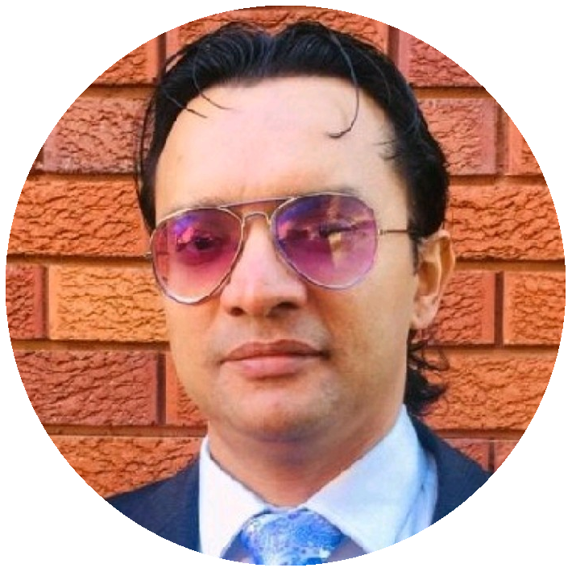

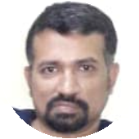
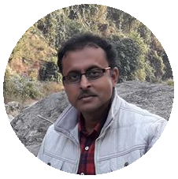
Core Team
Anirban Chakrabarty
Innovation Lead
Empathetic innovator with expertise in full stack IT development including cloud technologies, AI, Project Management & Design Thinking.
Vivek S Bendre
IT Head
IT entrepreneur with experience in setting up ODCs from scratch. Presently CEO, of FluxionBits, Bangalore
Debasish Dutta
Academic Head (Proposed)
26 years of teaching experience in internationally reputed schools like La Martiniere, Calcutta. Students love his teaching style.
Ananya Moitra
Marketing Head
25 years of experience in promoting & campaigning products & services across geographies. A noted poet & musician. Has an MBA in Finance.
Parag Biswas
Content Development Head (Honorary)
Award winning film maker, TV reporter, actor, anchor, quiz master, commentator & a school teacher.

Slide 8

Where We Stand Now
Work in Progress
App & DevOps prototyping
Pilot phase of content creation
Resources Available
Talented team members & managers
Studio setup on 5000sqft
Challenges
Most resources are part time partners
Require infrastructure investment
Funding for marketing

Slide 9




Rollout and Marketing
CBSE – X, XII – Maths, English & Computer Science
High demand, high returns, low risk
Tuitions are highly sought after
Marketing Plan
Primary focus on digital marketing
Flagship Launch: ICSE, CBSE – V to XII – All subjects
35 million students, 76% seek tuitions
Affluent families with high priority on education
Global Rollout
Carry out geography based market analysis
Prioritize high demand & less risk business

Slide 10

Financial Prospects
Unicorn in 5 years just through flagship courses
4.4 million students in each year
Sale 1 course per 100 students & double it each year
Edtech is the new fintech
Phenomenal growth, 21 unicorns, 2 decacorns
Presently $60 bn, $350 bn by 2025, $1 tn by 2027
Global, never-ending prospect
Increasing demand, low risk & low investment
Low maintenance, same course to run for many years
$1 billion!
$
Launch 1 2 3 4 5 6

Slide 11
Return on Investment
$
Budget: ₹ 1 Crore in four months
Break-even in just 3 months
Sale only 1400 courses @ $100 each
Just 1 sale per ~3,000 students
Profitable investment opportunity
25% yearly gain over 3 years
Detailed monthly reporting
million US$
0 1 2
Years
$

Slide 12

Partner with Us
Once in a lifetime growth opportunity in Edtech
Catapult into the billion dollar board room
Start with zero investment
Enjoy the autonomy and job satisfaction
Innovate & implement freely with your creativity
Versatile career path, learn new skills as you grow
$

Slide 13


