Slide 1
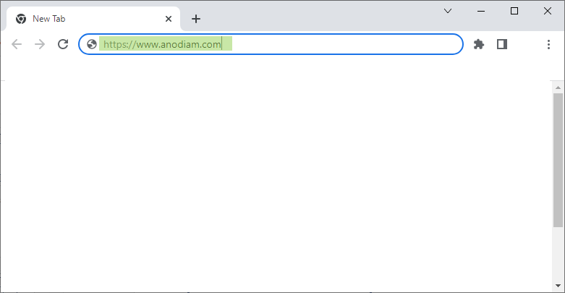

Accessing Anodiam App
Anodiam

Slide 2
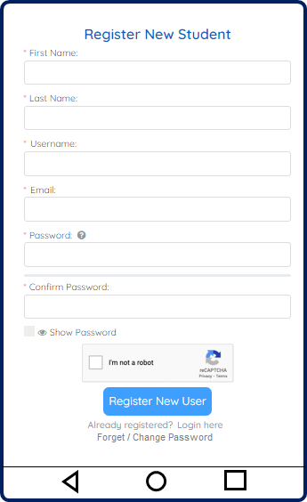
REGISTRATION PAGE - Mobile

Slide 3
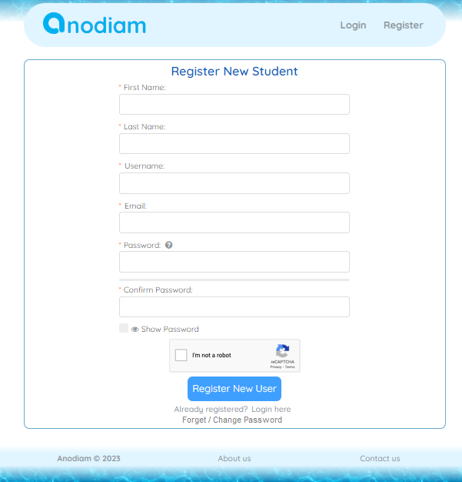
REGISTRATION PAGE - Web

Slide 4

REGISTRATION - CREATE PROFILE PAGE - Mobile
Welcome FirstName! Complete your profile and get Discounts!
Validation / Success messages in Red / Green
Referrer’ Email
?
Board
Class
Phone Number
O
ISD
Address
Guardian’s Name
Guardian's Phone Number
O
ISD
Guardian’s Email
Create
Skip

Slide 5
REGISTRATION - CREATE PROFILE PAGE - Web
Welcome FirstName! Complete your profile and get Discounts!
Validation / Success messages in Red / Green
Referrer’s Email
?
Guardian’s Name
Board
Guardian's Phone Number
O
ISD
Class
Guardian’s Email
Phone Number
O
ISD
Address
Create
Skip
Static Footer

Slide 6
LOGIN PAGE - Mobile
Login
Validation messages in Red
Username
Password
N
Login
Not yet registered? Register here
Change / Forgot password
Login with Facebook
Login with Google

Slide 7
LOGIN PAGE - Web
Static Header
Login
Validation messages in Red
Username
Password
N
Login
Not yet registered? Register here
Change / Forgot password
Login with Facebook
Login with Google
Static Footer

Slide 8

Splash Screen - Mobile

Slide 9
CHANGE / FORGET PASSWORD PAGE - Mobile
Change Password
Validation / Success messages in Red / Green
* Username
* Email
* New Password
N
Text describing password field
* Confirm New Password
N
Change Password

Slide 10
CHANGE / FORGET PASSWORD PAGE - Web
Static Header
Change Password
Validation / Success messages in Red / Green
* Username
* Email
* New Password
Text describing password field
N
* Confirm New Password
N
Change Password
Static Footer

Slide 11
MY PROFILE PAGE - Mobile
Profile
Validation / Success messages in Red / Green
Email
Board
Class
Phone Number
O
ISD
Address
Guardian’s Name
Guardian's Phone Number
O
ISD
Guardian’s Email
Update
J
m
&
$$
_
My Profile
Search Course
My Courses
Discounts
Achievements

Slide 12
MY PROFILE PAGE - Web
Static Header
m
User Name
Home | My Courses | Discounts | Scholarships
A
My Profile
Logout
Validation / Success messages in Red / Green
Email
Guardian’s Name
Board
Guardian's Phone Number
O
ISD
Class
Guardian’s Email
Phone Number
O
ISD
Address
Update
Skip
Static Footer

Slide 13
SEARCH COURSES PAGE - Mobile
Search Courses
Board
Class
Subject
m
COURSE ONE
Course
Two
Card
COURSE IMAGE
a
ICSE | Class | Physics | Teacher
YYYYY (# Ratings)
2-3 lines about this course. more…
Original Price: ₹50,000/-
Your Discount: 90%
Buy Now ₹5,000/-
Course Three
Card
Other
cards…
BUY SELECTED COURSES
J
m
&
$$
_
My Profile
Search Course
My Courses
Discounts
Achievements

Slide 14
SEARCH COURSES PAGE - Web
Static Header
m
User Name
Home | My Courses | Discounts | Scholarships
A
My Profile
Logout
Filters:
COURSE ONE
Course
Two
Card
COURSE IMAGE
Board
a
ICSE | Class | Physics | Teacher
YYYYY (# Ratings)
Class
2-3 lines about this course. more…
Original Price: ₹50,000/-
Your Discount: 90%
Subject
Buy Now ₹5,000/-
Course Three
Card
Other
cards…
BUY SELECTED COURSES
Static Footer

Slide 15
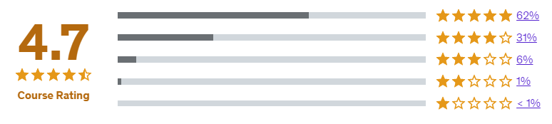
SEARCH COURSES DETAILPAGE - Mobile
Course Title
Course Title
Free Introductory Videos of the Course
Free Introductory Videos of the Course
Or Teacher Profile Video
Or Teacher Profile Video
Board: ICSE | Class: X | Subject: Physics | Teacher: Name
Board: ICSE | Class: X | Subject: Physics | Teacher: Name
(# Ratings) | Number of Purchases: 12,345
(# Ratings) | Number of Purchases: 12,345
r
10-12 lines about this course in little detail.
10-12 lines about this course in little detail.
Chapter 1 Name Preview
Chapter 2 Name Preview
Chapter 3 Name
Chapter 4 Name Preview
More…
Chapter 1 Name Preview
Chapter 2 Name Preview
Chapter 3 Name
Chapter 4 Name Preview
More…
Original Price: ₹50,000/-
Your Discount: 90%
Original Price: ₹50,000/-
Your Discount: 90%
Buy Now ₹5,000/-
Buy Now ₹5,000/-
Also suggested for you:
Also suggested for you:
Course
Two
Card
Other
cards…
Course
Two
Card
Other
cards…
Suggested for you…
Suggested for you…
J
m
&
$$
_
J
m
&
$$
_
My Profile
Search Course
My Courses
Discounts
Scholarships
My Profile
Search Course
My Courses
Discounts
Scholarships

Slide 16
SEARCH COURSES DETAILPAGE - Web
Static Header
m
User Name
Home | My Courses | Discounts | Scholarships
A
Course Title
Board: ICSE | Class: X | Subject: Physics | Teacher: Name
(# Ratings) | Number of Purchases: 12,345
10-12 lines about this course in little detail.
Chapter 1 Name Preview
Chapter 2 Name Preview
Chapter 3 Name
Chapter 4 Name Preview
More…
(# Ratings) | Number of Purchases: 12,345
r
Free Introductory Videos of the Course
10-12 lines about this course in little detail.
Or Teacher Profile Video
Also suggested for you:
Course
Two
Card
Other
cards…
Original Price: ₹50,000/-
Buy Now ₹5,000/-
Your Discount: 90%
Static Footer

Slide 17

CHECKOUT / PAY PAGE - Mobile
Checkout
Validation / Success messages in Red / Green
Invoice Summary
Course Title 1 ₹50,000/-
Course Title 2 ₹50,000/-
Original Total Price ₹1,00,000/-
Initial Discount Token
#abcdefgh123456789 60%
Inward Referral Discount Token
#ref123456789 50%
Achiever’s Discount Token
#fer987654321 50%
Final Discount: 90% ₹90,000/-
Offer Price ₹10,000/-
Pay by Debit/Credit Card
Name on Card
Card Number
CVV Number
Expiry (MM/YY)
a
Securely store this payment information
a
COMPLETE CHECKOUT

Slide 18
CHECKOUT / PAY PAGE - Web
Static Header
m
User Name
Home | My Courses | Discounts | Scholarships
A
Validation / Success messages in Red / Green
My Profile
Logout
Pay by Debit/Credit Card
Invoice Summary
Name on Card
Course Title 1 ₹50,000/-
Course Title 2 ₹50,000/-
Original Total Price ₹1,00,000/-
Initial Discount Token
#abcdefgh123456789 60%
Inward Referral Discount Token
#ref123456789 50%
Achiever’s Discount Token
#fer987654321 50%
Final Discount: 90% ₹90,000/-
Offer Price ₹10,000/-
Card Number
CVV Number
Expiry (MM/YY)
a
Securely store this payment information
a
COMPLETE CHECKOUT
Static Footer

Slide 19
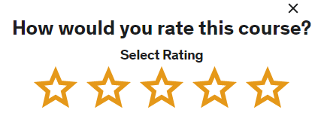
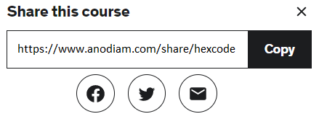
MY COURSES PAGE - Mobile
My Courses
My Courses
My Courses
COURSE ONE
Course
Two
Card
COURSE ONE
Course
Two
Card
COURSE ONE
Course
Two
Card
COURSE IMAGE
COURSE IMAGE
COURSE IMAGE
ICSE | Class | Physics | Teacher
ICSE | Class | Physics | Teacher
ICSE | Class | Physics | Teacher
33 videos | 25 quizzes | 16:43 Hrs
33 videos | 25 quizzes | 16:43 Hrs
33 videos | 25 quizzes | 16:43 Hrs
32% Complete
32% Complete
32% Complete
Your Rating:
Share
Your Rating:
Share
Your Rating:
Share
Other
cards…
Other
cards…
Other
cards…
J
m
&
$$
_
J
m
&
$$
_
J
m
&
$$
_
My Profile
Search Course
My Courses
Discounts
Scholarships
My Profile
Search Course
My Courses
Discounts
Scholarships
My Profile
Search Course
My Courses
Discounts
Scholarships

Slide 20
MY COURSES PAGE - Web
Static Header
m
User Name
Home | My Courses | Discounts | Scholarships
A
My Profile
Logout
COURSE ONE
Course
Three
Card
COURSE IMAGE
Course
Two
Card
ICSE | Class | Physics | Teacher
33 videos | 25 quizzes | 16:43 Hrs
32% Complete
Your Rating:
Share
Other
cards…
Static Footer

Slide 21
STUDY COURSE PAGE - Mobile
Course One
Chapter 1 Name
7 8
|| 4
-5 P Q +5
⚙
3:45 / 9:05
2x
Contents
Section 1
1. Chapter 1 Name
2. Chapter 2 Name
3. Quiz 1 60%
Section 2
4. Chapter 3 Name
a
a
Teacher’s Notes
Lines of notes and links to downloadable docs
Link to doc 1
Queries and Resolutions
DD/MM/YYYY : username
Query raised by username on given date
Resolution: Approved by: Teacher DD/MM/YYYY
Link to doc
DD/MM/YYYY : username
Unresolved Query raised by username on given date
Raise a query:
👍
9
👍
12
Raise

Slide 22
STUDY COURSE PAGE - Web
Static Header
m
User Name
Home | My Courses | Discounts | Scholarships
A
Course One
1. Chapter 1 Name
Contents
Section 1
1. Chapter 1 Name
2. Chapter 2 Name
3. Quiz 1 60%
Section 2
4. Chapter 3 Name
5. Quiz 2
6. Chapter 4 Name
Section 3
7. Chapter 5 Name
a
7 8
a
a
|| 4
-5 P Q +5
⚙
3:45 / 9:05
2x
a
Teacher’s Notes
Lines of notes and links to downloadable docs
Link to doc 1
Queries and Resolutions
DD/MM/YYYY : username
Query raised by username on given date
Resolution: Approved by: Teacher DD/MM/YYYY
Link to doc
DD/MM/YYYY : username
Unresolved Query raised by username on given date
Raise a query:
👍
9
👍
12
Raise a query
Static Footer

Slide 23
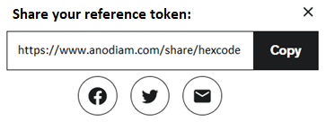
DISCOUNTS PAGE - Mobile
Discounts
Discounts
Initial Discount:
Fill up the My Profile tab including guardian’s details and start
getting massive discounts once they confirm their email.
Initial Discount:
Fill up the My Profile tab including guardian’s details and start
getting massive discounts once they confirm their email.
Token | Expiry | Discount
Hex code | DD/MM/YYYY | 60%
Token | Expiry | Discount
Hex code | DD/MM/YYYY | 60%
Reference Discount:
Get discount because username referred you.
Reference Discount:
Get discount because username referred you.
Token | Expiry | Discount
Hex code | DD/MM/YYYY | 50%
Token | Expiry | Discount
Hex code | DD/MM/YYYY | 50%
Buddy Discount:
Username1 & username2 purchased through your reference.
Outward Referral Discount:
Username1 & username2 purchased through your reference.
Token | Expiry | Discount
Hex code | DD/MM/YYYY | 50%
Token | Expiry | Discount
Hex code | DD/MM/YYYY | 50%
Share your reference token
Share your reference token
Scholarship Discount:
Claim discount of getting 90% on all quizzes of course one.
Scholarship Discount:
Claim discount of getting 90% on all quizzes of course one.
Token | Expiry | Discount
Hex code | DD/MM/YYYY | 50%
Token | Expiry | Discount
Hex code | DD/MM/YYYY | 50%
J
m
&
$$
_
J
m
&
$$
_
My Profile
Search Course
My Courses
Discounts
Scholarships
My Profile
Search Course
My Courses
Discounts
Scholarships

Slide 24
DISCOUNTS PAGE - Web
Static Header
m
User Name
Home | My Courses | Discounts | Scholarships
A
Discounts
My Profile
Logout
Initial Discount:
Fill up the My Profile tab including guardian’s details and start
getting massive discounts once they confirm their email.
Buddy Discount:
Username1 & username2 purchased through your reference.
Token | Expiry | Discount
Hex code | DD/MM/YYYY | 50%
Token | Expiry | Discount
Hex code | DD/MM/YYYY | 60%
Share your reference token
Reference Discount:
Get discount because username referred you.
Scholarship Discount:
Claim discount of getting 90% on all quizzes of course one.
Token | Expiry | Discount
Hex code | DD/MM/YYYY | 50%
Token | Expiry | Discount
Hex code | DD/MM/YYYY | 50%
Static Footer

Slide 25
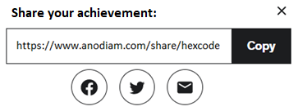
ACHIEVEMENTS / SCHOLARSHIPS PAGE - Mobile
Achievement / Scholarships
Achievement / Scholarships
Course One:
Course One:
Achievement / Scholarship | Share
Completed 50%
90% marks in quiz
Achievement / Scholarship | Share
Completed 50%
90% marks in quiz
Course Two:
Course Two:
Achievement / Scholarship | Share
Started course
Achievement / Scholarship | Share
Started course
J
m
&
$$
_
J
m
&
$$
_
My Profile
Search Course
My Courses
Discounts
Scholarships
My Profile
Search Course
My Courses
Discounts
Scholarships

Slide 26
ACHIEVEMENTS / SCHOLARSHIPS PAGE - Web
Static Header
m
User Name
Home | My Courses | Discounts | Scholarships
A
Achievement / Scholarships
My Profile
Logout
Course One:
Achievement / Scholarship | Share
Completed 50%
90% marks in quiz
Course Two:
Achievement / Scholarship | Share
Started course
Static Footer

Slide 27


HEADER, FOOTER & LOGO – .png images

