Slide 1

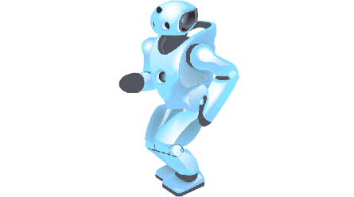












Artificial Intelligence
Time for Your Child to join the Party
AI Will Replace 75% of Today’s Jobs within 15 Years
Only Way to AI-Proof Your Child’s Career Is to Genuinely Teach AI
AI Tuitions for ICSE/CBSE/WB, Class IX-XII
Robotics / AI / Coding for Kids Class III-VIII
Robotics & IoT – From Children’s Level till Hands-on with Microcontrollers
Python, C, C++ - Basics till TensorFlow, Keras & PyTorch, OpenCV etc.
Data Science Concepts / AI – Lucid details till Professional Mathematical Models
Clear Each Concept with Data Visualization & Analytics
Computer Vision, NLP – Cool Play around to Advanced Professional Projects
Technical Communication Skills & Business Intelligence
Project based, fun & easy learning
Globally experienced faculty from prestigious organizations
Bring a friend & get
50% OFF
Multiple Subjects
50% OFF
N-1/25 Kunal Road, Patuli,
Kolkata 700094
Near Fire Brigade & Krishi Vikas
anirban@anodiam.com
9073 700094
www.anodiam.com

Slide 2


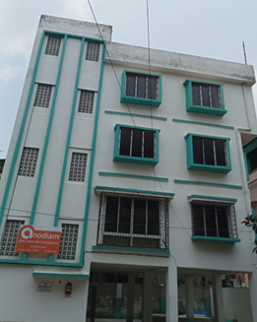


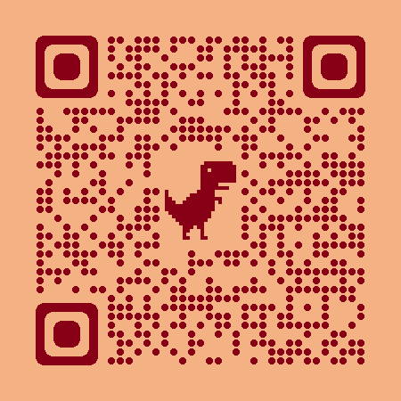

Coaching Classes
ARTIFICIAL
INTELLIGENCE
& IoT
NEET &
IIT JEE
Top-quality Teachers
Latest Techniques
400+ Courses
PTM, Counselling
Doubt Clearing, Mock Tests
Smart Classrooms, AC, CCTV
International Management
App Arriving Soon
VIII-XII
ICSE/CBSE/WB
All Subjects
IT/AI Training
& Projects
BCom, BBA,
CA, CMA, CS, CFA
Spoken Eng,
Grooming
Bring a friend & get
50% OFF
Multiple Subjects
50% OFF
Scan &
Follow for
Discounts
N-1/25 Kunal Road, Patuli, Kolkata 700094, Near Fire Brigade & Krishi Vikas
www.anodiam.com || anirban@anodiam.com
9073 700094

Slide 3

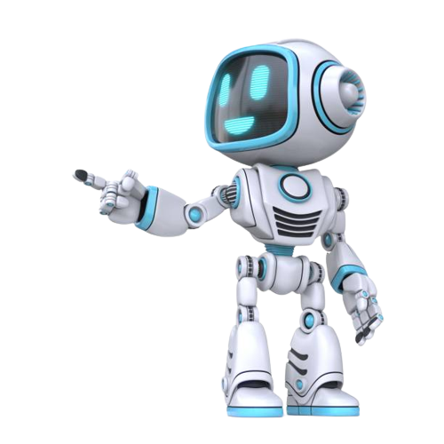



IT/AI Training & Projects
Python, Data Science & AI, Data Analytics
Computer Vision, NLP, DSP, IoT, Robotics
Java, Advanced Java, .NET, Azure
JavaScript, React, MUI, Native, PHP, WordPress
Linux, Shell, CCNA
DevOps, Docker, Kubernetes, AWS, GCP
MySQL, SQL Server, Oracle, Firebase
Prince2, Agile, Cyber security, Selenium
MS Office, Adv Excel, Tally, C, C++, Python, HTML, CSS
Grooming, Interview Prep, Network Hardware
Top-Quality Industry Veteran Trainers, Hands-on
Project-Based, Career Focused, Certification Help
Smart Classrooms, AC, CCTV, App Arriving Soon
Bring a friend & get
50% OFF
Multiple Subjects
50% OFF
Scan &
Follow for
Discounts
N-1/25 Kunal Road, Patuli, Kolkata 700094, Near Fire Brigade & Krishi Vikas
www.anodiam.com || anirban@anodiam.com
9073 700094

Slide 4





Commerce Tuitions
IX-XII CSE/CBSE/WB
BCom, BBA, CA, CMA, CS, CFA
Grooming, Spoken Eng, Ielts, Toefl
Interview Prep, Foreign Languages
Finest Teachers from Best Institutes
Smart Classrooms, AC, CCTV, Latest Techniques
International Management, App Arriving Soon
Bring a friend & get
50% OFF
Multiple Subjects
50% OFF
Scan &
Follow for
Discounts
N-1/25 Kunal Road, Patuli, Kolkata 700094, Near Fire Brigade & Krishi Vikas
www.anodiam.com || anirban@anodiam.com
9073 700094

Slide 5





NEET, IIT-JEE, Class VIII-XII
NEET
IIT-JEE (Mains & Advance)
VIII-XII – ICSE/CBSE/WB
Science, Arts, Commerce
Finest Teachers from Best Institutes
Smart Classrooms, AC, CCTV, Latest Techniques
Doubt Clearing, Mock Tests, PTM, Counselling
International Management, App Arriving Soon
Bring a friend & get
50% OFF
Multiple Subjects
50% OFF
Scan &
Follow for
Discounts
N-1/25 Kunal Road, Patuli, Kolkata 700094, Near Fire Brigade & Krishi Vikas
www.anodiam.com || anirban@anodiam.com
9073 700094

