Slide 1
Anodiam Core Student App: Wireframes
Version | Editor | Reviewer | Date | Note
1.0 | AC |  | 30/03/2022 | MVP Student Mobile App

Slide 2
Anodiam Icons
Phone Icon: ‘#2f5597’
Trademark Icon ©: ‘#2f5597’
Dark Theme Icon / Logo: ‘#dae3f3’
Anodiam Font All texts in the app, unless otherwise specified should be of Google Fonts Oxygen.
Catchline: grade education in your grip!

Slide 3
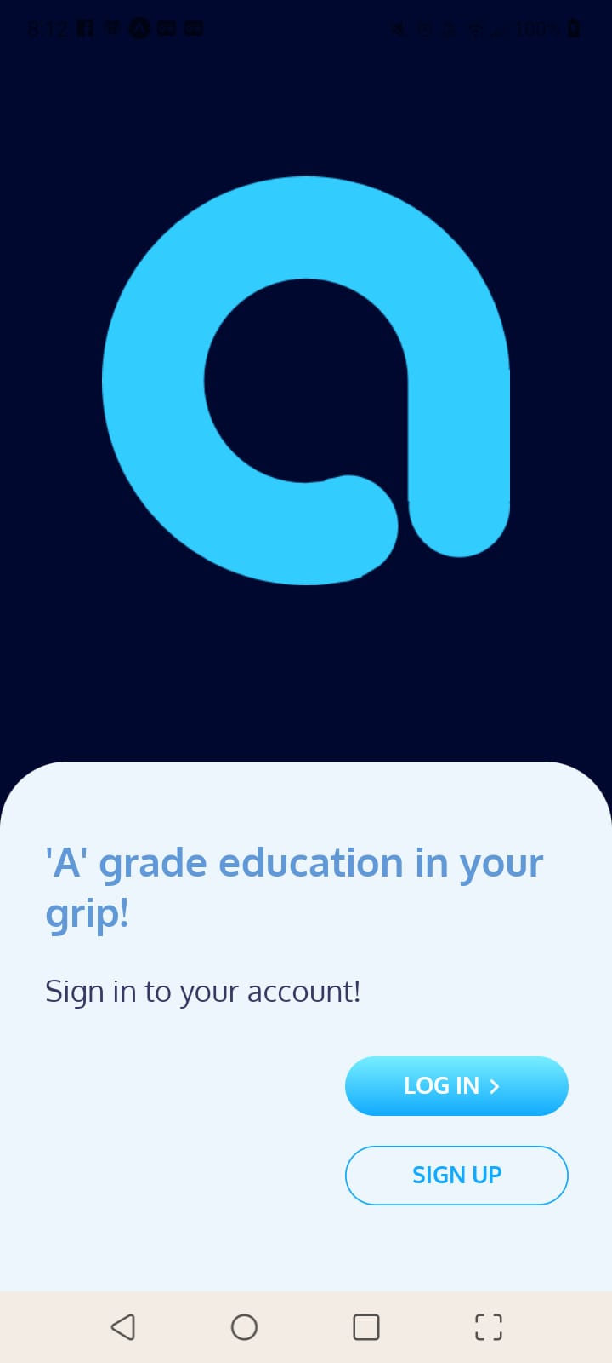
Splash Screen:
On tapping Anodiam icon, new user comes here
CSS checked in git repository: mobileApp001-mvp

Slide 4
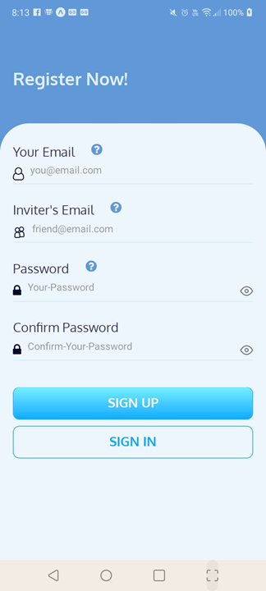
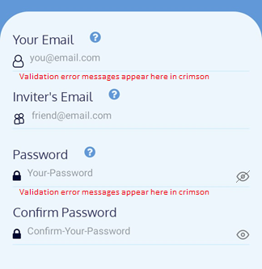
Sign Up Screen:
CSS checked in git repository: mobileApp001-mvp
Sample validation error messages: exact text of individual error messages documented in respective user-stories of product backlog document
Show hide password icon

Slide 5
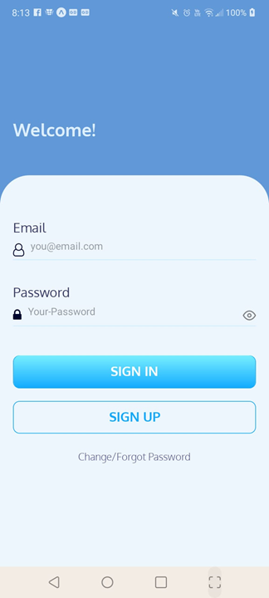
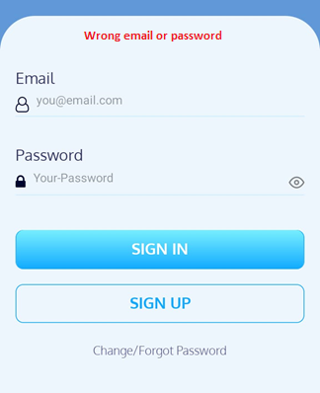
Log in Screen:
CSS checked in git repository: mobileApp001-mvp
Login validation to be shown like this

Slide 6
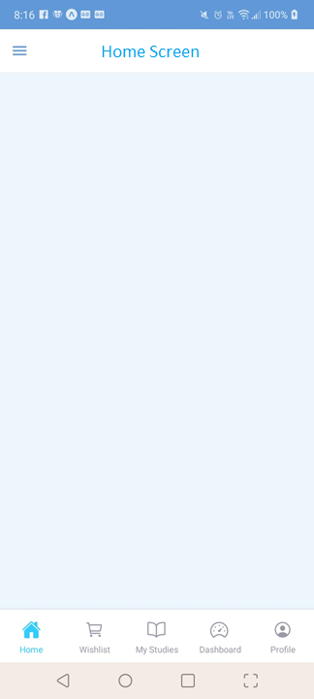
Home Screen and Bottom Tab Navigation:
Post Login user lands up in Home Screen
CSS checked in git repository: mobileApp001-mvp
Bottom tab navigation shows 5 links (Home, Wishlist, My Studies, Dashboard and Profile). The selected page (Home) displays.
Submenus inside each navigation will be under the drawer navigation at top left.

Slide 7
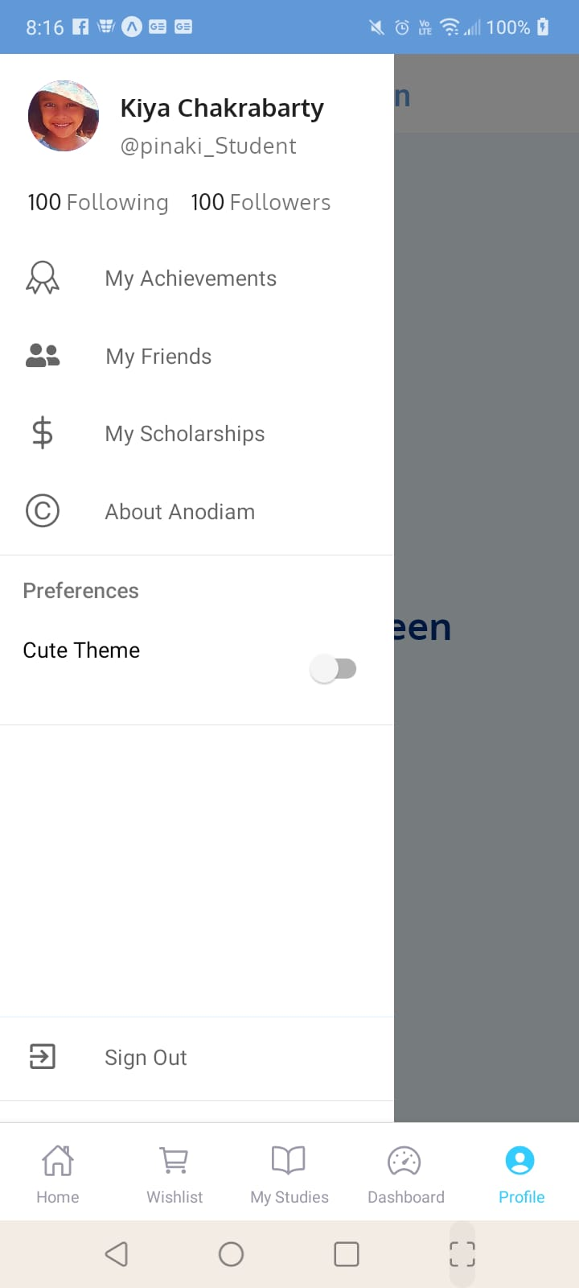
Profile Drawer Navigation:
Profile menu will have the Drawer Navigation items in the left

