Slide 1













Artificial Intelligence
Time for Your Child to join the Party
AI Will Replace 75% of Today’s Jobs within 15 Years
Only Way to AI-Proof Your Child’s Career Is to Genuinely Teach AI
AI Tuitions for ICSE/CBSE/WB, Class IX-XII
Robotics / AI / Coding for Kids Class III-VIII
Robotics & IoT – From Children’s Level till Hands-on with Microcontrollers
Python, C, C++ - Basics till TensorFlow, Keras & PyTorch, OpenCV etc.
Data Science Concepts / AI – Lucid details till Professional Mathematical Models
Clear Each Concept with Data Visualization & Analytics
Computer Vision, NLP – Cool Play around to Advanced Professional Projects
Technical Communication Skills & Business Intelligence
Project based, fun & easy learning
Globally experienced faculty from prestigious organizations
Own Edtech Mobile App
Bring a friend & get
50% OFF
Multiple Subjects
50% OFF
N-1/25 Kunal Road, Patuli,
Kolkata 700094
Near Fire Brigade & Krishi Vikas
anirban@anodiam.com
9073 700094
www.anodiam.com

Slide 2


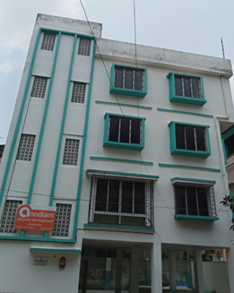


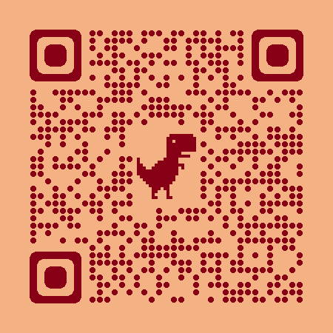

Coaching Classes
ARTIFICIAL
INTELLIGENCE
& IoT
NEET &
IIT-JEE
(Mains & Adv)
Edtech App
Top-quality Teachers
400+ Courses
Study Materials, PTM, Counselling
Mock Tests, Doubt Clearing
Smart Classrooms, AC, CCTV
International Management
VIII-XII
ICSE/CBSE/WB
ALL SUBJECTS
IT TRAINING
& PROJECTS
BCom, BBA,
CA, CMA, CS, CFA
Spoken English
Grooming
Bring a friend & get
50% OFF
Multiple Subjects
50% OFF
Scan &
Follow for
Discounts
N-1/25 Kunal Road, Patuli, Kolkata 700094, Near Fire Brigade & Krishi Vikas
9073 700094
www.anodiam.com || anirban@anodiam.com

Slide 3

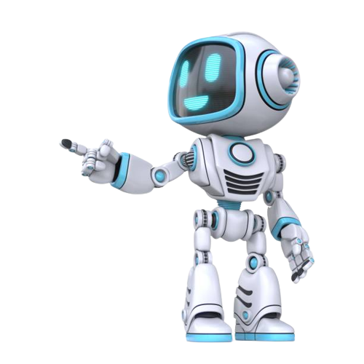



IT/AI Training & Projects
Python, Data Science & AI, Data Analytics
Computer Vision, NLP, DSP, IoT, Robotics
Java, Advanced Java, .NET, JavaScript
React, MUI, Native, PHP, WordPress
C, C++, Python, Linux, Shell, CCNA, DevOps
Docker, Kubernetes, AWS, GCP, Azure
MySQL, SQL Server, Oracle, Firebase
Prince2, Agile, Cyber Security, Selenium
MS Office, Adv Excel, Tally, HTML, CSS
Grooming, Interview Prep, Network Hardware
Edtech App
Industry Veteran Trainers, Project-Based
Career Focused, Certification Help
Smart Classrooms, AC, CCTV
Bring a friend & get
50% OFF
Multiple Subjects
50% OFF
Scan &
Follow for
Discounts
N-1/25 Kunal Road, Patuli, Kolkata 700094, Near Fire Brigade & Krishi Vikas
9073 700094
www.anodiam.com || anirban@anodiam.com

Slide 4





Commerce Tuitions
IX – XII CBSE, ICSE, WB
BCom, BBA, CA, CMA, CS, CFA
Interview Prep, Grooming
Spoken English, Ielts, Toefl
Edtech App
Finest Teachers from Best Institutes
Career Focused, Doubt Clearing, Counselling
Smart Classrooms, AC, CCTV
Bring a friend & get
50% OFF
Multiple Subjects
50% OFF
Scan &
Follow for
Discounts
N-1/25 Kunal Road, Patuli, Kolkata 700094, Near Fire Brigade & Krishi Vikas
9073 700094
www.anodiam.com || anirban@anodiam.com

Slide 5





NEET, IIT-JEE, Class VIII-XII
NEET
IIT-JEE (Mains & Adv)
VIII-XII – ICSE/CBSE/WB
Science, Arts, Commerce
Edtech App
Finest Teachers from Best Institutes
Doubt Clearing, Counselling
Smart Classrooms, AC, CCTV
Bring a friend & get
50% OFF
Multiple Subjects
50% OFF
Scan &
Follow for
Discounts
N-1/25 Kunal Road, Patuli, Kolkata 700094, Near Fire Brigade & Krishi Vikas
9073 700094
www.anodiam.com || anirban@anodiam.com

Slide 6


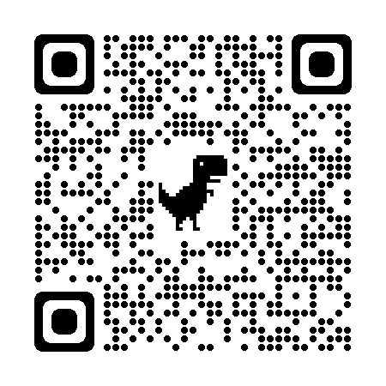
N-1/25 Patuli, Kol 94
Near Patuli Fire Brigade & Krishi Vikas
9073 700094
NEET & IIT-JEE
VIII-XII – All Subjects & Boards
AI / IT – School-Students to Engineers
BCom, BBA, CA, CMA, CS, CFA
Grooming-Interview, Spoken, Ielts, Toefl
Study Materials, 400 Courses, 20 Classrooms
Best Teachers, Doubt Clearing, Mock Tests, PTM, Counselling
Proj-Based, Certification Help, Career Focused
Smart Classrooms, AC, CCTV * As required
Own Edtech App
50%
Off
Scan &
Follow for
Discounts
Study multiple subjects
Or just bring in a friend
& get up to
Education that enlightens!

