Slide 1



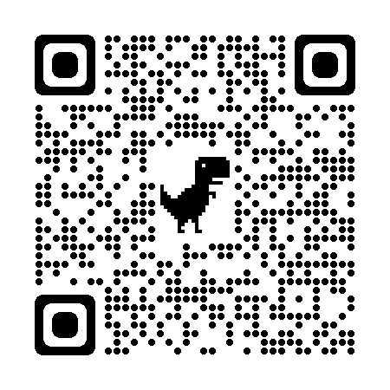



Scan & follow on for Discounts
Bring a friend & get
50% OFF
Multiple Subjects
50% OFF
www.anodiam.com || anirban@anodiam.com

