Slide 1


The Edtech that creates possibilities beyond
barriers through innovation & empathy.
Business Introduction
Ananya Moitra
Marketing Head
ananyaloveslife@gmail.com
+61 405706206

Slide 2






Education System Needs Our Help
?
Learning is fun, still so many kids dislike school
Yale university research says 75% US kids - tired, stressed & bored
Small attention span; yet repetition impossible
Most kids don’t have time left for sports etc.
Disruptions due to absenteeism, pandemic.
Education system needs the Edtech evolution
300 – 3000 year old system: not very innovative & expedient
Top-down approach: could be more empathetic towards students
Capped by numbers: should be scaled up leveraging technology
Education has to be cost effective for the future community
Flaws of tuition classes (online & in person)
Most students cannot access the best teachers and materials
Often lacks consistency, dependability & comprehensive coverage
Lacks convenience of time, repeatability etc.
Not affordable for many parents
Drawbacks of competitors
Lack high quality, focussed content with comprehensive coverage
Unsuitable for a wide range of merit levels
Inflated price, misleading ads & pressure sales scandals
Toxic work culture
PC: news.yale.edu Jan 2020

Slide 3




Anodiam Model: Connecting Most Students to the Best Education
Content Team
Students
High Quality Contents:
Video,
& non video
Anodiam mobile app & web site
Exceptionally well designed, user centric, cloud based
Registered students/parents purchase listed courses online
Students learn in own time, pace & comfort; raise queries
Queries resolved within 3 business days
Highest quality content to ensure genuine learning
Professional pre-recorded content: engaging, fun, in-depth
Exam oriented comprehensive coverage of syllabus
80% video & 20% non-video (notes, diagrams)
Self tests, repeat until perfection, no red ink
Value driven business model for maximum returns
Ensure students & parents find us dependable
Affordable, demand driven, AI based pricing for optimum sales
Extensive marketing
Teachers
Constant
Assistance
Queries
Resolutions
Ratings & feedback
Film Crew &
Head Teachers
Platform Dev & Support
Platform Dev & Support
$
Platform Team
IT, Marketing
Operations etc.

Slide 4
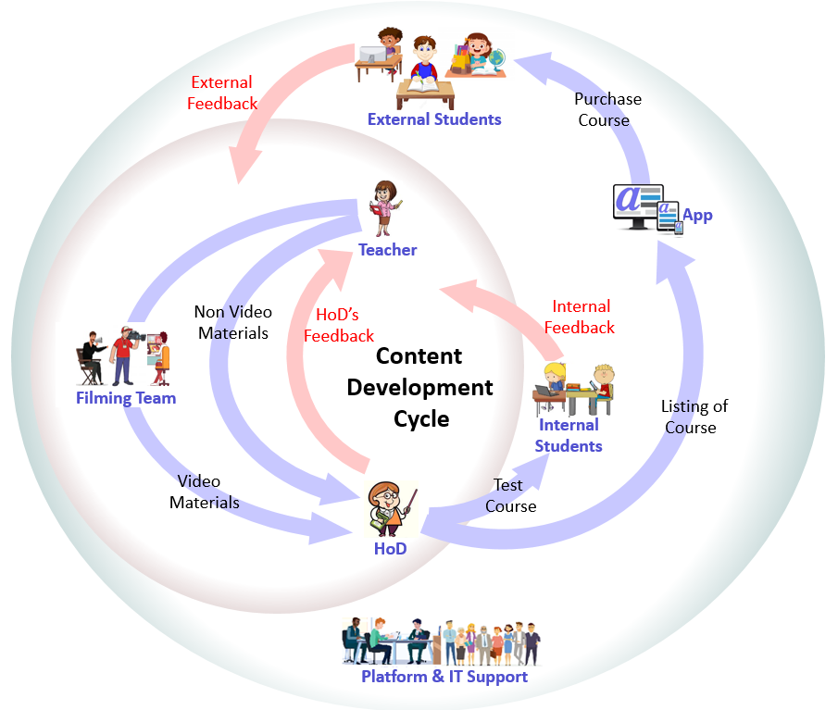


Content Quality is Our Game Changer
Sophisticated quality lifecycle
Professional feedback based management at all levels
Systematic version management
Internally tested with real students
Ensure better grades for students of all merit levels
You would wish, you were taught like this
Official training video from Google Cloud
Very lucid & engaging physics teaching from Vedantu
Maths tutoring on Youtube
Minimize every scope of improvement
Monotonous for school students
Unnecessary over use of graphics & incorrect English
Rushed through conceptual topics at very high speed

Slide 5




Technology and Apps
Content
Creation App
Anodiam
App & Website
Admin
Apps
IT landscape
Anodiam app & website for students
Content creation & quality control app
Teachers’ query resolution and student support app
External integration (Ops, Sales, Marketing, HR)
Tech stack
App Dev: Java Spring Boot, Hibernate, MySQL
Mobile Dev: React Native
Cloud & Containerization: GCP, Kubernetes
CI/CD, DevOps: Ansible, Jenkins
Cyber Security
UX: Bootstrap, JavaScript
Analytics, Data Science & AI
Software development centre
Highly skilled resource pool at moderate rates
Convenient location in Bangalore
Google
Kubernetes
Engine
Ingress
Prometheus
Monitoring
Frontend
Cloud SQL
REST API
Google Cloud
Storage
Google Cloud

Slide 6
Business Model
$
Affordable pricing to optimize sales & maximize profit
Dynamic unit sale price as per market conditions at any moment
This will generate maximum profit by optimizing sales volume
Discount offers used to adjust unit sale price of the courses
AI based pricing model to automate the above steps
Student oriented & value driven
Ensure students & parents find us dependable
Costumer retention & repeat business is high priority
Highly quality focused and best value for money
Demand driven rollouts - high return & low risk
Periodically consider new high demand markets
Perform extensive research on opportunities vs risks
Prioritize on the basis of high returns vs low risk
March
July
November
March
$
Offer Price of Courses in INR(₹)
Minimum Price | 5,000
Mean Price | 7,300
Median Price | 7,000
Maximum Price | 10,000
** 1₹ = 0.017US$

Slide 7
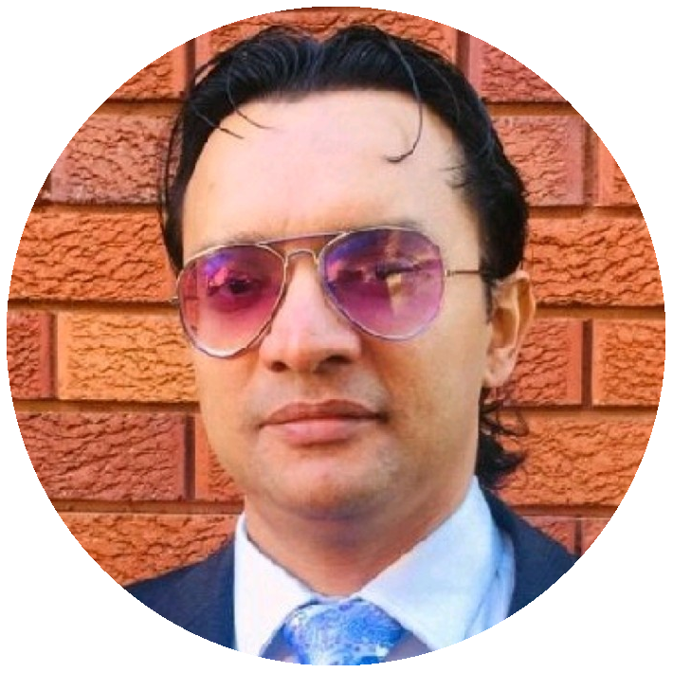

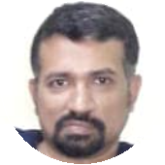
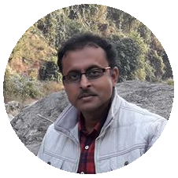
Core Team
Anirban Chakrabarty
Innovation Lead
Empathetic innovator with expertise in Cloud Technologies, Artificial Intelligence, Project Management & Design Thinking.
Vivek S Bendre
IT Head
IT entrepreneur with experience in setting up multiple off shore delivery centers from scratch. Presently CEO, of FluxionBits, Bangalore
Debasish Dutta
Academic Head (Proposed)
26 years of teaching experience in internationally reputed schools like La Martiniere Calcutta. Students love his teaching style because he understands their perspective.
Ananya Moitra
Marketing Head
25 years of experience in promoting & campaigning products & services across geographies. A noted poet & musician. Has an MBA in Finance.
Parag Biswas
Content Development Head (Honorary)
Award winning film maker, TV reporter, actor, anchor, quiz master, commentator & school teacher.

Slide 8

Where We Stand Now
Work in Progress
IT development set up at Bangalore
App & DevOps prototyping in progress
Pilot phase of content creation successful
Content dev cycle & QC process established
Pandemic mitigation plan established
Resources Available
Talented teachers & head teachers from premier institutes
Seasoned filming team & graphic artists
Experienced IT & management team
Studio floor of 5000 square feet in Kolkata
Studio setup: lighting, recording, light board etc.
Challenges
Most resources are part time business partners
Full time employees would be easier to manage
Require investment in equipment & infrastructure
Funding required for marketing & campaign

Slide 9




Rollout and Marketing
Launch: CBSE – X, XII – Maths & Computer Science
High demand, high return business, very low risk
Tuitions are most sought after for critical subjects in exam years
Relatively easy to find great teachers
Marketing Plan
Initial focus on digital marketing
Long term focus on traditional marketing
Flagship Launch: ICSE, CBSE – V to XII – All subjects
Huge market: More than 50 million students
~76% seek private tuitions, some more than 14 hrs per week
Kids’ education is highest priority for families
Affluent middle class, parents spend up to A$4K a year
High quality education inaccessible to many
Demand at both metro & remote areas
Prevailing tuition culture: content production easy
Global Rollout
Carry out market analysis for different geographies
Prioritize high demand & less risk businesses
IT to be mostly reused, only new content to be created

Slide 10

Financial Prospects
Financial plan - unicorn in only 5 years
~2.1 million students in ICSE & CBSE in each class
About 8 subjects in each class from V to XII
Sales target: 1 course per 100 students & double it each year
Revenue projections $1.04 bn in just 5 years
Edtech is the new fintech
Young and fastest growing industry, just 8-10 years old
21 unicorns & 2 decacorns, total valuation A$80 bn
E learning to be A$445 bn by 2025, A$1.4 tn by 2027 - Forbes
Byju’s incepted in 2013 & already valued at A$17.5 bn
Unacademy started in 2015, valued at A$3.4 bn
Never-ending, global prospect
Consistently increasing global demand for high quality education
Low risk, low investment & high returns
Repeated sales & business from existing courses over many years
Only ~10-55% maintenance & enhancement cost per year
$
$1 billion!
Launch 1 2 3 4 5 6

Slide 11
Return on Investment
$
Budget: ₹ 1 Crore in four months
Break even selling less than 1400 courses (~3 months)
Mean unit price of course: ₹7,300/-
Just 1 sale required per ~3,000 target students to break even
50% yearly gain promised on investment
million US$
0 1 2
Years
$

Slide 12


