Slide 1

Let’s Break the Ice
Presenter: Ananya Moitra, Anirban Chakrabarty
Date: Feb-2021
Contents: About Us, Mission & vision
How It Works
About Anodiam© App
Course Listing Requirements
Artefacts & Contents
Video Contents
Non Video Contents
Query Resolution
Key Stakeholders & Synergy
Quality Is Never an Accident
Traditional Education Systems vs. Us
Taking Responsibility of Our Students
Win-Win Situation
Artificial Intelligence Based Pricing
Revenue Potential & Sales Targets
Payouts
Platform Development Roadmap
Terms and Conditions
FAQs

Slide 2


About Us:
An Australian edtech endeavour
Mission & Vision:
Creating a world of possibilities for everyone beyond barriers & boundaries through innovation & empathy

Slide 3









How It Works
Create courses: Video, non video contents and automated tests
Queries
Teachers
Resolutions
Constant assistance
Students
Rate courses
Purchase courses on Anodiam© app
Learn online in own time, pace and comfort
Cannot download materials that are not open
Team Members, Reviewers, Videographers

Slide 4

About Anodiam© App
Courses listed online in Anodiam© mobile app / website
Registered students / parents can purchase courses online
Courses correspond to complete syllabus for a board, subject & class
No bulk breaking: don’t provide materials for particular topics separately
Great, in depth coverage of syllabus
Professionally planned
Highest quality
Thoroughly exam oriented

Slide 5

Initial Launching Courses for India
Boards
ICSE
CBSE
Class 9 | Class 10 | Class 11 | Class 12
English | English | English | English
Physics | Physics | Physics | Physics
Chemistry | Chemistry | Chemistry | Chemistry
Mathematics | Mathematics | Mathematics | Mathematics
Computer Science | Computer Science | Computer Science | Computer Science
Biology | Biology | Biology | Biology
Geography | Geography | Geography | Geography
 |  | Accountancy | Accountancy
 |  | Economics | Economics

Slide 6

Course Listing Requirements
Anodiam© courses should ensure for students:
Best possible genuine learning
Highly engaging
Grades improvement & optimum support for each student
Most meritorious students should secure ranking grades
All listed courses should be:
Approved through all stages of quality control
Updated and upgraded at fixed periodicity
Suggestive exam questions
Students’ queries and feedbacks
Changes in syllabus

Slide 7

Artefacts & Contents
Types of Artefacts, Contents or Deliverables
Video Materials / Contents
Non video Materials / Contents
Query Resolution
Schemes of Work (AKA Schema)

Slide 8

Video Contents
Teacher will teach similar to traditional classrooms
Thoroughly planned, professional and quality controlled content
Recorded once and streamed on demand in App, NOT DOWNLOADABLE
No repetitive task, teachers can utilize time in value added tasks
Students can watch repetitively
Can watch in own pace (0.5X – 2X), time and comfort
Contents updated regularly to ensure quality improvement

Slide 9

Non Video Contents
Notes, mnemonics, diagrams, charts, cheat sheets, flash cards, key points, transcripts, sample question answers, worked out examples etc.
Usually images or documents, some are printable, downloadable
Uploaded into App, students can utilize as and when required
Contents updated periodically to ensure regular quality improvement

Slide 10

Query Resolution
Students will raise queries and doubts for the teachers in Anodiam© app
Teachers to resolve each query in 3 working days. Assistant teachers required if
Number of students grow
Number of queries grow
Academic reviewer will help when teacher is on leave
Assistant teachers required when both on leave
Payment for Assistant teachers will be adjusted from the growing revenue
Resolution can usually be texts, documents or images sent back to query raising student’s profile
In case of similar queries by multiple students, teacher may update course with a new content (video or non video as required)
Academic reviewer guide when content needs to be updated due to similar queries

Slide 11

Some Example Videos
Real Good Ones
Data Storage in Google Cloud: https://www.youtube.com/watch?v=8DMOJ6Lgm7s&list=RDCMUCJS9pqu9BzkAMNTmzNMNhvg&index=4
Percentage https://www.youtube.com/watch?v=JeVSmq1Nrpw
Catch What Is Wrong in These
https://www.youtube.com/watch?v=2vMEQ5zs1ko
https://www.youtube.com/watch?v=3CoCsDrBsYs
https://www.youtube.com/watch?v=kKKM8Y-u7ds&t=151s

Slide 12












Quality Is Never an Accident
Teacher
Syllabus review cycle
2
Syllabus
1
Students
Interactive
Learning
Feedback
4
3
Non video schema review cycle
Non video schema
19
6
5
Non video contents review cycle
Non video contents
7
Upload
Academic Reviewer
App
9
8
18
Video Schema review cycle
Video schema
Upload
16
17
10
Schema discussion
Rehearsals & Confirmation
Video contents review & approval
Video contents
15
Graphics
discussion &
agreement
13
11
Approval
Filming
13
Final films
14
Raw films
12
Film Crew
Film Reviewer
Graphic Illustrator

Slide 13

Key Stakeholders & Synergy
Students
Platform Team
Application Development
IT Support
Cloud Infra
Asst. Teachers
Legal Team
Finance Team
Sales & Marketing
HR & Recruitment
Platform Managers
Content Team
Teacher
Academic Reviewer
Videographer
Film Director
Film Editor
Film Reviewer
Admin Manager
Office Admin
Education
Team
Anodiam©

Slide 14
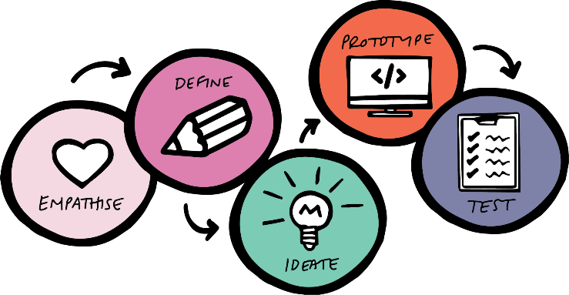

Traditional Education Systems vs. Us
Command & Control vs. Service & Empathy
Design thinking: Start with exactly what our students need
Top-down vs. Bottom-up
Head of the organization is a servant leader
Un-inclusive Vs Inclusive
We want to touch as many lives as possible
Our numbers are not capped
Your voice will be heard
Innovation lifecycle and ideation drives

Slide 15
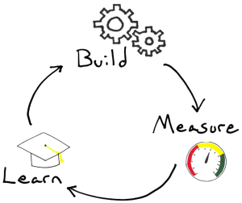
KPAs
Genuine Learning
Increasingly engaging courses: Automated analytics, Rating by students & parents
Exam Oriented: Complete coverage and depth: Improve grades
Ensure Quality
Quality Control cycles
Query resolution: Teacher student connection
Taking Responsibility of Our Students

Slide 16

Win-Win Situation
Students
Best quality courses & query resolutions: Improve grades
Automated feedbacks on practice tests: Repetition until perfection
Learn in own time, pace and comfort: Reduce time & energy waste
No red ink policy
Parents
Reduce dependency on traditional supplementary education
Receive automated reports and analytics
One stop solution: Peace of mind
Internal Stakeholders
Ongoing and unlimited career growth
No repetitive work: Touch more lives instead
Job satisfaction
Money and time freedom

Slide 17
Artificial Intelligence Based Pricing
Unit price of courses will be variable and not fixed
AI algorithm will decide course price and aim to maximize
Total profit
Numbers of courses sold
Discount sales schemes will include:
Offer prices
Coupons
Scholarships
Flash sales
Buddy schemes
Etc.
‘M’ shaped seasonal curves with periodicity of 1 year
Unit Pricing (₹) of Courses
Min Price | 1,099.95
Target Q1 Price | 2,199.95
Target Mean Price | 2,899.95
Target Median Price | 4,399.95
Target Q3 Price | 8,699.95
Max Price | 17,499.95
Upper Outlier | 34,899.95

Slide 18
Revenue Potential & Sales Targets
Courses classified according to total revenue earned as below:
Levels | Revenue Reqd. (₹) | Approx. Students
Launcher | 727,700 | 250
Starlet | 2,910,800 | 1000
Celebrity | 11,643,200 | 4000
Star | 46,572,800 | 16000
Super Star | Unlimited | Unlimited
Every month all stakeholders to receive payout as a share of the profit
Payouts will vary according to profits made out of the sales revenue

Slide 19
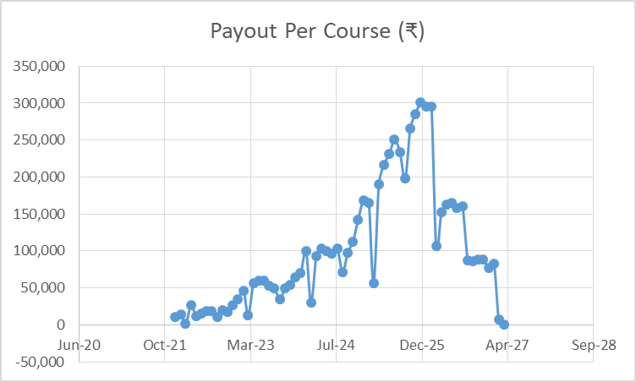
Teachers’ Payout Per Course
Teacher’s share per level of the course (₹):
Every month all stakeholders to receive payout as a share of the profit
Payouts will vary according to profits made out of the sales revenue
Stakeholder’s payouts for a sales volume will be paid in 3 instalments:
50% on immediate month
25% after 6 months of supporting the students
Last 25% after 1 year of supporting the students
Levels | Approx. Students | Teacher's Share
Launcher | 250 | 91,690
Starlet | 1000 | 320,916
Celebrity | 4000 | 1,054,437
Star | 16000 | 3,255,002
Super Star | Unlimited | Unlimited

Slide 20
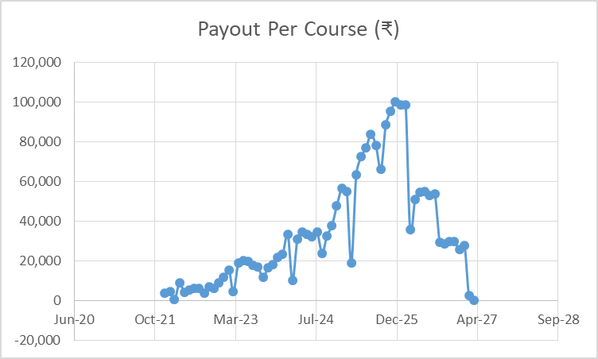
Academic Reviewers’ Payout Per Course
Academic Reviewers’ share per level of the course (₹):
Every month all stakeholders to receive payout as a share of the profit
Payouts will vary according to profits made out of the sales revenue
Stakeholder’s payouts for a sales volume will be paid in 3 instalments:
50% on immediate month
25% after 6 months of supporting the students
Last 25% after 1 year of supporting the students
Levels | Approx. Students | Academic Reviewers’ Share
Launcher | 250 | 30,563
Starlet | 1000 | 106,972
Celebrity | 4000 | 351,479
Star | 16000 | 1,085,001
Super Star | Unlimited | Unlimited

Slide 21
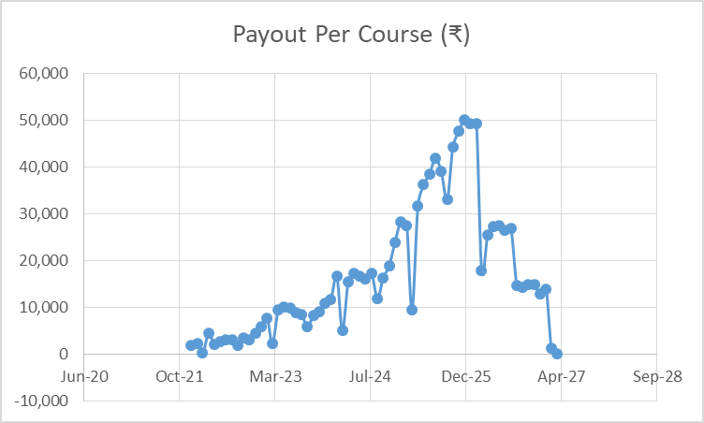
Videographers’ Payout Per Course
Videographers’ share per level of the course (₹):
Every month all stakeholders to receive payout as a share of the profit
Payouts will vary according to profits made out of the sales revenue
Stakeholder’s payouts for a sales volume will be paid in 3 instalments:
50% on immediate month
25% after 6 months of supporting the students
Last 25% after 1 year of supporting the students
Levels | Approx. Students | Videographers’ Share
Launcher | 250 | 15,282
Starlet | 1000 | 53,486
Celebrity | 4000 | 175,740
Star | 16000 | 542,500
Super Star | Unlimited | Unlimited

Slide 22
Film Directors’ Payout Per Course
Film Directors’ share per level of the course (₹):
Every month all stakeholders to receive payout as a share of the profit
Payouts will vary according to profits made out of the sales revenue
Stakeholder’s payouts for a sales volume will be paid in 3 instalments:
50% on immediate month
25% after 6 months of supporting the students
Last 25% after 1 year of supporting the students
Levels | Approx. Students | Film Directors’ Share
Launcher | 250 | 15,282
Starlet | 1000 | 53,486
Celebrity | 4000 | 175,740
Star | 16000 | 542,500
Super Star | Unlimited | Unlimited

Slide 23
Graphic Illustrators’ Payout Per Course
Graphic Illustrators’ share per level of the course (₹):
Every month all stakeholders to receive payout as a share of the profit
Payouts will vary according to profits made out of the sales revenue
Stakeholder’s payouts for a sales volume will be paid in 3 instalments:
50% on immediate month
25% after 6 months of supporting the students
Last 25% after 1 year of supporting the students
Levels | Approx. Students | Graphic Illustrators’ Share
Launcher | 250 | 30,563
Starlet | 1000 | 106,972
Celebrity | 4000 | 351,479
Star | 16000 | 1,085,001
Super Star | Unlimited | Unlimited

Slide 24
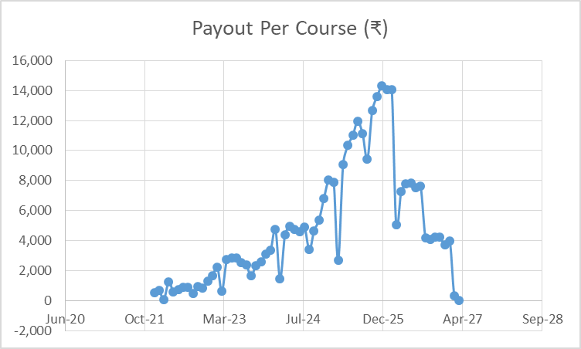
Film Reviewers’ Payout Per Course
Film Reviewers’ share per level of the course (₹):
Every month all stakeholders to receive payout as a share of the profit
Payouts will vary according to profits made out of the sales revenue
Stakeholder’s payouts for a sales volume will be paid in 3 instalments:
50% on immediate month
25% after 6 months of supporting the students
Last 25% after 1 year of supporting the students
Levels | Approx. Students | Film Reviewers’ Share
Launcher | 250 | 4,366
Starlet | 1000 | 15,282
Celebrity | 4000 | 50,211
Star | 16000 | 155,000
Super Star | Unlimited | Unlimited

Slide 25
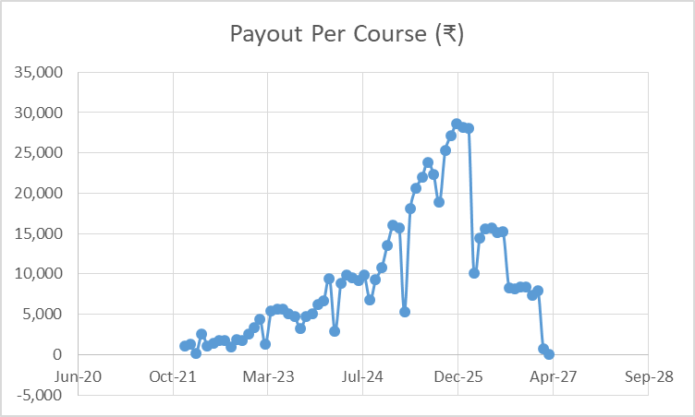
Content Managers’ Payout Per Course
Content Managers’ share per level of the course (₹):
Every month all stakeholders to receive payout as a share of the profit
Payouts will vary according to profits made out of the sales revenue
Stakeholder’s payouts for a sales volume will be paid in 3 instalments:
50% on immediate month
25% after 6 months of supporting the students
Last 25% after 1 year of supporting the students
Levels | Approx. Students | Content Managers’ Share
Launcher | 250 | 8,732
Starlet | 1000 | 30,563
Celebrity | 4000 | 100,423
Star | 16000 | 310,000
Super Star | Unlimited | Unlimited

Slide 26

Platform Development Roadmap
Monolithic Web Apps
Teacher, Admin Student App
Deployment & Hosting
Containerization & Monitoring
Cyber Security
Automation, Pen & Load Testing
Backup & Recovery
Mobile Apps
Web Services
Student App
Automatic MCQ
Query & Resolution Module
Reviewer Web Apps
Academic & Film Reviewers
Supporting Web Apps
Film Crew
Graphic Illustrators
Managers, Admin
HR, Legal
Finance & Accounts Apps
Partner Payout
Cost Center Management
Analytics & Artificial Intelligence
AI Based Course Pricing
Analytics for Teachers
Analytics for Corporate
Patents & Students Reporting

Slide 27

Legal Terms & Conditions
All Stakeholders Must Abide by the Following:
(s)he must be law abiding person with no pending legal litigations
Must consent to and clear police verification / background check in all countries of stay
Must consent to and clear drug test
Must consent to and clear working with children check in the respective countries
Must live a simple, respectable life appropriate for a teacher in the respective community
Must not be involved in any controversial politics, religious belief, sexuality etc.

Slide 28

Business Terms & Conditions
All Stakeholders Must Abide by the Following:
Must sign a Non Disclosure Agreement with Anodiam© for the protection of:
Anodiam’s proprietary content
Personal information of students, parents or other stakeholders of Anodiam©
Must not be involved in any kind of plagiarism in producing the course content
Content must not contain any direct or indirect mentioning of:
Political views or agenda
Religious beliefs
Sexuality and lifestyle choices
Employee separation, leave, promotions, payouts and other organizational processes must follow Anodiam© defined policies

Slide 29

FAQs
When are you going to start the work? What stage are you in now?
Will I be paid as an employee? Or shall I be a profit sharing partner?
When am I going to start earning? How much can I earn?
How much time do I need to devote?
How am I going to answer the queries raised by the students?
How will I support all the students when number gets large?
Which board, subject and class shall I teach?
How will my created contents be protected from piracy?
How shall I check answer sheets?
What is the leave policy?
What is the exit / separation policy?

Slide 30


