Slide 1


The EdTech that creates possibilities beyond
barriers through innovation & empathy.
Company Introduction
Ananya Moitra
Marketing Head
ananyaloveslife@gmail.com
+61 405706206

Slide 2






Education System Needs Your Help
?
Learning is fun, still so many kids dislike school
Yale university research says 75% US kids - tired, stressed & bored
Small attention span; yet repetition impossible
Most kids don’t have time left for sports etc.
Disruptions due to absenteeism, pandemic.
Education system needs the EdTech evolution
300 – 3000 year old system: not very innovative & expedient
Top-down approach: could be more empathetic towards students
Capped by numbers: should be scaled up leveraging technology
Education has to be cost effective for the future community
Flaws of tuition classes (online & in person)
Most students cannot access the best teachers and materials
Often lacks consistency, dependability & comprehensive coverage
Lacks convenience of time, repeatability etc.
Not affordable for many parents
Drawbacks of competitors
Lack high quality, focussed content with comprehensive coverage
Unsuitable for a wide range of merit levels
Inflated price, misleading ads & pressure sales scandals
Toxic work culture
PC: news.yale.edu Jan 2020

Slide 3




Anodiam Model: Connecting Most Students to the Best Teachers
Content Team
Students
High Quality Contents:
Video,
& non video
Anodiam mobile app & web site
Exceptionally well designed, user centric, cloud based
Registered students/parents purchase listed courses online
Students learn in own time, pace & comfort; raise queries
Queries resolved within 3 business days
Highest quality content to ensure genuine learning
Professionally managed content: engaging, fun, in-depth
Exam oriented comprehensive coverage of syllabus
80% video & 20% non-video (notes, diagrams)
Self tests, repeat until perfection, no red ink
Value driven business model for maximum returns
Ensure students & parents find us dependable
Affordable, demand driven, AI based pricing for optimum sales
Extensive marketing
Teachers
Constant
Assistance
Queries
Resolutions
Ratings & feedback
Film Crew &
Head Teachers
Platform Dev & Support
Platform Dev & Support
$
Platform Team
IT, Marketing
Operations etc.

Slide 4

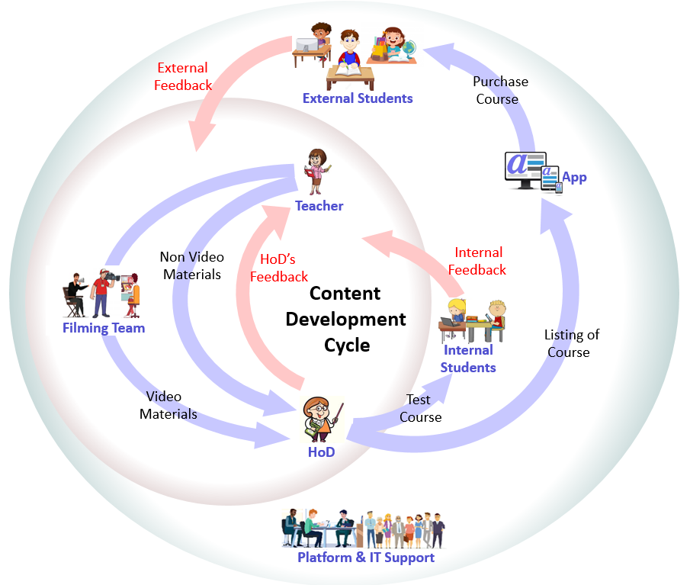


We Ensure Quality at Every Step
Feedback based content development
Courses developed with internal & external feedback at all levels
Each course tested with real students
Ensure better grades for students of all merit levels
You would wish, you were taught like this
Official training video from Google Cloud
Very lucid & engaging physics teaching from Vedantu
Maths tutoring youtube video
Only the highest quality standards for our content
Corporate training, a bit monotonous for school students
Unnecessary over use of graphics & incorrect English
Rushed through conceptual topics at extremely high speed
Work in progress
Professional, global IT & management team
Studio setup in Kolkata: lighting, recording, light board
Pilot phase of content creation successful
Content development & quality control process established

Slide 5



Your Career Potential with Our Long Term Rollout Plans
Initial Launch: CBSE – X, XII – Maths, English & Computers
High demand, very low risk
Tuitions are most sought after for critical subjects in exam years
Flagship Launch: ICSE, CBSE – V to XII – All subjects
Huge market: More than 50 million students
~76% seek private tuitions, some more than 14 hrs per week
Kids’ education is highest priority for families
Demand at both metro & remote areas
Marketing Plan
Initial focus on digital marketing
Long term focus on traditional marketing
Your Long Term Global Career Prospects
We carry out market analysis for different geographies
Prioritize high returns & less risk businesses
You get infinite scope to grow your career with us
Edtech is the New Fintech
Young & unsaturated industry with high demand certainty
Total valuation A$80 bn, 21 unicorns & 2 decacorns in just 7 years
Forbes says e-learning to be A$445 bn by 2025, A$1.4 tn by 2027
1 billion!
$

Slide 6


