Slide 1
International Edtech App, recruiting in Kolkata for ICSE & CBSE, major subjects, IX to XII.
Multi million dollar career opportunity for those who can create finest video lessons that are:
> Fun & engaging
> Exam oriented & in-depth
Whatsapp CV for interview / audition to +61 470 142 229.

Slide 2
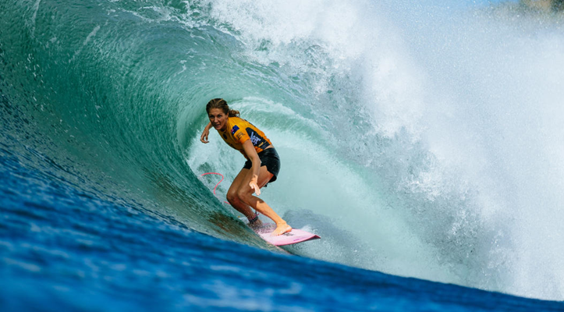

Do you have the fire?
Join us to create premium quality pre-recorded content to become a celebrity teacher!
E Learning industry growing to $325 Billion By 2025 – Forbes
🖝🖝 Professional team support, infrastructure & extensive marketing provided.

