Slide 1
Anodiam Teacher App: Wireframes
Link: https://github.com/anodiamadm/Docs > ProjectExecution > BA > SpecsWireframes
Version | Editor | Reviewer | Date | Note
1.0 | AC | AM | 13/11/2020 | Teacher App wireframes

Slide 2
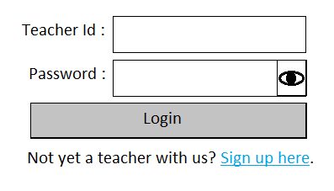
Teacher App: Signup / Login page
Link: https://anodiam.com/teache

Slide 3
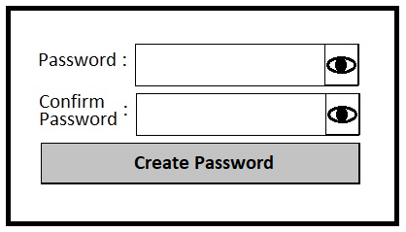
Teacher App: Signup - Confirm Password
Link: https://anodiam.com/teache

Slide 4


#0f0f7f, 40px
nodiam
60px
Type Here
60px
60px
60px
Sign Up
Login
cooper black, 36, #fff
200 px horizontal, 40 px vertical, #fff
Arial, 16, #afafff, Middle alignment
Arial, 18, B, 0f0f7f
Arial, 18, B, 0f0f7f
Logo Reverse colour right aligned. 15 Px gape from the left wall
#6f6fef-67%
#fff-100%, 100 Px,
Header
#6f6fef, 98%, 47%, #fff 1%
Arial, #fff, 14
35 %, #0f0f7f
© 2020 Anodiam All rights reserved

Slide 5
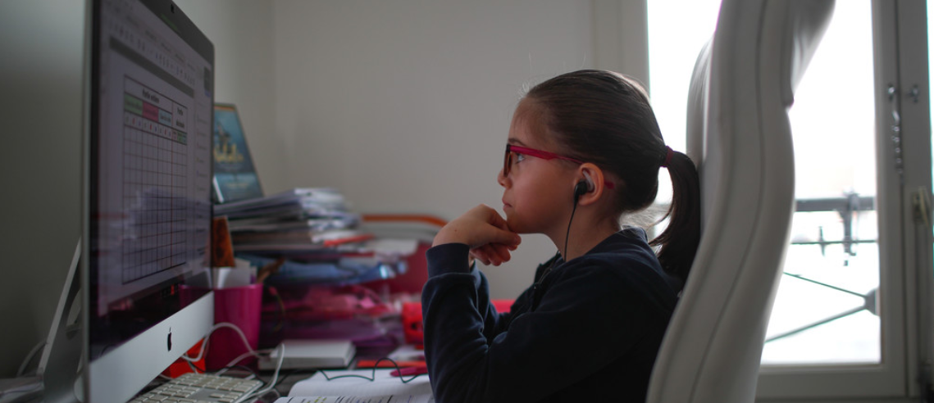
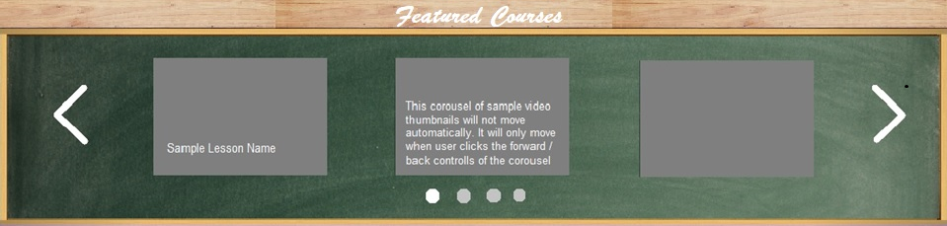
nodiam
Type Here
Sign Up Login
10px
Carousel with notes will display one by one within 4 sec
50 px
10px
Carousel will display 3 featured courses at a time
10px
© 2020 Anodiam All rights reserved

Slide 6


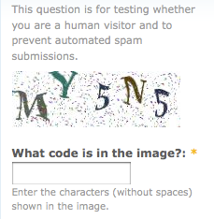
nodiam
#fff when Active, 60 px
Arial, 16, B, #6f6fef
#dfdfff, 400 px
Sign Up
Login
Radio button is Green when Active
Click on the btton if you are the guardian
Arial, 16, #0f0f7f
User Name
User name should contain an Upper case and a special character
Create Password
Password should be 5-15 character
Calibri, 12, I, #2f2faf
Confirm Password
Give a text alert if mismatched
Email ID
Validate with “@”
Confirm Email ID
Give a text alart if mismatched
Mobile No
Arial,14, #0f0f7f (All other lebels will be same )
Cooper black, 20, B, #0f0f7f
Cancelt
Submitt
Captcha

Slide 7
nodiam
10 px
15 px
Home
Log Out
10 px
30 px
Arial, B, 24, #6f6fef , #fff with mouse rollover
Arial, 16, B, #0f0f7f, (#fff with mouse rollover)
120 px
Login
User Name
60 px
Arial, 18, B, #0f0f7f applies for all the lebels
Password
60 px
Email ID
Button fill #6f6fef, button border # 0f0f7f, Arial, 18, B, #0f0f7f (#fff when active)
Submit
120 px
15 px
© 2020 Anodiam All rights reserved

Slide 8


nodiam
Type Here
Home
Log Out
My courses
Profile photo (optional)
Wish list
Cart
© 2020 Anodiam All rights reserved

Slide 9
nodiam
My courses
Maths
algebra
Chaptor 1
chaptor2
Video
Test papers
Physics
Chem
English
Bio

