Slide 1

Python Programming: Introduction & Installation
General Purpose Language:
Machine Learning AI
GUI, Web, Software Dev
Download Install & Run
https://www.python.org
Start > Python IDLE
Write a line of code
e.g. 2+3 OR print(“Hello World”)
Press Enter to execute
Confirm Python installation
Python Features:
Interpreted
Object oriented
High Level
Current version 3.x
Community version of PyCharm IDE
https://www.jetbrains.com/pycharm/download
Install 64 bit (depending on system)
Start > PyCharm > Create New Project > filename.py
+, -, * (multiply), /, % (remainder), **(power), // (integer division)
print(“Answer is: ”, answer)
Run the file
Escape Characters: print("Rupa\'s “Laptop”\n\tWorks very fast!")
CONCEPTION >> PRACTICE >> CONFIDENCE >> HIGHEST GRADES © PROTECTED ANODIAM 2023 || PRIVATE & CONFIDENTIAL

Slide 2
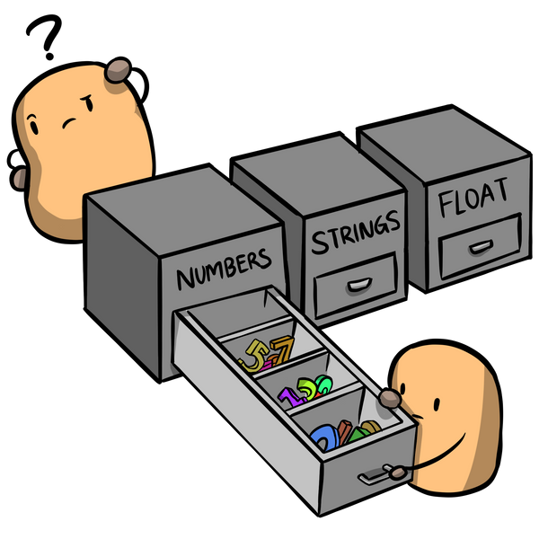
Python Programming: Variables & Strings
Types:
int e.g. 4, 1000, -34 etc.
float e.g. 33.4, -0.0005
string e.g. ‘My friend Tom’, ‘cricket’ etc.
Assignment:
x = 2
name = ‘Rupa’
Strings:
Strings are immutable:
str1 = “My Name”
str1[3] = ‘n’ # Error
A | n | o | d | i | a | m |  | R | o | c | k | s
0 | 1 | 2 | 3 | 4 | 5 | 6 | 7 | 8 | 9 | 10 | 11 | 12 | àindex
-13 | -12 | -11 | -10 | -9 | -8 | -7 | -6 | -5 | -4 | -3 | -2 | -1
CONCEPTION >> PRACTICE >> CONFIDENCE >> HIGHEST GRADES © PROTECTED ANODIAM 2023 || PRIVATE & CONFIDENTIAL

Slide 3
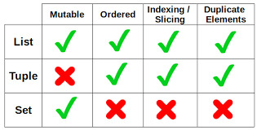
Python Programming: Lists, Tuples & Sets
Lists: [ ]
Mutable
E.g.: myList = [23, 91, 9, 507]
Functions used in List:
append()
insert()
remove()
pop()
clear()
extend()
max(list)
min(list))
sum(list))
sort()
sort(reverse=True)
Tuples: ( )
Immutable
Iteration is faster than list
E.g.: myTuple = (23, 91, 9, 507)
Sets: { }
Like mathematical sets: do not consider
repetition
E.g.: mySet = (23, 91, 9, 507, 91)
Uses hashing for performance
No index for sets
Mutable
Functions used in Set:
add()
remove()
set1.update(set2)
CONCEPTION >> PRACTICE >> CONFIDENCE >> HIGHEST GRADES © PROTECTED ANODIAM 2023 || PRIVATE & CONFIDENTIAL

Slide 4
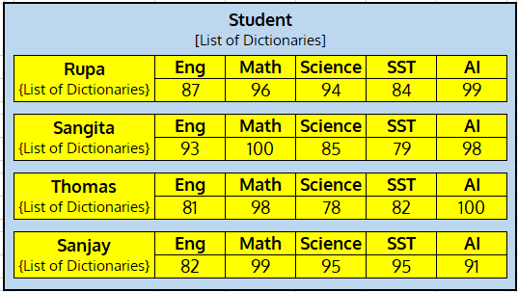
Python Programming: Dictionaries
Dictionaries: { key : value }
Key must be unique and immutable
Key can ne numeric or non-numeric
Access values through key/get( ) function
Can zip 2 lists (key-list & value-list) to form a dictionary
Real Life dictionaries can have nested lists, tuples, sets &
other dictionaries inside
CONCEPTION >> PRACTICE >> CONFIDENCE >> HIGHEST GRADES © PROTECTED ANODIAM 2023 || PRIVATE & CONFIDENTIAL

Slide 5
Python Programming: Variables
Variables Trivia:
num = 3
id(num)
name = ‘Rupa’
id(name)
Two variables assigned same values: a = 5, b=5
id(a) will therefore point to the same memory as id(b)
Constants:
Actually variables with names in CAPS e.g. PI = 3.14
Garbage Collection:
Unused objects and variables are garbage collected by Python
CONCEPTION >> PRACTICE >> CONFIDENCE >> HIGHEST GRADES © PROTECTED ANODIAM 2023 || PRIVATE & CONFIDENTIAL

Slide 6
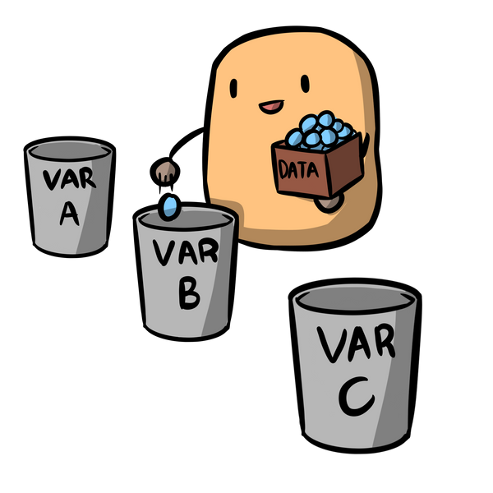
Python Programming: Data Types & Operators
Data Types:
None: var not assigned (null)
Numeric:
Int
Float
Complex e.g. 6+4.5j
Bool True, False
List
Tuple
Set
String
Range
Dictionary
** Character data type absent in Python
Types of Operators :
Arithmetic e.g. + - * / % etc.
Assignment assigning values ( = )
Relational compare two variables ( “>” “<“ “==“ “>=“ “<=“ “!=“ )
Logical “AND” “OR” “NOT”
Unary negating a value
Bitwise “XOR” “<<” “>>” etc.
Sequence
CONCEPTION >> PRACTICE >> CONFIDENCE >> HIGHEST GRADES © PROTECTED ANODIAM 2023 || PRIVATE & CONFIDENTIAL

