Slide 2
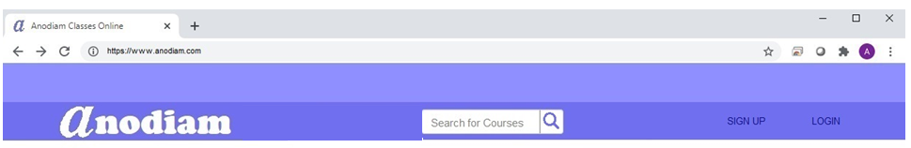
Home Screen: Header: Desktop
Logo
Height: 30px; Length: 240px; Radius: 4px; #fff;
Arial Narrow, Bold, 16; #8f8fff (Active #0f0f7f)
Width: 2px; #6f6fef
Right Aligned;
Arial Narrow, Bold, 16; #0f0f7f (Active, Hover #fff)
50px; #8f8fff
Width:50px; #6f6fef
10px
30px X 30px; Radius: 4px; #dfdfff;
100px
100px
100px
100px
Logo: Reverse Color, Right Aligned; height 50px
Cooper Black, Bold, 32; #fff
&#x1F50D; Ariel Bold 24; #8f8fff (Active #6f6fef)
Home Screen: Header: Responsive

Slide 3
100px; #8f8fff
Arial Narrow, Bold, 12; #0f0f7f

Slide 4

33%; #8f8fff
34%; linier color gradient
Arial Narrow, Bold, 12; #0f0f7f
100px; #8f8fff
33%; #ffffff

Slide 5
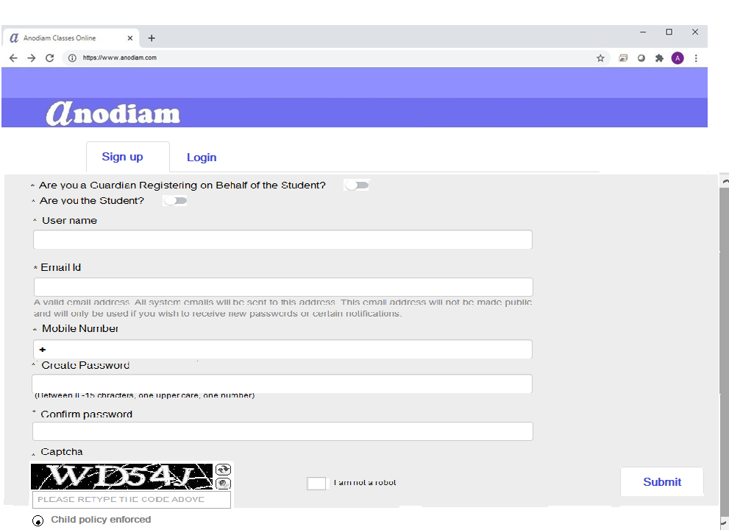
Button, Arial Narrow, Bold, 12; #2f2faf
Arial Narrow , 9; #0f0f7f
Arial Narrow , 9; #4f4fcf,(sam e applies to all other fields)
Arial Narrow, 9; #0f0f7f
Arial Narrow, 9; #0f0f7f
Arial Narrow, 8; #7f7fff
80% , #dfdfff
Plus symbol, Arial Narrow, 9; #0f0f7f
Arial Narrow, 9; #0f0f7f
40px, #8f8fff
Arial Narrow, 8; #7f7fff
Arial Narrow, 9; #0f0f7f
Button, Arial Narrow, Bold, 12; #2f2faf
Arial Narrow, 9; #0f0f7f
check box when blank fill color #ffffff, round, border color 9f9fff, when checked color #0f0f7f
Arial Narrow , 9; #0f0f7f
Tick box when blank fill color #ffffff, square, border color 9f9fff, when ticked color #0f0f7f
Arial Narrow, 9; #0f0f7f

Slide 6
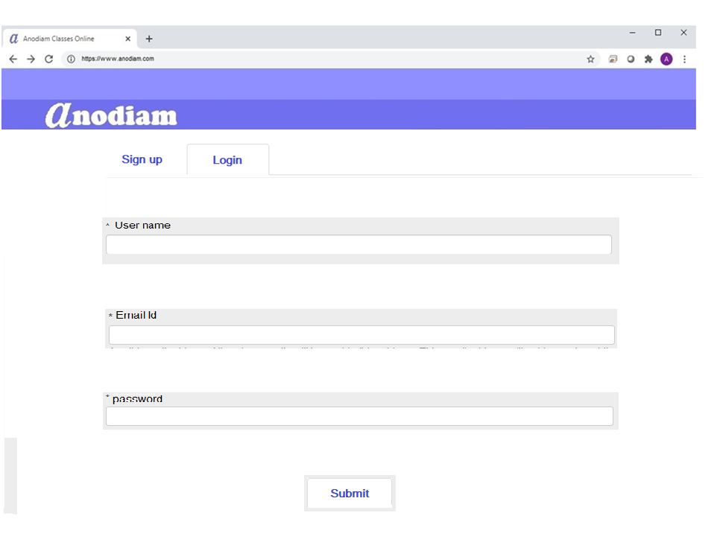
Button, Arial Narrow, Bold, 12; #2f2faf
Arial Narrow, 9; #0f0f7f
80% , #dfdfff
Arial Narrow , 9; #4f4fcf,(sam e applies to all other fields)
Button, Arial Narrow, Bold, 12; #2f2faf

