Slide 1
JAY SIR
Subhamay Dey
History - VIII – XII
Geography - VIII – X
Visual Storyteller
8 Yrs Exp. & Detail Oriented
Caring Like Elder Brother
Loves Teaching
His diligent care helped Trisha score so well !
– Trisha’s mother
Explains well, takes tests & clears all doubts. Excellent!
– Emon Kalsa’s mother

Slide 2
JAY SIR
Subhamay Dey
Accountancy & Business Studies - VIII – XII
Visual Storyteller
8 Yrs Exp. & Detail Oriented
Caring Like Elder Brother
Loves Teaching
His diligent care helped Trisha score so well !
– Trisha’s mother
Explains well, takes tests & clears all doubts. Excellent!
– Emon Kalsa’s mother

Slide 3
Dipanwita Biswas
M.A. (English), B.Ed.
English - VIII
Motherly & Empathetic
Innovative Techniques
Diligent & Adaptive
16 Yrs Experienced
Excellent teacher, I owe so much to this wonderful lady for my career!
– Susanta Das, ex student

Slide 4

Avishek Sir
Avishek Adhikari
Maths - VIII – XII
Cracked IIT, ISI PhD (Ongoing)
8 Yrs Exp. & Detail Oriented
Lots of Successful Students
$\frac{100}{100}$ in Maths in HS & 10th
B.Sc. Math CU 1st Class 1st
M.Sc. Math CU 1st Class 1st
Neel depended on him so much to score !
– Neel’s mother
Explains well, takes tests & clears all doubts. Excellent!
– Emon Kalsa’s mother

Slide 5
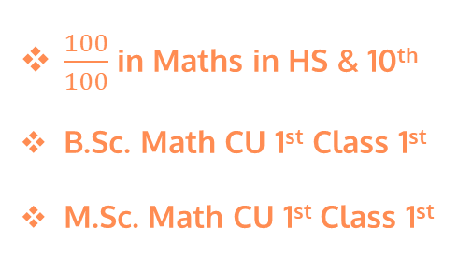
Avishek Sir
Avishek Adhikari
Physics - VIII – XII
Cracked IIT, ISI PhD (Ongoing)
8 Yrs Exp. & Detail Oriented
Lots of Successful Students
$\frac{100}{100}$ in Maths in HS & 10th
B.Sc. Math CU 1st Class 1st
M.Sc. Math CU 1st Class 1st
Neel depended on him so much to score !
– Neel’s mother
Explains well, takes tests & clears all doubts. Excellent!
– Emon Kalsa’s mother

Slide 6
Arijit Sir
Arijit Bhattacharya
accounts - IX – XII (All Boards)
Taught in Gurukul Institution
5 Yrs Exp. & Detail Oriented
Lots of Successful Students
Adrija gots 95% marks in CBSC Accounts
Subham gots 87% marks in CBSC Accounts
Ruchi gots 97% marks in CBSC Accounts

Slide 7
Abhipsha mam
Abhipsha Dutta
Chemistry - XI – XII
B.Ed – WBUTTEPA
Edu Grow Learning App
4 Yrs Exp. & Detail Oriented
M. Sc. Jadavpur University
Tutopia Learning App 2021-22
Lots of Successful Students
Suparna Roy Gupta scored 97% in ICSE absolutely for Her. – Suparna’s mother

Slide 8
K U
Anupam Sir
Anupam Sen
Commerce stream - IX – XII (All Boards)
FCA , ICAI
35 Yrs Corporate Exp.
Build up from grass route
Friendly Caring
Uncountable successful students

