Slide 1
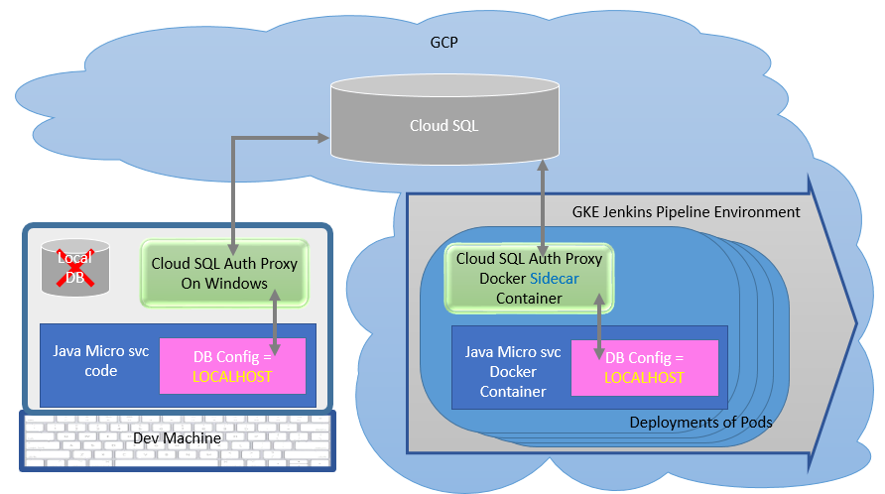
Anodiam CloudSQL Connection Architecture
using
Sidecar Gcloud Auth Proxy Container
In Dev machine:
Install gcloud SDK CLI
Login and Run cloud_sql_proxy
Connect to cloud SQL
No need for local DB
Run DB Scripts
Run Java codes with Junits
Check into git
In GKE Jenkins Pipeline
Check out, build, test
Create Java Micro svc Docker container
Deploy Java Micro svc container to K8s
Deploy sidecar Gcloud Proxy Container
Micro svc can access cloud SQL DB
No config changes required

