Slide 1





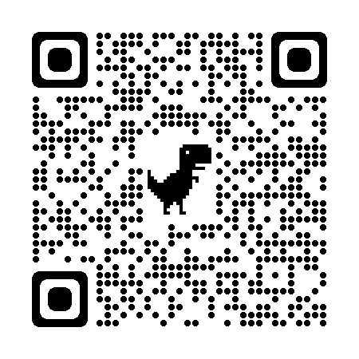






Bring a friend & get
50% OFF
Multiple Subjects
50% OFF
Scan & follow on for Discounts
NEET & IIT-JEE
VIII-XII – All Subjects & Boards
AI & IT – School Kids to Engineers
BCom, BBA, CA, CMA, CS, CFA
Grooming, Spoken Eng, Ielts, Toefl
Own Edtech App
www.anodiam.com || anirban@anodiam.com

