Slide 1

The EdTech that creates possibilities beyond
barriers through innovation & empathy.
Business Introduction
Anirban Chakrabarty
Innovation Lead
1120anirban@gmail.com
+61 470142229

Slide 2


Education System Needs Our Help
Learning is fun, still so many kids dislike school
Yale says 75% students - tired, stressed & bored
Small attention span, but repetition not possible
Scope for better empathy towards students
Most kids don’t have time left for sports etc.
Disruptions due to absenteeism, pandemic etc.
Good schools capped by number of seats
Steep competition to even qualify for quality education
Most private schools are extremely expensive
300 to 3000 year old system needs the EdTech evolution
Easy to implement most futuristic innovation & ideas
Flaws of existing tuition classes & EdTechs
Contents lack consistency, dependability & comprehensive coverage
Student centric design & quality control is missing
Most unsuitable for a wide range of merit levels
Misleading ads & pressure sales scandals are rife
Inflated price, not affordable for many parents
?
PC: news.yale.edu Jan 2020

Slide 3




The Anodiam Solution
Content Team
Students
Create Courses:
Video,
non video &
tests
Exceptionally Well Designed App
User based design, fast, secure, scalable, no downtime
Students learn in own time, pace & comfort
80% video & 20% non-video (notes, diagrams) contents
Queries resolved through app within 3 business days
Self tests, repeat until perfection, no red ink
Performance dashboard for students
Content Created from Students’ Perspective
Before go-live, test each course with real students
Ensure better grades for students of all merit levels
Collect rating & detail feedback
Revamp 5-10% of content quarterly
Comprehensive coverage of syllabus & exam oriented
Highly engaging, fun, in-depth, one stop solution
Highly talented and specialized team
Competitive Pricing
Data based intelligent pricing model
Teachers
Constant
Assistance
Queries
Resolutions
Ratings & feedback
Film Crew &
HoDs
Platform Dev & Support
Platform Dev & Support
Platform Team
IT, Marketing
Operations etc.
$
Notes:
Connecting teacher and student only: Does not leverage the Idea that sourse of education can be recorded and stored
Best teacher does not get connected to many students
Production in quality distribution in quantity
whynot uber-menulog model of just connecting providers and consumers?
Producing in quality, selling in quantity.
(Netflix model) Piracy protection of Anodiam content
Reduce initial funding

Slide 4
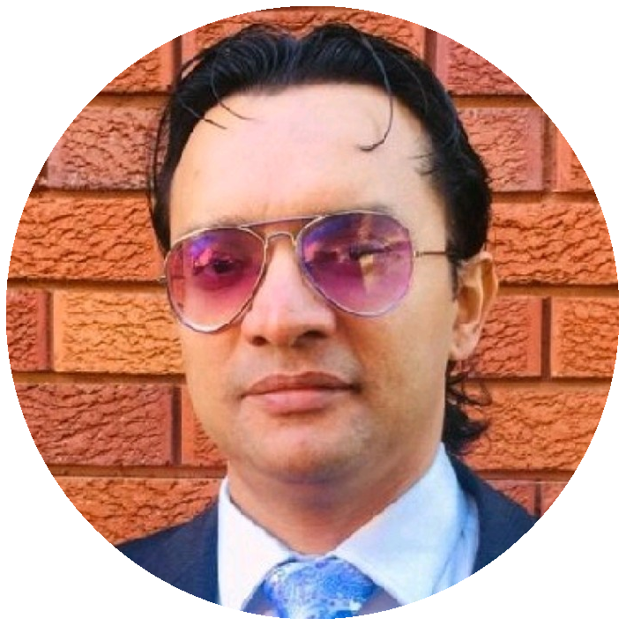

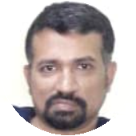
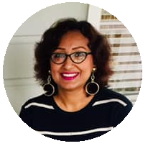
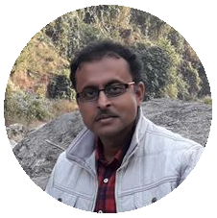
Core Team
Anirban Chakrabarty
Innovation Lead
Empathetic innovator with expertise in Cloud Technologies, Artificial Intelligence, Project Management & Design Thinking.
Vivek S Bendre
IT Head
IT entrepreneur with experience in setting up multiple off shore delivery centers from scratch. Presently CEO, of FluxionBits, Bangalore
Debasish Dutta
Academic Head
26 years of teaching experience in internationally reputed heritage schools like La Martiniere Calcutta. Students love his teaching most because he understands their perspective best.
Ananya Moitra
Marketing Head
25 years of experience in promoting & campaigning products & services across geographies. A noted poet & musician. Has MBA in Finance.
Parag Biswas
Content Development Head
Award winning film maker, TV reporter, actor, anchor, quiz master, commentator & school teacher.

Slide 5
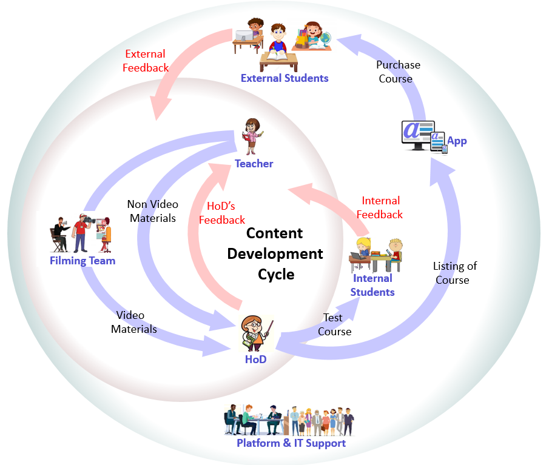

Advancements & Impediments
Work in Progress
IT development set up at Bangalore
App & DevOps prototyping in progress
Pilot phase of content creation successful
Content dev cycle & QC process established
Pandemic mitigation operation plan
Resources Available
HoDs from premier institutions
Talented on-screen teachers
Award wining film makers, youtubers
Professional videographers, graphic artists
Excellent IT & management team
Studio floor of 5000 sqft in Kolkata
Studio setup: lighting, recording, light board etc.
Challenges
Most resources are part time business partners, full time employment would be easier to manage
Require investment in equipment & infrastructure
Need funds for marketing & campaign

Slide 6





Technology
Content
Creation App
Mobile & Web App
Admin
Web App
Tech Stack
App Dev: Java Spring Boot, Hibernate, MySQL
Mobile Dev: React JS
Cloud & Containerization: GCP, Kubernetes, Itsio, Prometheus, Grafana
CI/CD, DevOps: Ansible, Jenkins
Cyber Security
UX: Bootstrap, Java Script, Thymeleaf
Analytics, Data Science & AI: Python, Keras
Tech support
Offshore Development Centre
Highly skilled resource pool
Moderate rates
Convenient location for talent availability
Google Kubernetes
Engine
Ingress
Prometheus
Monitoring
Frontend
PV-MySQL
REST API
Google
Cloud
Storage
Google Cloud

Slide 7



Rollout, Marketing & Campaign Plan
Initial Launch in India: ICSE & CBSE boards
year 9 through year 12 - all major subjects
Huge market for these boards: ~20 million students
~76% seek tuitions, average 10 plus hrs per week
Kids’ education is super high priority for families
Affluent middle class, parents spend up to A$4K a year
High quality education inaccessible to many
Demand at both metro & remote areas
Prevailing tuition culture: content production easy
Marketing Plan
Initial focus on digital marketing
Discount schemes
Long term focus on traditional marketing
Repeat business
Global Rollout Planning
Carry out market analysis for different geographies
Prioritize high demand & less risk businesses
IT to be mostly reused, only new content to be created

Slide 8




Competition & Market Analysis
Proven growth: edtech is the new fintech
21 unicorns and 2 decacorns already
Total valuation above A$77 billion
Low risk, high return & low investment
High profile investors already in business
Extensive & ever increasing demand
Byju’s started in 2013 & already valued at A$17.5 billion
Revenue doubled in FY20 during pandemic
Byju’s recently acquired Akash for A$1.3 billion
Unacademy started in 2015, valued at A$3.4 billion
Drawbacks of competitors
Lacking high quality content with comprehensive coverage
Exam oriented approach missing
Does not help students of all merit levels
Misleading ads & pressure sales scandals
Inflated price, not affordable for most parents
Toxic work culture
$

Slide 9
Business Model
$
Offer Price of Courses in INR(₹)
Minimum Price | 2,000
Mean Price | 7,000
Median Price | 7,500
Maximum Price | 10,000
Data driven offer pricing
Determine optimum offer price for a course
on a given day depending on demand
Ensure maximum profit through optimum sales
AI model to be trained with data from initial cycles
Thoroughly student driven
Ensure students & parents fund us dependable
Costumer retention is high priority
Value for money
** 1₹ = 0.017US$
March
July
November
March

Slide 10
Phenomenal ROI
3 stage roll out in 12 months for ICSE & CBSE
Stage | Duration (months) | Subjects | Content Budget | IT Module | IT Budget | Marketing | Total Cost
1 | 4 | Mathematics Physics Computers | 379,313 | Student App | 553,520 | 186,567 | 1,119,399
2 | 3 | Chemistry Biology | 270,938 | Content Creation App | 374,000 | 128,988 | 773,925
3 | 5 | English Geography Accounts Business | 433,500 | Admin App | 568,480 | 200,396 | 1,202,376
** All amounts in US$ |  |  |  |  |  |  | 3,095,700
Billion dollars in 5 years!!!
Low maintenance cost
US$ 0.619 million @ 20% per year
Very easily covered by the profit made
Low risk
Huge, ever increasing user base
Consistent demand for high quality education

Slide 11


