Slide 1

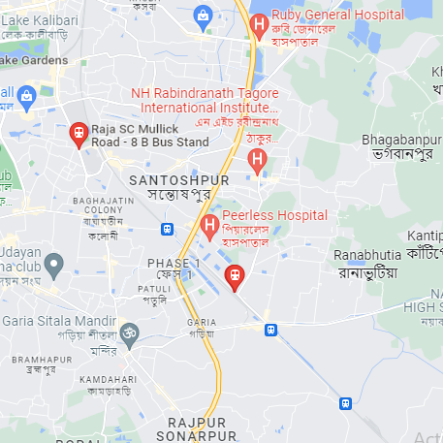
ANODIAM COACHING CENTRE – MANAGEMENT SUMMARY
For Our Students
Our Specializations
About the Institution
Best teachers in town
Individual care for students
Best teaching techniques
Doubt clearing sessions
Extra makeup classes
Regular mock exams
Parent teacher meetings
All round feedback
Career counselling
ICSE / CBSE / WB Board
Class VI to XII
All subjects
NEET / IIT / JEE
Competitive exams
Spoken English & grooming
Professional counselling
Convenient location
4 floors (4000 sqft) area
Open 7 days
15 class rooms
Edtech app by 2023
Management Summary:
2% of students going to all nearby good schools in 10km radius should enrol
Work with the most popular tutors in Kolkata. Also compassionate faculty
Excellent marketing, student relationship, quality control & management
150 – 200 classes per week with total ~3000 – 4000 enrolments targeted
Competitive pricing, optimal expenditure, focus on profitability
Anodiam
CONCEPTION >> PRACTICE >> CONFIDENCE >> HIGHEST GRADES © PROTECTED ANODIAM 2023 || PRIVATE & CONFIDENTIAL

Slide 2
ANODIAM COACHING CENTRE – FOR OUR FACULTY
For Our Faculty Members
For Our Students
Most rewarding package
Astronomical growth
Best talents in the field
Teamwork & synergy
Professional & compassionate
Gratifying environment
Effective marketing support
Proficient management
Feature rich app support
About the Institution
Best teachers in town
Individual care for students
Best teaching techniques
Doubt clearing sessions
Extra makeup classes
Regular mock exams
Parent teacher meetings
All round feedback
Career counselling
ICSE/CBSE/WB VI-XII all subjects
NEET/IIT/JEE competitive exams
Great location, open 7 days
4 floors 4ksqft, 15 class rooms
Spoken English & grooming
Professional counselling
Edtech app by 2023
CONCEPTION >> PRACTICE >> CONFIDENCE >> HIGHEST GRADES © PROTECTED ANODIAM 2023 || PRIVATE & CONFIDENTIAL

Slide 3

nodiam.com
International Coaching Institute – Australia, India
N-25 Patuli, Near Krishi Bikash, Kolkata 700094
☎ 9073 700094
Admissions Open!
Hurry! Introductory offer ends soon!
CONCEPTION >> PRACTICE >> CONFIDENCE >> HIGHEST GRADES

Slide 4

nodiam.com
International Coaching Institute – Australia, India
N-25 Patuli, Near Krishi Bikash, Kolkata 700094
☎ 9073 700094
Admissions Open!
ICSE / CBSE / WB, Class VI – XII, All Subjects
NEET / IIT / JEE Competitive Exams
Spoken English, IELTS, PTE & Grooming
Hurry! Introductory offer ends soon!
CONCEPTION >> PRACTICE >> CONFIDENCE >> HIGHEST GRADES

Slide 5

nodiam.com
International Coaching Institute – Australia, India
N-25 Patuli, Near Krishi Bikash, Kolkata 700094
☎ 9073 700094
Best Teachers in Town!
Individual Care || Unique Techniques || Doubt Clearing & Makeup Classes
Regular Mock Tests || Parent Teacher Meeting || 360° Feedback || Student Counselling
Hurry! Introductory offer ends soon!
CONCEPTION >> PRACTICE >> CONFIDENCE >> HIGHEST GRADES

Slide 6

nodiam
Best App for Students
Education that enlightens!
App Launching in
2023
CONCEPTION >> PRACTICE >> CONFIDENCE >> HIGHEST GRADES

Slide 7
ANODIAM – Print on Gel Pen Free Merchandise for Marketing
nodiam.com
Australia, India
🏠 N-25 Patuli, Kol 94
☎ 9073 700094
CONCEPTION >> PRACTICE >> CONFIDENCE >> HIGHEST GRADES © PROTECTED ANODIAM 2023 || PRIVATE & CONFIDENTIAL

Slide 8
ANODIAM – Rubber Stamp
nodiam
nodiam
Proprietor
N-95 Patuli
Kolkata 700094

Slide 10
