Slide 1

The EdTech that creates possibilities beyond
barriers through innovation & empathy.
Business Introduction
Anirban Chakrabarty
Innovation Lead
1120anirban@gmail.com
+61 470142229

Slide 2


Education System Needs Help
?
Learning is fun, still so many kids dislike school
Yale says 75% students - tired, stressed & bored
Small attention span; yet repetition impossible
Most kids don’t have time left for sports etc.
Disruptions due to absenteeism, pandemic...
EdTech evolution for the 300 - 3000 years old system
Futuristic, innovative and expedient
Connect student to teacher in an empathetic manner
Scales up leveraging technology: not capped by numbers
Very cost effective
Flaws of existing tuition classes & EdTechs
Most students cannot access best teachers and materials
Contents lack consistency, dependability & comprehensive coverage
Most unsuitable for wide range of merit levels
Misleading ads & pressure sales scandals are rife
Inflated price, not affordable for many parents
PC: news.yale.edu Jan 2020

Slide 3




Connect Most to the Best
Content Team
Students
Create Courses:
Video,
non video &
tests
Production in quality
Content Created from Students’ Perspective
Before go-live, test each course with real students
Ensure better grades for students of all merit levels
Collect rating & detail feedback
Revamp 5-10% of content quarterly
Comprehensive coverage of syllabus & exam oriented
Highly engaging, fun, in-depth, one stop solution
Highly talented and specialized team
Distribution in quantity
Exceptionally well designed App, user centric & cloud based
Fast, secure, scalable & highly available
Students learn in own time, pace & comfort
80% video & 20% non-video (notes, diagrams) contents
Queries resolved through app within 3 business days
Self tests, repeat until perfection, no red ink
Performance dashboard for students
Competitive, AI based intelligent pricing model
Teachers
Constant
Assistance
Queries
Resolutions
Ratings & feedback
Film Crew &
HoDs
Platform Dev & Support
Platform Dev & Support
Platform Team
IT, Marketing
Operations etc.

Slide 4
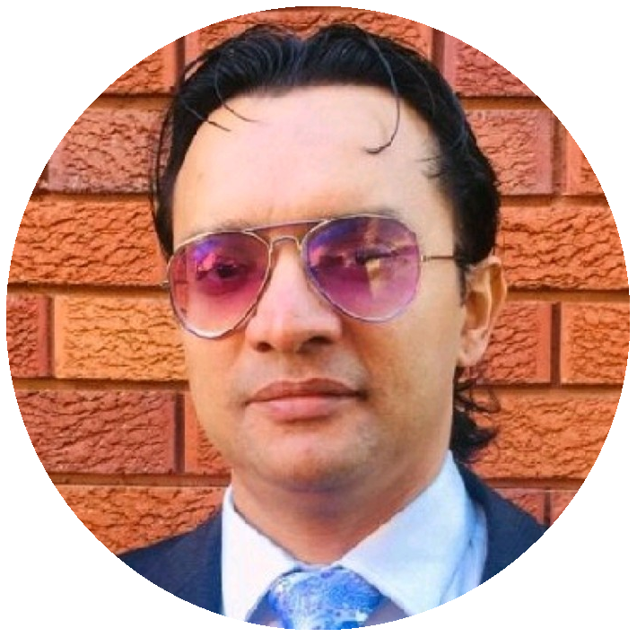




Core Team
Anirban Chakrabarty
Innovation Lead
Empathetic innovator with expertise in Cloud Technologies, Artificial Intelligence, Project Management & Design Thinking.
Vivek S Bendre
IT Head
IT entrepreneur with experience in setting up multiple off shore delivery centers from scratch. Presently CEO, of FluxionBits, Bangalore
Debasish Dutta
Academic Head (Proposed)
26 years of teaching experience in internationally reputed heritage schools like La Martiniere Calcutta. Students love his teaching most because he understands their perspective best.
Ananya Moitra
Marketing Head
25 years of experience in promoting & campaigning products & services across geographies. A noted poet & musician. Has MBA in Finance.
Parag Biswas
Content Development Head (Honorary)
Award winning film maker, TV reporter, actor, anchor, quiz master, commentator & school teacher.

Slide 5
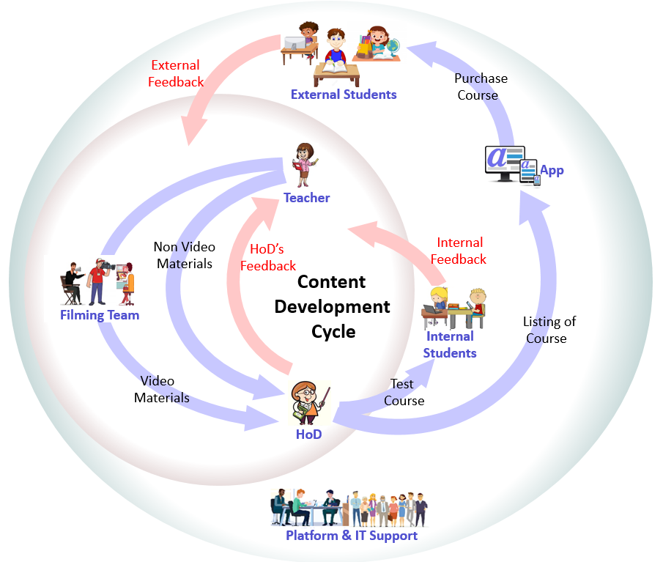

Where We Stand Now
Work in Progress
IT development set up at Bangalore
App & DevOps prototyping in progress
Pilot phase of content creation successful
Content dev cycle & QC process established
Pandemic mitigation plan
Resources Available
HoDs from premier institutions
Talented on-screen teachers
Award wining film makers, youtubers
Professional videographers, graphic artists
Excellent IT & management team
Content creation software: Doodley, Speechelo, OBS
Studio floor of 5000 sqft in Kolkata
Studio setup: lighting, recording, light board etc.
Challenges
Most resources are part time business partners, full time employment would be easier to manage
Require investment in equipment & infrastructure
Need funds for marketing & campaign

Slide 6
Business Model
Offer Price of Courses in INR(₹)
Minimum Price | 2,000
Mean Price | 7,300
Median Price | 7,000
Maximum Price | 10,000
$
Demand driven, affordable pricing
Determine optimum offer price for a course on a given day depending on demand
Affordable offer price to ensure optimum sales therefore maximum profit
Offer various discount schemes. e.g. buddy scheme, scholarships, flash sales, introductory offer etc.
AI based intelligent pricing model to be trained with data from initial sales cycles
Thoroughly student driven
Ensure students & parents find us dependable
Costumer retention & repeat business is high priority
Quality focused, value for money
** 1₹ = 0.017US$
March
July
November
March

Slide 7





Technology
Content
Creation App
Mobile & Web App
Admin
Web App
Tech Stack
App Dev: Java Spring Boot, Hibernate, MySQL
Mobile Dev: React JS
Cloud & Containerization: GCP, Kubernetes, Itsio, Prometheus, Grafana
CI/CD, DevOps: Ansible, Jenkins
Cyber Security
UX: Bootstrap, Java Script, Thymeleaf
Analytics, Data Science & AI: Python, Keras
Tech support
Software Development Centre
Highly skilled resource pool
Moderate rates
Convenient location for talent availability
Google Kubernetes
Engine
Ingress
Prometheus
Monitoring
Frontend
PV-MySQL
REST API
Google
Cloud
Storage
Google Cloud

Slide 8




Market Analysis and Competition
$
Edtech is the new fintech
21 unicorns and 2 decacorns already
Total industry valuation above A$77 billion in just 8 years
Low risk, high return & low investment
Forbes says elearning to be A$445 billion by 2025
A$1.4 trillion by 2027
High & mid cap investors already in business
Backed by extensive & ever increasing demand
Byju’s started in 2013 & already valued at A$17.5 billion
Revenue doubled in FY20 during pandemic
Byju’s recently acquired Akash for A$1.3 billion
Unacademy started in 2015, valued at A$3.4 billion
Drawbacks of competitors
Lacking high quality content with comprehensive coverage
Exam oriented approach missing
Does not help students of all merit levels
Misleading ads & pressure sales scandals
Inflated price, not affordable for most parents
Toxic work culture

Slide 9




Rollout and Marketing Plan
Initial Launch: CBSE – 10 & 12 – Maths & Computer Science
High demand, high return business, very low risk
Tuitions are most sought after for critical subjects in exam years
Relatively easy to find great teachers
Flagship Launch: ICSE, CBSE – 5 to 12 – All subjects
Huge market: ~50 million students
~76% seek tuitions, average 10 plus hrs per week
Kids’ education is super high priority for families
Affluent middle class, parents spend up to A$4K a year
High quality education inaccessible to many
Demand at both metro & remote areas
Prevailing tuition culture: content production easy
Marketing Plan
Initial focus on digital marketing
Long term focus on traditional marketing
Global Rollout
Carry out market analysis for different geographies
Prioritize high demand & less risk businesses
IT to be mostly reused, only new content to be created

Slide 10
Return on Investment
$
Initial Launch Budget: ₹ 1.44 Crores in three months
Sale of 1000 copies of each course to break even
Mean price of each course: ₹7,300/-
Total students in CBSE, Class 10 & 12: 40,00,000.
Only 1 sale per 4,000 students implies 1000 copies sold
Revenue:
2(courses) X 1000(sales/course) X ₹7300/-(unit price)
₹1.46 Crores
Break even to be achieved within 3-6 months
50% gain promised on investment in 1 year
$

Slide 11

Future Investment Potential
Continuous expansion
Enhancement, sales & support of existing courses over
the years
Increasing market penetration
Regular rollout of new courses
Global expansion across continents
Low maintenance cost
~20-25% of initial development cost per course per year
Maintenance cost is very easily covered by profit margin
Unicorn in 5 years
1 billion!
Low risk, high returns, global business
Huge, ever increasing user base
Consistent demand for high quality education

Slide 12


