Slide 1

The EdTech that creates possibilities beyond
barriers through innovation & empathy.
Business Introduction
Anirban Chakrabarty
– Innovation Lead
1120anirban@gmail.com
+61 470142229

Slide 2





Education System Needs the EdTech Support
Learning is fun, still so many kids dislike school
Yale says 75% students - tired, stressed & bored
Small attention span of most students
Repetition is key but not possible without year loss
Not much scope for empathy towards student
Most kids don’t have time left for sports etc.
Disruptions due to absenteeism, pandemic etc.
Good institutes capped by number of seats
Steep competition to qualify
Most exuberantly unaffordable
300 to 3000 year old system needs evolution
Ideation & innovation difficult
Futuristic tech like AI / AR / VR not easy
PC: news.yale.edu – Jan, 2020

Slide 3







Anodiam’s Solution
Content Team
Students
Exceptionally well designed app
User based design, fast, secure, scalable, no downtime
Students learn in own time, pace & comfort
80% video & 20% non-video (notes, diagrams) contents
Queries resolved through app within 3 business days
Self tests, repeat until perfection, no red ink
Performance dashboard for students
Content created from students’ perspective
Before go-live, we try each course with real students
Ensure better grades for students of all merit levels
Collect rating & detail feedback
Update 5-20% of content quarterly
Comprehensive coverage of syllabus & exam oriented
Highly engaging, fun, in-depth, one stop solution
Best teachers & HoDs from renowned institutes
Award winning film & media professionals & youtubers
Seasoned managers with decades of expertise
Competitive pricing
AI based pricing model to ensure profit maximization
Discount schemes, scholarships, coupons, flash sales
Create Courses:
Video,
non video &
tests
Teachers
Constant
Assistance
Queries
Resolutions
Film Crew &
HoDs
Ratings & feedback
Platform Dev & Support
Platform Dev & Support
Platform Team
IT, Marketing
Operations etc.

Slide 4
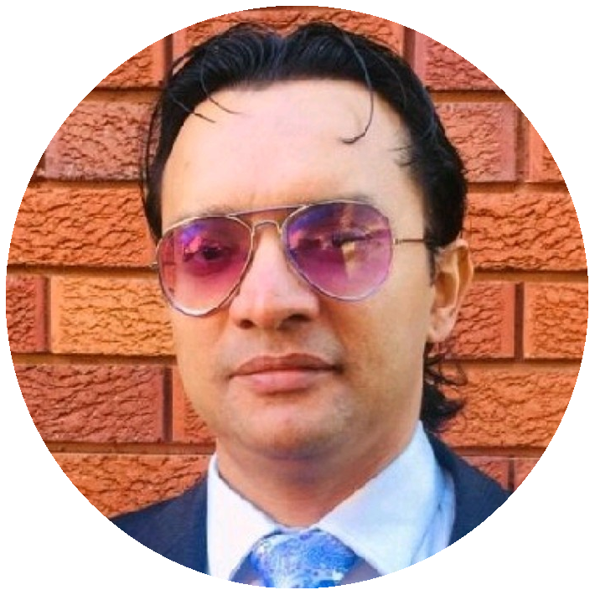
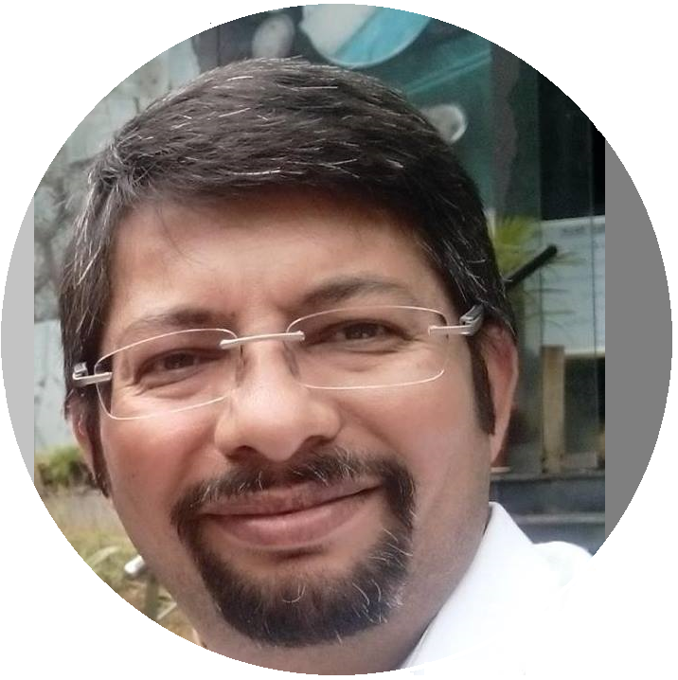
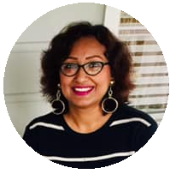

Core Team
Anirban Chakrabarty
– Innovation Lead
Empathetic innovator with expertise in Cloud technologies, Artificial Intelligence, Project Management and Design Thinking.
Vivek S Bendre
– IT Head
IT entrepreneur with experience in setting up multiple off shore delivery centers from scratch. Presently CEO, of FluxionBits, Bangalore
Ananya Moitra
– Marketing Head
25 years of experience in promoting & campaigning products & services across geographies. A noted poet & musician. Has MBA in Finance.
Parag Biswas
– Content Development Head
Award winning film maker, TV reporter, actor, anchor, quiz master, commentator & school teacher.

Slide 5
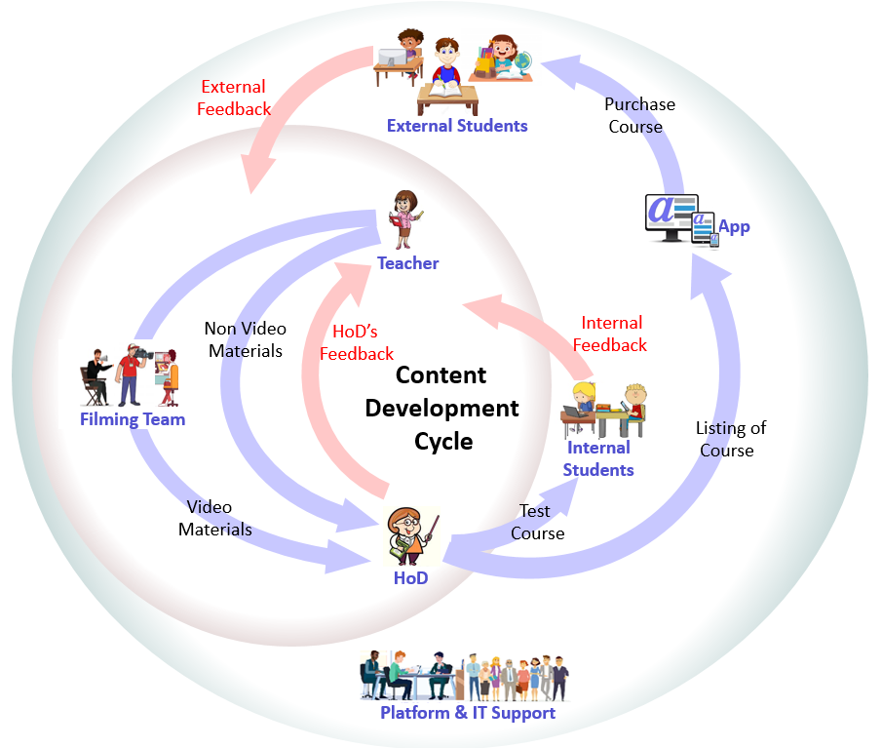
How We Are Progressing
Work in progress
IT development set up at Bangalore
App & DevOps prototyping in progress
Pilot phase of content creation successful
Content dev cycle & QC process established
Resources available
HoDs from premier institutions on board
Talented on-screen teachers
Award wining film makers, youtubers
Tollywood videographers, graphic artists
Excellent IT & management team
Studio floor of 5000 sqft in Kolkata
Studio setup: lighting, recording, light board etc.
Challenges
Most resources are part time business partners, full time employment would be easier to manage
Require investment in equipment & infrastructure
Need funds for marketing & campaign

Slide 6
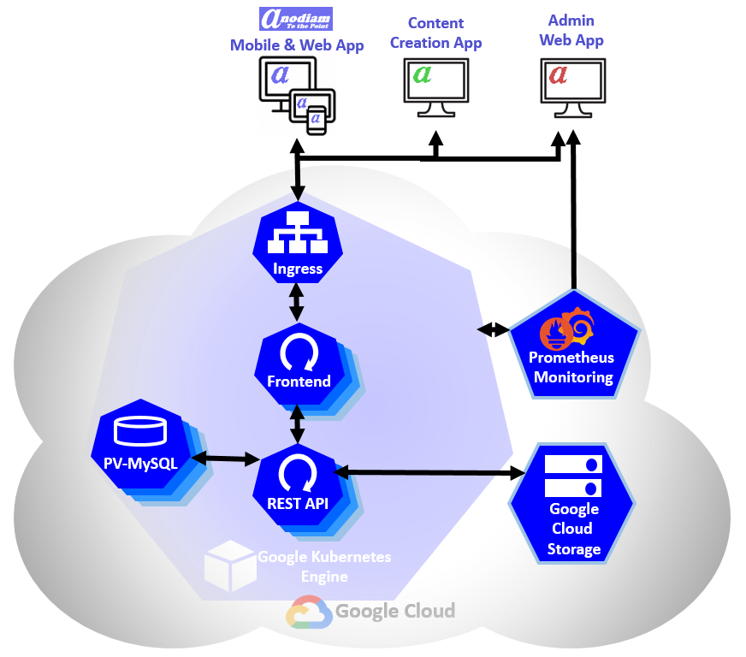
Technology:
Tech Stack:
Cloud and Containerization: GCP, Kubernetes, Itsio, Prometheus, Grafana
CI/CD, DevOps: Ansible, Jenkins
App Dev: Java Spring Boot, Hibernate, MySQL
Cyber Security
UX: Bootstrap, Java Script, Thymeleaf
Mobile Dev: React JS
Analytics, Data Science & AI: Python, Keras
Tech support
Offshore Development Centre:
Cunningham Road, Bengaluru, India

Slide 7


Marketing & Campaign Plan
Initial Launching for ICSE & CBSE
year 9 through 12; all major subjects
Huge market: ~20 million students
High quality education inaccessible to most
Demand at both metro & remote areas
Most parents from affluent middle class
Keen to invest on genuine learning
Prevailing tutoring culture
Content production easy
Digital Marketing
Social Media Marketing
Search Engine Marketing
Repeat business
Discount sales schemes to grab the market
Traditional Marketing
TV Ads
Billboards
Eventually cover all business appropriate boards across geographies

Slide 8
Analysis of The Competition
Proven growth: edtech is the new fintech
21 unicorns and 2 decacorns already
Total valuation above A$80 billion
Extensive and ever increasing demand
Byju’s phenomenal success despite failing to deliver
Lacking high quality, comprehensive coverage
Misleading ads & pressure sales scandals
Still, revenue doubled in FY20

Slide 9
Business Model
Unit price of courses will be variable and not fixed
AI algorithm will decide course price and aim to maximize
Total profit
Numbers of courses sold
Discount sales schemes will include:
Offer prices
Coupons
Scholarships
Flash sales
Buddy schemes
Etc.
‘M’ shaped seasonal curves with periodicity of 1 year
Unit Pricing (₹) of Courses
Min Price | 1,099.95
Target Q1 Price | 2,199.95
Target Mean Price | 2,899.95
Target Median Price | 4,399.95
Target Q3 Price | 8,699.95
Max Price | 17,499.95
Upper Outlier | 34,899.95

Slide 10
Return on Investment, Profitability

Slide 11
Thank You!
Key Takeaways on low risk, High gain with Edtechs especially Anodiam

