Slide 1
Visiting Card – Back Side

Slide 2



Visiting Card – CEO
e05a
Mr. Anirban Chakrabarty
C.E.O.
B.E.(Electronics), M.B.A. (Finance)
anirban@anodiam.com
+91 9073 700094
+61 470 142 229
N - 1/25 Patuli, Kolkata 700094
8/71 Wolseley Street
Bexley, Australia 2207
@
anodiam.com

Slide 3
Visiting Card – CIO
e05a
Mr. Debasish Nath
C.I.O.
anodiam.dn@gmail.com
+91 79759 42642
N – 1/25 Patuli
Near Krishi Bikash Kendra
Kolkata 700094
@
anodiam.com

Slide 4
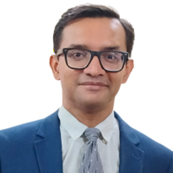
Identity Card – CEO
e05a
Mr. Anirban Chakrabarty
C.E.O.
B.E.(Electronics), M.B.A. (Finance)
anirban@anodiam.com
+91 9073 700094
+61 470 142 229
N - 1/25 Patuli, Kolkata 94
8/71 Wolseley Street
Bexley, Australia 2207
@
anodiam.com

Slide 5
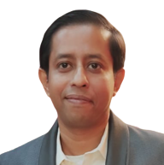
Identity Card – CIO
e05a
Mr. Debashish Nath
C.I.O.
anodiam.dn@gmail.com
+91 79759 42642
N – 1/25 Patuli
Near Krishi Bikash Kendra
Kolkata 700094
@
anodiam.com

