Slide 1








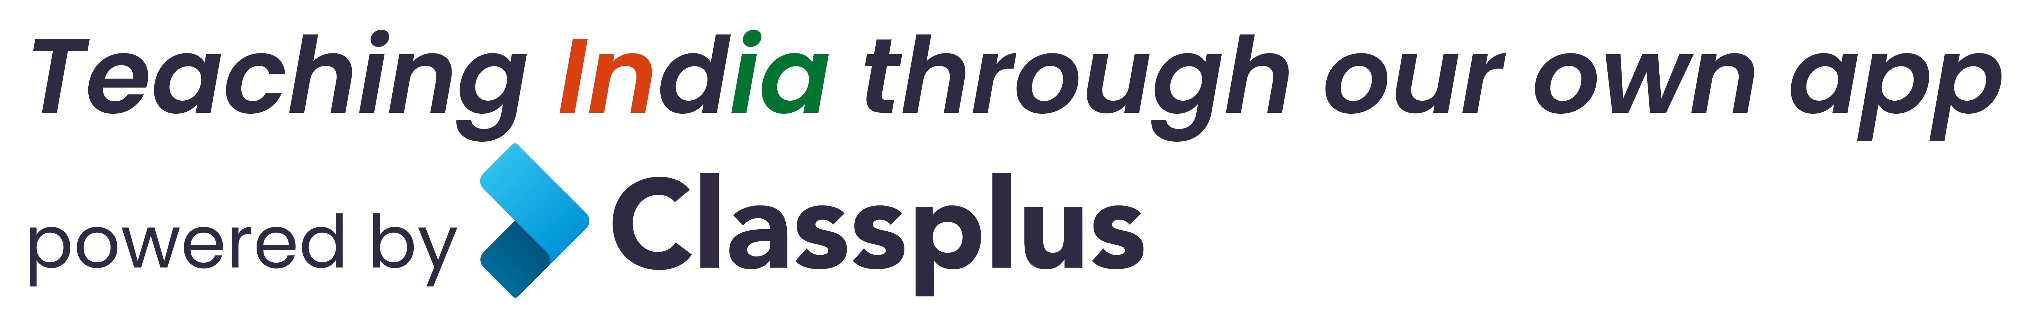
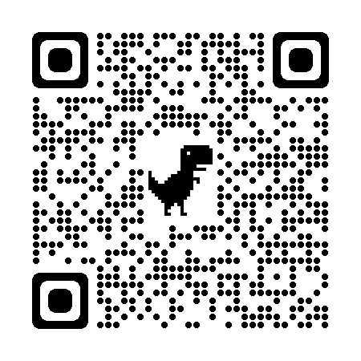
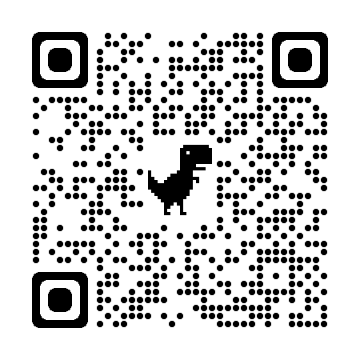


Coaching Classes
9073 700094
N-1/25 Patuli, Kol 94, Near Fire Brigade & Krisi Vikas
Upto 50% Off
T&C Apply
Follow
for Discount
App Download
ARTIFICIAL INTELLIGENCE – Class III – XII
IT & AI Professional Training & Projects
VIII-XII - All Subjects & Boards
NEET, IIT-JEE (Mains & Advanced)
MBA, BBA, BCom, CA, CMA, CS, CFA
CLAT, LLB, LLM
Grooming, IELTS, TOEFL, Foreign Languages
Finest Teachers, Study Mats, Mock Tests, Doubt Clearing, PTM, Counselling
20 Smart Classrooms, 400+ Courses, AC, CCTV
Professional Courses are Project-Based, Certification-Oriented & Job-Focused
www.anodiam.com || anirban@anodiam.com

Slide 2

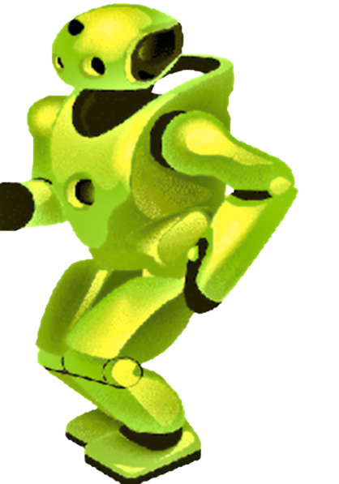
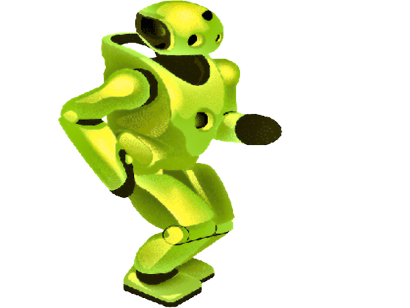
Artificial Intelligence & IT Training
N-1/25 Patuli, Kol 94, Near Fire Brigade & Krisi Vikas
9073 700094
Upto 50% Off
T&C Apply
Follow
for Discount
App Download
AI, IoT-Robotics, Coding – Class III-XII
IT & AI Professional Training & Projects
Data Science, Computer Vision, NLP, DSP, Python
Data Analytics, C, C++, IoT, Robotics
Java, .NET, JavaScript, ReactJS, Native, PHP
DevOps, Docker, Kubernetes, Cloud
Database, Firebase, Cyber Security, Automation Test
Pmp, Agile, Office, Adv Excel, Tally, Html, Css
Globally experienced faculty from prestigious organizations, fun learning
Project-based, Job-Focused, Certification-Help, Smart Classrooms, AC, CCTV
www.anodiam.com || anirban@anodiam.com

