Slide 1
Anodiam: Wireframes
Link: https://github.com/anodiamadm/Docs > ProjectExecution > BA > SpecsWireframes
Version | Editor | Reviewer | Date | Note
1.0 | AM | AC | 05/08/2020 | Initial version

Slide 2


#0f0f7f, 40px
nodiam
60px
Type Here
60px
60px
60px
Sign Up
Login
cooper black, 36, #fff
200 px horizontal, 40 px vertical, #fff
Arial, 16, #afafff, Middle alignment
Arial, 18, B, 0f0f7f
Arial, 18, B, 0f0f7f
Logo Reverse colour right aligned. 15 Px gape from the left wall
#6f6fef-67%
#fff-100%, 100 Px,
Header
#6f6fef, 98%, 47%, #fff 1%
Arial, #fff, 14
35 %, #0f0f7f
© 2020 Anodiam All rights reserved

Slide 3
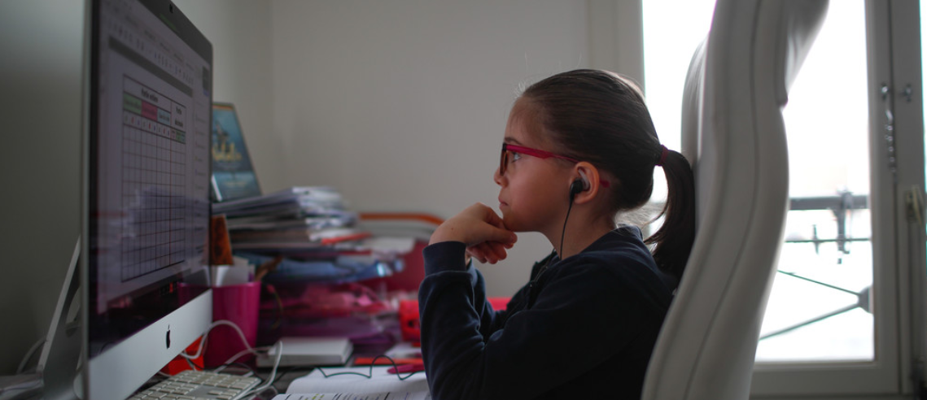
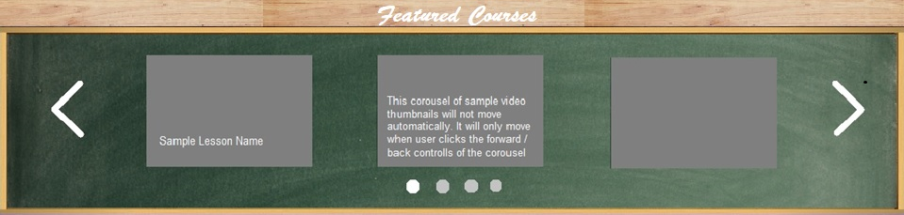
nodiam
Type Here
Sign Up Login
10px
Carousel with notes will display one by one within 4 sec
50 px
10px
Carousel will display 3 featured courses at a time
10px
© 2020 Anodiam All rights reserved

Slide 4


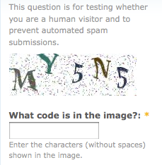
nodiam
#6f6fef 98%, #9f9fff 60%, #fff 1%, Linier gradient
Sign Up
Login
Click on the button if you are the guardian
Arial, 16, #0f0f7f
User Name
User name should contain an Upper case and a special character
Create Password
Password should be 5-15 character
Confirm Password
Give a text alert if mismatched
Email ID
Validate with “@”
Confirm Email ID
Give a text alart if mismatched
Arial,14, #0f0f7f
Cancelt
Submitt

