Slide 1
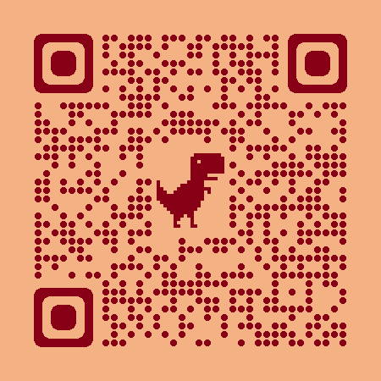
N-1/25 Patuli, Kolkata 700094
Near Patuli Fire Brigade & Krishi Vikas
9073 700094
NEET & IIT JEE
Artificial Intelligence & IoT
ICSE/CBSE/WB VIII-XII Science, Arts, Commerce
IT Training & Projects for Engineers
BCom, BBA, CA, CMA, CS, CFA
Spoken English, Grooming
50 Top-quality Teachers, Latest Techniques
400 Courses, 20 Smart Classrooms, AC, CCTV
Doubt Clearing, Mock Tests, PTM, Counselling
International Management, App Arriving Soon
Get Inaugural Discounts
Scan to Follow on
Study Multiple Subjects
Or Just Bring in a Friend
50%
Off
Education that enlightens!

