Slide 1
Anodiam Teacher App: Wireframes
Link: https://github.com/anodiamadm/Docs > ProjectExecution > BA > SpecsWireframes
Version | Editor | Reviewer | Date | Note
1.0 | AC | AM | 24/11/2020 | Teacher App wireframes

Slide 2
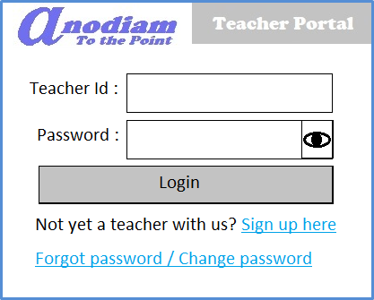
Teacher App: Signup / Login page
Link: https://anodiam.com/teacher

Slide 3
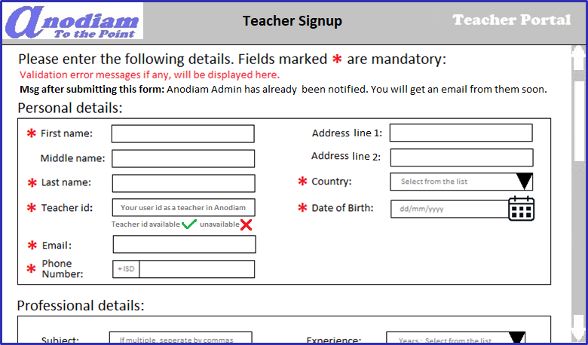
Teacher App: Signup – Teacher Signup page
Personal details section
Link: https://anodiam.com/teacher/signup
Notes:
Reorder the fields

Slide 4
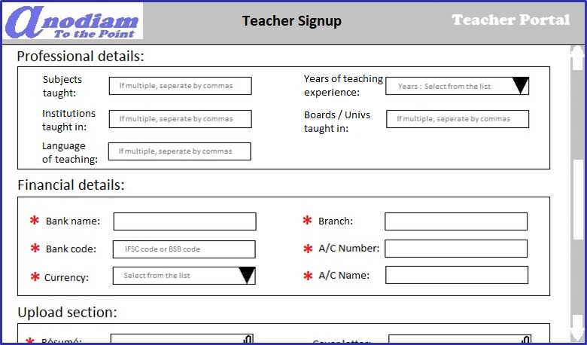
Teacher App: Signup – Teacher Signup page
Professional and Financial details section
Link: https://anodiam.com/teacher/signup
Notes:
Reorder fields: in Financial info
Language should be dropdown, also change help text for language

Slide 5
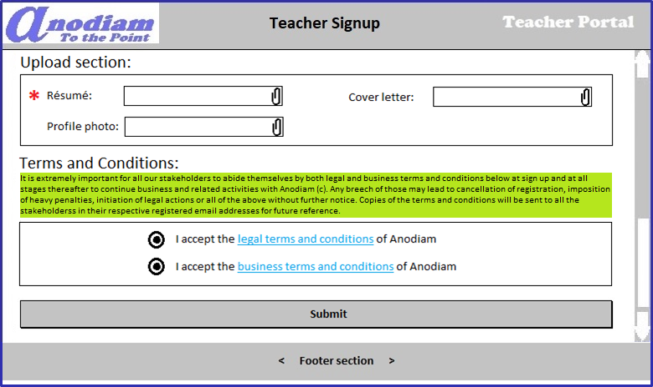
Teacher App: Signup – Teacher Signup page
Upload section and T&C details
Link: https://anodiam.com/teacher/signup

Slide 6
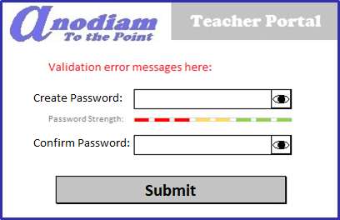
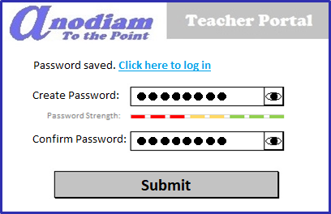
Teacher App: Signup – Create Password page
Link: https://anodiam.com/teacher/createpassword/{userid}
On Click

Slide 7
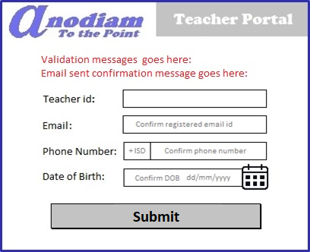
Teacher App: Signup – Forget / Change Password page
Link: https://anodiam.com/teacher/changepassword/{userid)

Slide 8
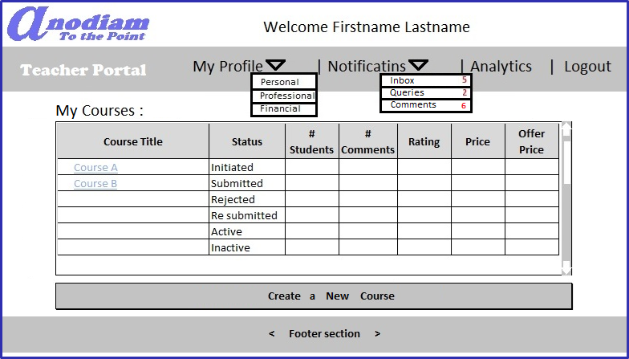
Teacher App: My Teacher Home / View All Courses page
Link: https://anodiam.com/teacher/myhome/{userid}

Slide 9
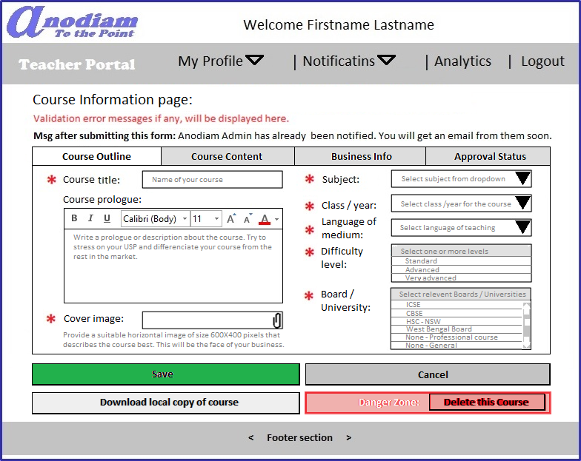
Teacher App: Create Course page Outline tab
** Only non-active courses can be deleted
Link: https://anodiam.com/teacher/addnewcourse/{userid}

Slide 10
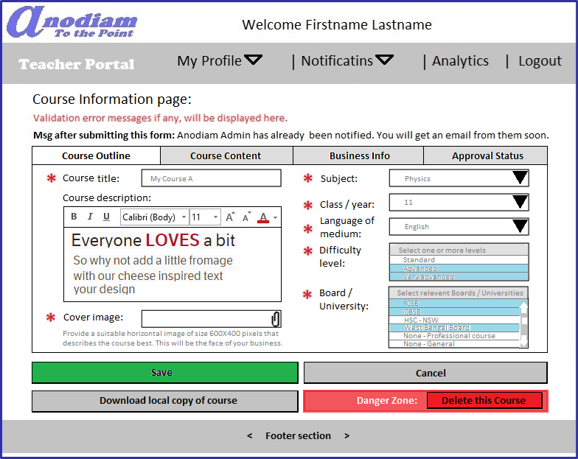
Teacher App: View, Update Course page Outline tab
** Only non-active courses can be deleted
Link: https://anodiam.com/teacher/addnewcourse/{userid}

Slide 11
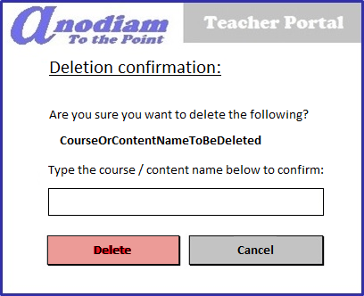
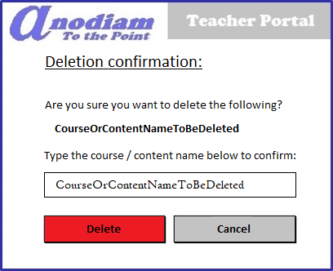
Teacher App: Confirm Deletion dialogue
** Only non-active courses can be deleted
Link: https://anodiam.com/teacher/addnewcourse/{userid}
On confirmation of Course / Content name
Delete button is enabled

Slide 12
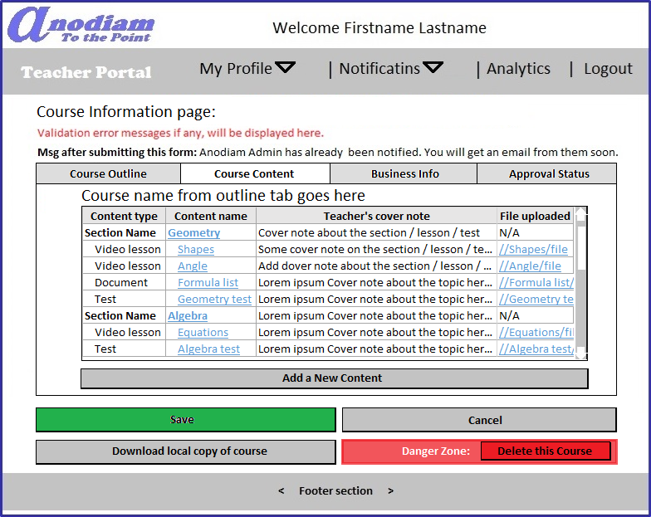
Teacher App: Create Course page Content tab
Link: https://anodiam.com/teacher/addnewcourse/{userid}

Slide 13
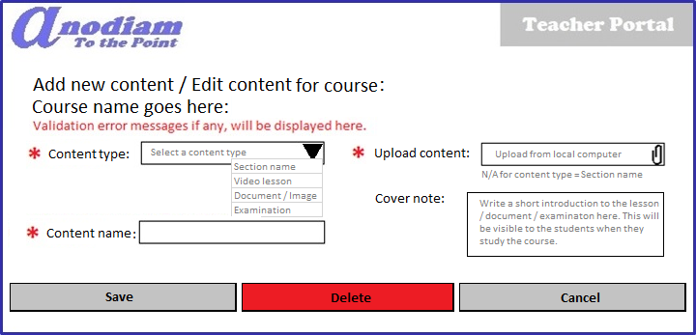
Teacher App: Content Detail (Add / Update / Delete) dialogue
Link: https://anodiam.com/teacher/addnewcourse/{userid}

Slide 14
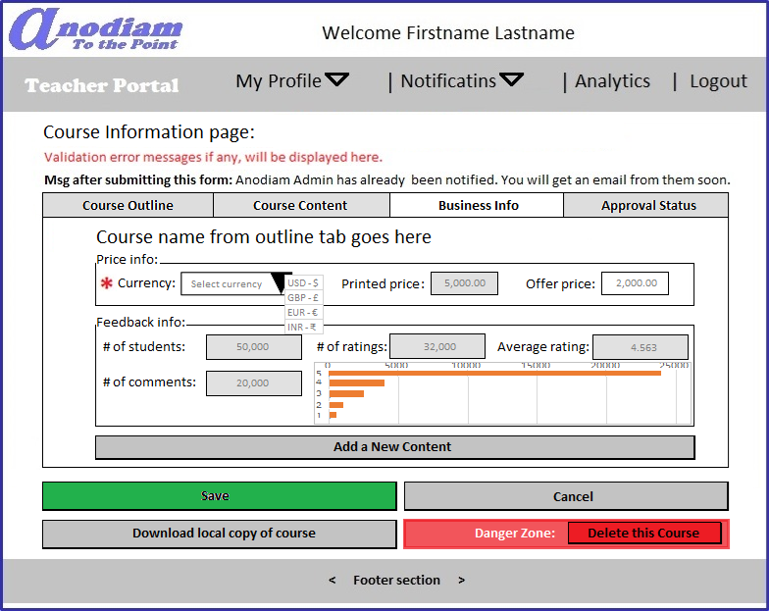
Teacher App: Create Course page Business Info tab
Link: https://anodiam.com/teacher/addnewcourse/{userid}

Slide 15
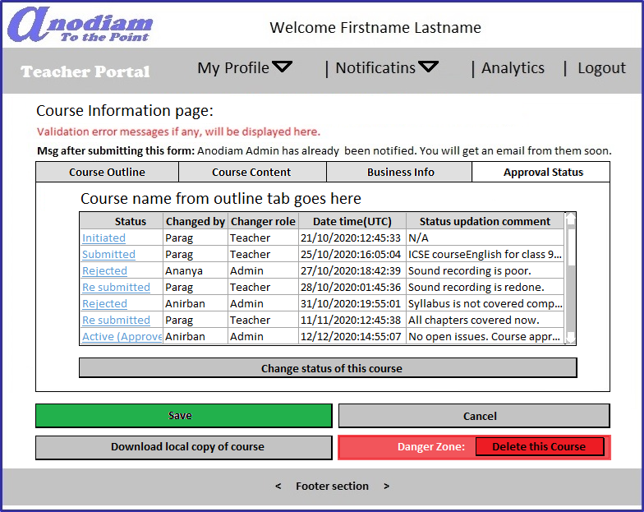
Teacher App: Create Course page Approval Status tab
Link: https://anodiam.com/teacher/addnewcourse/{userid}

Slide 16
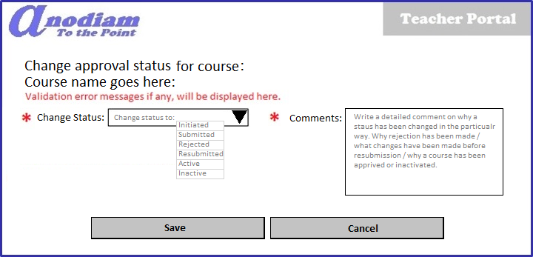
Teacher App: Approval Status dialogue
Link: https://anodiam.com/teacher/addnewcourse/{userid}

Slide 17
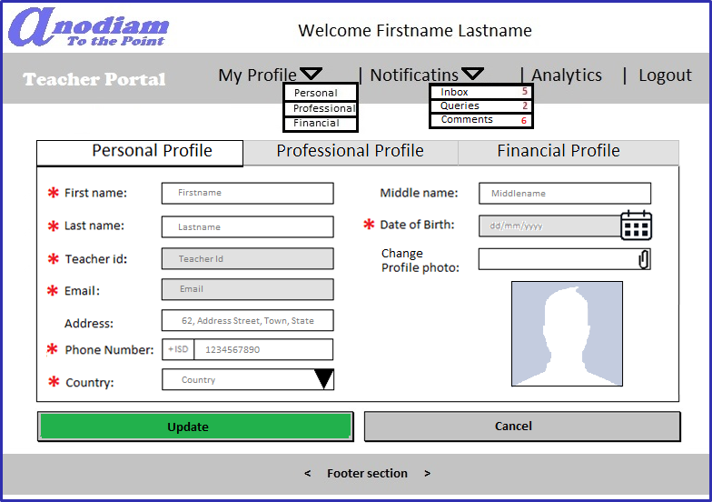
Teacher App: Personal Profile page
Link: https://anodiam.com/teacher/myprofile/personal/{userid}
Notes:
Ordering of fields should correspond to Signup – Teacher Signup page - Personal details section

Slide 18
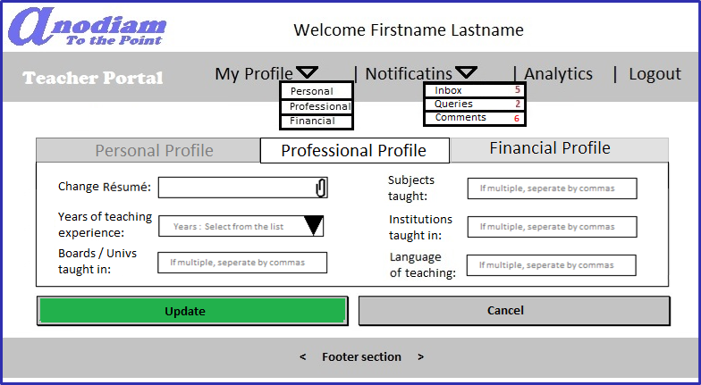
Teacher App: Professional Profile page
Link: https://anodiam.com/teacher/myprofile/professional/{userid}

Slide 19
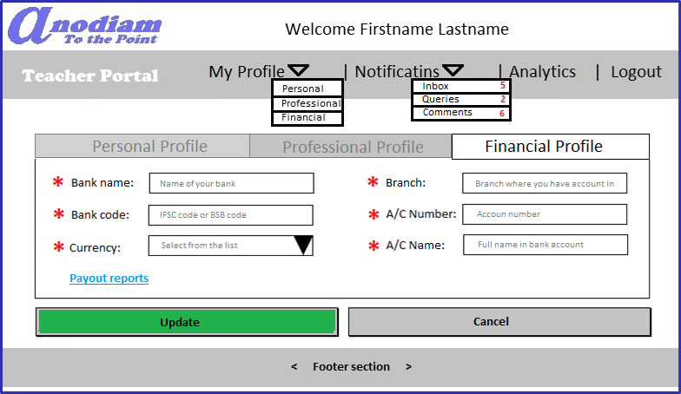
Teacher App: Financial Profile page
Link: https://anodiam.com/teacher/myprofile/financial/{userid}
Notes:
Ordering of fields should correspond to Signup – Teacher Signup page – Financial details section

Slide 20
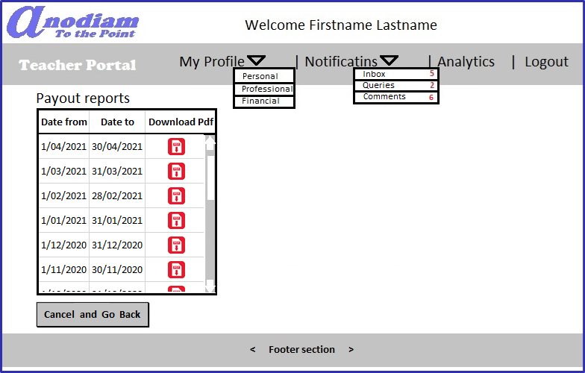
Teacher App: Payout Reports page
Link: https://anodiam.com/teacher/myprofile/payouts/{userid}

Slide 21
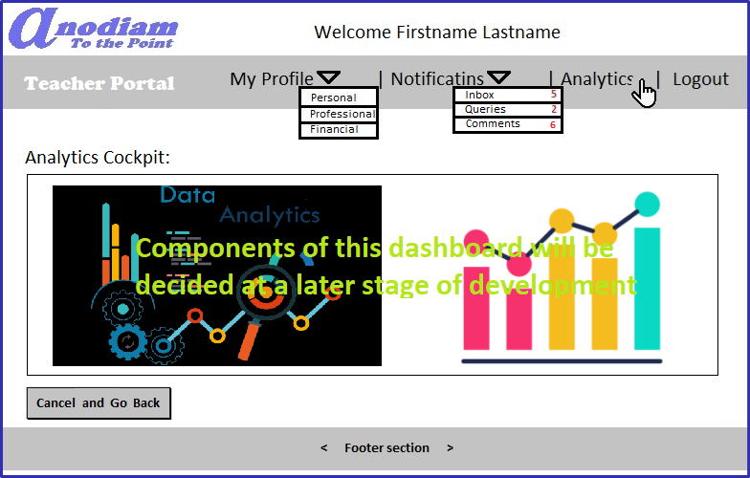
Teacher App: Analytics page
Link: https://anodiam.com/teacher/myprofile/analytics/{userid}

Slide 22
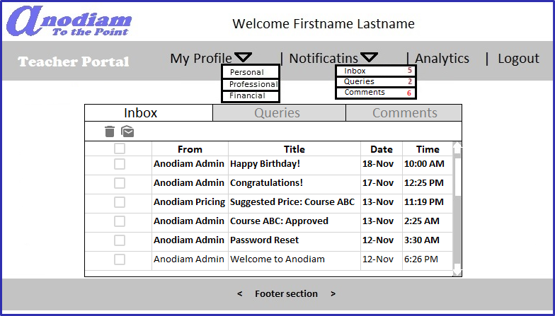
Teacher App: Notifications > Inbox page
Link: https://anodiam.com/teacher/inbox/{userid}

Slide 23
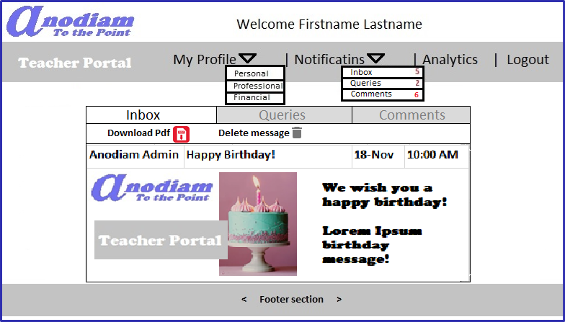
Teacher App: Notifications > Inbox > Message page
Link: https://anodiam.com/teacher/message/{messageid}

Slide 24
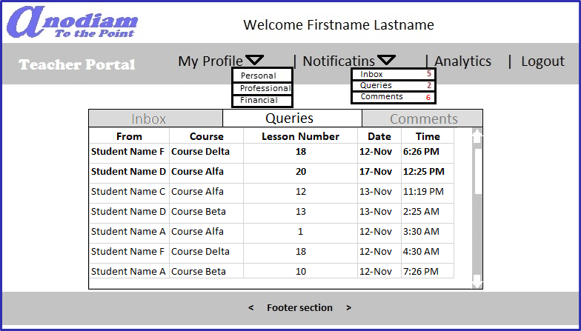
Teacher App: Notifications > Queries page
Link: https://anodiam.com/teacher/queries/{userid}

Slide 25
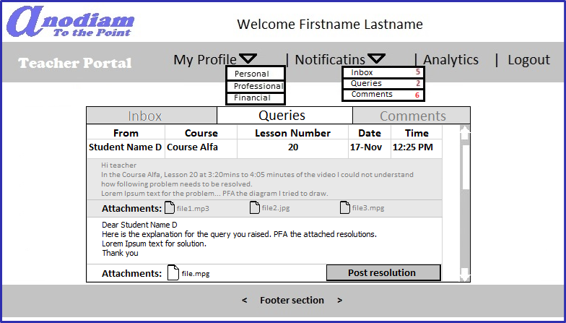
Teacher App: Notifications > Queries > Query > Resolve page
Link: https://anodiam.com/teacher/query/{queryid}

Slide 26
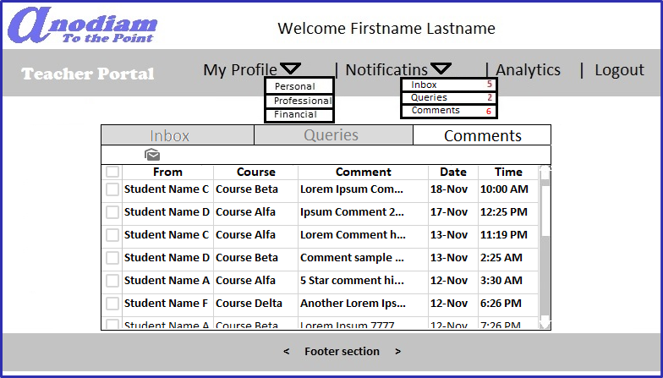
Teacher App: Notifications > Comments page
Link: https://anodiam.com/teacher/comments/{userid}

Slide 27
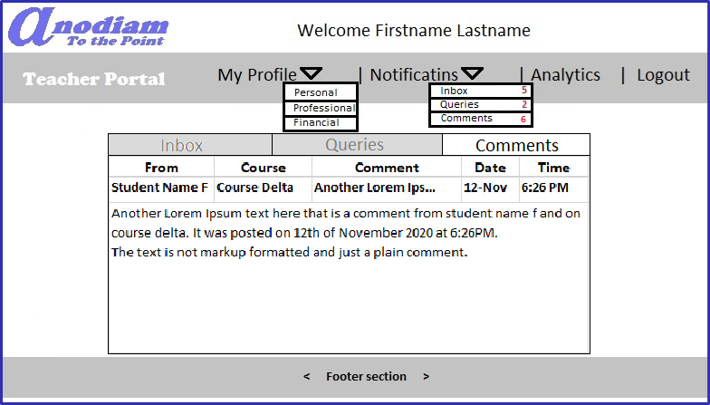
Teacher App: Notifications > Comments > Comment page
Link: https://anodiam.com/teacher/comment/{commentid}

