Slide 1
Anodiam Teacher App: Wireframes
Link: https://github.com/anodiamadm/Docs > ProjectExecution > BA > SpecsWireframes
Version | Editor | Reviewer | Date | Note
1.0 | AC | AM | 24/11/2020 | Teacher App wireframes

Slide 2
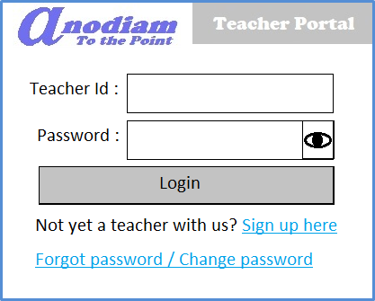
Teacher App: Signup / Login page
Link: https://anodiam.com/teacher

Slide 3
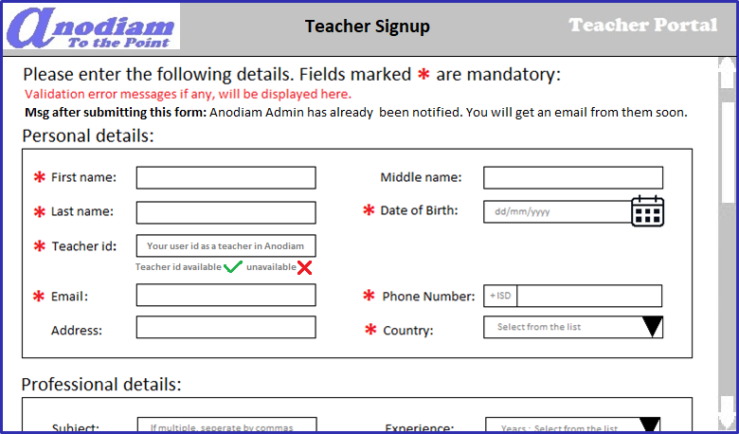
Teacher App: Signup – Teacher Details page - 1
Link: https://anodiam.com/teacher/signup

Slide 4
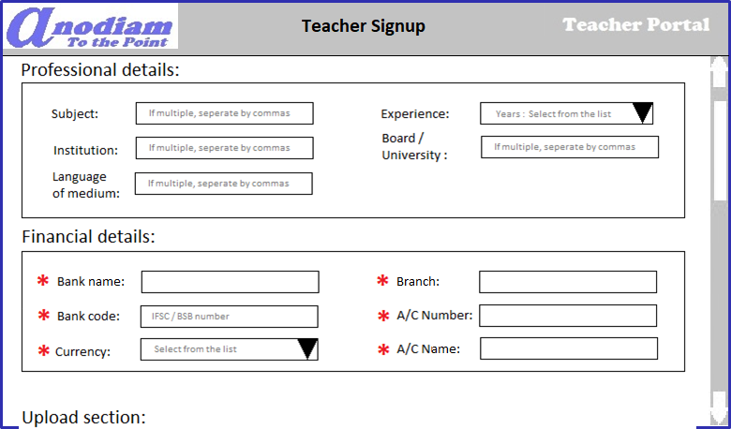
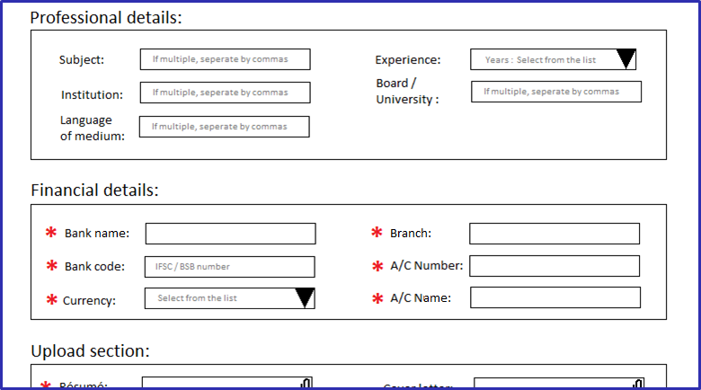
Teacher App: Signup – Teacher Details page contd. - 2
Link: https://anodiam.com/teacher/signup
Notes:
Add scroll bar
Language of Course/s
Experience “in years”
Following fields should have balloon help
Institution
Language of medium(Language of courses)
Board/University
Bank Code : IFSC code or BSB code

Slide 5
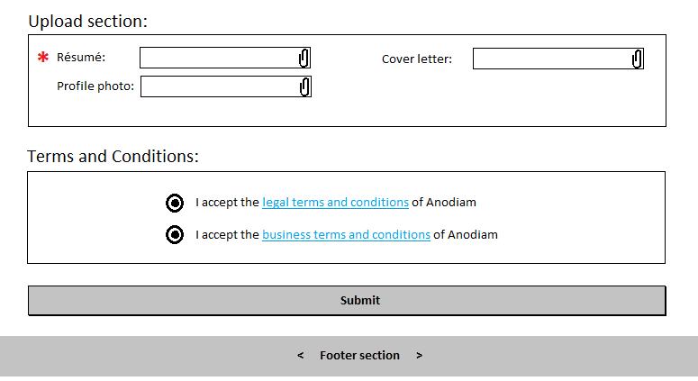
Teacher App: Signup – Teacher Details page contd. - 3
Link: https://anodiam.com/teacher/signup
Notes:
End of the acceptance of T&C there will be a note saying “Anodiam takes t&c very seriously and any breech of it would lead to cancellation of registration, heavy penalty, legal action or both. Copies of both the terms and conditions will be sent to the teachers in their registered email id for future reference.

Slide 6
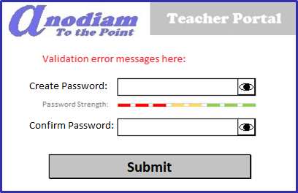
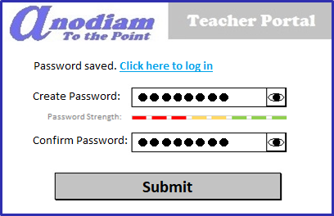
Teacher App: Signup – Create Password page
Link: https://anodiam.com/teacher/createpassword/{userid}
On Click

Slide 7
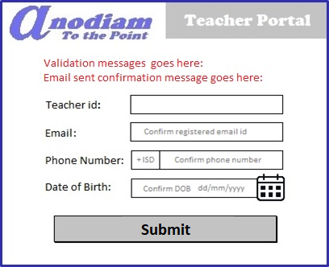
Teacher App: Signup – Forget / Change Password page
Link: https://anodiam.com/teacher/changepassword/{userid)

Slide 8
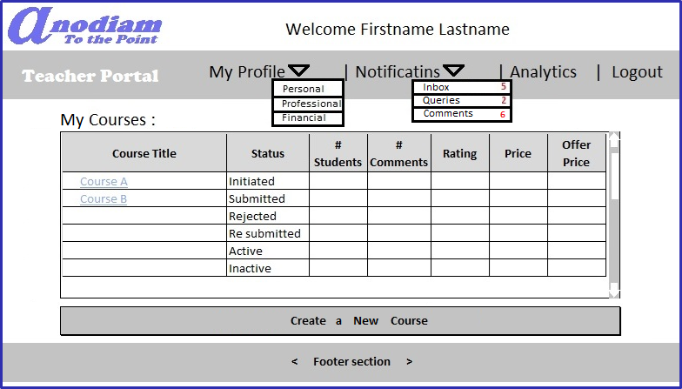
Teacher App: My Teacher Home / View All Courses page
Link: https://anodiam.com/teacher/myhome/{userid}

Slide 9
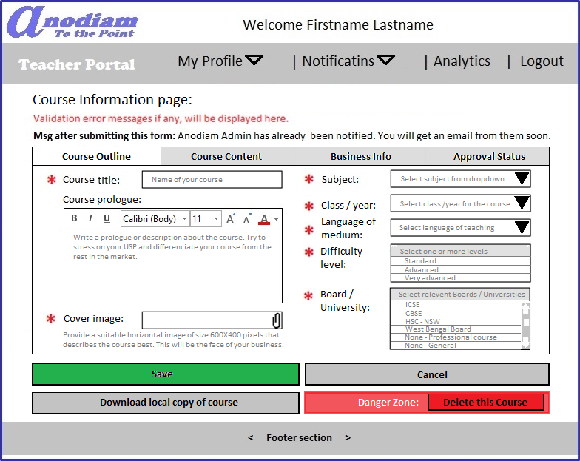
Teacher App: Create Course page Outline tab
** Only non-active courses can be deleted
Link: https://anodiam.com/teacher/addnewcourse/{userid}

Slide 10
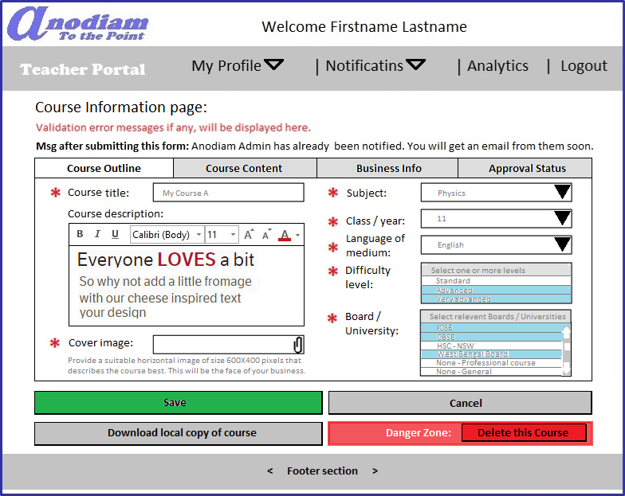
Teacher App: View, Update Course page Outline tab
** Only non-active courses can be deleted
Link: https://anodiam.com/teacher/addnewcourse/{userid}

Slide 11
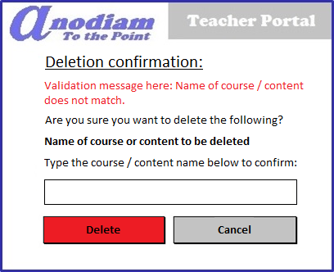
Teacher App: Confirm Deletion dialogue
** Only non-active courses can be deleted
Link: https://anodiam.com/teacher/addnewcourse/{userid}

Slide 12
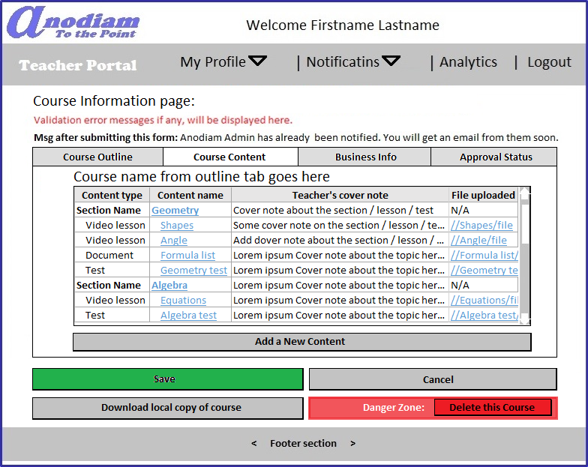
Teacher App: Create Course page Content tab
Link: https://anodiam.com/teacher/addnewcourse/{userid}

Slide 13
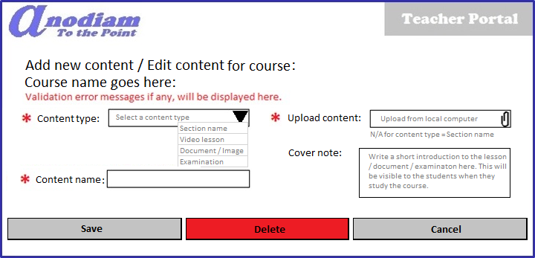
Teacher App: Content Detail (Add / Update / Delete) dialogue
Link: https://anodiam.com/teacher/addnewcourse/{userid}

Slide 14
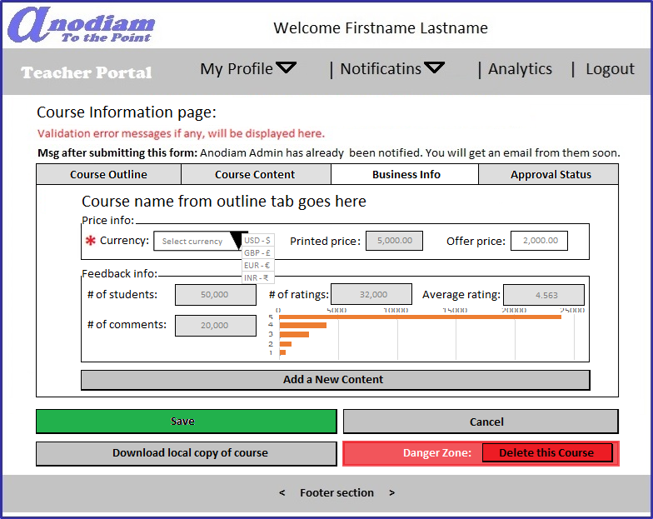
Teacher App: Create Course page Business Info tab
Link: https://anodiam.com/teacher/addnewcourse/{userid}

Slide 15
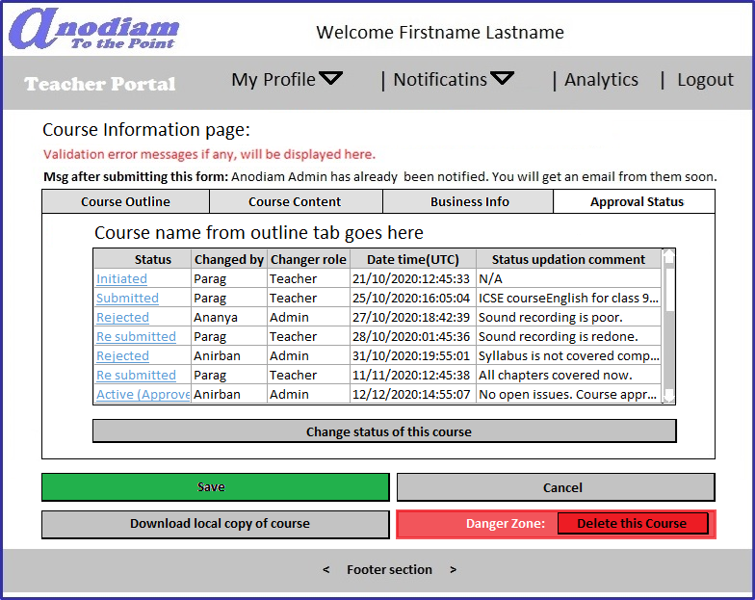
Teacher App: Create Course page Approval Status tab
Link: https://anodiam.com/teacher/addnewcourse/{userid}

Slide 16
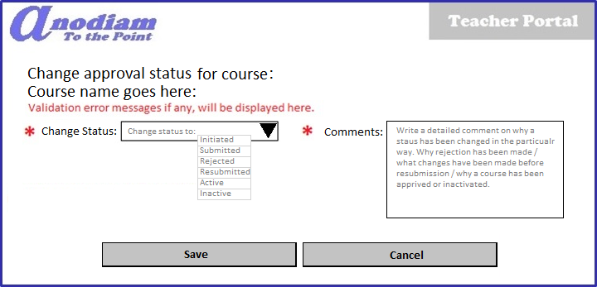
Teacher App: Approval Status dialogue
Link: https://anodiam.com/teacher/addnewcourse/{userid}

Slide 17
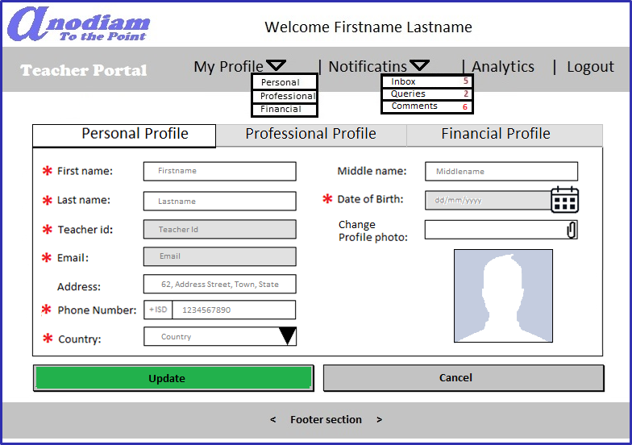
Teacher App: Personal Profile page
Link: https://anodiam.com/teacher/myprofile/personal/{userid}

Slide 18
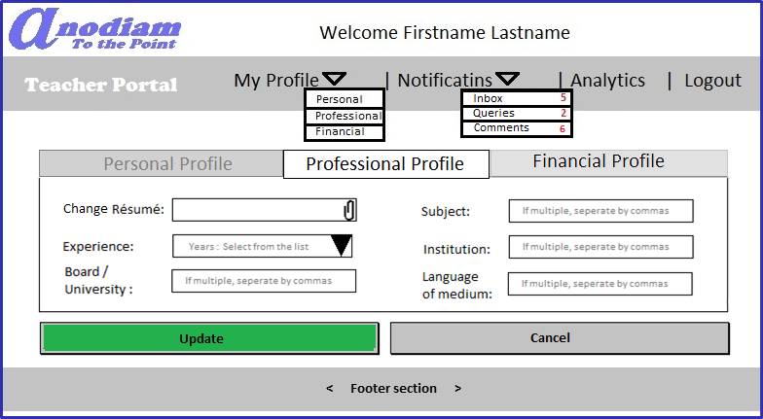
Teacher App: Professional Profile page
Link: https://anodiam.com/teacher/myprofile/professional/{userid}

Slide 19
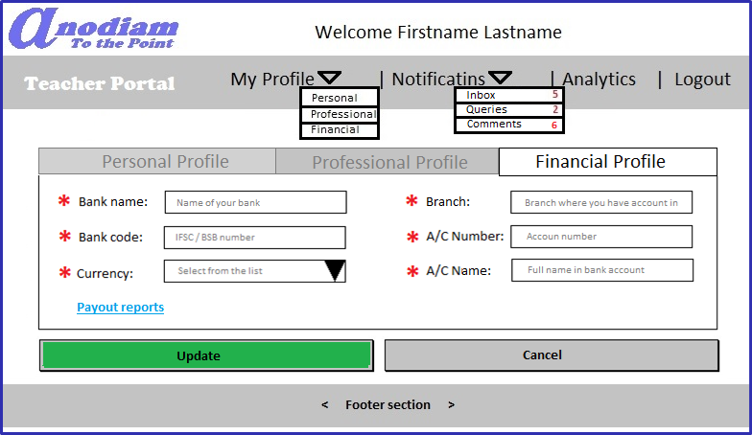
Teacher App: Financial Profile page
Link: https://anodiam.com/teacher/myprofile/financial/{userid}

Slide 20
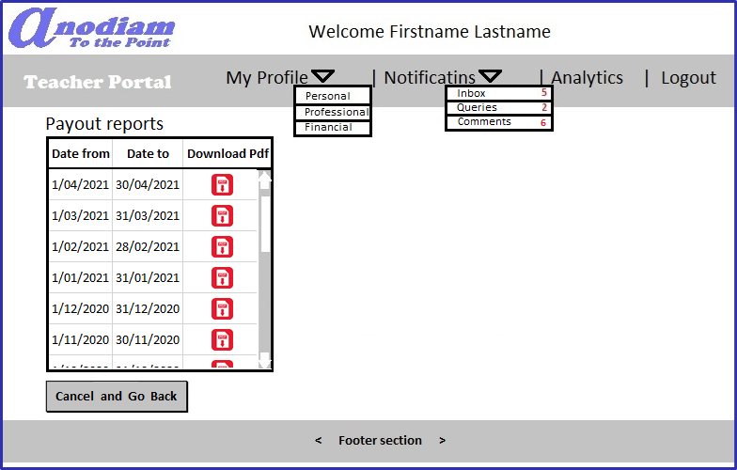
Teacher App: Payout Reports page
Link: https://anodiam.com/teacher/myprofile/payouts/{userid}

Slide 21
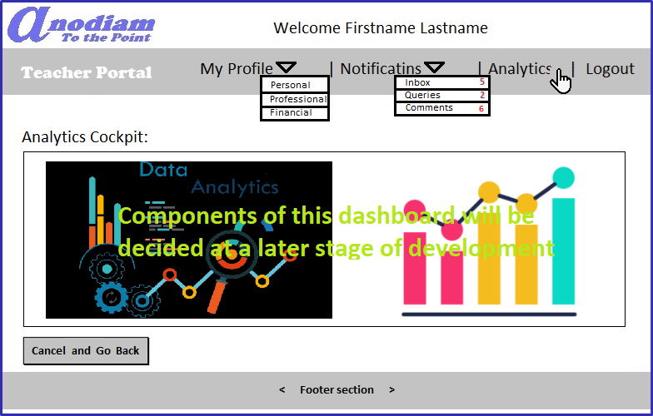
Teacher App: Analytics page
Link: https://anodiam.com/teacher/myprofile/analytics/{userid}

Slide 22
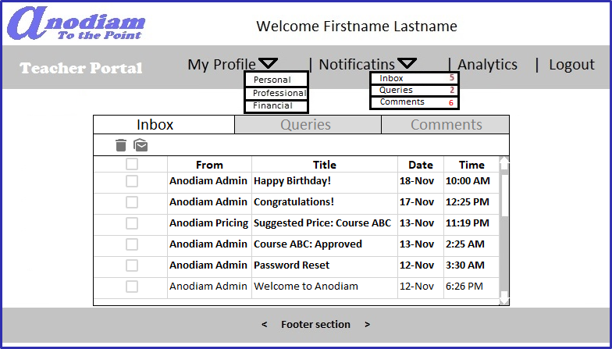
Teacher App: Notifications > Inbox page
Link: https://anodiam.com/teacher/inbox/{userid}

Slide 23
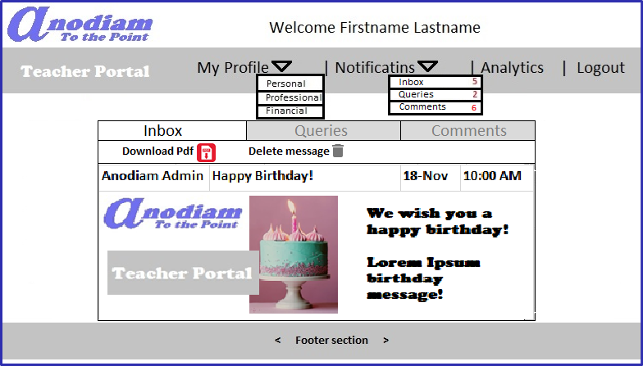
Teacher App: Notifications > Inbox > Message page
Link: https://anodiam.com/teacher/message/{messageid}

Slide 24
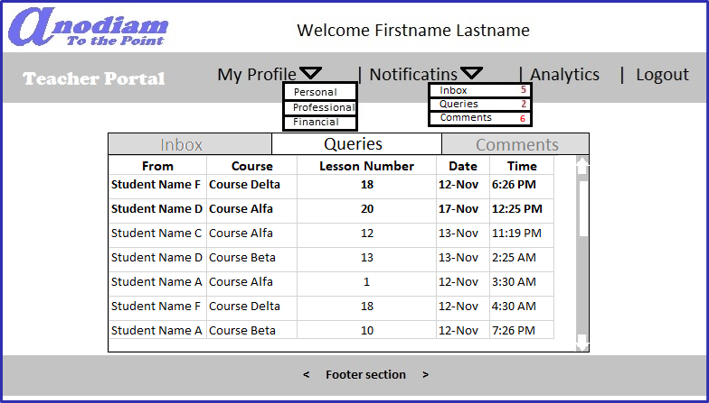
Teacher App: Notifications > Queries page
Link: https://anodiam.com/teacher/queries/{userid}

Slide 25
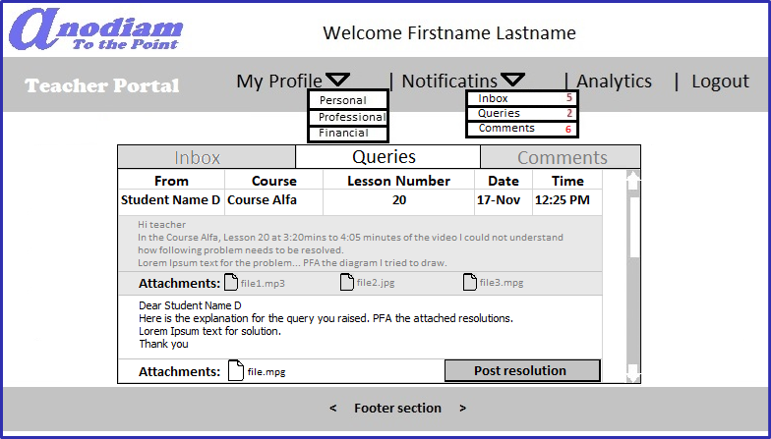
Teacher App: Notifications > Queries > Query > Resolve page
Link: https://anodiam.com/teacher/query/{queryid}

Slide 26
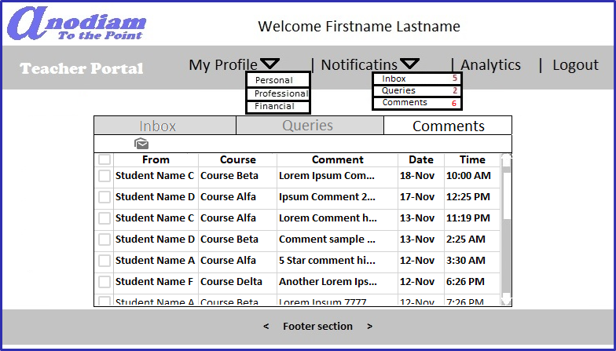
Teacher App: Notifications > Comments page
Link: https://anodiam.com/teacher/comments/{userid}

Slide 27
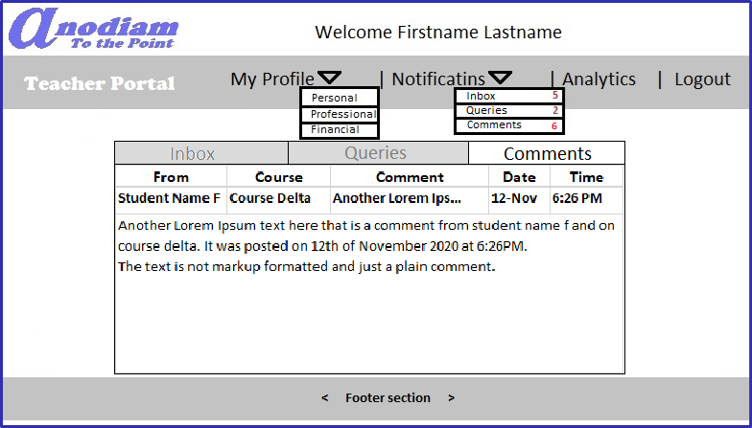
Teacher App: Notifications > Comments > Comment page
Link: https://anodiam.com/teacher/comment/{commentid}

