Slide 1
Anodiam: Wireframes
Link: https://github.com/anodiamadm/Docs > ProjectExecution > BA > SpecsWireframes
Version | Editor | Reviewer | Date | Note
1.0 | AM | AC | 05/07/2020 | Initial version

Slide 2
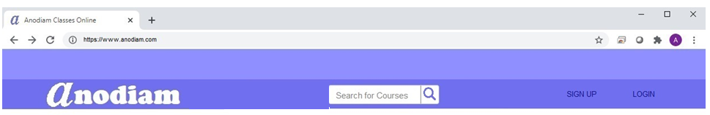
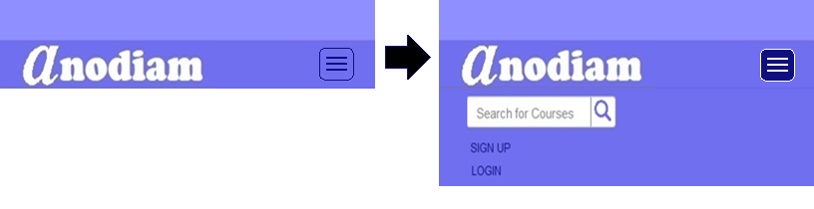
Home Screen: Header: Desktop
Logo
Height: 30px; Length: 240px; Radius: 4px; #fff;
Arial Narrow, Bold, 16; #8f8fff (Active #0f0f7f)
Width: 2px; #6f6fef
Right Aligned;
Arial Narrow, Bold, 16; #0f0f7f (Active, Hover #fff)
50px; #8f8fff
Width:50px; #6f6fef
10px
30px X 30px; Radius: 4px; #dfdfff;
100px
100px
100px
100px
Logo: Reverse Color, Right Aligned; height 50px
Cooper Black, Bold, 32; #fff
&#x1F50D; Ariel Bold 24; #0f0f7f (Active # 8f8fff)
100%
Home Screen: Header: Responsive
100%
#6f6fef; #0f0f7f
Active;
#0f0f7f; #fff

Slide 3
Home Screen: Footer: Desktop & Responsive
Margin 10px;
100px; #8f8fff
Arial Narrow, Bold, 12; #0f0f7f

Slide 4

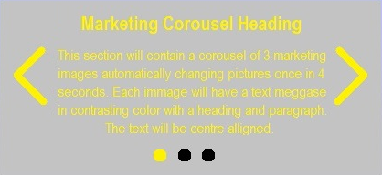
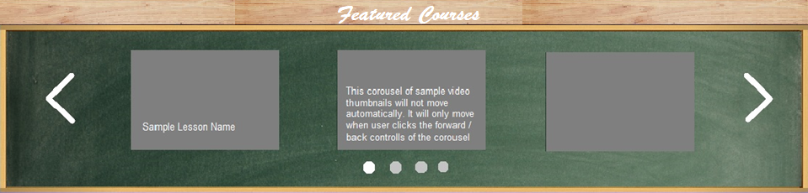
Home Screen: Body: Desktop & Responsive
100%
10px
33% #8f8fff;
34% Linier gradient;
33% #fff
Background: Blackboard Image (to be created)
25%
10px
50%
25%

Slide 5
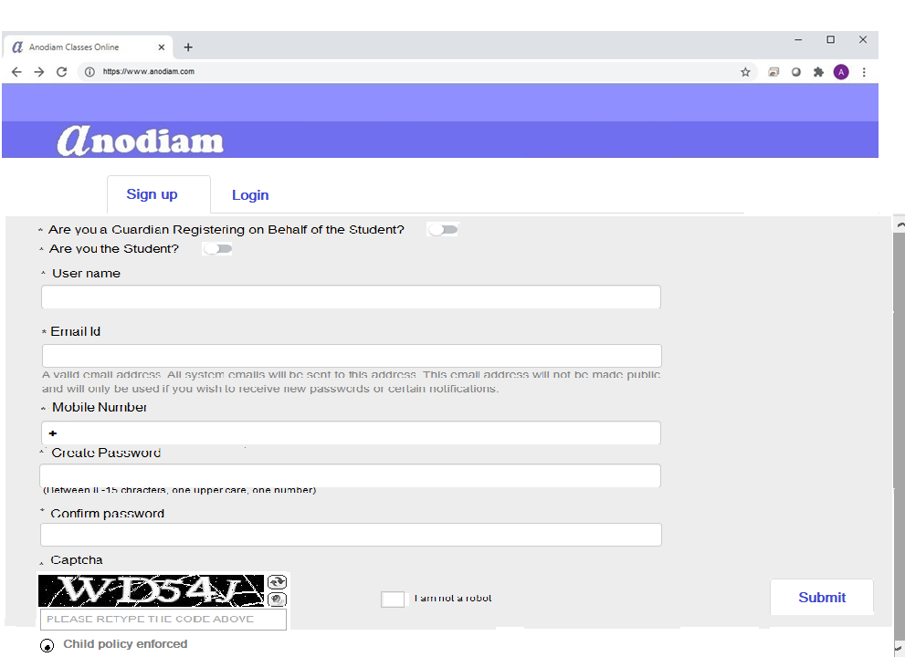
Button, Arial Narrow, Bold, 12; #2f2faf
Arial Narrow , 9; #0f0f7f
Arial Narrow , 9; #4f4fcf,(sam e applies to all other fields)
Arial Narrow, 9; #0f0f7f
Arial Narrow, 9; #0f0f7f
Arial Narrow, 8; #7f7fff
80% , #dfdfff
Plus symbol, Arial Narrow, 9; #0f0f7f
Arial Narrow, 9; #0f0f7f
40px, #8f8fff
Arial Narrow, 8; #7f7fff
Arial Narrow, 9; #0f0f7f
Button, Arial Narrow, Bold, 12; #2f2faf
Arial Narrow, 9; #0f0f7f
check box when blank fill color #ffffff, round, border color 9f9fff, when checked color #0f0f7f
Arial Narrow , 9; #0f0f7f
Tick box when blank fill color #ffffff, square, border color 9f9fff, when ticked color #0f0f7f
Arial Narrow, 9; #0f0f7f

Slide 6
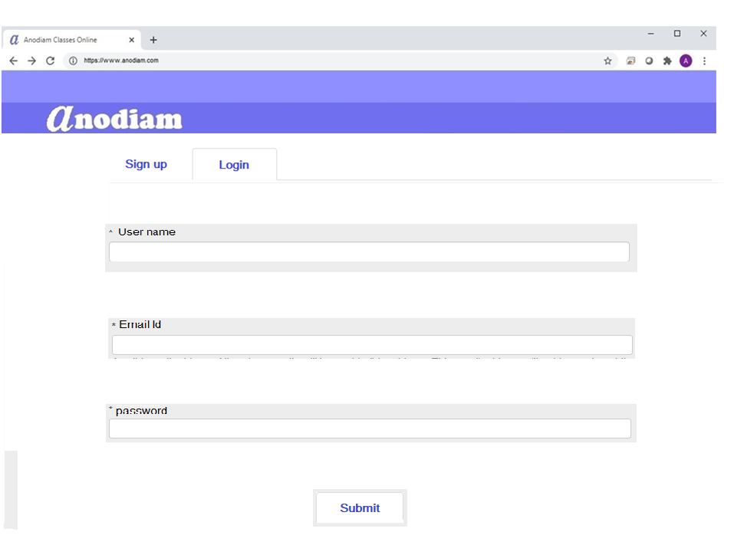
Button, Arial Narrow, Bold, 12; #2f2faf
Arial Narrow, 9; #0f0f7f
80% , #dfdfff
Arial Narrow , 9; #4f4fcf,(sam e applies to all other fields)
Button, Arial Narrow, Bold, 12; #2f2faf

