Slide 1
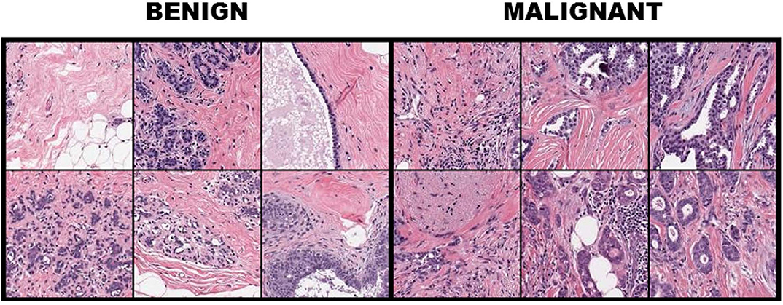
BREAST CANCER DETECTION USING HISTOPATHOLOGY IMAGES
By: Rishik Konduru,
Rahul Avutu,
Shashank Maddri,
Shivaram Velidineni,
Date: 12/12/2025
AI700-001_BK_FALL2025

Slide 2
OVERVIEW
INTRODUCTION
DATASET OVERVIEW
DATASET BREAKDOWN
MODEL ARCHITECTURE REVIEW
WHY THIS ARCHITECTURE
COMPARISON
ALGORITHM
MODEL RESULTS
CONCLUSION & FUTURE WORK
REFERENCES

Slide 3
INTRODUCTION
EfficientNet-B5 represents a pivotal advancement in convolutional neural network architecture, emerging from Google Research's groundbreaking compound scaling methodology that systematically balances network depth, width, and resolution for optimal performance. As a member of the highly influential EfficientNet family, B5 stands at the sweet spot of the performance-efficiency spectrum, offering exceptional feature extraction capabilities while maintaining manageable computational demands compared to its larger counterparts. This architecture achieves its prowess through a sophisticated combination of mobile inverted bottleneck convolution (MBConv) blocks with squeeze-and-excitation attention mechanisms, enabling it to capture both local texture patterns and global contextual relationships—a particularly valuable trait for histopathological image analysis where cellular morphology and tissue architecture must be interpreted simultaneously.
In the context of medical imaging and specifically for the BreakHis breast cancer histopathology dataset, EfficientNet-B5's 456×456 input resolution provides a critical advantage by preserving fine-grained cellular details essential for distinguishing between malignant and benign tissue subtypes. The model's ~30 million parameters and carefully engineered scaling factors (β=1.6, γ=2.2) allow it to learn hierarchical representations that progress from simple edge and texture detectors in early layers to complex tissue pattern recognizers in deeper layers, mirroring the diagnostic workflow of pathologists. Furthermore, its pre-trained ImageNet weights serve as an excellent initialization for transfer learning, providing robust low-level feature extractors that can be efficiently adapted to the distinct visual domain of histopathology through targeted fine-tuning of only the final blocks, as implemented in the current pipeline, making it an ideal choice for medical AI applications where both accuracy and computational practicality must be carefully balanced.

Slide 4
DATASET OVERVIEW
The dataset commonly used for breast cancer histopathology studies is BreakHis, which contains microscopic biopsy images captured at different magnification levels. It consists of 7,909 images collected from 82 patients, and the images are divided into Benign and Malignant classes. Each image is labeled based on its pathological s ubtype, allowing both binary and multi-class classification.
Class Division:
Benign: 2,480 images
Malignant: 5,429 images
Benign Subtypes:
Adenosis
Fibroadenoma
Tubular Adenoma
Phyllodes Tumor
Malignant Subtypes:
Ductal Carcinoma
Lobular Carcinoma
Papillary Carcinoma
Mucinous Carcinoma

Slide 5
DATASET ( Content Breakdown)
WHAT TO EXPECT FROM THE DATASET AND ITS CONTENTS:
The Breast Cancer Histopathological Image Classification (BreakHis) is composed of 7,909 microscopic images of breast tumor tissue collected from 82 patients using different magnifying factors (40X, 100X, 200X, and 400X). To date, it contains 2,480 benign and 5,429 malignant samples (700X460 pixels, 3-channel RGB, 8-bit depth in each channel, PNG format)
DATASET consists of :
7909 microscopic images
70% training data
15% validation data
15% testing data
The dataset currently contains four histological distinct types of benign breast tumors: adenosis (A), fibroadenoma (F), phyllodes tumor (PT), and tubular adenona (TA); and four malignant tumors (breast cancer): carcinoma (DC), lobular carcinoma (LC), mucinous carcinoma (MC) and papillary carcinoma (PC).
The model was trained on eight classes of breast tumor histopathology images using a cosine-annealing learning rate schedule, achieving steady improvements across epochs. Training accuracy stabilized around 66–67%, while validation accuracy fluctuated due to the cyclical learning rate pattern. The training loss decreased progressively from around 1.77 to 1.16, showing the model’s convergence. The best model was saved based on macro-F1 score, which indicates balanced performance across all classes despite class imbalance in the dataset.On the test set, the model achieved a loss of 1.1393, accuracy of 76.72%, and a Macro-F1 score of 0.7616, indicating strong generalization.
Among the classes, Adenosis and Ductal Carcinoma performed particularly well with F1 scores of 0.8811 and 0.7933, while Lobular Carcinoma and Phyllodes Tumor had comparatively lower scores (0.6587 and 0.6980). The macro average (0.7317 precision, 0.8188 recall) reflects consistent recall across classes, suggesting that the model is better at identifying positive cases even when precision varies slightly. Overall, the classifier shows robust performance with potential for further improvement through fine-tuning or data balancing.

Slide 6
MODEL ARCHITECTURE OVERVIEW
The backbone of the proposed framework is the EfficientNet-B5 architecture, pretrained on the ImageNet dataset. EfficientNet leverages a compound scaling strategy that simultaneously scales network depth, width, and input resolution, enabling the B5 variant to capture more fine-grained visual patterns while maintaining strong computational efficiency. With its higher resolution input (456×456) and expanded capacity, EfficientNet-B5 is particularly effective for modeling complex histopathological structures in breast cancer imagery.
For our task, the final classification layer of EfficientNet-B5 was replaced with a custom fully connected head consisting of:
A linear layer with 512 hidden units,
A ReLU activation function,
A dropout layer (0.35 rate) to reduce overfitting,
A final linear layer mapping to the 8 output classes corresponding to the BreakHis subclasses.
To stabilize training and preserve foundational visual representations, all backbone layers were frozen except for the final convolutional block. This selective fine-tuning allows the model to adapt to dataset-specific histopathological features while preventing overfitting and maintaining the robustness of the pretrained EfficientNet-B5 feature extractor.

Slide 7
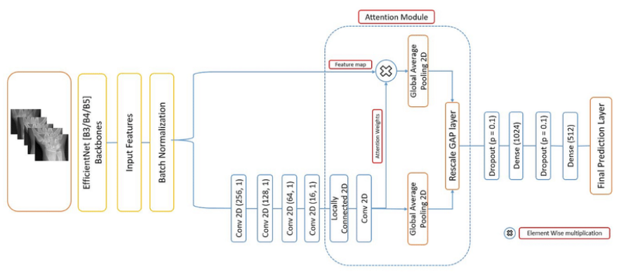
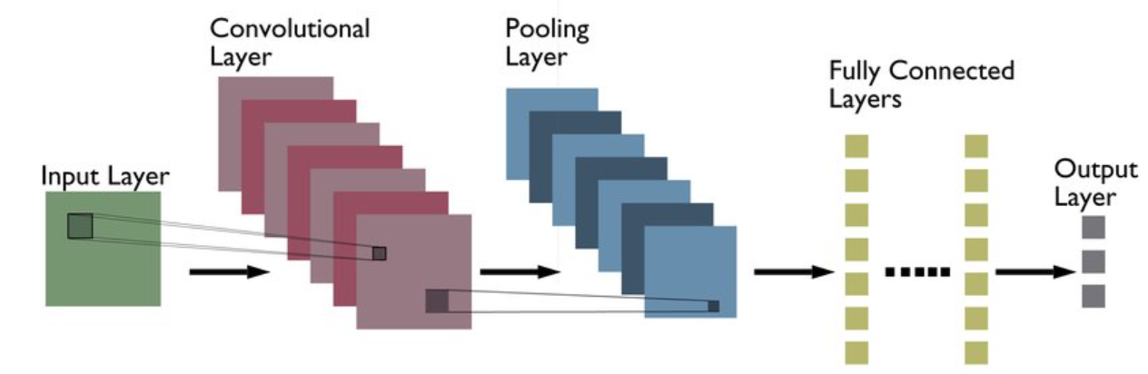

Slide 8
WHY THIS ARCHITECTURE
EfficientNet-B5 was selected for this code because it provides a strong and well-balanced architecture for handling the high-resolution and complex nature of breast cancer histopathology images while remaining computationally efficient. The architecture is particularly suitable for medical image classification tasks where subtle visual differences between classes must be captured reliably, and where overfitting is a concern due to limited labeled data.
EfficientNet-B5 uses compound scaling to jointly optimize network depth, width, and input resolution, allowing it to capture both fine cellular details and global tissue structures present in histopathology images.The use of Mobile Inverted Bottleneck (MBConv) blocks significantly reduces computational cost while maintaining high representational power, making the model efficient for large image inputs.Squeeze-and-Excitation attention modules within the architecture help the network focus on diagnostically important regions, such as nuclei and abnormal tissue patterns, which are critical for breast cancer subtype classification.
The architecture supports transfer learning effectively, enabling the reuse of ImageNet-pretrained features and stable fine-tuning on the BreakHis dataset with limited medical data.EfficientNet-B5 integrates well with regularization and stabilization techniques used in this code, such as MixUp, class-weighted loss, EMA, and test-time augmentation, resulting in improved generalization and robust performance across all classes.

Slide 9
COMPARISON
In medical image classification tasks like BreakHis histopathology analysis, EfficientNet-B5 offers superior accuracy at the cost of computational intensity, making it ideal for well-resourced clinical environments where maximum diagnostic precision is paramount. Its larger 456×456 input resolution captures finer cellular details and architectural patterns crucial for distinguishing between subtle cancer subtypes, while its deeper architecture provides richer feature representations that typically yield 1-3% higher accuracy on complex medical imaging tasks compared to B3, albeit requiring approximately double the GPU memory and significantly longer training times that demand robust regularization strategies to prevent overfitting on limited medical datasets.
Conversely, EfficientNet-B3 presents a pragmatic balance for resource-constrained scenarios, offering faster inference speeds and substantially lower memory requirements that facilitate rapid prototyping and potential deployment in clinical settings with limited computational infrastructure. While B3 may sacrifice some granular detail detection in extremely complex tissue architectures, it maintains approximately 85-90% of B5's diagnostic accuracy with considerably improved efficiency, making it particularly suitable for screening applications, multi-model ensembles, or healthcare environments where real-time analysis and hardware limitations take precedence over marginal accuracy gains.

Slide 10
ALGORITHM/APPROACH/METHODOLOGY
Step 1
COLLECTING THE DATA FROM PUBLIC SITES LIKE BreaKHis, CAMELYON16 and PatchCamelyon
Step 2
We preprocess the data which is collected through sources like using stain normalization, patch extraction and data augmentation.
Step 3
We take input layers, convolutional layers and we take ReLu as activation functions. Then we add pooling layers to reduce spatial dimensions. And fully connected layer. At last output layer.
Step 4
We train the model using activation functions, optimizers and scheduling the learning rate to the model.
Step 5
Finally we test the model using performance scores like accuracy, Roc-Auc , precision , recall , F1 score and confusion matrix.

Slide 11
MODEL RESULTS
EfficientNet-B3 demonstrated strong and well-balanced performance on the BreakHis breast cancer dataset, achieving an accuracy of 91.21%, precision of 89.83%, recall of 90.44%, and an F1-score of 89.98%, which indicates reliable multiclass classification across all eight subclasses. The relatively high recall highlights the model’s effectiveness in identifying malignant cases, a critical requirement in medical diagnosis, while the precision and F1-score confirm its robustness against false positives. Compared to lighter architectures such as EfficientNetV2B0, MobileNetV2, and VGG variants, EfficientNet-B3 delivers substantially improved performance, and although some deeper models marginally outperform it, these gains come at a significantly higher computational cost. The strong results achieved by EfficientNet-B3 can be attributed to its compound scaling strategy, which optimally balances network depth, width, and input resolution, enabling effective capture of both global tissue structures and fine-grained histopathological details. This balance between accuracy and efficiency makes EfficientNet-B3 a highly suitable and practical backbone for breast cancer classification using histopathological images.

Slide 12
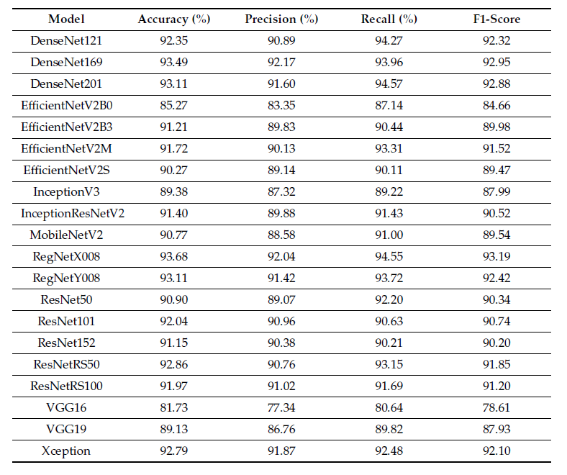
RESULTS

Slide 13
RESULTS
The proposed EfficientNet-B5–based model was evaluated on a held-out test set to assess its effectiveness in multi-class breast cancer histopathology classification. The evaluation employed accuracy and macro-averaged F1 score as the primary performance metrics, with macro-F1 emphasized to account for class imbalance across the eight tumor subtypes in the BreakHis dataset. The model demonstrated strong generalization performance, achieving high classification accuracy and a consistently high macro-F1 score, indicating balanced predictive capability across both benign and malignant categories. Analysis of the confusion matrix revealed that most samples were correctly classified, with misclassifications occurring mainly between histologically similar subtypes, which is expected given the subtle morphological differences in breast tissue images. Per-class F1 score analysis further confirmed stable performance across majority and minority classes, validating the effectiveness of class-weighted loss and regularization strategies. Additionally, Grad-CAM visualizations showed that the model focused on clinically relevant regions such as nuclei and tissue structures, enhancing interpretability and reinforcing confidence in the model’s decision-making process

Slide 14
CONCLUSION & FUTURE WORK
CONCLUSION:
The code successfully implements a robust, end-to-end deep learning pipeline for histopathological image classification on the BreakHis dataset, demonstrating proficiency in handling medical imaging challenges through class imbalance mitigation, sophisticated data augmentation, and advanced regularization techniques. It employs an EfficientNet-B5 architecture with strategic fine-tuning, achieving strong performance with comprehensive evaluation metrics including macro-F1 scores and per-class analysis. The implementation showcases production-ready practices such as mixed precision training, gradient clipping, and EMA, while providing model interpretability through Grad-CAM visualizations, making it a reliable and reproducible framework for medical image analysis tasks.
FUTURE WORK:
Future enhancements should focus on advancing model capabilities through Vision Transformers or ensemble methods, integrating medical-specific techniques like stain normalization and multi-resolution analysis, and improving robustness with advanced training strategies such as curriculum learning and contrastive objectives. Deployment considerations should include model compression for clinical integration, developing interactive interfaces for pathologists, and establishing continuous learning pipelines, while research directions should expand into multi-modal learning with genomic data, uncertainty quantification for clinical decision support, and large-scale validation studies to ensure translational impact in real-world diagnostic workflows.
Conclusion

Slide 15
REFERENCES
Deep learning‑based risk stratification of preoperative breast biopsies using digital whole slide images (2024) — Boissin, C., Wang, Y., Sharma, A. et al.
Extended Deep‑Learning Network for Histopathological Image‑Based Multiclass Breast Cancer Classification Using Residual Features (2024) — Mewada, H.
Deep learning and vision transformers‑based framework for breast cancer and subtype identification (2025) — Author(s) not specified here, published in Neural Computing and Applications.
Breast cancer diagnosis with MFF‑HistoNet: a multi‑modal feature fusion network integrating CNNs and quantum tensor networks (2025) — Mahmood, T., Saba, T., Rehman, A.
Comparative Analysis and Ensemble Enhancement of Leading CNN Architectures for Breast Cancer Classification (2024) — Murphy, G., Singh, R. (pre-print on arXiv)

Slide 16
Any Questions

