Slide 1
Graded Assignment- 05
Screen Shots

Slide 2
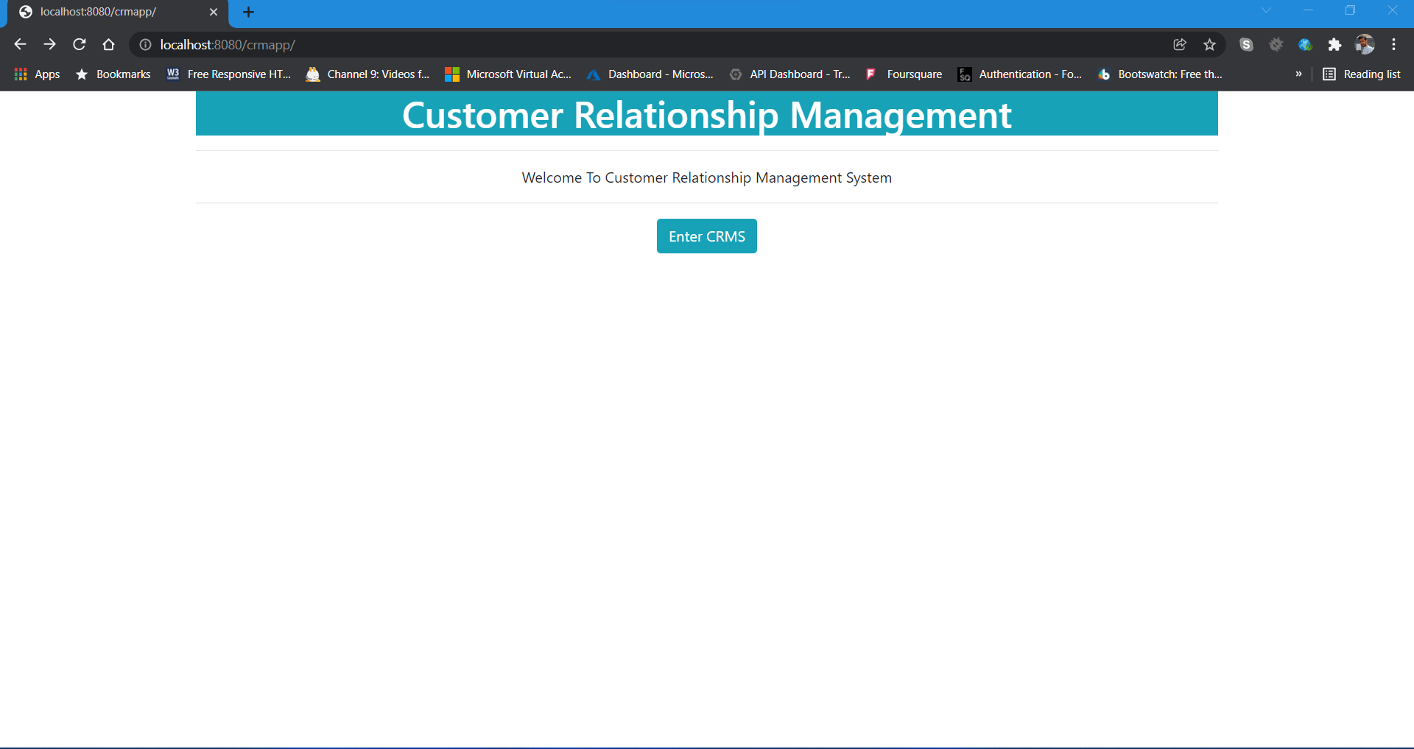
1) Home Page

Slide 3
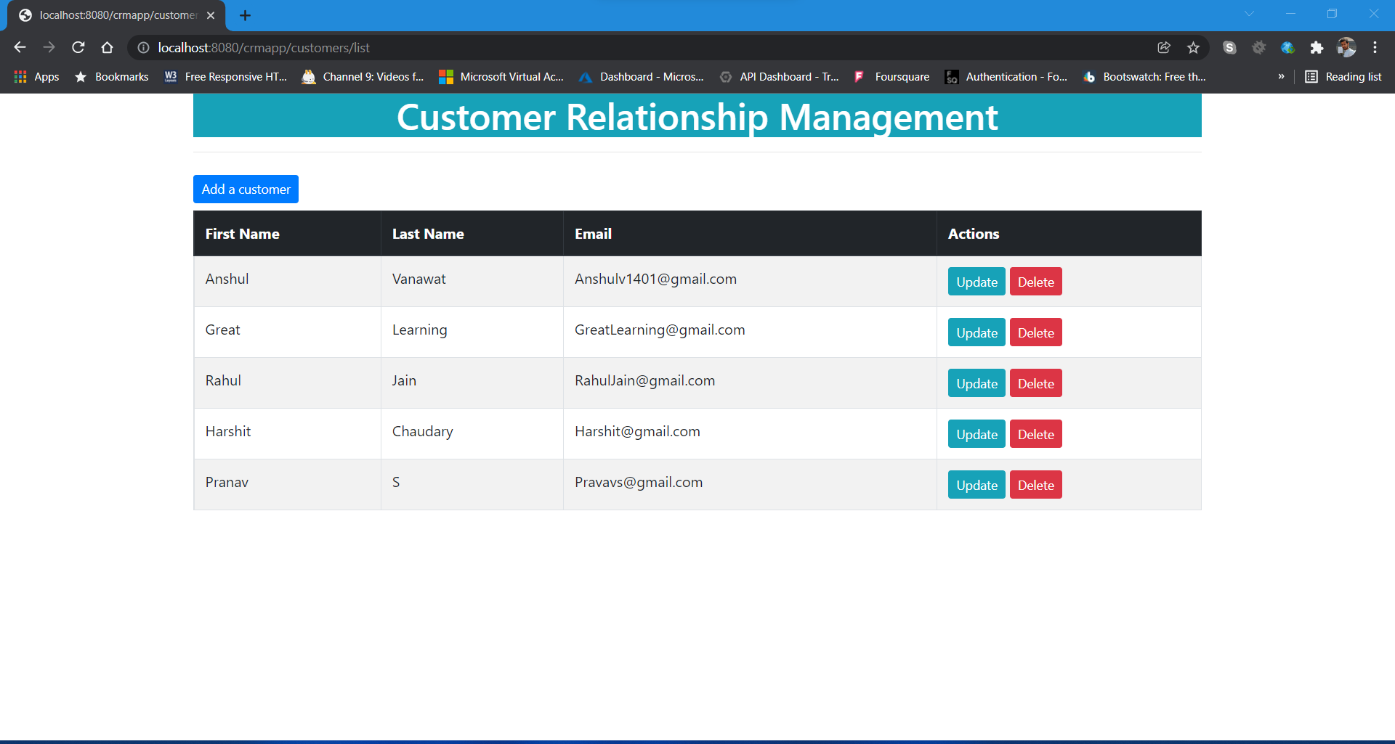
2)Main page – Customer list

Slide 4
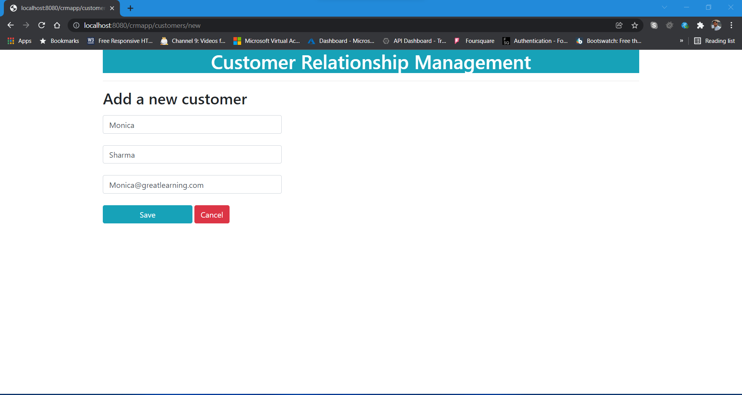
3) Add new customer

Slide 5
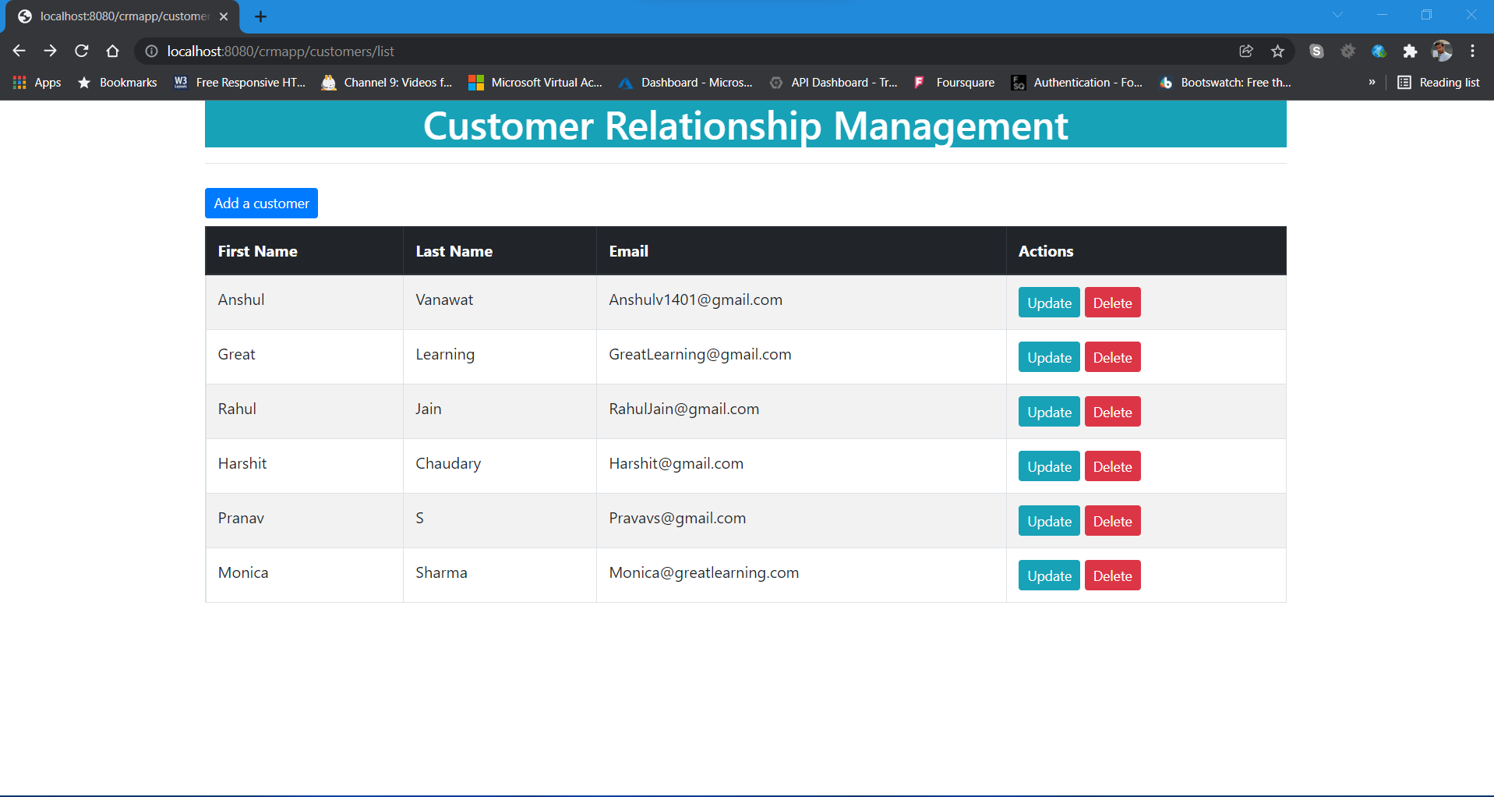
4) Added customer Successfully

Slide 6
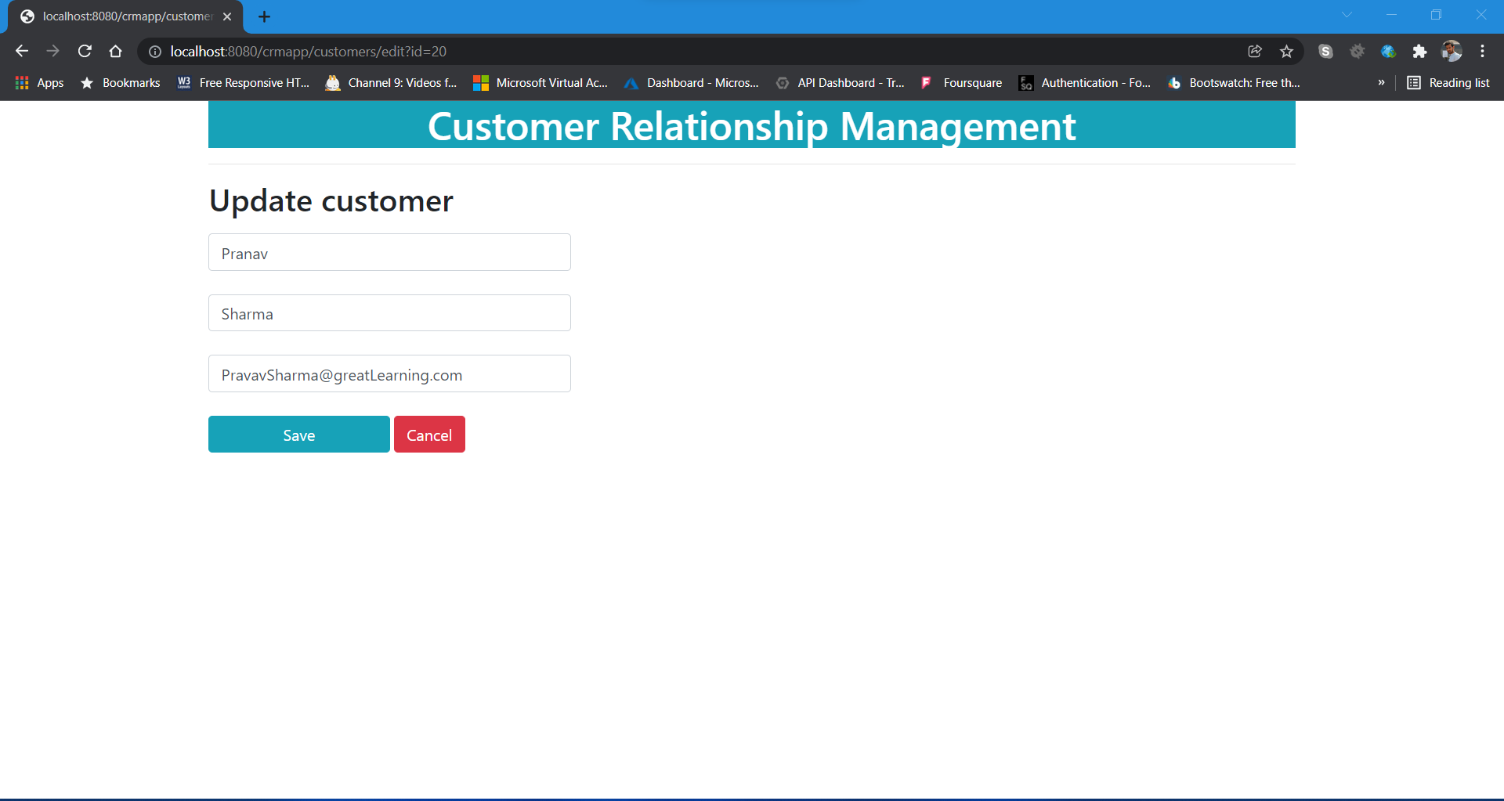
5) Update Customer

Slide 7

6) Updated Successfully (customer “Pranav”)

Slide 8
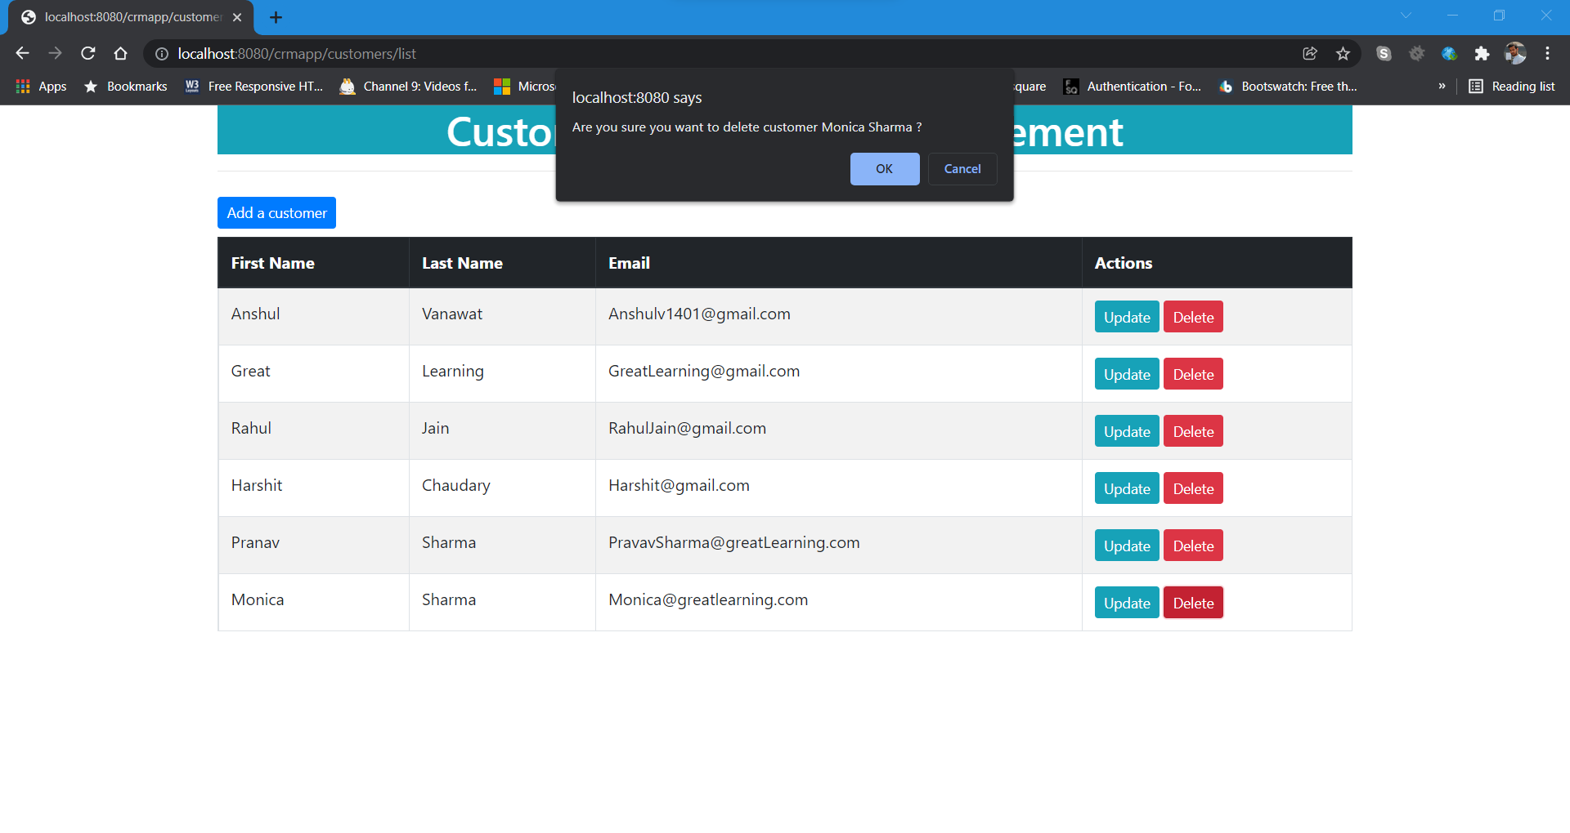
7) Delete customer

Slide 9
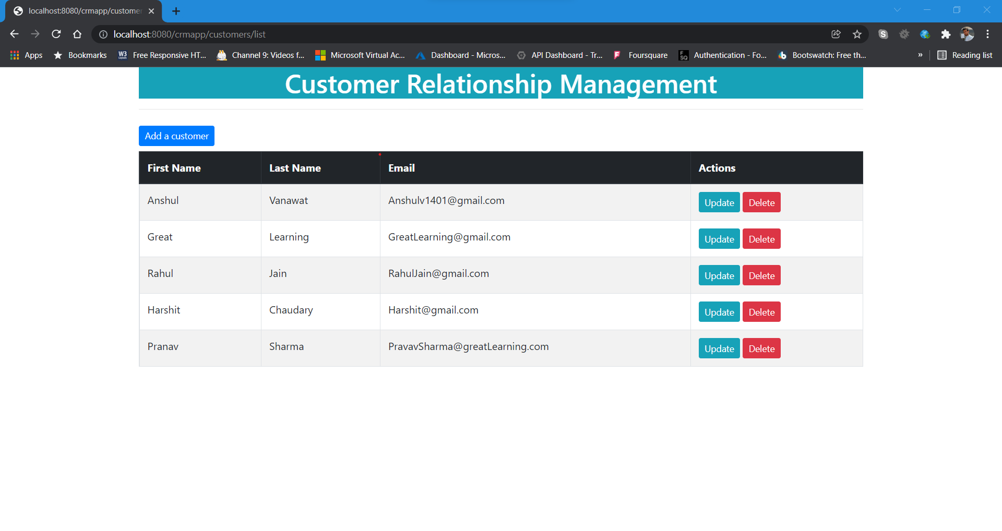
8) Customer Deleted Successfully

