Slide 1
MyChat
- Where People Connect

Slide 2
ABSTRACT
The Most important thing people need to heal, succeed, and thrive is “Human Connection”.
The Purpose of this software is to help people from any part of the world to connect with each other.
The conversations and data are totally Encrypted.
Sending and receiving various types of files is available.
MyChat uses Client-Server Technology/Socket Programming due to which you can communicate with people seamlessly.

Slide 3
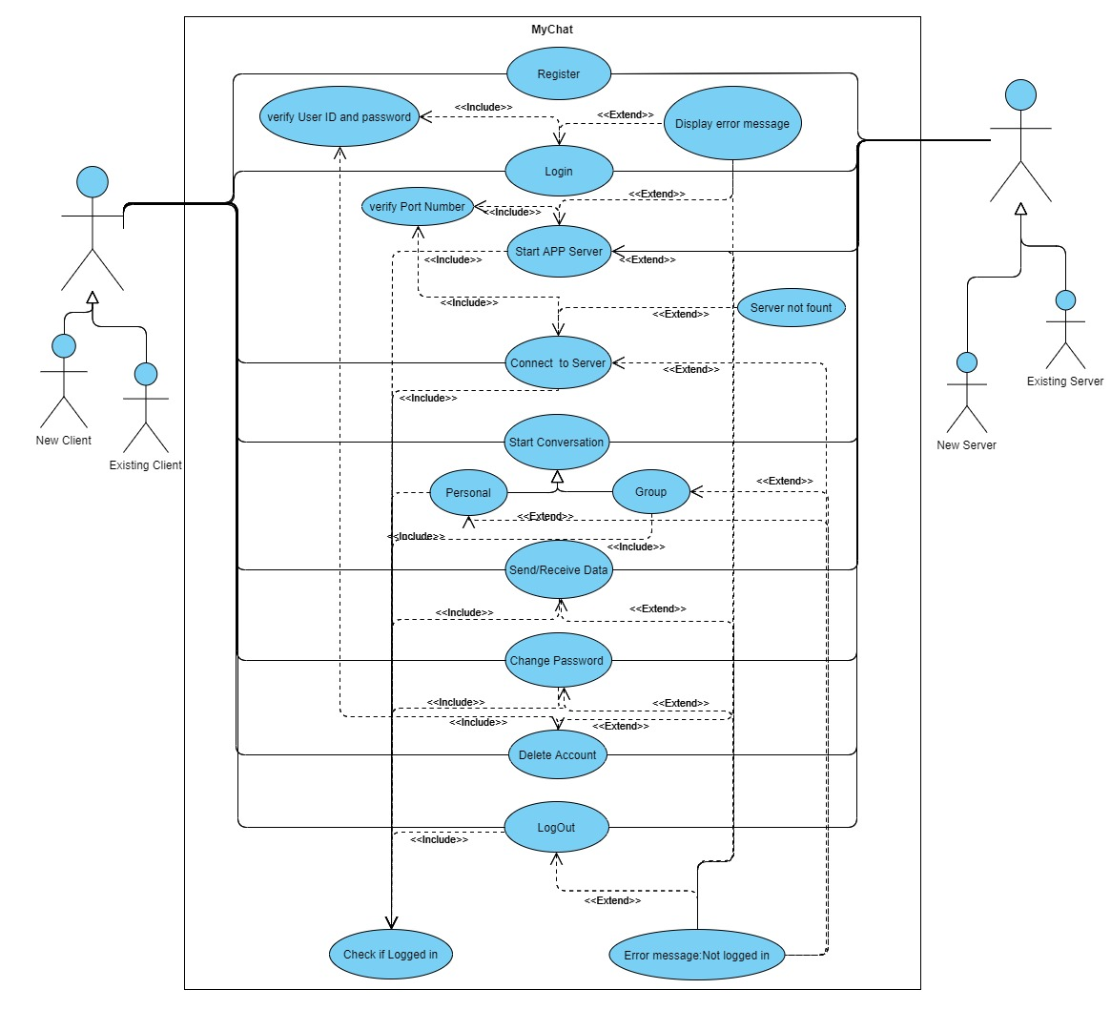
USE CASE DESCRIPTION

Slide 4
TECHNOLOGY USED
2.1 Software Requirements
Minimum supported client : Windows 8.1, Windows Vista
Minimum supported server : Windows Server 2003
Intel/Ryzen Processor
GCC Compiler
Libraries and Headers : ws2_32.lib and winsock2.h, ws2tcpip.h, pthread.h
2.2 Hardware Requirements
250-833 MHz of Processor Speed
200MB of Minimum Space
System Type : 32-bit or More
128MB RAM
Standard QWERTY serial or PS/2 keyboard.
Compatible Standard Mouse

Slide 5
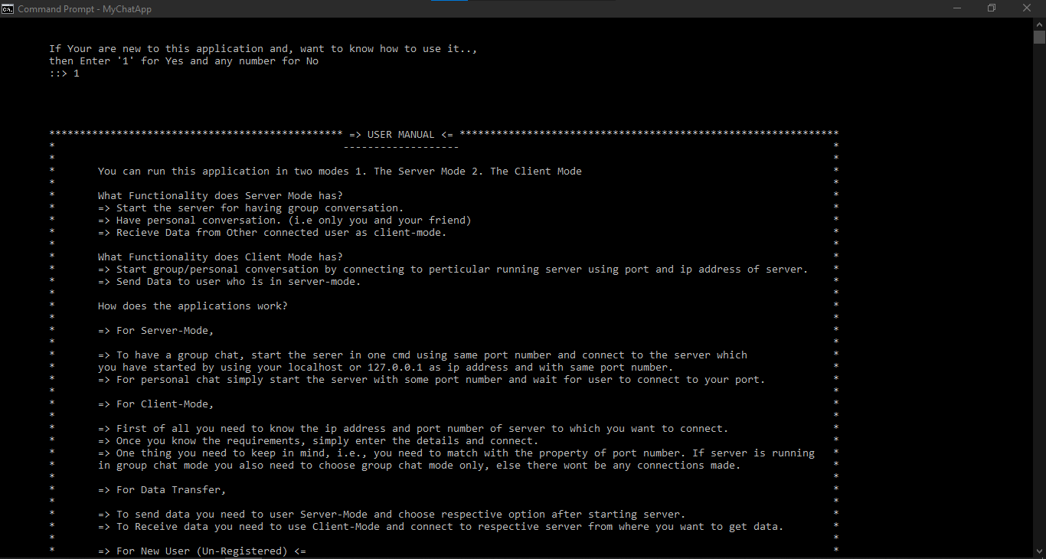
RESULTS

Slide 6
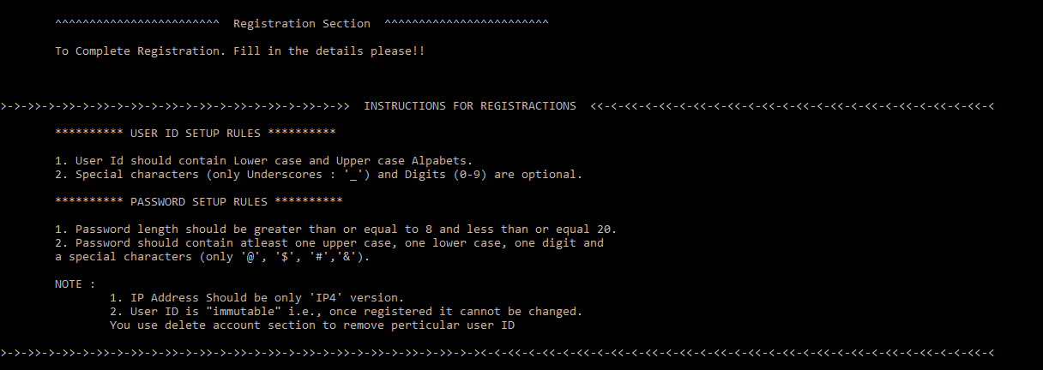

Slide 7
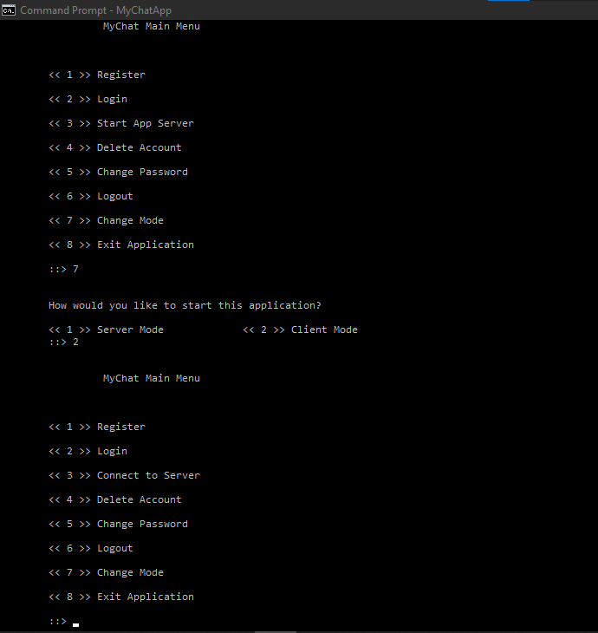

Slide 8
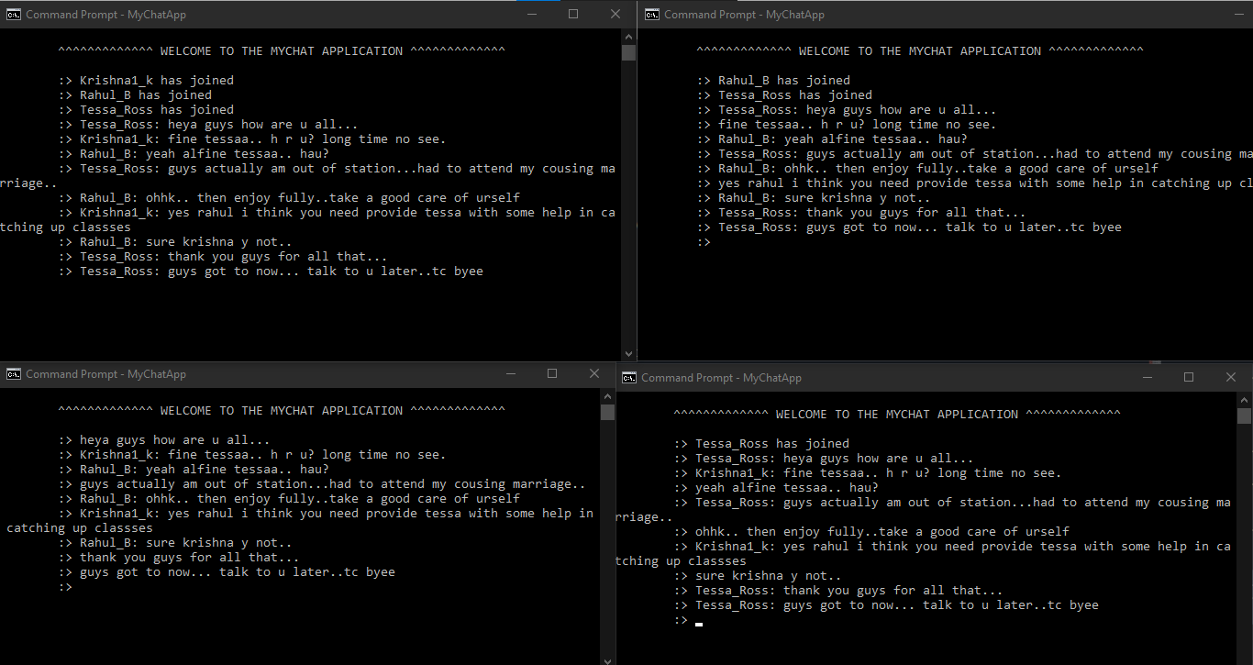

Slide 9
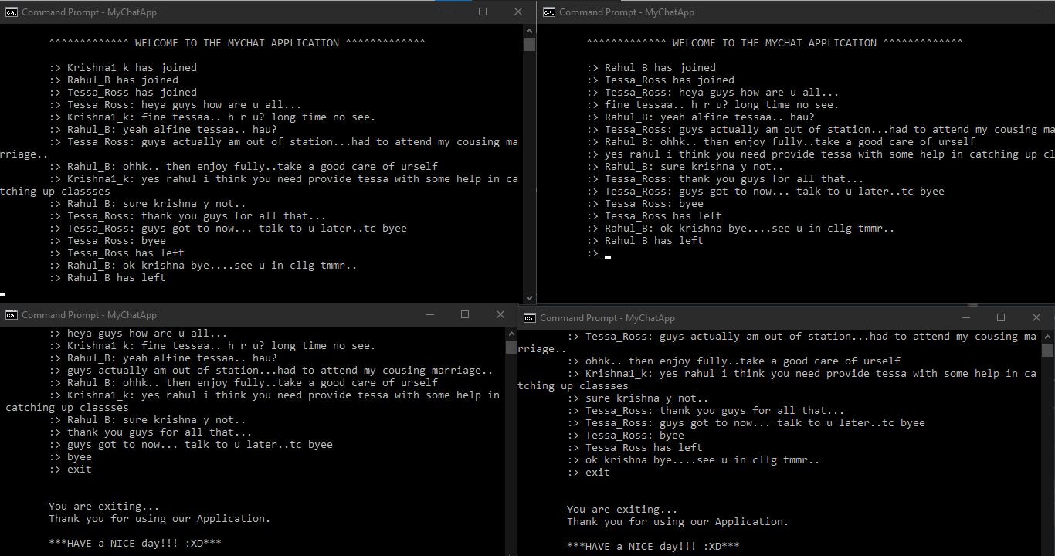

Slide 10
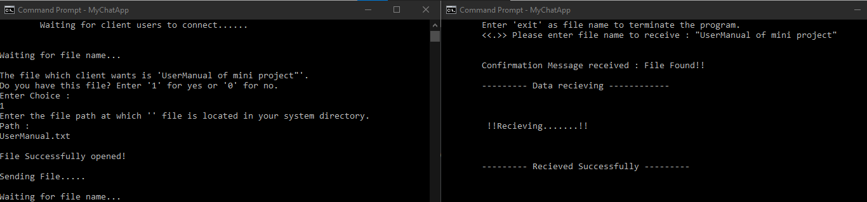

Slide 11
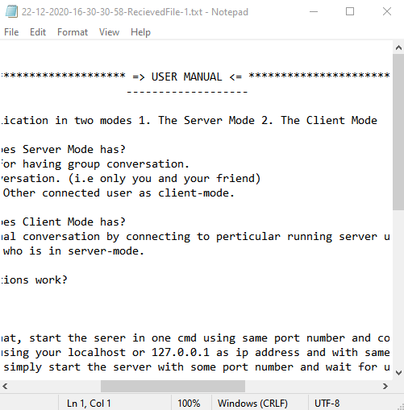

Slide 12
Conclusion And Future Work
Implementing and developing the MyChat Application - Mini project helped us to understand the one of the most robust feature that is Socket Programming technology in C which forms the basic for the Server-Client Connections in Networking field.
Understanding and analyzing the real time scenario’s and implementing/developing the application to solve the problem gave an effective way to apply the concepts that we have learnt. The fundamental and basic concepts which form the root for networking and system programming like Sockets Functionality, TCP/UDP Protocols, DNS networking concepts(basics), Multi - threading for Multiple Client-Single Server Connections.
The encryption algorithm that helped to code and decode the data while transferring data and handle client connections using threads except being other technologies like select and fork, since threading concept is applicable in most of the other programming languages which makes it as fundamental and robust way to handle works/parallel connections in networking.

Slide 13
Bachu Rahul(087) &
K.Krishna(077)
Team Mychat

