Slide 1

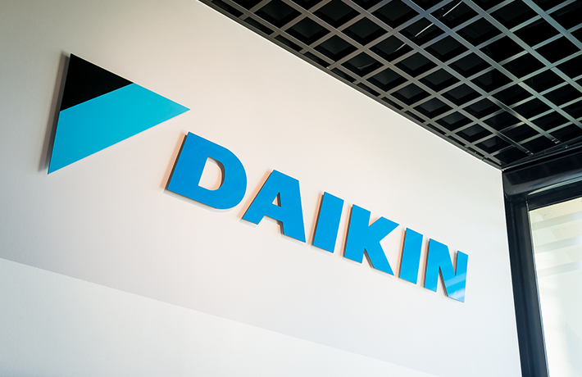
ERD FOR DAIKIN INDUSTRIES
INDUSTRY VISIT PROJECT
Project: Industry Visit at Daikin Industries
Objective: Create an Entity Relationship Diagram (ERD) for Daikin Industries
Focus: Modeling key business processes and data flow
Name - RAHUL BAJAJ
Roll No. - 055036
Section - K

Slide 2

PROBLEM STATEMENT
During the industry visit to Daikin Industries, our primary objective was to gain insights into the company's operational processes, particularly its data management practices. The challenge was to design an Entity Relationship Diagram (ERD) that accurately represents the company's data flow, covering critical aspects such as order processing, inventory management, customer interactions, supplier coordination, and production efficiency. By developing a well-structured ERD, we aim to enhance data organization, improve decision-making, and optimize overall operational workflows.

Slide 3




DATA AND ANALYSIS
Order Processing: Work orders are linked with production lines, inventory, and suppliers to ensure seamless manufacturing and timely delivery.
Supplier Coordination: Supplier data is stored and linked with inventory and production components to facilitate procurement.
Inventory Management: Inventory tracking is crucial for maintaining optimal stock levels and avoiding delays.
Production & Maintenance: Machines and production lines require regular maintenance logs and sensor data analysis to avoid breakdowns.
Employee Management: Employee details, roles, and shift schedules impact overall operational efficiency.
Quality Control: Quality checks are integrated within the workflow to maintain product standards and compliance.

Slide 4

OBSERVATIONS
A structured and well-defined database system is necessary to handle the complex relationships between different operational components.
Inventory and supplier management play a crucial role in optimizing production efficiency.
Automating work orders and integrating maintenance logs can prevent unexpected machine downtime.
Data redundancy should be minimized by implementing a normalized database schema.
Efficient tracking of quality control measures ensures that defective products do not reach customers.

Slide 5

INSIGHTS AND RECOMMENDATIONS
Database Management System Implementation: Implement a robust relational database system to ensure smooth data operations.
Automated Order Processing: Introduce automation in work order processing to reduce human errors and delays.
Inventory Optimization: Implement real-time inventory tracking to avoid shortages and overstocking.
Supplier Relationship Management: Develop a supplier performance tracking system to improve procurement efficiency.
Maintenance Scheduling System: Automate machine maintenance tracking to reduce downtime and increase productivity.
Data Security & Integrity: Implement access control measures to ensure sensitive data is protected from unauthorized access.

Slide 6
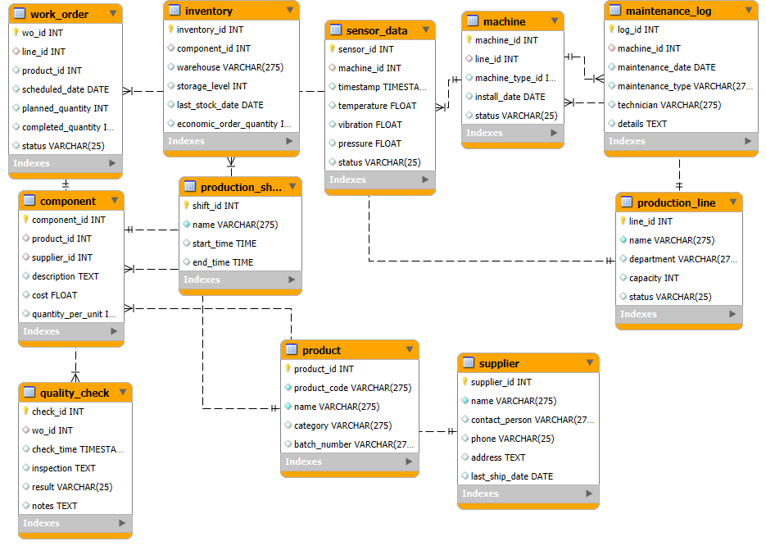

ERD DIAGRAM

