Slide 1

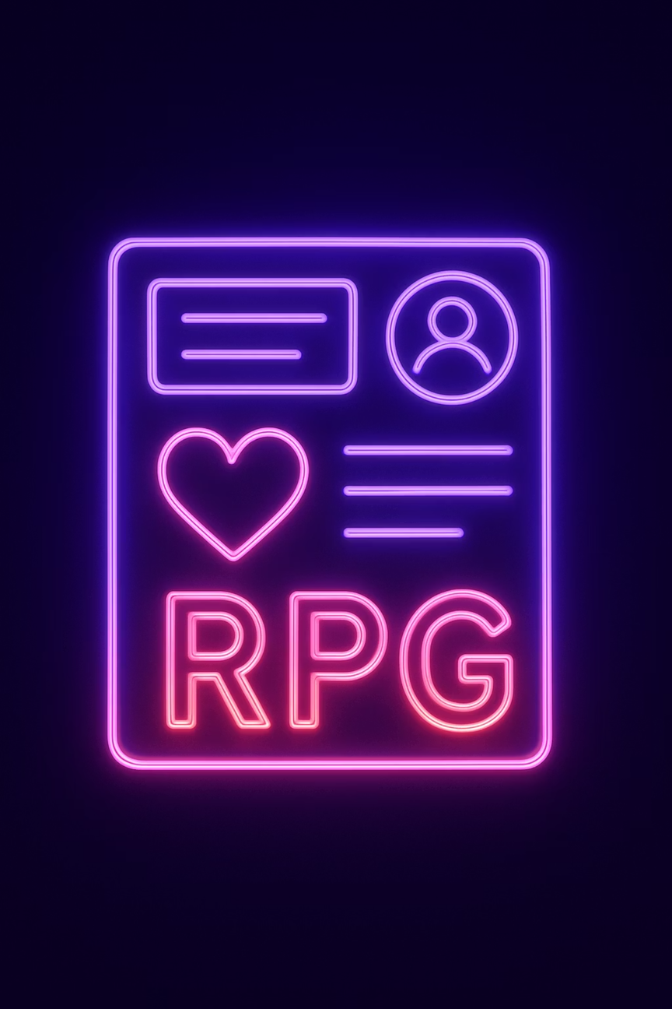
🎮 LifeRPG - Gamify Your Life!
⚔️ Transform Your Daily Tasks into Epic Adventures ⚒️
Notes:
1.7.2013
1
‹#›

Slide 2
Problem Statement ⚠️
Modern social media platforms often promote time-wasting habits, reduce productivity, and expose users to unrealistic or low-value content.
At the same time, traditional productivity tools lack engagement and fail to motivate consistent action.
There is a need for an interactive, meaningful system that replaces passive consumption with active self-improvement while effectively tracking real-life progress.
Notes:
1.7.2013
1
‹#›

Slide 3
Our Solution
LifeRPG addresses the problems through following ways:
Replaces passive scrolling with active growth: Converts real-life tasks into quests, shifting users from consuming content to building habits.
Gamified motivation system: XP, stars, and skill progression (intelligence, strength, discipline, charisma) make productivity engaging and rewarding.
Meaningful social interaction: Users share real achievements instead of fake or low-value content, creating a positive community.
Consistency through structure: Daily challenges, progress tracking, and level-based progression encourage long-term discipline and habit building.
Notes:
1.7.2013
1
‹#›

Slide 4
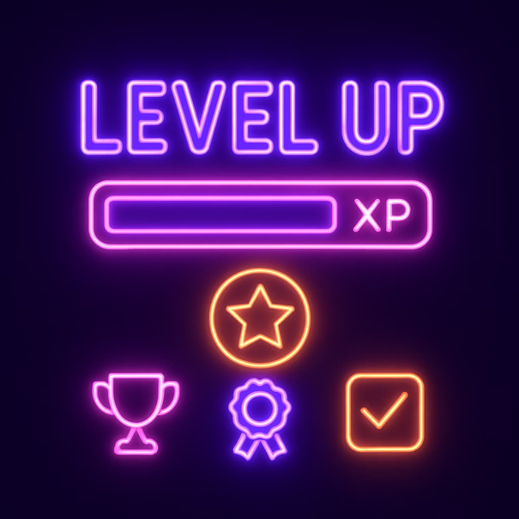







What is LifeRPG?
A Revolutionary Gamified Life Manager 🎯
LifeRPG transforms boring routines into exciting RPG quests, making personal development addictive and fun. Turn everyday tasks into epic adventures with XP rewards, level-ups, global competition and exciting coupon rewards.
Gamification Engine 💡
Progression System 🏆
Social Competition 👥
Transform tasks into quests with XP rewards
50-level RPG-style leveling with stat boosts
Real-time leaderboard and achievements
Notes:
1.7.2013
2
‹#›

Slide 5









🚀 Key Features That Level Up Your Life
Secure Authentication
XP & Leveling System
Dynamic Quest Pool
Custom avatars, personalized profiles, and password recovery system
Animated progress bars, level-up rewards, and 50-level progression
5 daily quests from curated pool, smart selection, main quests for goals
Character Stats
Real-time Leaderboard
Mage Guide System
Strength, Intelligence, Discipline, Charisma with visual tracking
Global rankings and competitive gameplay
Interactive companion with contextual tips throughout your journey
Chronicles System
Coupon Marketplace
Enterprise Portal
Posts with images, WYSIWYG editor, likes, comments, and quest integration
Fantasy-themed reward marketplace where users redeem brand discount coupons using LifeRPG coins earned through real-life achievements.
merchant dashboard for brands to create, manage, and track coupon campaigns, redemptions, and user engagement.
Notes:
1.7.2013
3
‹#›

Slide 6



🛠️ Technology Stack 🎨
🎨 Frontend Technologies
🚀 Backend Technologies
⚛️ React (Vite)
🎨 Tailwind CSS
🟢 Node.js
🚂 Express.js
Modern UI framework with blazing fast performance
Utility-first styling for rapid development
JavaScript runtime for server-side logic
Web framework for RESTful API endpoints
🍃 MongoDB
🔐 JWT + 🔒 bcrypt
✨ Framer Motion
📡 Axios
NoSQL database for flexible data storage
API communication and data handling
Secure authentication and password hashing
Smooth animations and micro-interactions
Notes:
1.7.2013
4
‹#›

Slide 7
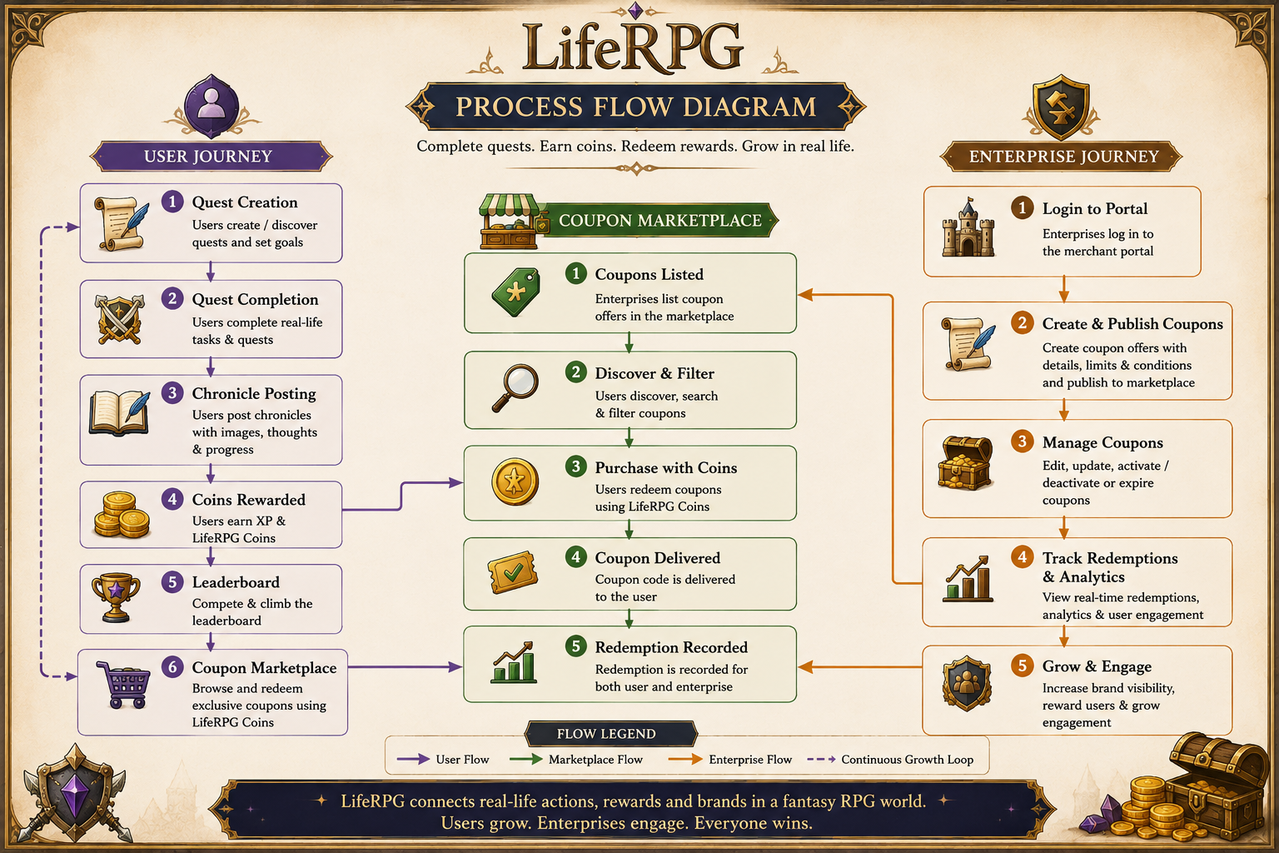
Notes:
1.7.2013
5
‹#›

Slide 8
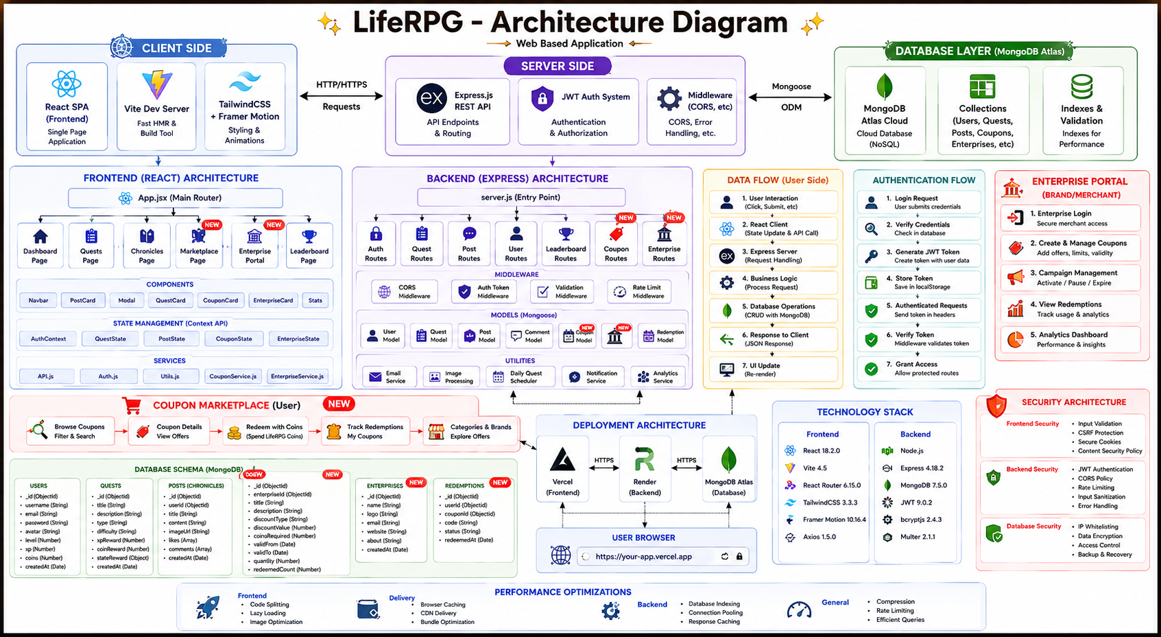
Notes:
1.7.2013
6
‹#›

Slide 9




Core Functionality Deep Dive
XP System Calculation 📈
Quest Pool Engine 📋
Mage Guide🧙‍♂️
Chronicles System 📄
Dynamic XP calculations based on quest difficulty, completion time, and skill bonuses. 50-level progression with tiered boosts (0% to 25%) at milestone levels.
Smart algorithm selects 5 daily quests from 25 curated options using date-based seeding. Main quests track long-term goals with skill-based rewards.
Contextual tips and interactive companion provides guidance throughout user journey.
Advanced WYSIWYG editor with 16:9 cropping, perfect pixel-perfect images, likes, comments with replies, and quest achievement sharing.
Notes:
1.7.2013
7
‹#›

Slide 10


🎨 UI/UX Design Philosophy 🌙
Dark Gaming Theme 🌙
Responsive Design 📱
Immersive cyberpunk aesthetics with neon purple, pink, and blue accents throughout the interface
Desktop, tablet, and mobile compatibility with adaptive layouts and touch-friendly interactions 👆
Smooth Animations ✨
Framer Motion-powered transitions, hover effects, loading spinners, and animated level-ups
Notes:
1.7.2013
8
‹#›

Slide 11




🌟 Impact & Use Cases
🎓 Education Sector
💼 Professional Development
Study motivation and progress tracking 📚
Assignment completion gamification 📝
Learning habit formation 🎯
Skill acquisition tracking 💪
Project management gamification 📋
Career goal achievement 🚀
🏃 Personal Growth
👥 Social Applications
Fitness and health habit tracking 🏃‍♂️
Mindfulness and meditation practice 🧘‍♀️
Reading and learning goals 📖
Team challenges and collaboration 🤝
Community achievements 🏆
Friendly competition 🎮
Notes:
1.7.2013
9
‹#›

Slide 12
🚀 Future Roadmap & Next Steps 🎯
✅ Current Advantages
🔮 Future Enhancements
📈 Increased Engagement
📱 Mobile App
Gamification drives motivation and habit formation
React Native with push notifications 🔔 and offline mode
🤖 AI Integration
👥 Community Building
Smart quest suggestions and adaptive difficulty
Leaderboard competition and shared achievements
👥 Enhanced Social
📱 Web-Based Access
Guilds, team quests, real-time chat 💬
No installation, works on any device
🔗 Integrations
Calendar, productivity tools, wearables ⌚
Notes:
1.7.2013
10
‹#›

