Slide 1

FINAL YEAR PROJECT
A
Project Presentation
on
Project Title
Presented By
Name of Students (Roll No) N
ame of Students (Roll No)
Name of Students (Roll No)
Guided By
Name of Guide
Designation
Department of ..................Name of Department......
ITS Engineering College , Greater Noida
Dr. A.P.J. Abdul Kalam Technical University, Lucknow, Uttar Pradesh

Slide 2
Outline
Alignment with UN Sustainable Development Goals (SDGs)
Introduction
Liturature Survey
Research Gap
Project Objectives
Problem statement
Proposed Work /Methodology
System Design
Implementation Details
Result and Analysis
Conclusion
References
Appendix

Slide 3
Alignment with UN Sustainable Development Goals (SDGs)
Alignment of Project with SDG No... & SDG No...
SDG 9 – Industry, Innovation & Infrastructure
Goal: Build resilient infrastructure, promote inclusive and sustainable industrialization, and foster innovation.
Project Relevance & Contribution:
Encourages technological innovation through the use of LSTM-based Deep Learning for intelligent sales prediction.
Builds digital infrastructure by integrating AI with social media and sales data for real-time business insights.
Supports data-driven decision-making, reducing dependence on manual or outdated analytical methods.
Promotes sustainable industrialization by helping companies use marketing resources efficiently and reduce waste.
Contributes to the development of AI-driven tools, strengthening industrial and research capabilities.
Impact Highlights:
Fosters innovation in AI and analytics
Enhances efficiency in digital marketing and retail
Builds intelligent and scalable business infrastructure

Slide 4
Alignment with UN Sustainable Development Goals (SDGs)
Summary
Focus Area | SDG Target (Code & Summary) | Project Contribution
Innovation & Research | SDG 9.5 – Promote research and innovation in industry. | Implements AI (LSTM) for predicting social media impact on sales, fostering technological innovation and research in marketing analytics.
Digital Infrastructure | SDG 9.1 – Develop reliable and sustainable infrastructure. | Builds a data-driven digital system integrating social media and sales data for smarter, real-time business decisions.
Economic Growth | SDG 8.2 – Improve productivity through technology and innovation. | Enhances marketing efficiency and sales prediction, supporting sustainable business growth and productivity.
Skill Development | SDG 8.6 – Promote skill development and employment. | Encourages AI & data science learning, preparing youth for future-ready digital jobs.

Slide 5
Introduction
Social media platforms have become a powerful driver of consumer purchasing decisions.
Brands rely heavily on user-generated content, reviews, likes, shares, and influencer posts to impact product sales .
Understanding the relationship between social media engagement and sales is crucial for businesses .
Deep Learning provides advanced techniques to analyze massive unstructured data (text, images, hashtags, sentiment).
This project aims to predict and measure the influence of social media activity on product sales using deep learning model.
Example: Nike’s influencer campaigns achieved over 2.3 million impressions with an engagement rate of 8.7%, driving strong brand visibility and conversions.

Slide 6
Literature Survey
Tan, Y. (2025). [6] Sales data on social media platforms exhibit characteristics of high dimensionality, strong nonlinearity, and multiple cycles. Traditional time series models (such as ARIMA and SARIMA) can handle trends and seasonal changes, but their eﬀectiveness is limited when dealing with complex variable interactions. Over the years, DL methods based on recurrent neural networks have become mainstream.
Sharma, A., Patel, N., & Gupta, R. (2022). [7] LSTM networks, a type of recurrent neural network (RNN), have proven their eﬀicacy in time series forecasting due to their ability to model long-term dependencies and manage sequential data (Hochreiter & Schmidhuber, 1997). Their architecture, which includes forget, input, and output gates, allows them to better capture temporal dynamics, making them suitable for sales prediction where historical patterns significantly influence future outcomes.
P. Yadav, C. R. Barde [1] states that a framework that integrates Bidirectional Long Short-Term Memory (BiLSTM) and Word2Vec for analyzing social media data to better align supply with real-time demand trends. This method effectively captured consumer sentiment and external influencers but encountered challenges related to the high volume of unstructured data and computational overhead. Similarly proposed a hybrid machine learning system that combines Graph Convolutional Networks (GCN), Long Short-Term Memory (LSTM), and attention mechanisms to optimize inventory through the analysis of temporal patterns and supply chain relationships. However, the complexity and resource requirements of their approach pose challenges for practical implementation in small or medium-sized enterprises.

Slide 7
Literature Survey
Kasemrat, R., & Kraiwanit, T. (2025) . [3] With the growing complexity of consumer data, Long Short-Term Memory (LSTM) networks have emerged as robust solutions for capturing temporal dependencies. and developed LSTM specifically to manage the long-term dependencies inherent in sequential data. This makes LSTM suitable for e-commerce, where customer behaviour evolves over time and requires nuanced understand. However, despite LSTM's predictive capabilities, its “black box” nature has driven researchers to enhance it with mechanisms that improve interpretability, such as Explainable AI (XAI) techniques.
Sharma, A., Patel, N., & Gupta, R. (2022). [7] provide an extensive evaluation of LSTM structures, underscoring their robust-ness in handling vanishing gradient problems common in traditional RNNs. Several studies have demonstrated LSTM’s capability in financial time series forecasting, showcasing improved performance over conventional methods. Tan, Y. (2025). [6] These studies indicate that the integration of visualization improves prediction accuracy while notably enhancing user trust and interpretability. This ﬁnding aligns with the approach in this study that combines multi-layer LSTM with dynamic heatmaps and feature weight visualization, conﬁrming the visualization tools’ keyrole in improving interpretability.

Slide 8
Research Gap
Integration Challenge : Most studies focus either on sentiment analysis or sales forecasting, but not both together in a unified framework . Lack of integration leads to incomplete understanding of how customer opinions + engagement patterns drive sales .
Limited Multi-Modal Analysis :Social media data includes text (reviews, comments), images (product photos, ads), and engagement metrics (likes, shares).Existing models usually handle only one data type, reducing prediction accuracy.
Real-Time Decision Making Gap:Current models often analyze data in batches (offline), not in real-time . Marketers need instant insights during campaigns to adjust strategies dynamically.
Explainability & Trust Deficit :Deep learning models (LSTM, BiLSTM) provide accurate predictions but function as a black box.Without clear explanation of feature contributions, businesses hesitate to adopt them.
Scalability & Resource Constraints : Complex hybrid models (e.g., GCN + LSTM + Attention) are powerful but computationally expensive, making them impractical for SMEs and startups.

Slide 9
Project Objectives
Integration Challenge : Most studies focus either on sentiment analysis or sales forecasting, but not both together in a unified framework . Lack of integration leads to incomplete understanding of how customer opinions + engagement patterns drive sales .
Limited Multi-Modal Analysis :Social media data includes text (reviews, comments), images (product photos, ads), and engagement metrics (likes, shares).Existing models usually handle only one data type, reducing prediction accuracy.
Real-Time Decision Making Gap:Current models often analyze data in batches (offline), not in real-time . Marketers need instant insights during campaigns to adjust strategies dynamically.
Explainability & Trust Deficit :Deep learning models (LSTM, BiLSTM) provide accurate predictions but function as a black box.Without clear explanation of feature contributions, businesses hesitate to adopt them.
Scalability & Resource Constraints : Complex hybrid models (e.g., GCN + LSTM + Attention) are powerful but computationally expensive, making them impractical for SMEs and startups.

Slide 10
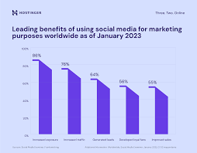
Problem Statement
Businesses invest heavily in social media marketing, yet measuring its true impact on sales and engagement remains challenging.
Traditional models fail to capture sequential patterns in customer behavior, while the fast-paced nature of online interactions complicates the link between engagement metrics and actual sales.
Moreover, limited explainability in deep learning models reduces marketers’ trust.
Hence, there is a need for a robust LSTM-based framework that enhances prediction accuracy and provides interpretable insights into customer engagement and sales impact.
2025 Social Commerce Statistics

Slide 11
Proposed Work
2 -3 Slides (with Diagram)

Slide 12
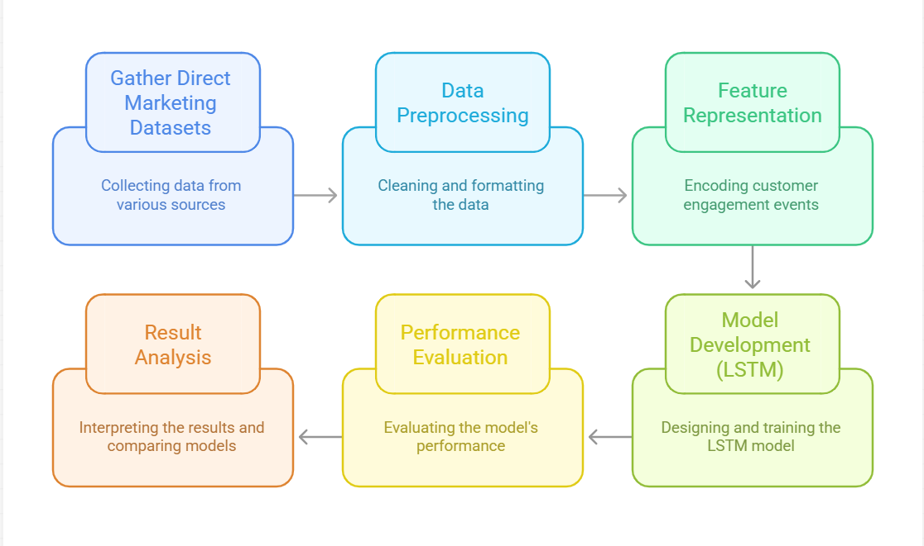
Proposed Architecure/ Methodology
Fig.1. Flowchart Depicting Proposed Architecure

Slide 13
System Design
2-3 Slides (as Required)
Fig.1. ..............e

Slide 14
Implementation Details
3-5 Slides (as Required)
Fig.1. ..............e

Slide 15
Result and Analysis
•1-2 Slides ( with Tables/ chart/ graphs )
Model Performance Evaluation: We used a Bidirectional LSTM model because, unlike a standard LSTM that only looks at past data, BiLSTM processes the sequence both forward and backward.
This means it not only understands how past user interactions influence future sales, but also how future patterns or trends can provide context for earlier data points.
Results:
To evaluate our model’s performance, we used key statistical measures that show how well the predictions align with real sales data:
Strong positive correlation (r = 0.82) between predicted and actual sales.
R2 Score = 0.9620 (captures fluctuations/variance in sales is captured by the model)
RMSE(Root Mean Squared Error) = 6.5% (very low prediction error)
Average Sales= 75847.19
Overall, a strong correlation (r=0.82), high R² (0.962), and low RMSE (6.5%) together confirm that our BiLSTM model accurately captures real sales behavior, with minimal deviation from actual performance.

Slide 16
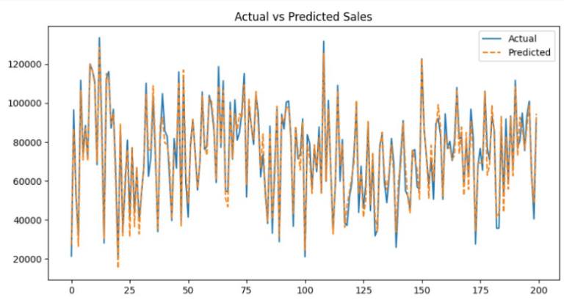
Result and Analysis
Analysis:
Figure 1: The pie chart displays how different platforms contribute to overall sales impact:
Instagram contributes the highest share at 45%
YouTube follows with 35%
Facebook accounts for 20%
Figure 2: This graph compares the actual sales values (in blue) with the sales predicted by our BiLSTM model (in orange)
Close alignment indicates that our modeleffectively captures sales trends, seasonality, and temporal patterns, resulting in high prediction accuracy and low error.

Slide 17
Conclusion & Future Work
Conclusion
1-2 Slids ( with Limitation & Future scope)

Slide 18
Conclusion & Future Work
Conclusion
1-2 Slids ( with Limitation & Future scope)

Slide 19
References
[1]. P. Yadav, C. R. Barde. Retail Real-Time Sales Prediction System Using LSTM and XGBoost
[2]. Kasemrat, R., & Kraiwanit, T. (2025). Attention-Enhanced LSTM for High-Value Customer Behavior Prediction: Insights from Thailand’s E-Commerce Sector. Intelligent Systems with Applications, 200523.
[3]. Tan, Y. (2025). E-commerce Sales Prediction and Analysis Based on Multi-layer LSTM and Interactive Visualization Techniques. International Journal of High Speed Electronics and Systems, 2540898.
[4]. Sharma A., Patel, N., & Gupta, R. (2022). Enhancing Predictive Sales Analytics Using LSTM Networks and Random Forest Algorithms. European Advanced AI Journal, 11(8).
[5]. Gegeleso, B., & Ebiesuwa, O. (2025). Comparative Analysis of Random Forest and LSTM Models for Customer Churn Prediction Based on Customer Satisfaction and Retention. Indonesian Journal of Data and Science, 6(2), 313-323.
[6]. Bozbura, M., Tunç, H. C., Kusak, M. E., & Sakar, C. O. (2019, January). Detection of e-Commerce Anomalies using LSTM-recurrent Neural Networks. In DATA (pp. 217-224).

Slide 20
References
[7]. Ebrahimi, P., Basirat, M., Yousefi, A., Nekmahmud, M., Gholampour, A., & Fekete-Farkas, M. (2022). Social networks marketing and consumer purchase behavior: the combination of SEM and unsupervised machine learning approaches. Big Data and Cognitive Computing, 6(2), 35.
[8]. Dai Y, & Huang, J. (2021, February). A sales prediction method based on lstm with hyper-parameter search. In Journal of Physics: Conference Series (Vol. 1756, No. 1, p. 012015). IOP Publishing.
[9]. Xu G., Ren, M., Wang, Z., & Li, G. (2024). MEMF: Multi-entity multimodal fusion framework for sales prediction in live streaming commerce. Decision Support Systems, 184, 114277.
[10]. Sarkar M., & De Bruyn, A. (2021). LSTM response models for direct marketing analytics: Replacing feature engineering with deep learning. Journal of Interactive Marketing, 53(1), 80- 95.
[11]. Zhang L., & Wei, Q. (2024). Personalized and contextualized data analysis for E-commerce customer retention improvement with Bi-LSTM churn prediction. IEEE Transactions on Consumer Electronics.
[12]. Hooshmand Pakdel, G., He, Y., & Chen, X. (2025). Predicting customer demand with deep learning: An LSTM-based approach incorporating customer information. International Journal of Production Research, 1-13.

Slide 21
Appendix
CONTRIBUTION OF PROJECT
1. Objective and Relevance of Project | 250 – 500 words
2. Technical Novelty and Utility | 250 – 500 words
3. Expected Outcome/Deliverables *For VIII Sem it would be Deliverables | 250 words
4. Paragraph on following concerns related to Project
4a. Social Relevance | 250 words
4b. Environmental Sustainability | 250 words
4c. Ethical, Legal and Cultural Aspect | 250 words

Slide 22
Thank You

