Slide 1

FINAL YEAR PROJECT
A
Project Presentation on
ARVA AI
Autonomous Decision Intelligence System
Presented By
Rahul Bhardwaj(2302220100143)
Sakshi Sharma(2302220100162)
Rishabh Verma(2302220100152)
Sambhawna Bajpei(2402220109010)
Guided By
Ms. Anuradha Yadav
Department of Computer Science & Engineering
ITS Engineering College, Greater Noida
Dr. A.P.J. Abdul Kalam Technical University, Lucknow, Uttar Pradesh
Notes:
[Sources]
Internal source: README.md — ARVA AI project scope and positioning.

Slide 2
Outline
1. Sustainable Development Alignment
2. Introduction & Literature Survey
3. Research Gap & Objectives
4. Problem Statement
5. Proposed Work & Methodology
6. System Architecture & Implementation
7. Results and Analysis
8. Conclusion & Future Work
9. References & Project Contribution
Notes:
[Sources]
Internal source: README.md and docs/architecture.md.

Slide 3
Alignment with UN Sustainable Development Goals (SDGs)
ARVA AI aligns with resilient, innovative and sustainable digital infrastructure.
SDG 9 — Industry, Innovation & Infrastructure
ARVA AI advances resilient digital infrastructure by turning telemetry, forecasting and constrained optimization into explainable AI-infrastructure decisions. Its simulation-first digital twin enables safe experimentation before operational rollout.
SDG 8 — Decent Work & Economic Growth
By reducing manual incident triage and improving use of expensive GPU capacity, the system supports more productive technical operations and responsible growth of AI-enabled work.
SDG 13 — Climate Action
Energy, power and cost are part of each plan evaluation, making resource-aware scheduling visible and governable.
SDG 9 — Industry, Innovation & Infrastructure
ARVA turns telemetry, forecasting and constrained optimization into explainable AI-infrastructure decisions. Its simulation-first digital twin enables safe experimentation before operational rollout.
SDG 8 & SDG 13
Better use of costly GPU capacity supports productive technical work, while cost, power and energy are evaluated with every plan.
Notes:
[Sources]
Internal source: README.md; docs/architecture.md; docs/optimization.md.
External context: United Nations Sustainable Development Goals, https://sdgs.un.org/goals

Slide 4
ARVA AI — Sustainable Development Contribution
Summary
Focus Area | SDG Target | ARVA AI Contribution
Innovation | SDG 9.5 — research & innovation | Applies forecasting, policy validation and CP-SAT optimization to GPU infrastructure.
Digital Infrastructure | SDG 9.1 — resilient infrastructure | Uses a persistent digital twin to test disruptions, recovery and replanning safely.
Resource Efficiency | SDG 8.2 — productivity | Compares scheduling alternatives using cost, queue, SLA and efficiency outcomes.
Climate Awareness | SDG 13.3 — climate action | Includes power and energy estimates in governed infrastructure decisions.
Notes:
[Sources]
Internal source: docs/architecture.md; docs/optimization.md.
External context: United Nations Sustainable Development Goals, https://sdgs.un.org/goals

Slide 5
Introduction
AI infrastructure teams must decide where workloads run, when to replan and how to recover from failure — often under cost, capacity and policy pressure.
Traditional observability shows utilization and alerts, but leaves the decision to the operator.
ARVA AI is a simulation-first autonomous decision-intelligence control plane. It observes a persistent GPU digital twin, forecasts demand, detects operational risk, compares plans, validates policy and records outcomes.
The central question: not only “What is happening now?” but “What should happen next — and why?”
Notes:
[Sources]
Internal source: README.md — product positioning and included scope.

Slide 6
Literature Survey
Cluster management research shows that resource allocation is more than simple placement.
Borg demonstrated policy-aware cluster management at very large scale, combining admission control, packing, monitoring and simulation tools.
Tiresias focused on distributed deep-learning jobs, where uncertain duration, multi-GPU demand and queue delay make general schedulers insufficient.
  Gavel showed why hardware heterogeneity matters: different models perform differently across accelerator types, so allocation policy must be heterogeneity-aware.
  These works motivate ARVA AI’s combination of workload evidence, constrained placement and alternative-plan evaluation.
Notes:
[Sources]
External sources:
Verma et al. (2015), Borg — https://research.google/pubs/large-scale-cluster-management-at-google-with-borg/
Gu et al. (2019), Tiresias — https://www.usenix.org/conference/nsdi19/presentation/gu
Narayanan et al. (2020), Gavel — https://arxiv.org/abs/2008.09213

Slide 7
Literature Survey
Literature Survey
ARVA AI translates research lessons into an operator-facing decision loop.
A digital twin creates a safe, deterministic environment for forecasting demand, testing failures and evaluating recovery.
Instead of exposing a single opaque scheduling result, ARVA evaluates five heuristics plus an OR-Tools CP-SAT alternative under the same workload state.
Every candidate plan carries objective values, policy violations, rationale and expected outcome.
The design joins optimization quality with explainability, governance and replayable evidence.
From cluster research to an operator-facing decision loop
Digital twin — a safe deterministic environment for forecasting demand, testing failures and evaluating recovery.
Alternative plans — five heuristics plus OR-Tools CP-SAT are evaluated under the same workload state.
Governed outcome — every candidate carries objective values, policy checks, rationale and expected impact.
Notes:
[Sources]
Internal source: docs/architecture.md; docs/optimization.md.
External source: Google OR-Tools CP-SAT documentation — https://developers.google.com/optimization/cp/

Slide 8
Research Gap
Operational gap: Existing infrastructure dashboards reveal utilization and incidents, but do not explain the best next action.
Optimization gap: A scheduler may generate a placement, yet operators need alternatives that expose trade-offs among cost, queue delay, SLA and energy.
Governance gap: Automated actions need explicit policy checks, approval gates, role-based access and an immutable audit trail.
Safety gap: Connecting experimental AI directly to production clusters creates operational risk.
ARVA AI addresses these gaps through a simulation-first, closed-loop control plane that keeps decisions measurable, explainable and governed.
Notes:
[Sources]
Internal source: README.md; docs/architecture.md; docs/optimization.md.

Slide 9
Project Objectives
1. Model a persistent, heterogeneous GPU fleet as a deterministic digital twin.
2. Produce demand forecasts and evidence-backed capacity, queue, cost and reliability risks.
3. Compare FIFO, priority, fair-share, bin-packing, deadline-aware and CP-SAT plans on a common state.
4. Enforce policy guardrails across simulation, recommendation, approval and controlled-autonomous modes.
5. Give operators a complete decision trail: alternatives, rationale, actor, execution state and measured outcome.
6. Demonstrate disruption recovery and repeatable scheduler evaluation.
Notes:
[Sources]
Internal source: README.md; docs/architecture.md; docs/optimization.md; docs/demo.md.

Slide 10
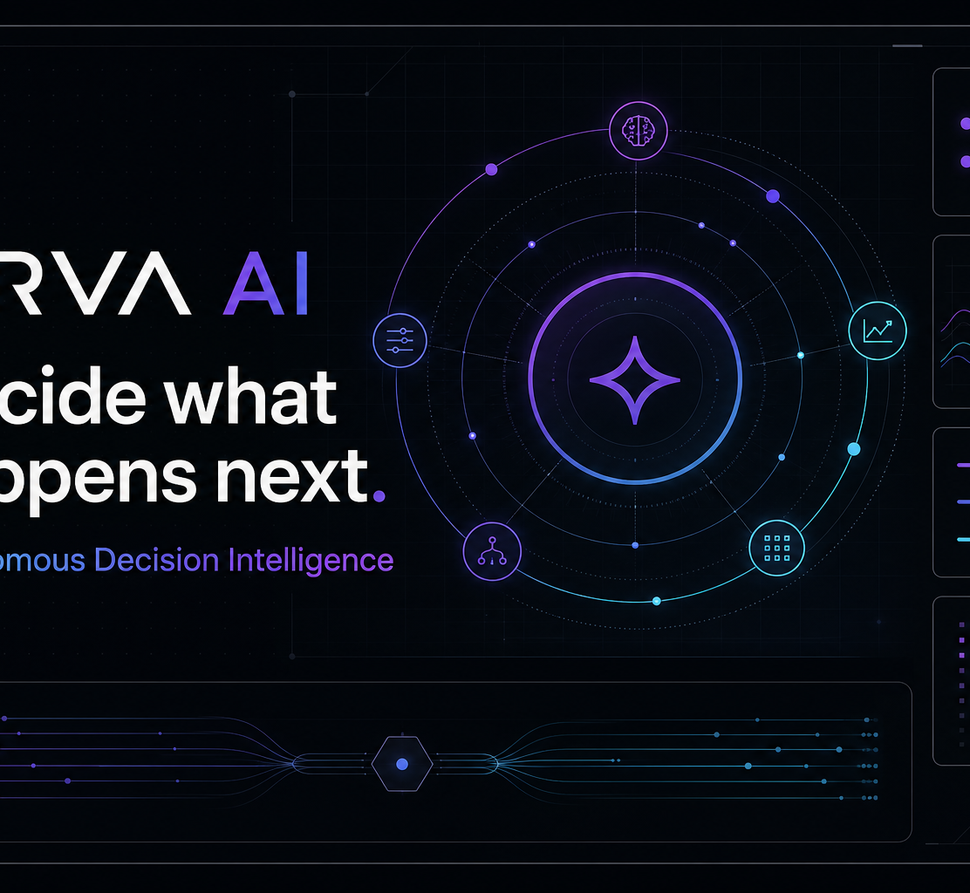
Problem Statement
GPU infrastructure is heterogeneous, shared and disruption-prone. Demand spikes, deadline-sensitive jobs, rising prices and node failures can interact faster than manual workflows.
The challenge is to recommend a feasible action that balances throughput, urgency, cost, power and safety — while allowing an operator to understand and govern that choice.
ARVA AI addresses this challenge in a controlled simulator before real infrastructure adapters are introduced.
Decision intelligence for AI infrastructure
Notes:
[Sources]
Internal source: README.md — simulation-first boundary and product positioning.
Asset: frontend/public/og.png (project-owned ARVA AI visual).

Slide 11
Proposed Work
ARVA AI converts observed infrastructure state into a governed next-best action.
Observe → Predict → Assess → Optimize → Validate → Decide → Execute → Learn
ARVA turns observed infrastructure state into a governed next-best action.
Observe → Predict → Assess → Optimize
Validate → Decide → Execute → Learn
Each decision is supported by forecasts, risk evidence, scheduler alternatives, policy checks and an auditable outcome.
Notes:
[Sources]
Internal source: docs/architecture.md — closed decision loop.

Slide 12
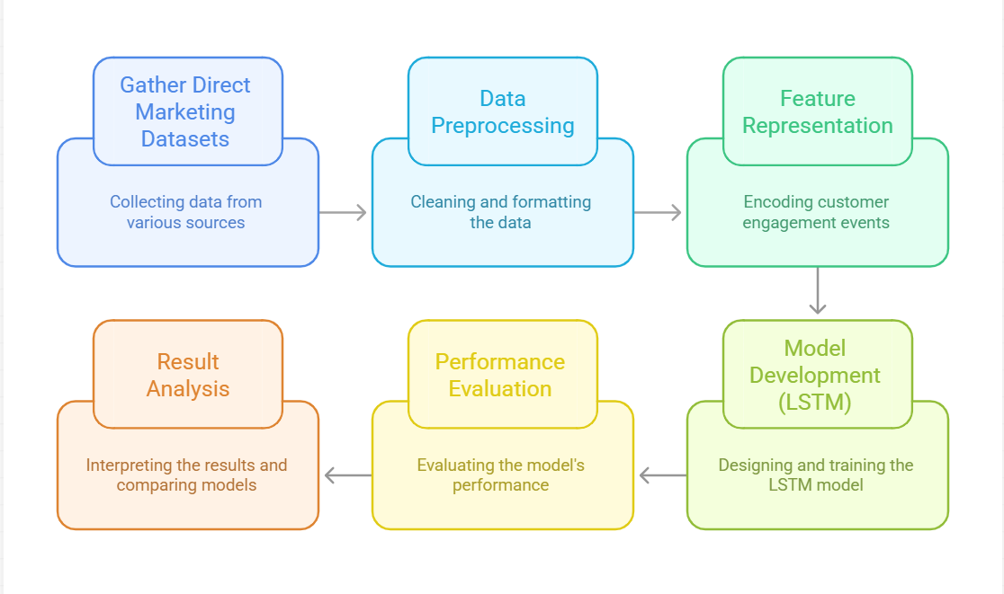
Proposed Architecture / Methodology
Persistent workload, node and telemetry state
Digital
Twin
Forecast +
Risk
Scheduler
Alternatives
Policy +
Approval
Outcome +
Replan
Measured cost • energy • queue • SLA • reliability become evidence for the next planning cycle
Fig. 1. ARVA AI closed-loop methodology
Notes:
[Sources]
Internal source: docs/architecture.md — closed loop; docs/optimization.md — alternative generation and constraints.

Slide 13
System Design
Redis
Events + Pub/Sub
REST + WebSocket
FastAPI
Decision Services
Operator
Browser
Vinext / React
Control Plane
Simulation
Worker
PostgreSQL
Source of Truth
Fig. 2. ARVA AI control-plane architecture
Notes:
[Sources]
Internal source: docs/architecture.md — component architecture and responsibilities.

Slide 14
Implementation Details
Twin &
Simulation
Forecasting &
Risk Evidence
Optimization &
Policy
Decisions, Audit
& Experiments
Modes: Simulation • Recommendation • Approval • Controlled Autonomous
Fig. 3. Modular implementation and governed autonomy
Notes:
[Sources]
Internal source: README.md; docs/architecture.md — modules, audit and deployment modes.

Slide 15
Result and Analysis
Verification confirms that ARVA AI is a working, deterministic simulation-first MVP.
Validation gates
• Backend lint and 15 pytest tests passed
• Frontend lint, test suite, type check and production build passed
• Docker services, database migrations, authentication, security headers, WebSocket telemetry and durable Redis events passed
• Seeded environment: 3 clusters, 15 GPU nodes, 3 profiles, 3 teams and 200 workloads
Demonstrated scenario
A 90-minute baseline was followed by a demand spike, urgent deadline workload, 45% GPU price increase and active-node failure. The system produced forecasts, risks, alternative plans, policy checks and a repeatable recovery sequence.
Notes:
[Sources]
Internal source: docs/final-verification.md — static, runtime and demo verification.

Slide 16
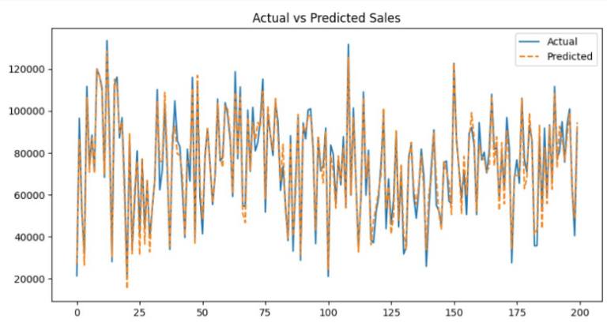
Result and Analysis
Scheduler comparison — same disrupted workload state
ARVA CP-SAT — 675.455 score • $854.16 • 51 jobs
FIFO — 667.360 score • $885.17 • 51 jobs
ARVA CP-SAT achieved the highest composite score and the lowest estimated cost among the evaluated alternatives.
Recovery restored 15/15 nodes.
These are measured demo outputs.
Notes:
[Sources]
Internal source: docs/final-verification.md — scheduler scores, estimated cost, job placement and recovery result.

Slide 17
Operator Experience
A complete decision trail for the AI-infrastructure operator
Command Center: fleet, capacity and governed actions; Simulation: inject demand, price and node-failure events; Forecasting & Risk Center: inspect evidence; Decisions & Experiments: compare, approve and replay; Audit: trace material decisions.
Notes:
[Sources]
Internal source: README.md; docs/demo.md — implemented UI routes and recommended demo journey.

Slide 18
Conclusion & Future Work
Conclusion
ARVA AI combines a persistent GPU digital twin, forecasting, risk evidence, scheduler alternatives, CP-SAT placement and policy controls in one explainable loop.
Current boundary
The project is intentionally simulation-first: it does not yet write to Kubernetes or cloud control planes.
Future work
Add audited infrastructure adapters, TLS and secret rotation, managed PostgreSQL/Redis with backups, richer ML forecasting and production safety reviews.
Conclusion
1-2 Slids ( with Limitation & Future scope)
ARVA AI demonstrates a governed path from infrastructure signals to measurable decisions.
ARVA combines a persistent GPU digital twin, forecasting, risk evidence, scheduler alternatives, CP-SAT placement and policy controls in one explainable loop.
Current boundary: simulation-first MVP; no Kubernetes or cloud write adapter is enabled.
Future work: audited infrastructure adapters, TLS and secret rotation, managed PostgreSQL/Redis backups, richer ML forecasting and production safety reviews.
Notes:
[Sources]
Internal source: README.md — production boundary; docs/final-verification.md — verified outcome.

Slide 19
References
[1] ARVA AI Project README. Autonomous Decision Intelligence System.
[2] ARVA AI Architecture Documentation. Control-plane shape, closed loop, security boundaries and deployment modes.
[3] ARVA AI Optimization Documentation. Scheduler alternatives, CP-SAT model and policy-aware plan ranking.
[4] ARVA AI Simulation Documentation. Deterministic lifecycle, disruptions, checkpoints and recovery.
[5] ARVA AI Demo Documentation. Official repeatable demand, price and node-failure scenario.
[6] ARVA AI Final Verification. Test/runtime gates and measured scheduler/recovery outcomes.
Notes:
[Sources]
Internal sources: README.md; docs/architecture.md; docs/optimization.md; docs/simulation.md; docs/demo.md; docs/final-verification.md.

Slide 20
References
[7] Verma, A. et al. (2015). Large-scale cluster management at Google with Borg. EuroSys.
https://research.google/pubs/large-scale-cluster-management-at-google-with-borg/
[8] Gu, J. et al. (2019). Tiresias: A GPU Cluster Manager for Distributed Deep Learning. NSDI.
https://www.usenix.org/conference/nsdi19/presentation/gu
[9] Narayanan, D. et al. (2020). Heterogeneity-Aware Cluster Scheduling Policies for Deep Learning Workloads. OSDI.
https://arxiv.org/abs/2008.09213
[10] Google OR-Tools. Constraint Optimization / CP-SAT documentation.
https://developers.google.com/optimization/cp/
[11] United Nations. Sustainable Development Goals.
https://sdgs.un.org/goals
Notes:
[Sources]
External sources listed on slide.

Slide 21
Appendix
CONTRIBUTION OF PROJECT
1. Objective & Relevance | A governed decision layer for shared AI/GPU infrastructure.
2. Technical Novelty | Digital twin + alternatives + policy + audit in one closed loop.
3. Expected Outcome | Explainable, measurable and replayable infrastructure decisions.
4. Social Relevance | More productive and safer AI-infrastructure operations.
5. Environmental Relevance | Cost, power and energy are evaluated with each plan.
6. Ethical Consideration | RBAC, explicit autonomy modes, approvals and append-only audit events.
7. Production Path | Audited adapters, TLS, secret rotation and managed data services.
Notes:
[Sources]
Internal source: README.md; docs/architecture.md; docs/optimization.md.

Slide 22
Thank You
Notes:
[Sources]
Thank-you closing slide based on supplied academic template.

