Slide 1

Python to Java Compiler
Aditya Shenoy | - | 161080036
Rahul Bhoir | - | 161080063
Kalyani Borkar | - | 171081990
Rani Deore | - | 171081993

Slide 2
Contents
Abstract
Situation
Task
Action
Result

Slide 3
Abstract

Slide 4
Abstract
Python and Java programming languages have many benefits as well as drawbacks in them
The major benefits of these are that the development time of Python is less and run time of Java is less
Due to this, there is a gap between the application areas of Java and Python in the industries
Our project will combine the benefits of both the languages by translating the source code from Python to Java
This will reduce the development time and thus increase the productivity of the industries

Slide 5
Situation

Slide 6
Advantages of Python over Java
Popularity
Python is more popular than Java
Syntax
Something that can be done in one line in Python, requires lengthy code in Java
Productivity
Python development boosts productivity due to fewer lines of code and less errors
Python is easy to learn and easy to use due to its syntax
Simplicity/Verbosity

Slide 7
Advantages of Java over Python
Speed
Java is 25X more faster than Python
Database Access
Python’s database access layers are weaker than Java’s Java Database Connectivity (JDBC)
Compilation
Compiles easily on any platform without hassles
Language type
General purpose programming language; follows “write once run anywhere”

Slide 8
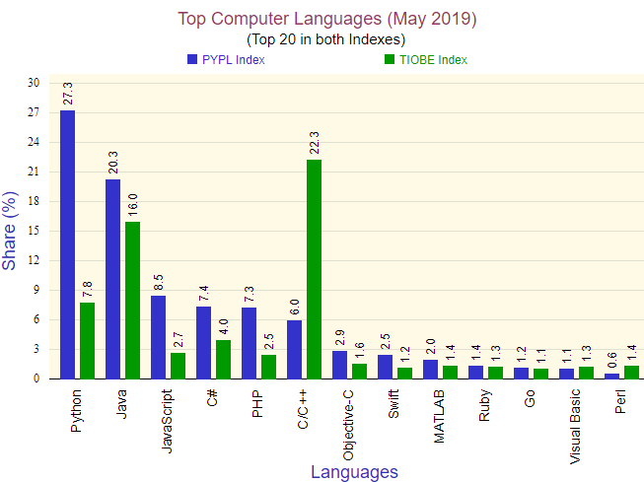
Top Computer Languages in 2019
PYPL index is measured by the amount of tutorials searched on search engines
TIOBE index is measured by the amount of hits of the most popular search engines
Python has the highest PYPL index whereas Java has the highest PIOBE index

Slide 9
Task

Slide 10
Task
Our task is to compile the Python script into Java source code
The algorithm used in the code must not change during the compilation process
The compilation must be efficient by translating to Java library functions whenever possible
Combine the benefits of both the languages

Slide 11
Action

