Slide 1

Drones for Disaster Mitigation
Aditya Shenoy – 161080036
Rahul Bhoir – 161080063
Kalyani Borkar – 171081990
Rani Deore – 171081993

Slide 2
Summary
Current Earthquake Rescue Planning is not optimal and is time consuming
This project aims to deploy drones and use machine learning to make optimal rescue plans in lesser period of time
In this project, we have to automate the drone to collect building data from the affected area, classify its damage using machine learning model and find optimal path for the rescue team
By this project, rescue team would be able to save more lives in an efficient manner

Slide 3
Current Earthquake Rescue Planning
No systematic planning
Less time available for rescue planning
Absence of readily available rescue equipment
Lack of personnel with emergency response skills
Less resources for rescue available
Cannot decide which area to rescue first
Human detection by their voices only
http://news.bbc.co.uk/2/hi/americas/8459653.stm
https://www.cn.undp.org/content/china/en/home/ourwork/crisispreventionandrecovery/overview/training-on-earthquake-emergency-search-and-rescue.html

Slide 4
Our Task
Use of automated drone to collect information of affected areas
Predict earthquake damage scale of buildings using trained ML model
Create a graph of buildings and add appropriate weights to the edges
Find a path covering maximum buildings in short time for rescue

Slide 5
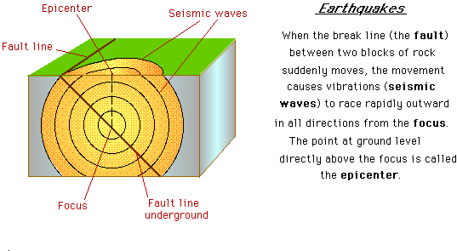
Earthquake Characteristics
http://www.coolgeography.co.uk/A-level/AQA/Year%2013/Plate%20Tectonics/Earthquakes/Causes%20&%20Characteristics.htm

Slide 6
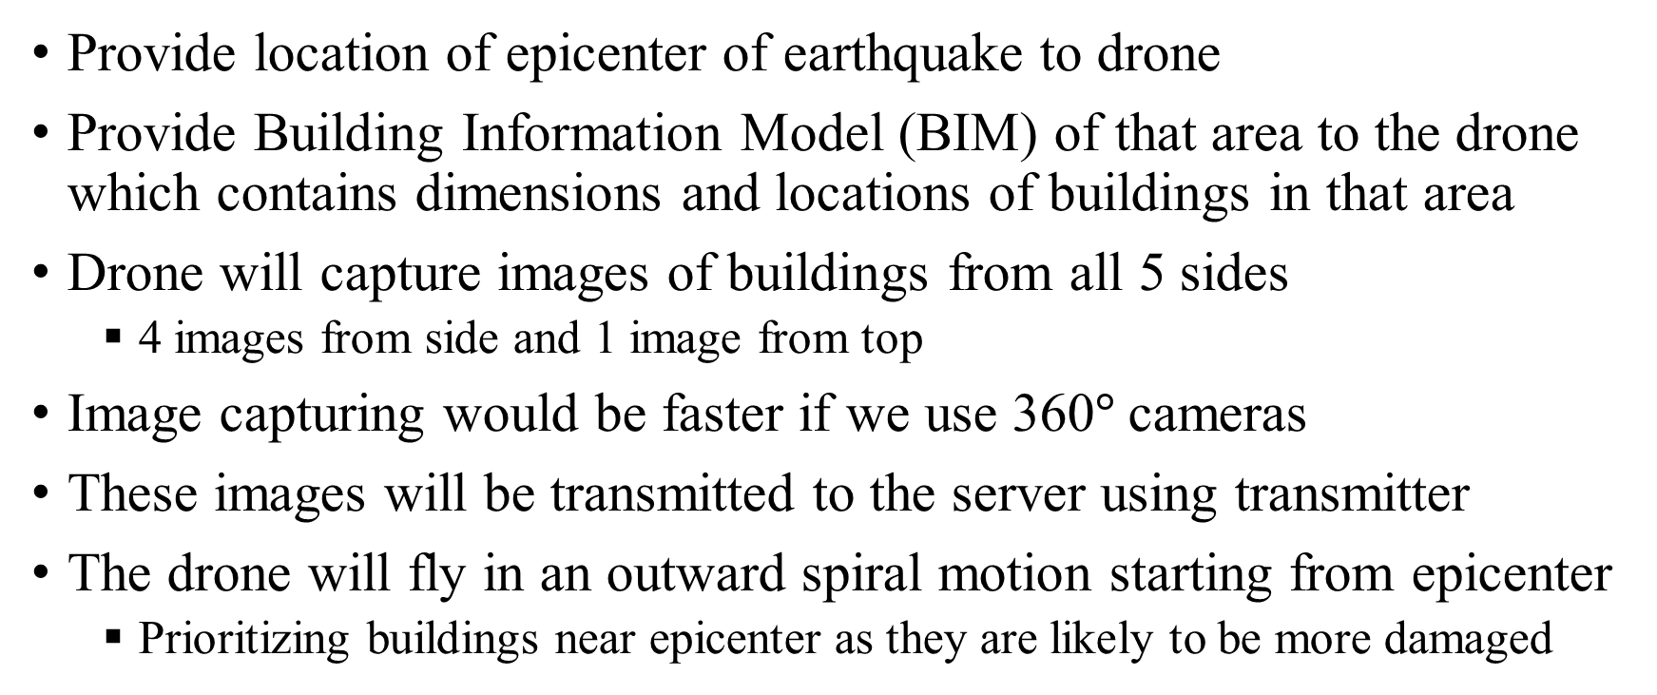
Information Collection by Drones
Provide location of epicenter of earthquake to drone
Provide Building Information Model (BIM) of that area to the drone which contains dimensions and locations of buildings in that area
Drone will capture images of buildings from all 5 sides
4 images from side and 1 image from top
Image capturing would be faster if we use 360$°$cameras
These images will be transmitted to the server using transmitter
The drone will fly in an outward spiral motion starting from epicenter
Prioritizing buildings near epicenter as they are likely to be more damaged
https://en.wikipedia.org/wiki/Building_information_modeling

Slide 7
Drone Challenges
GPS signals are blocked
Earthquake affected areas can have tower signals damaged
Decreased battery life
Drones have limited battery life i.e. they need to be charged periodically
Wrong direction during flight
Drone can fly in wrong direction if the drone is not calibrated properly
https://www.fortressuav.com/blog/2018/10/18/drone-problems-3-issues-commonly-seen-in-todays-drones

Slide 8
Classification of Earthquake damage using ML model
The input layer of Artificial Neural Network (ANN) would be scaled image captured by drone
The input layer will also consist of other factors like location of building, epicenter location, etc.
One or more hidden layers in the network
The exact architecture will be decided by the training and validation datasets
One output node which will provide output in range [0, 1]
Scale the output to the range [0, 12] to provide the Mercalli scale

Slide 9
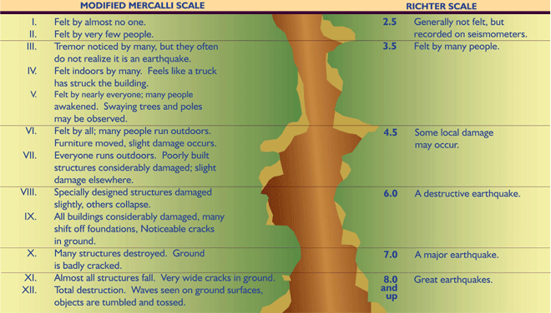
Modified Mercalli Scale
http://www.coolgeography.co.uk/A-level/AQA/Year%2013/Plate%20Tectonics/Earthquakes/Causes%20&%20Characteristics.htm
https://simple.wikipedia.org/wiki/Mercalli_intensity_scale

Slide 10
Neural Network Challenges
Priors – Selection of proper features that can predict output correctly
Memory – Neural network with higher number of nodes will require higher memory
Overfitting/Underfitting – Selection of proper architecture for neural network is important to avoid overfitting and underfitting
Large Data Requirements – Neural network needs large datasets so that they can learn the mapping of features to output accurately
https://www.quora.com/What-are-the-major-challenges-of-a-neural-network-and-deep-neural-network

Slide 11
Construction of Graph
Nodes of the graph will be the buildings
The graph will be a complete graph i.e. all nodes would be connected to all other nodes as drones can directly fly between buildings
The weight of the edges would be
Directly proportional to the Euclidean distance between buildings
Indirectly proportional to the earthquake scale of the destination node

Slide 12
Path Finding in Graph
We will use Travelling Salesman Problem (TSP) to find the shortest path covering all the buildings in minimum cost
This path will start from a building with highest earthquake scale or the building which is closer to the rescue department
The path need not be closed as returning back to source is not required
Approximation to avoid exponential computational time complexity
This path will be provided to the rescue team
https://en.wikipedia.org/wiki/Travelling_salesman_problem

Slide 13

Current Work Status
Research on various drone models suggested by seniors of Electronics
Started collecting dataset for earthquake classification ($≈$50 images)
Study on earthquake characteristics and scale
Studied papers and articles on similar projects
https://www.ngdc.noaa.gov/nndc/struts/results?bt_0=2000&st_0=&type_17=EXACT&query_17=None+Selected&op_12=eq&v_12=&type_12=Or&query_14=None+Selected&type_3=Like&query_3=&st_1=&bt_2=&st_2=&bt_1=&bt_4=&st_4=&bt_5=&st_5=&bt_6=&st_6=&bt_7=&st_7=&bt_8=&st_8=&bt_9=&st_9=&bt_10=&st_10=&type_11=Exact&query_11=&type_16=Exact&query_16=&bt_18=&st_18=&ge_19=&le_19=&type_20=Like&query_20=&display_look=194&t=101650&s=1&submit_all=Search+Database

Slide 14
Conclusion
Systematic rescue planning will be done by our project
Automated drones will enable us to collect earthquake data with minimal human personnel
Optimal rescue plan including prioritizing areas to rescue first in minimum time

Slide 15
Bibliography
http://news.bbc.co.uk/2/hi/americas/8459653.stm
https://www.cn.undp.org/content/china/en/home/ourwork/crisispreventionandrecovery/overview/training-on-earthquake-emergency-search-and-rescue.html
http://www.coolgeography.co.uk/A-level/AQA/Year%2013/Plate%20Tectonics/Earthquakes/Causes%20&%20Characteristics.htm
https://en.wikipedia.org/wiki/Building_information_modeling
https://www.fortressuav.com/blog/2018/10/18/drone-problems-3-issues-commonly-seen-in-todays-drones
http://www.coolgeography.co.uk/A-level/AQA/Year%2013/Plate%20Tectonics/Earthquakes/Causes%20&%20Characteristics.htm
https://simple.wikipedia.org/wiki/Mercalli_intensity_scale
https://www.quora.com/What-are-the-major-challenges-of-a-neural-network-and-deep-neural-network
https://en.wikipedia.org/wiki/Travelling_salesman_problem
https://www.ngdc.noaa.gov/nndc/struts/results?bt_0=2000&st_0=&type_17=EXACT&query_17=None+Selected&op_12=eq&v_12=&type_12=Or&query_14=None+Selected&type_3=Like&query_3=&st_1=&bt_2=&st_2=&bt_1=&bt_4=&st_4=&bt_5=&st_5=&bt_6=&st_6=&bt_7=&st_7=&bt_8=&st_8=&bt_9=&st_9=&bt_10=&st_10=&type_11=Exact&query_11=&type_16=Exact&query_16=&bt_18=&st_18=&ge_19=&le_19=&type_20=Like&query_20=&display_look=194&t=101650&s=1&submit_all=Search+Database

Slide 16
Bibliography
https://www.researchgate.net/publication/335360750_Evaluation_of_Human_Body_Detection_Using_Deep_Neural_Networks_with_Highly_Compressed_Videos_for_UAV_Search_and_Rescue_Missions?_iepl%5BactivityId%5D=1180116671664128&_iepl%5BactivityTimestamp%5D=1575802943&_iepl%5BactivityType%5D=service_add_recommendation_publication&_iepl%5Bcontexts%5D%5B0%5D=homeFeed&_iepl%5BrecommendationActualVariant%5D=your_network_slot_machine%3Esocial_v3_people_you_follow&_iepl%5BrecommendationDomain%5D=&_iepl%5BrecommendationScore%5D=35.961658477783&_iepl%5BrecommendationTargetActivityCombination%5D=&_iepl%5BrecommendationType%5D=&_iepl%5BfeedVisitIdentifier%5D=&_iepl%5BpositionInFeed%5D=0&_iepl%5BsingleItemViewId%5D=AO14fVT0nSkjfJOt02fMYrKq&_iepl%5BviewId%5D=jjtewvZFYSzoYFtjj0qcEzz0&_iepl%5BhomeFeedVariantCode%5D=nu&_iepl%5B__typename%5D=HomeFeedTrackingPayload&_iepl%5BinteractionType%5D=publicationTitle&_iepl%5BtargetEntityId%5D=PB%3A335360750
https://www.researchgate.net/publication/224314709_Human_Body_Detection_and_Geolocalization_for_UAV_Search_and_Rescue_Missions_Using_Color_and_Thermal_Imagery
https://www.researchgate.net/publication/283537233_Drone_Applications_for_Supporting_Disaster_Management
https://www.wired.com/2017/01/chinas-launching-drones-fight-back-earthquakes/
https://drones.fsd.ch/en/4229/

