Slide 1

Drones for Disaster Mitigation
Aditya Shenoy – 161080036
Rahul Bhoir – 161080063
Kalyani Borkar – 171081990
Rani Deore – 171081993
Under the guidance of Dr. V. B. Nikam

Slide 2
Content
Introduction
Problem Statement
Objective
Challenges
Feasibility Analysis
Proposed Framework
Literature Survey
System Requirements

Slide 3
Introduction

Slide 4
As use of drones rapidly expands, it is aided by improvements in technology such as high-speed cameras, sensors, and processors able to analyze the data rapidly and efficiently on the drone.
Drones can either be controlled manually by an operator or fly autonomously, but as the use for an operator increases the cost considerably, it is clearly preferable for them to operate autonomously.
A true unmanned aerial vehicle, UAV, is preprogrammed prior to flight to do a specific set of tasks on a specific flight path.

Slide 5
In disaster mitigation, accurate infrastructure damage scaling is an issue
Currently, there is no systematic planning of rescue operations
Scarcity of available rescue equipment and skilled personnel
Less automated life detection framework available

Slide 6
Problem Statement

Slide 7
The proposed system should be able to capture images/videos of disaster affected areas using autonomously path planned drone, that can be further processed for infrastructure damage detection which is one of the crucial components of disaster mitigation involving path planning, detection of life using fine microphone and thermal sensor which will be efficient in rescuing more lives.

Slide 8
Objective

Slide 9
Autonomous path planning of drones
Image, video, and sensor data capturing using drone camera
Life detection using captured data
Infrastructure damage scaling using 3D modelling by photogrammetry
Rescue path planning for the rescue team

Slide 10
Challenges

Slide 11
Drone path planning should also consider periodic recharging of drones
Initial drone calibration to avoid flight in wrong direction
Life detection through thick walls and debris
Loss of network signals if towers get damaged due to disaster
Computational complexity for planning of rescue path

Slide 12
Feasibility Analysis

Slide 13
Cost of drones, cameras, and sensors is high
The sensors and cameras that we have studied are appropriate for collecting the data required by our project
This project would be useful in disaster prone areas
Drones need regular maintenance
Network strength needs to be maintained

Slide 14
Proposed Framework

Slide 15
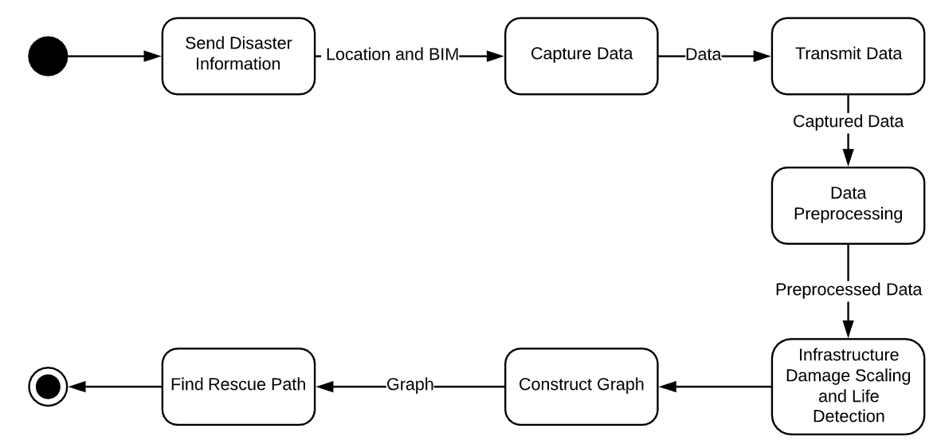

Slide 16
Calculate the path of the drone and feed it for autonomous flight
Capture image/videos and sensor data
Transmit the data to the server
Preprocess the data and apply trained machine learning model on it to classify infrastructure damage scale and life detection
Construct a graph and find path for rescue mission

Slide 17
Literature Survey

Slide 18
Sr. No. | Paper Title | Summary
1 | Evaluation of Disaster Response System Using Agent-Based Model With Geospatial and Medical Details | Agent based modelling describing the cooperation of overall process in disaster response for transporting patients to definitive care
2 | An Integrated Traveling Salesman and Coverage Path Planning Problem for Unmanned Aircraft Systems | Optimal path planning for UAVs to cover multiple regions by integrating TSP and CPP
3 | Through Wall Human Detection Under Small Samples Based on Deep Learning Algorithm | Effective detection of human targets behind walls using deep learning algorithm
4 | Design and Deployment of UAV-Aided Post-Disaster Emergency Network | Ad-hoc network of mobiles and UAVs where towers are damaged for post-disaster management

Slide 19
Sr. No. | Paper Title | Summary
5 | Distributed Reinforcement Learning in Emergency Response Simulation | Use of reinforcement learning to plan rescue plans based on previous rescue plans
6 | Through-Wall Detection of the Moving Paths and Vital Signs of Human Beings | Detection of human activities through wall using ultra wide band radar
7 | Multimedia for Disaster Information Management | Analyzing social media, emergency management responders, etc data before, during and after disaster
8 | Help from the Sky: Leveraging UAVs fir Disaster Management | Network assisted UAVs for disaster prediction, assessment, and response and limitations of drones
9 | Audio-Based Search and Rescue With a Drone | Estimating the direction of sound source given audio measurements from an array of microphones

Slide 20
System Requirements

Slide 21
Drone
4k60 HDR Camera
RF Sensor
IR Sensor
Fine Microphone
TensorFlow
Python

Slide 22
Thank You

