Slide 1
Picking

Slide 2
What is picking?
Selecting an object on the screen
What does this require?
  Get Mouse Location
  Compute what objects are rendered at the position

Slide 3
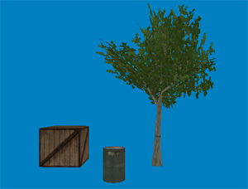
Example

Slide 4
How to do it
http://www.opengl.org/resources/faq/technical/selection.htm
http://gpwiki.org/index.php/OpenGL:Tutorials:Picking
http://www.lighthouse3d.com/opengl/picking/index.php?openglway

Slide 5
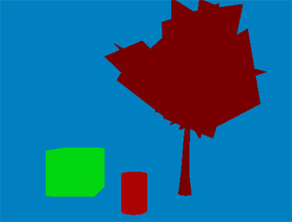
Color Picking
http://gpwiki.org/index.php/OpenGL_Selection_Using_Unique_Color_IDs

Slide 6
Color Picking: Step 1
When the user clicks the mouse:
Render all the pickable objects in the scene, each with a unique color
  How to render an object to be a specific color?
    glColor3f(r,g,b);
    Is this enough?
    glDisable(GL_TEXTURE2D); glDisable(GL_LIGHTING); glDisable(GL_FOG);

Slide 7
Color Picking: Step 2
Figure out what the color of the pixel is where the mouse was clicked
void glReadPixels(GLint x, GLint y, GLsizei width, GLsizei height, GLenum format, GLenum type, GLvoid * data);Parametersx, y
Specify the window coordinates of the first pixel
that is read from the frame buffer.
This location is the lower left corner of a rectangular block of pixels.
width, height
Specify the dimensions of the pixel rectangle.
width and height of one correspond to a single pixel.
format
Specifies the format of the pixel data. typically GL_RGB, GL_RGBA,
type
Specifies the data type of the pixel data.
Must be one of
GL_UNSIGNED_BYTE,
data
Returns the pixel data.
  How to set glReadPixels?

Slide 8
Color Picking: Step 2
  GLint viewport[4]; glGetIntegerv(GL_VIEWPORT, viewport);
  glReadPixels(x, viewport[3] - y, 1, 1, GL_RGB, GL_UNSIGNED_BYTE, pixel);
    Why do we do ‘viewport[3] – y’
      OS will often report mouse positions with the origin at the upper left
      GL always puts the origin at the lower left

Slide 9
Color Picking: Step 3
Once you know the unique color, you can identify the object that was picked
  Details
    When you false color your objects, wont this screw up rendering?
      Yes, but how can you prevent this?
      Don’t call glutSwapBuffers() directly after doing this.
      With double buffering, everything is initially drawn into the back buffer – the user only ever sees the front buffer.
      What are some limitations of this approach?

Slide 10
GL_SELECT
http://gpwiki.org/index.php/OpenGL:Tutorials:Picking
Render twice
  glRenderMode(GL_SELECT);
  SetViewport to one pixel
  It counts how many objects render to that pixel
  Read back # (glRenderMode(GL_RENDER)
  Identify objects – use name stack

Slide 11
GL_SELECT: Step 1
Tell GL which objects are pickable
glRenderMode(GL_SELECT);
  The default is glRenderMode(GL_RENDER);
Use the Name stack
    glInitNames() – initializes/clears the name stack
    glPushName, glPopName, glLoadName
      E.g., glPushName(Gluint name); - names are numbers – unique identifiers
Render your objects

Slide 12
GL_SELECT: Step 2
Define a buffer to store information about what was picked
#define BUFSIZE 512
GLuint selectBuf[BUFSIZE]
…
glSelectBuffer(BUFSIZE,selectBuf);

Slide 13
GL_SELECT: Step 3
Set the size of the selection region around the cursor to determine what has been picked
  void gluPickMatrix(GLdouble x, GLdouble y, GLdouble delX, GLdouble delY, GLint * viewport);
    x,y – mouse coords (viewport[3] – y)
    delX,delY – width and height of region
    viewport – the current viewport (e.g., glGetIntegerv(GL_VIEWPORT, viewport))

Slide 14
GL_SELECT: Step 4
Process the ‘hits’ ( where the cursor region overlaps with pickable objects)
    numhits = glRenderMode(GL_RENDER); // assuming you were previously in GL_SELECT mode
If there are hits, iterate through your select buffer (selectBuf) and decide how to process them

Slide 15
GL_SELECT: Select buffer example
Hit Record Contents | Description
0 | No names have been stored for the first hit
4.2822e+009 | Minimum depth for first hit
4.28436e+009 | Maximum depth for first hit
1 | Number of names for the second hit
4.2732e+009 | Minimum depth for second hit
4.27334e+009 | Maximum depth for second hit
6 | A single name for the second hit
2 | Number of names for the third hit
4.27138e+009 | Minimum depth for third hit
4.27155e+009 | Maximum depth for third hit
2 | First name for third hit
5 | Second name for third hit
Depth values (which are in the range [0,1]) are multiplied by 2³² – 1, before being placed in the hit record.

Slide 16
gluUnProject
Take x-y window coordinates and figure out what the corresponding 3D coordinates are.
  We are reversing the graphics pipeline!
What is a 2D coordinate after being ‘unprojected’ into 3D?

Slide 17

gluUnProject
x,y in window coordinates

Slide 18
gluUnProject
GLint gluUnProject( GLdouble winX, GLdouble winY, GLdouble winZ, const GLdouble *model, const GLdouble *proj, const GLint *view, GLdouble* objX, GLdouble* objY, GLdouble* objZ )
  winX,winY,winZ : window coordinates
  model: the modelview matrix you want to invert
  proj: the projection matrix you want to invert
  view: the viewport
  objX,objY,objZ: the resulting 3D coordinates
Why does the 2D window coordinates have 3 variables?
  If winZ == 0, then the resulting point will be on the near plane
  If winZ==1 then the resulting point will be on the far plane
Create a ray based on these near and far points
  Test for intersection with objects…

Slide 19
Ray-Object Intersections
This is very similar to collision detection
    REMEMBER: you must project the window points into the same coordinate system (e.g., world coordinates) as the objects you are trying to select. Keep this in mind when selecting the modelview matrix to use
You can do ray-BB, ray-sphere, or ray-triangle detection
  The resulting accuracy will be the same as it is for the associated collision detection routines

Slide 20
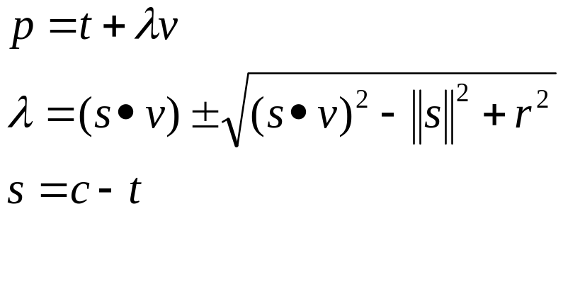
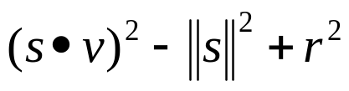
Ray-sphere intersection
(this is really for a line, but it works with some minor changes)
If == 0 hit on surface
If >0 intersection
If <0 no intersection
p is the intersection point
t is a point on the ray
v is the direction of the ray
c is the position of the sphere
r is the radius of the sphere

Slide 21
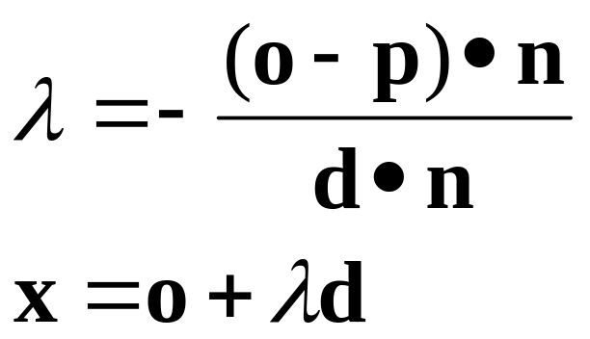
Ray-triangle intersection 1
Form a plane from the three vertices
Calculate ray intersection with plane
Where:
x is the intersection between the ray and the plane
o is the origin of the ray
d is the direction of the ray
n is the normal of the plane
p is a point on the plane
λ is the ray’s scalar parameter

Slide 22
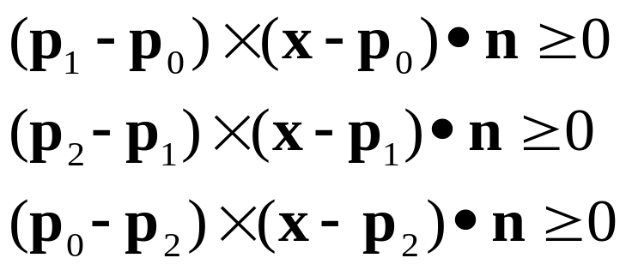
Ray-triangle intersection 2
Use cross products and the properties of vertex winding to figure out if x is inside the triangle
Where
p₀,p₁,p₂ are vertices of the triangle
x is the intersection point
n is the triangle normal
Intersection occurs if:
x
p₁
p₀
x
p₂

Slide 23
Ray-BB intersection
Find the ray intersection with one of the planes
Test against all the other planes to see if that intersection is in the BB
  (see point – plane collision detection lecture)

