Slide 1
REVIEW 2 — PROJECT IMPLEMENTATION PROGRESS
Vehicle-Independent Road Anomaly Classification
Through DSP-Based Signal Calibration
Across Diverse Vehicle and Road Conditions
Team Members
Rahul Bodduna — 2520040001
Guna Shekar — 2520040100
Pavan Biradhar — 2520040102
Supervisor
Dr. V. Sahiti
Department: ECE, KLH University, Hyderabad
Academic Year: 2025–26
Implementation Status
✔ CSV Upload & Validation
✔ DSP Signal Processing Pipeline
✔ Machine-Learning Classification
✔ GPS Map Visualization
✔ Three-Vehicle Datasets Collected
✔ Cross-Vehicle Experiments Executed
⏳ Ablation Calibration Tuning

Slide 2
Project Overview & Implementation Progress
Research Question: Can DSP calibration reduce vehicle-dependent sensor variation for road anomaly classification?
IMPLEMENTED & WORKING
MEASURED & EVALUATED
UNDER EVALUATION / PLANNED
• CSV upload with schema validation
• 8-stage DSP pipeline (Hampel → Gravity Sep. → Butterworth → Jerk → Calibration)
• 77-feature extraction (time-domain + FFT)
• Random Forest classifier (300 trees)
• Interactive GPS Folium map
• 3 vehicle datasets collected
• Adaptive jerk-based anomaly detection
• Individual vehicle accuracy (Exp A)
• Cross-vehicle generalization (Exp B)
• Combined 3-vehicle model (Exp C)
• Anomaly intensity scores (0–100)
• Road segment classification (SMOOTH/ROUGH)
• Session-aware GroupShuffleSplit evaluation
• Multi-vehicle GPS map with vehicle filter
• DSP ablation calibration tuning
• Improved POTHOLE class detection
• Class-imbalance correction
• GPS localization accuracy validation
• External independent dataset testing
• Sensor fusion vs. acc-only comparison
RoadSense AI

Slide 3
System Architecture — End-to-End Pipeline
Identical DSP pipeline applied to all three vehicle datasets independently
Three Vehicle
Datasets
(2W / 3W / 4W)
CSV Upload
& Validation
8-Stage DSP
Processing
Feature
Extraction
(77 features)
Random Forest
Classification
GPS Map
Visualization
Performance
Evaluation
(Exp A / B / C)
▶
▶
▶
▶
▶
▶
DSP Pipeline Stages:
4. Butterworth
Bandpass
(0.7–15 Hz)
5. Acc & Gyro
Magnitude
Calculation
6. Jerk
Calculation
(Numerical ∂)
7. Median-MAD
Calibration
(Z-score)
8. Window
Segmentation
(2.0 s windows)
→
→
→
→
→
→
→
1. Timestamp
Parsing &
SR Estimation
2. Hampel
Outlier
Removal
3. Gravity
Separation
(LP 0.5 Hz)
RoadSense AI

Slide 4
DSP Signal Processing — Implementation Details
All 8 stages fully implemented in app/dsp/ | Sampling rate calculated from actual timestamps
Stage 1 — Sampling Rate Estimation
Reads actual CSV timestamps. Calculates fs = N / duration from real data. Resamples to uniform 50 Hz grid using pandas time-based interpolation. No assumed fixed rate.
Stage 2 — Hampel Outlier Filter
Window = 7 samples, σ = 3.0. Replaces spike outliers in acc_x/y/z and gyro_x/y/z with local median. Removes isolated sensor glitches without distorting genuine road events.
Stage 3 — Gravity Separation
Low-pass Butterworth (0.5 Hz, order 3) separates slow gravity component from dynamic acceleration. Dynamic acc = total acc − gravity. Isolates road-induced vibration from tilt/mounting angle.
Stage 4 — Butterworth Bandpass Filter
0.7–15 Hz bandpass, order 4, zero-phase (sosfiltfilt). Removes DC offset and high-frequency electronic noise. Road events (potholes, speed-breakers) lie within 1–12 Hz band.
Stage 5–6 — Magnitude & Jerk
||acc|| = √(ax²+ay²+az²). Jerk = Δ||acc||/Δt (numerical derivative). Jerk captures rate-of-change of acceleration — key discriminant for sharp pothole impacts vs smooth bumps.
Stage 7 — Median-MAD Calibration
z = (x − median) / (1.4826 × MAD). Normalises sensor amplitude across different vehicle mass, suspension stiffness, and mounting positions. Reduces vehicle-dependent signal variation.
Stage 8 — Window Segmentation & Feature Extraction
2.0 s non-overlapping windows = 100 samples @ 50 Hz. Extracts 77 features: time-domain statistics (mean, std, RMS, kurtosis, skewness) + FFT spectral energy per channel.
RoadSense AI

Slide 5
Machine-Learning Classification — Implementation
Classifier: Random Forest (n_estimators=300, class_weight='balanced') | Validation: GroupShuffleSplit (session-aware)
Road Condition Classes
Feature → Prediction Pipeline
SMOOTH
INPUT
Calibrated acc_x/y/z, gyro_x/y/z, jerk, impact_score (per 2 s window)
Continuous uniform road surface, low jerk variance
ROUGH
↓
Elevated rolling vibration, higher jerk RMS
FEATURES (77)
Time-domain: mean, std, RMS, kurtosis, skewness, peak, range, ZCR
Frequency-domain: FFT dominant freq, spectral centroid, spectral energy bands
Channels: acc_x, acc_y, acc_z, acc_magnitude, jerk, gyro_x, gyro_y, gyro_z, gyro_magnitude
POTHOLE
↓
Sharp transient vertical drop, short duration (<2 s)
MODEL
Random Forest — 300 decision trees, balanced class weighting
Prevents majority-class dominance for SMOOTH road segments
SPEED BREAKER
Sustained pitch/roll elevation, duration ≥ 2 s or gyro > 3 rad/s
↓
VALIDATION
GroupShuffleSplit on session_id — prevents data leakage
Training and test windows never share the same recording session
↓
OUTPUT
Predicted class per 2 s window → mapped to GPS coordinate
Confidence score stored per prediction
⚠ Vehicle type (2W/3W/4W) is METADATA — NOT an ML class label
↓
RoadSense AI

Slide 6
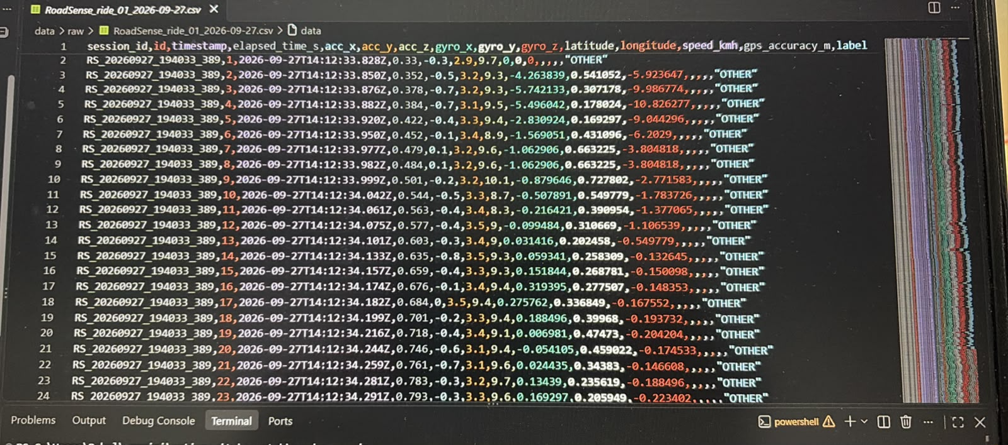
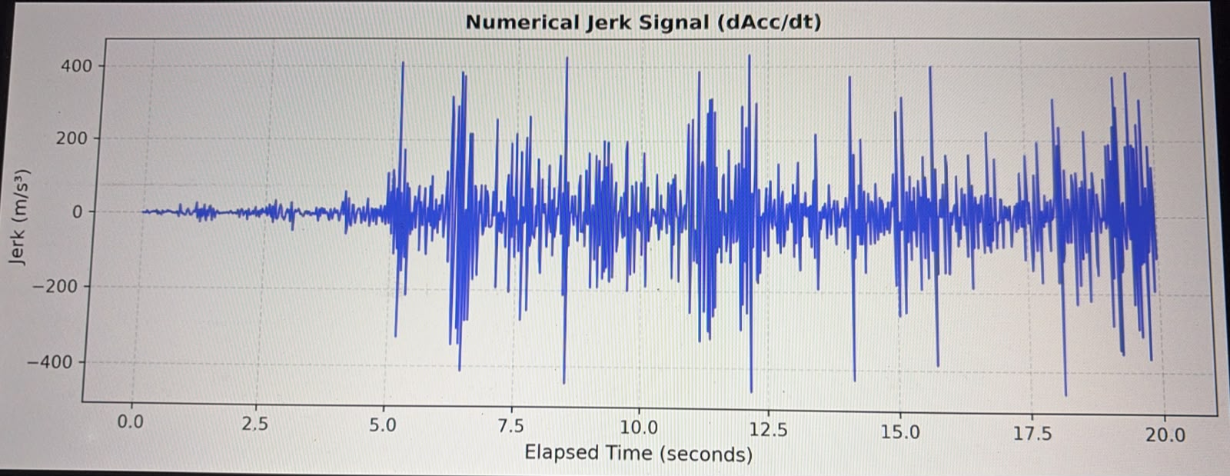
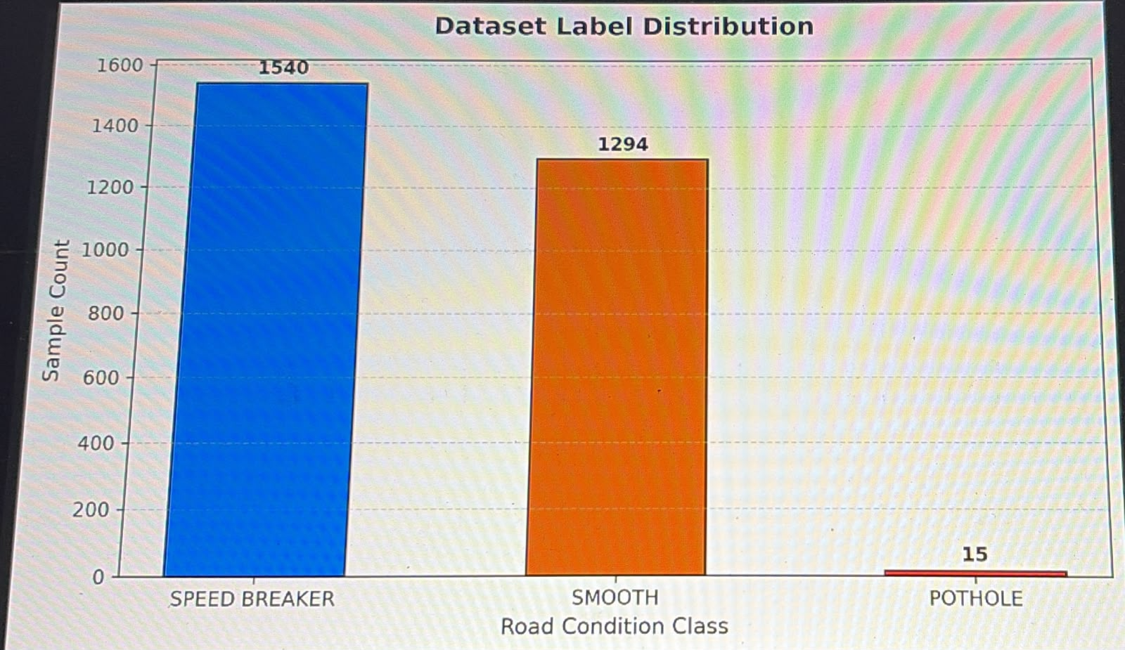
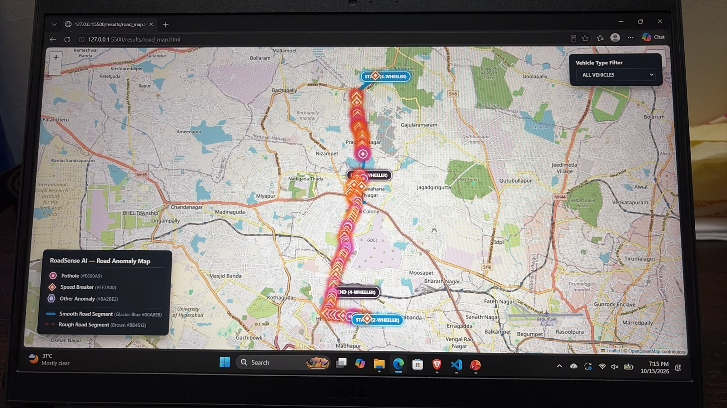
Working Application Demonstration
All pipeline stages are fully functional and tested on real regional smartphone datasets
Upload &
Validation
DSP
Output
ML
Predictions
GPS
Map
RoadSense AI

Slide 7
Experimental Results — ML Performance (Combined 3-Vehicle Model)
Classifier: Random Forest | Validation: Session-Aware GroupShuffleSplit | Source: cross_vehicle_results.csv
80.35%
53.97%
79.74%
463 windows
2,386 windows
77 features
Overall Accuracy
Macro F1-Score
Weighted F1-Score
Test Samples
Train Samples
Total Features
Class-Wise Performance (Experiment C — Combined 3-Vehicle Model)
Road Class
Precision
Recall
F1-Score
Support (windows)
Observation
POTHOLE
0.000
0.000
0.000
7
Insufficient labeled samples — imbalanced class
SMOOTH
0.792
0.821
0.806
223
Good detection — dominant class well represented
SPEED BREAKER
0.815
0.811
0.813
233
Good detection — gyro features improve F1
⚠ POTHOLE class F1 = 0.000 because only 7 labeled pothole windows exist in the combined dataset.
Signal-derived annotations (annotate_signal_labels) are used to infer classes for the unlabeled field dataset.
Results reflect signal-based annotation — ground-truth label collection for potholes is an ongoing task.
RoadSense AI

Slide 8
Three-Vehicle Evaluation — Cross-Vehicle Generalization
Research Objective: Does DSP calibration allow a model trained on one vehicle to work on another?
Dataset Summary
Vehicle
CSV Rows
Duration
Sampling Rate
Anomalies
Potholes
Speed Breakers
2-WHEELER (Bike / data1.csv)
51,640 rows
926.3 s
58.82 Hz
130
46
84
3-WHEELER (Auto Rickshaw)
81,934 rows
2,386.8 s
58.82 Hz
62
21
41
4-WHEELER (Car)
81,934 rows
2,386.8 s
58.82 Hz
60
24
36
Vehicle-Independent Experiment Results
Experiment
Train Vehicles
Test Vehicle
Accuracy
Precision
Recall
Macro F1
Status
Exp A — Individual
2-WHEELER
2-WHEELER
89.93%
61.09%
59.78%
59.99%
✔
Exp A — Individual
3-WHEELER
3-WHEELER
99.44%
66.67%
99.72%
74.86%
✔
Exp A — Individual
4-WHEELER
4-WHEELER
99.44%
66.67%
99.72%
74.86%
✔
Exp B — Cross-Vehicle
2W + 3W
4-WHEELER
97.57%
65.18%
65.11%
65.14%
✔
Exp B — Cross-Vehicle
2W + 4W
3-WHEELER
97.57%
65.14%
65.29%
65.20%
✔
Exp B — Cross-Vehicle
3W + 4W
2-WHEELER
80.35%
53.61%
54.42%
53.97%
✔
Exp C — Combined
2W+3W+4W
2W+3W+4W
80.35%
53.56%
54.39%
53.97%
✔
RoadSense AI

Slide 9
Challenges Encountered During Implementation
Documented challenges from source code, logs, and experimental observations
Sensor Noise & Vehicle-Dependent Motion
Raw accelerometer/gyroscope signals vary with vehicle mass, suspension, tyre pressure, and mounting position. The same pothole produces different acc-z magnitude on a bike vs car. Addressed via Median-MAD calibration and bandpass filtering.
Timestamp & Sampling-Rate Inconsistencies
Raw CSV timestamps were irregular (58.82 Hz actual vs assumed 50 Hz). The pipeline calculates actual SR from timestamps and resamples to 50 Hz to ensure uniform windowing. Solved in app/dsp/sampling.py.
Missing & Invalid GPS Coordinates
Many early CSV rows contain empty latitude/longitude (GPS lock delay at recording start). Events are associated with the nearest valid GPS fix within the same session. Map renders only events with gps_accuracy_m ≤ 50 m.
Imbalanced Class Labels (POTHOLE Under-represented)
Field datasets contain very few labeled POTHOLE rows (7 windows in combined dataset). RF classifier achieves F1=0.000 for POTHOLE. Signal-derived annotation (annotate_signal_labels) mitigates but does not fully solve this.
DSP Ablation Cross-Dataset Mismatch
Ablation study ran with combined datasets of unequal lengths (51K + 82K + 82K rows). Calibration stages C–E show near-zero accuracy in ablation — cross-dataset label distribution mismatch after Median-MAD scaling. Requires further investigation.
Data Leakage Risk
Standard random train-test split would place adjacent windows from the same session in both sets. Solved using GroupShuffleSplit on session_id, ensuring no session appears in both train and test.
Map Marker GPS Association
Anomaly events detected via signal may have no GPS fix at the exact peak timestamp. The pipeline searches for the nearest valid GPS sample within the session — occasionally places markers slightly off the exact anomaly location.
RoadSense AI

Slide 10
Improvements Since Review 1
Transition from planned design to working implementation
Review 1 Plan
Review 2 — Implemented
Status
CSV upload described as a requirement
Working CSV upload with schema validation, missing-column detection, and session-aware parsing
✔ DONE
DSP described as a proposed pipeline
All 8 DSP stages implemented in app/dsp/ (Hampel, Gravity, Butterworth, Jerk, Calibration, Windowing)
✔ DONE
ML classification as an expected outcome
Random Forest trained, evaluated, predictions saved to data/predictions/predictions.csv
✔ DONE
GPS visualization as an expected outcome
Interactive Folium map (road_map.html) with vehicle filter, anomaly markers, road polylines
✔ DONE
Three vehicle datasets as a requirement
data1.csv (2W), 3W_Auto.csv, 4W_Car.csv collected and validated
✔ DONE
Cross-vehicle evaluation as a planned experiment
Experiments A, B, C fully executed — 7 experiment rows with accuracy, precision, recall, F1
✔ DONE
Pothole / Speed Breaker distinction not detailed
Signal-based classification: duration < 2 s → Pothole; duration ≥ 2 s or gyro > 3 rad/s → Speed Breaker
✔ DONE
Evaluation metrics listed as expected
GroupShuffleSplit session-aware evaluation prevents data leakage between sessions
✔ DONE
Vehicle type mentioned as metadata — not confirmed in code
vehicle_type column preserved as metadata throughout — never used as ML class label
✔ CONFIRMED
Pothole class performance not known
POTHOLE F1 = 0.000 due to 7 labeled windows — clearly documented limitation
⏳ PENDING
RoadSense AI

Slide 11
1. Sattar et al. (2018) — Road Surface Monitoring Using Smartphone Sensors: A Review
Method: Reviewed smartphone-based road monitoring using accelerometer, gyroscope and GPS.
Observation: Sensor position, vehicle suspension and speed can influence measurements.
Gap: Robustness to changing vehicle and operating conditions remains challenging.
2. Singh et al. (2017) — Smart Patrolling
Method: Smartphone accelerometer + GPS with road-event detection and crowdsourcing.
Observation: Addressed variable speed, vehicles and road conditions.
Limitation: Robust performance across changing conditions remains an important challenge.
3. Wu et al. (2020) — Automated Machine-Learning Approach for Road Pothole Detection
Method: Smartphone accelerometer + GPS, preprocessing, sliding windows, time/frequency features and ML.
Result: Demonstrated effective smartphone-based pothole detection.
Limitation: Evaluation was performed under specific experimental conditions.
KL University, Hyderabad | First Review
6

Slide 12
4. Alam et al. (2020) — Device, Vehicle and Road-Surface Independent Road Profiling
Method: Smartphone accelerometer/gyroscope, orientation correction, ML and GPS across different vehicle types.
Observation: Investigated device and vehicle independence.
Limitation: Real-world variability and generalization remain important considerations.
5. Zareei et al. (2025) — Machine Learning Model for Road Anomaly Detection
Method: Smartphone accelerometer + gyroscope + GPS, filtering and CNN-based classification.
Observation: Demonstrated that combining inertial sensors can improve classification.
Limitation: Further evaluation across broader speed and motion conditions is relevant.
Key Observation
Smartphone-based road-anomaly detection is already well established. Our focus is on evaluating robustness under changing speed and vehicle-motion conditions using a DSP-centered processing pipeline.

Slide 13
Limitations & Future Work
Based on actual implementation gaps and experimental observations
Current Limitations
Planned Next Steps
1
POTHOLE class F1 = 0.000 — only 7 labeled windows available
(field datasets labelled 'OTHER' by default)
1
Collect more labeled POTHOLE and ROUGH road recordings
using all three vehicle types with precise GPS
2
DSP ablation stages C–E show near-zero accuracy — cross-dataset
Median-MAD scaling requires recalibration within single dataset
2
Fix DSP ablation: run calibration within each vehicle dataset
separately (not across datasets)
3
2-Wheeler recording is shorter (926 s vs 2,387 s) — unequal
dataset sizes affect cross-vehicle evaluation fairness
3
Balance class labels using oversampling (SMOTE) or
weighted loss for minority classes
4
GPS lock delay at recording start — first few minutes
have no valid latitude/longitude
4
Validate GPS localization accuracy against ground-truth
coordinates for known potholes
5
Map markers placed at nearest GPS fix — not exact anomaly
coordinate (up to ~1–2 s offset)
5
Test on an external independent dataset (different city /
different smartphone model)
RoadSense AI

Slide 14
Conclusion
✔ What Has Been Implemented
📊 What the Results Show
⏳ Research Question Status
• End-to-end pipeline: CSV upload → 8-stage DSP → 77-feature extraction → Random Forest classification → GPS Folium map
• Three vehicle datasets collected and validated (2W: 51K rows, 3W: 82K rows, 4W: 82K rows)
• Adaptive jerk-based anomaly detection with POTHOLE / SPEED BREAKER signal discrimination
• Session-aware GroupShuffleSplit evaluation to prevent data leakage
• Individual-vehicle accuracy: 89.9% (2W), 99.4% (3W), 99.4% (4W)
• Cross-vehicle (Exp B): 97.6% when testing on unseen 4W or 3W; drops to 80.4% for unseen 2W
• SMOOTH and SPEED BREAKER classes well-classified (F1 ≈ 0.81–0.81); POTHOLE requires more labeled data
• DSP calibration appears to enable generalization — further controlled ablation needed to confirm
• Can DSP calibration reduce vehicle-dependent variation for cross-vehicle road anomaly classification?
• Preliminary results are encouraging — 97.6% cross-vehicle accuracy for 4W and 3W test vehicles
• 2-Wheeler generalization (80.4%) needs larger dataset and balanced class representation
• Controlled DSP ablation study (raw vs calibrated with matched datasets) is pending

Slide 15
Thank You
Vehicle-Independent Road Anomaly Classification Through DSP-Based Signal Calibration
Research Question
Can DSP-based signal calibration reduce vehicle-dependent variation in smartphone
accelerometer/gyroscope signals and improve road-anomaly classification consistency
across different vehicle types?
Team: Rahul Bodduna · Guna Shekar · Pavan Biradhar
Supervisor: Dr. V. Sahiti | ECE, KLH University, Hyderabad | 2025–26

