Slide 1

AN ONLINE TRIP MANAGEMENT SYSTEM
Welcome to देशभ्रमणं.in

Slide 2
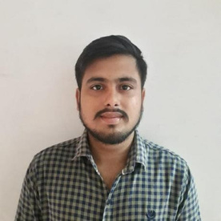



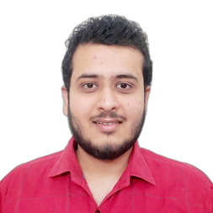

Akash Mishra
Rishon A Singh
Rahul Chandel
Brajesh Lovanshi
Vishal Bhargava
Contributors

Slide 3




J2EE
Spring Boot
Postman
JPA
Web technologies
Browser API
Hibernate
Swagger
JDBC
JSP
Java
Language
TECH STACK
IDE
STS
MYSQL
Database
Repository
Github

Slide 4







User authentication
REST API
Signup functionality
Create
Retrieve
Update
Login functionality
Destroy
ABSTRACT
Reports
Travel package reports
Customer reports

Slide 5



Login
Login
View routes
User management
Admin
View tours
Tour management
View travel packages
Travel package management
Book tickets
Route management
FUNCTIONALITY
Print tickets
Bus management
Cancel tickets
Ticket management
Payment
hotel management
Customer
Provide testimonials
View reports
View testimonials

Slide 6


viewAllBooking()
bookHotel(Booking book,IntegerhotelId)
bookPackage
(Booking book,IntegerpackageId)
Booking
cancelBooking
(Booking book)
viewBooking(Integer bookingId)
addUser
(Customer customer)
addCustomer
(Customer customer)
viewCustomer
(Integer customerId)
viewCustomer
(Integer customerId)
User
SERVICE METHODS
Customer
updateCustomer
(Customer customer)
updateCustomer
(Customer customer)
deleteCustomer
(Customer customer)
deleteCustomer
(Customer customer)
updatePackage
(Integer packageId)
addPackage
(Packages pack)
Package
deletePackag(Integer packageId)
searchPackage
(Integer packageId)

Slide 7
viewAllReports()
editReport
(Integer reportId)
addReports
(Report reports)
Reports
viewAllReports()
deleteReports
(Integer reportId)
viewRouteList()
addTravels
(Travels travels)
addRoute
(Route route)
searchTravels
(Integer travelId)
updateRoute(Integer routeId, Integer busId)
SERVICE METHODS
Route
Travel
updateTravels
(Travels travels)
removeRoute
(Integer routeId)
searchRoute
(Integer routeId)
viewTravels()
findByCustomerId
(Integer customerId)
addFeedback
(Feedback feedback
Feedback
viewAllFeedback()
findByFeedbackId
(Integer feedbackId)

Slide 8
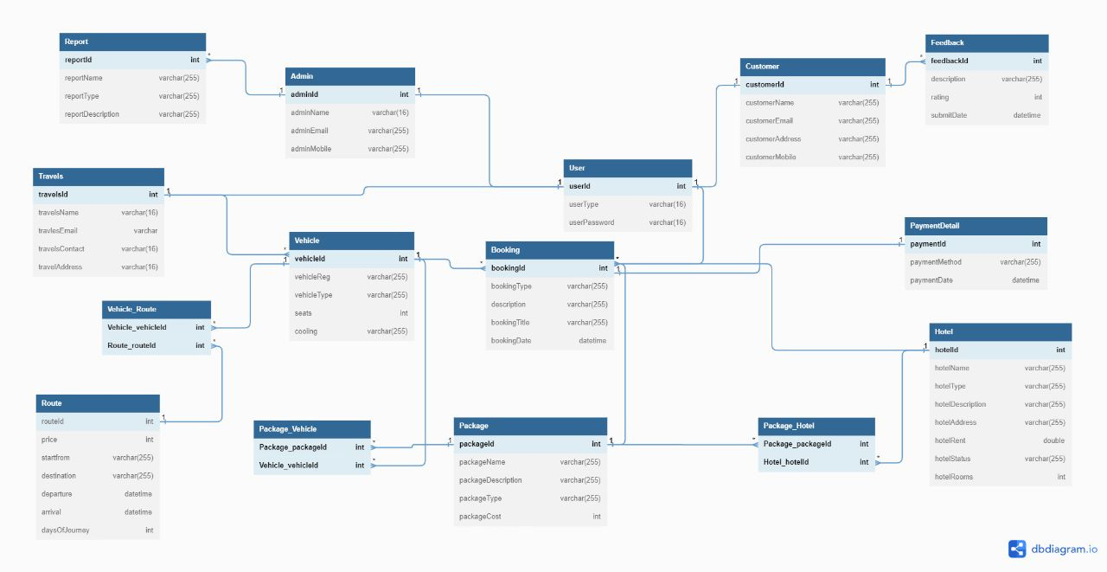
E-R diagram of trip management application

