Slide 1
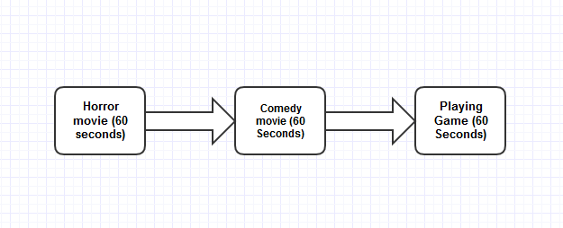
Data Acquisition and Feature Extraction
The data from 5 subjects were collected. We decided to use a horror movie during the first 60 seconds. The horror movie is followed by a comedy movie (60 seconds) and then the subject was asked to play some game (60 seconds). The process of our experiment is depicted below:
Afterward, each input time-series was divided into a sequence of discrete segments of 6 seconds and the mean value was calculated for each frequency band (Alpha, Low-beta and High-beta) during each of the time-segments.

Slide 2
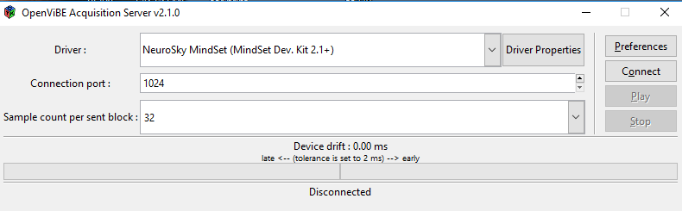
Data Acquisition using OpenVibe
STEP-1

Slide 3
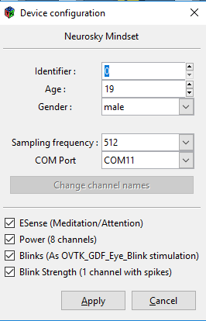
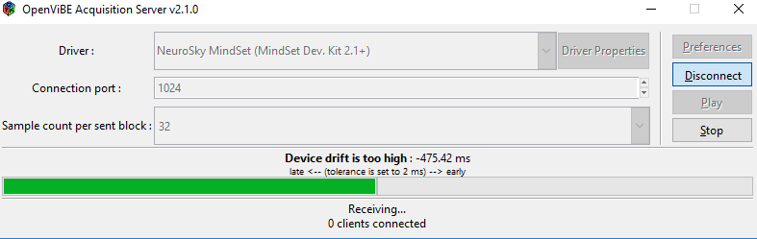
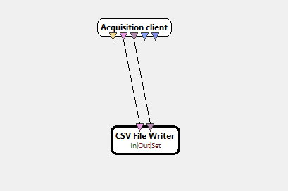
STEP-2
STEP-3
STEP-4

Slide 4
Average Accuracy Score after 5 Fold Cross Validation(KNN) Considering All Subjects
K-Value | Low beta | High beta | Alpha
1 | 0.53666666666666 | 0.716666666 | 0.59666666666
2 | 0.55333333333333 | 0.7833333333 | 0.636666666
3 | 0.61999999999999 | 0.8000000000000 | 0.636666666666
4 | 0.62 | 0.8333333333333 | 0.613333333333
5 | 0.5533333333333 | 0.8266666666 | 0.653333333333
6 | 0.7366666666666 | 0.760000000000 | 0.530000000000

Slide 5
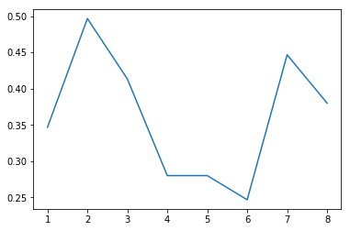
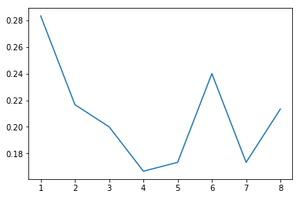
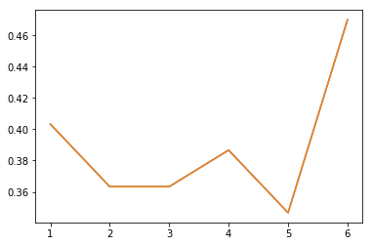
Parameter Tuning with Cross Validation(Misclassification Error vs K Plot)
Low beta | High beta | Alpha

Slide 6
Average Accuracy Score after 5 Fold Cross Validation(KNN) for Each Subject
K-value | Sub1 | Sub2 | Sub3 | Sub4 | Sub5
1 | 0.566666666666 | 0.333333333333 | 0.59999999999 | 0.466666666666 | 0.633333333333
2 | 0.5 | 0.433333333333 | 0.566666666666 | 0.5 | 0.5333333333
3 | 0.433333333333 | 0.366666666666 | 0.56666666666 | 0.3999999999 | 0.5666666666
4 | 0.466666666666 | 0.299999999999 | 0.599999999999 | 0.666666666666 | 0.633333333333
5 | 0.566666666666 | 0.399999999999 | 0.599999999999 | 0.566666666666 | 0.566666666666
6 | 0.5 | 0.5 | 0.599999999999 | 0.599999999999 | 0.499999999999

Slide 7
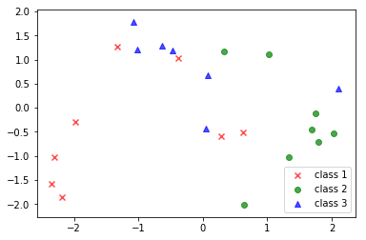
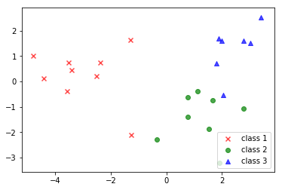
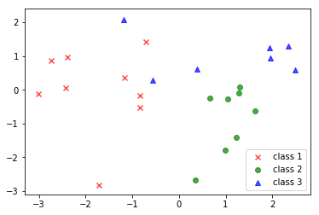
LDA Scatter Plot
Low beta | High beta | Alpha

Slide 8
Average Accuracy Score after 5 Fold Cross Validation(SVM, kernel=linear)
Low beta | High beta | Alpha
0.6866666666 | 0.7033333333333 | 0.7666666666666
Sub1 | Sub2 | Sub3 | Sub4 | Sub5
0.3666666666 | 0.40000000000 | 0.5666666666 | 0.433333333333333 | 0.766666666666666

Slide 9
ANOVA Test(Alpha, Low-Beta, High-Beta)
Sum of Squares(SS) between Class | Mean Square(MS) between Class | P-value
3.74E+10 | 1.87E+10 | 3E-08
Sum of Squares(SS) between Class | Mean Square(MS) between Class | P-value
6.4E+8 | 3.2E+8 | 0.0017612
Sum of Squares(SS) between Class | Mean Square(MS) between Class | P-value
2.36E+10 | 1.18E+10 | 6.2E-16

Slide 10
Conclusion
For all subjects except ‘Subject 5’ KNN (k-nearest neighbours) gives better accuracy than SVM (support vector machine).
The classification result of three emotions varies in subjects due to emotional dependency of subjects.
From the result of ANOVA Test , we can conclude that all higher frequency waves are statistically more significant than lower frequency waves present in the raw signal. Higher frequency waves like alpha, low beta and high beta all have p-value less than 0.01. Therefore, all of these waves were considered for classification of emotion.

