Slide 1
Disconnected Interaction Design
Likhitha Devineni
Rahul Garigipati
Manusha Vemulapalli
Bhumika Naik

Slide 2
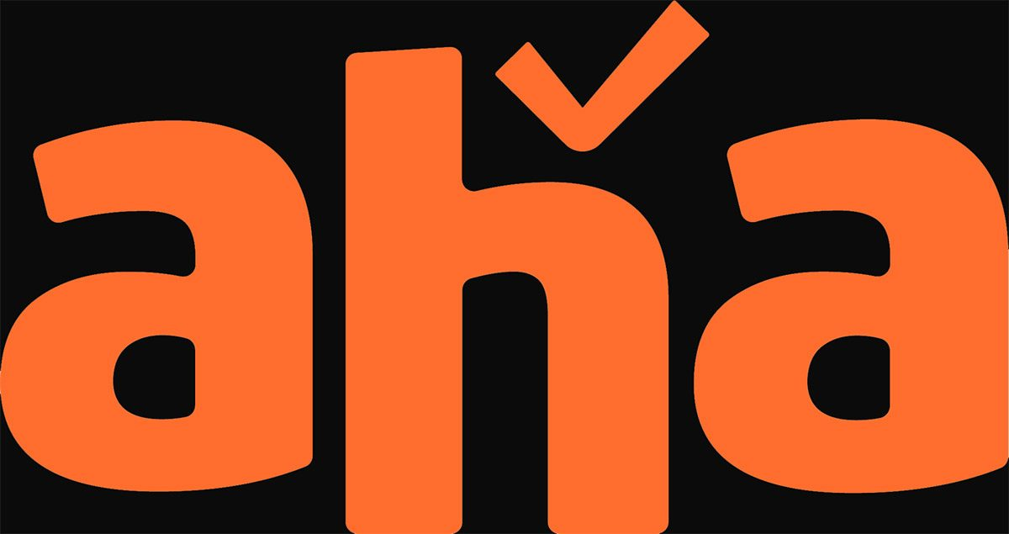
Aha – Streaming Service
Aha is an Indian Subscription digital video streaming service which offers Telugu(language) movie content.
It contains TV shows, movies, Web Series confines to Telugu language.
Aha is available as both web and device application.

Slide 3
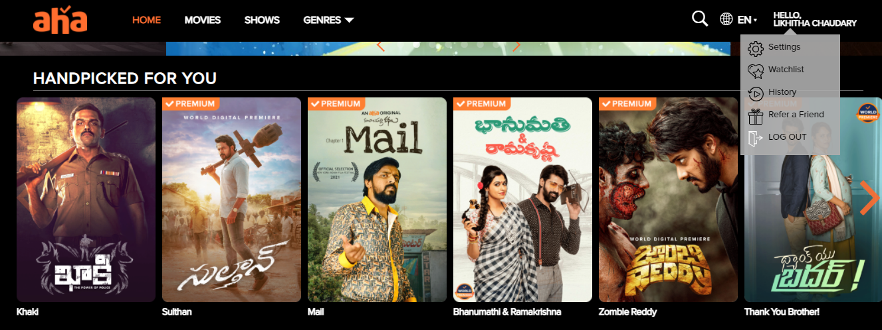
Short Comings
Affordance: Hyperlinks within a page or site which points to an additional content within the same site. Here when we press ‘History (inside the drag down)’ as shown in the picture it takes us to the continue watching page, but when it should take us to an actual history page.

Slide 4

Signifier: As we know a signifier indicates how/where an affordance is available through a Signal.
A visual indication that is clickable on web page. Here the ‘+’ icon is used to indicate that we can add a movie/show to a watchlist. But that is not interactive when you click on it. The ‘+’ icon is not a use in the picture frame and movie will not add to the watch list.

Slide 5
Improvements
Here the function ‘History’ is not serving any purpose, nothing but misleading the user as we already have the continue watching link on main page. History link also take to the continue watching field. So, we don’t need this extra link. We can improve the affordance by just removing this function from here.
The icon ‘+’ is not necessary here in the field because the signifier is not functional, as we already have a function to add a movie/show when we go to a particular movie/show, so we we can improve the signifier by making it work or just remove from there.

Slide 6
Thank You

