Slide 1
Disconnected Interaction Design
Rahul Garigipati

Slide 2
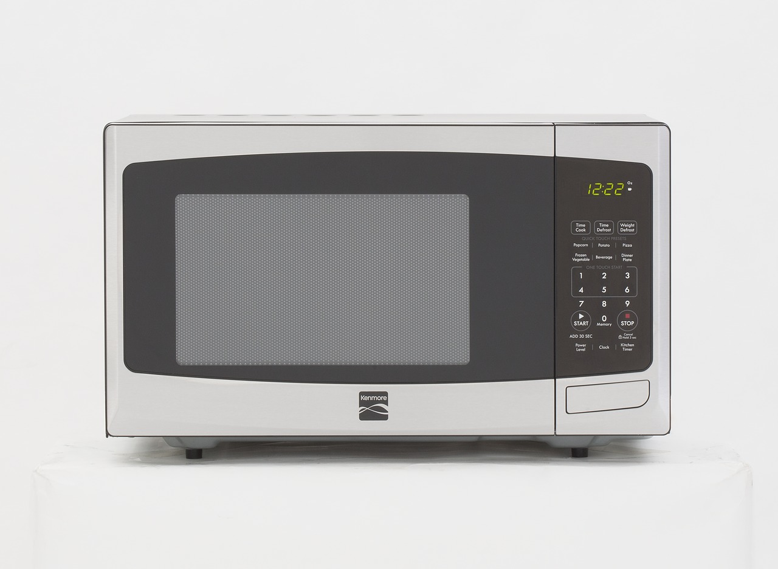
Describing the artifact (Microwave)
A microwave oven is an electric oven that heats and cooks' food.
They are a common kitchen appliance and are popular for reheating previously cooked foods and cooking a variety of foods.
They rapidly heat foods which can easily burn or turn lumpy if cooked in conventional pans.
We use them by just plugging in the device and heat the food.
We shouldn`t use traditional metal cookware and it is better not to cook recipe's that require a lot of water, because they don`t cook well in microwave and will probably take less time on stovetops.

Slide 3
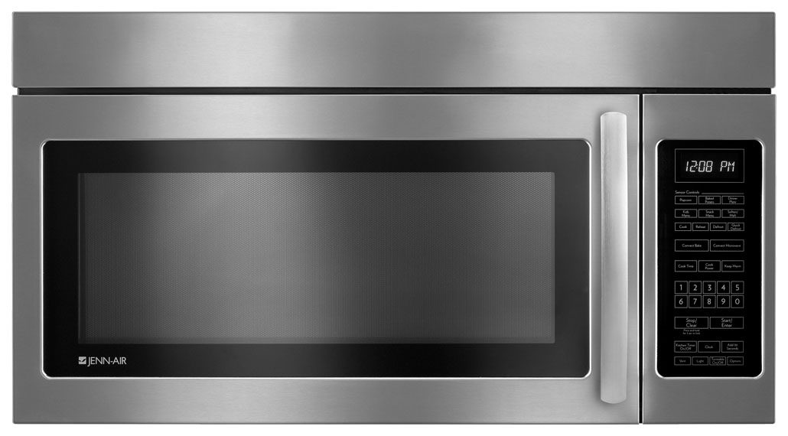
Using a Microwave shouldn`t be this confusing
This is a JENN-AIR Microwave oven.
This Jenn-Air microwave has 34-buttons (non-tactile) or (zero - feedback)
The Affordance of the oven is complicated and unnecessary because, there are a lot of functions that the oven can do and not everyone can get used to many functionalities of it. For example, many just wants to heat their food but gets stuck on what button to press. Whereas I just press the ‘start’ and if I want it to heat it some more time, I just press the ‘Add 30 sec`s’ .
The Signifier of the oven icon/symbol/display should be clear and visible. For example, I have used an oven where I had to press the buttons ‘2’ & ‘00’ for heating my coffee for 2 minutes. Because in most of the ovens I only need to press the button-2 to heat it for 2 minutes.

Slide 4
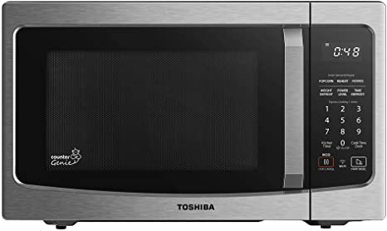
Interaction Design improvements
The Affordance of the artifact would be to make the functionalities to be much simpler and easy to understand for everyone who has no knowledge of the device.
And also, to make the device look less complicated with using only most needed functions.
The Signifier of the artifact would be to make the display icon to be much more visible and clearer.
The colour of the display icon must be visible to everyone who is not able to see clearly and must be easy to read.

Slide 5
Thank You

