Slide 1
HUMAN-CENTERED COMPUTING
Topic-1: Basic Kanban Board

Slide 2
What is Kanban Board?
Kanban is a lean method to manage and improve work across human systems.
Work items are visualized to give participants a view of progress and process, from start to finish.
Kanban Board is one of the tools that can be used to implement to manage work at a personal or organizational level.
The aim of the Kanban is to provide a visual process management system which aids decision making about what, when, and how much to produce.

Slide 3
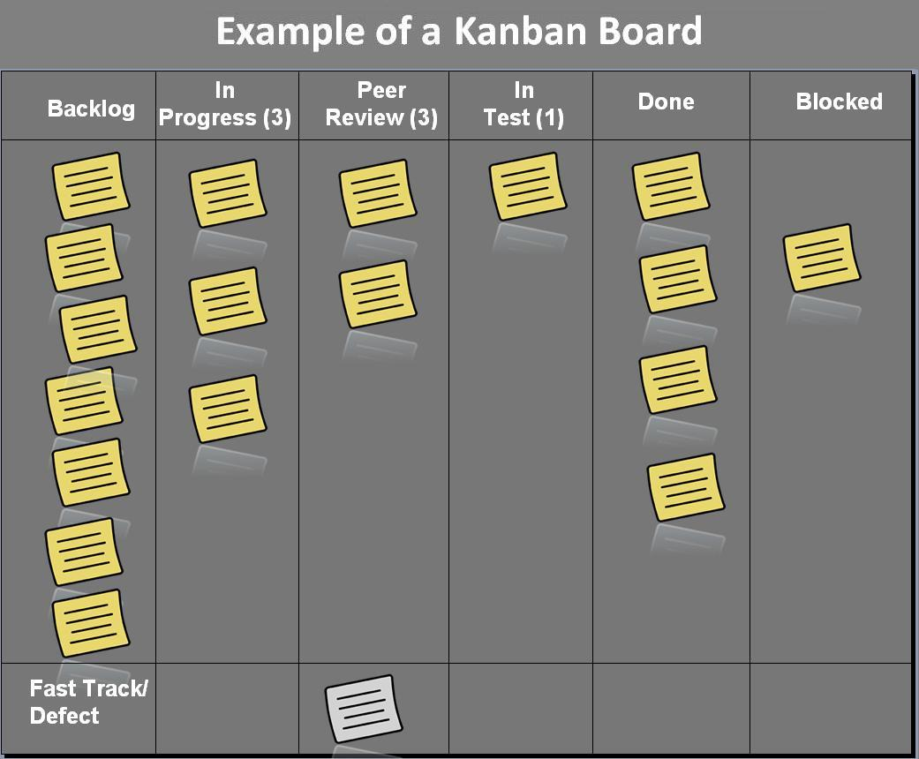
How to Use Kanban Board?
Kanban Boards visually depict work at various stages of process using cards to represent work items and columns to represent each stage of the process.
Cards are moved from left to right to show the progress and to help co-ordinate teams performing the work.
Examples of the Kanban Tools: Trello, Jira, Kanboard(Open Source).

Slide 4
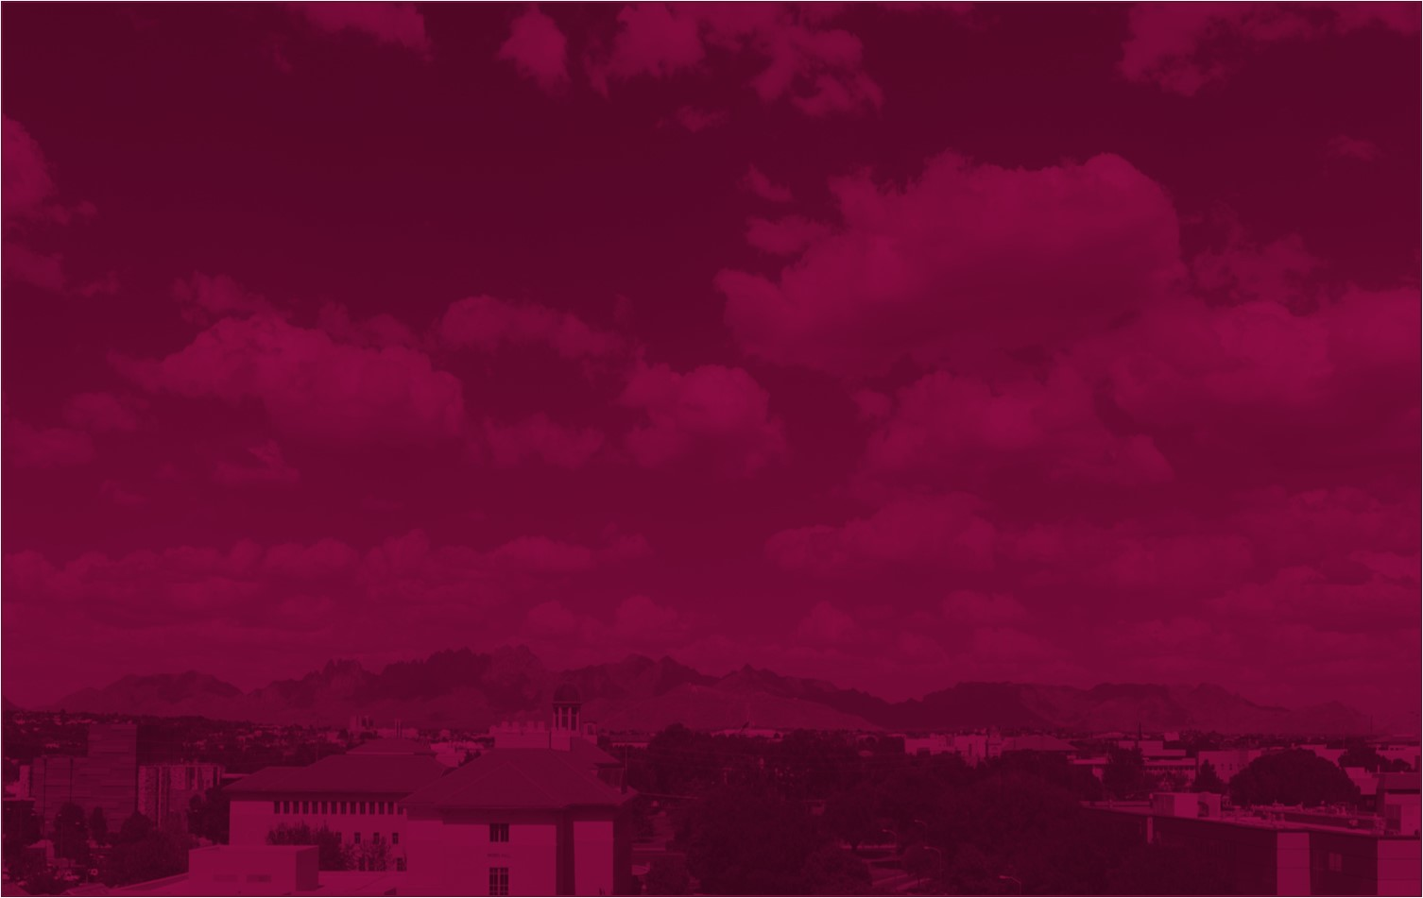
Thank You

